Slide 1
Bible Translation &
Textual Criticism

Slide 2
Contents
Introduction to Translation vs. Textual Criticism
Bible Translation Theory
Introduction to Textual Criticism

Slide 3
Translation vs. Textual Criticism
Translation
Original copies of Scripture have the same words in the same verse.
Difference in translations reflect how translators interpret those words for a target audience.
Textual Criticism / Textual Variants
Original copies of Scripture have different words in the same verse.
The practice of textual criticism determines which variant was most likely to be the original reading of Scripture.
When Bible translations differ, is it a difference in translation preference or a difference in judgment on what the most original reading of Scripture was in the original language of that verse?
It can be hard to tell unless you do your research.
The NET Bible (Bible.org) has a whole series of footnotes on whether there is a text-critical issue (tc: text-critical note) or a translation issue (tn: translator’s note). It also has sn footnotes, study notes that explain historical background issues, theological issues, and cross references.

Slide 4
Translation Issue
Everyone is looking at the same original words in the same verse but differ in best way to translate those same words.
E.g., “children” or “sons” for υἱοὶ (huioi ) in Matt 5:9:
μακάριοι οἱ εἰρηνοποιοί, ὅτι αὐτοὶ υἱοὶ θεοῦ κληθήσονται (NA28)
“Blessed are the peacemakers, for they will be called children of God” (NIV, NRSV).
“Blessed are the peacemakers: for they shall be called the children of God” (KJV, NKJV).
“Blessed are the peacemakers, for they will be called the children of God” (NET)
“Blessed are the peacemakers, for they shall be called sons of God” (ESV, NASB, CSB, ASV).
“The peacemakers are blessed, for they will be called sons of God” (HolmanCSB)
“Blessed are the peacemakers, for they will be called sons of God” (Berean)
“God blesses those who work for peace, for they will be called the children of God” (NLT).
“You’re blessed when you can show people how to cooperated instead of compete or fight. That’s when you discover who you really are, and your place in God’s family” (Message)
“Blessed [spiritually calm with life-joy in God’s favor] are the makers and maintainers of peace, for they will [express His character and] be called the sons of God” (Amplified)

Slide 5
Text-Critical Issue (Textual Variants)
There are different words in the earliest copies of the same verse in its original language.
Differing copies of the verse are called “textual variants”
Before we translate, we must determine which variant is most original.
E.g., “falsely” in Matt 5:11. Focus not on translation differences but on presence of “falsely/lies” reflecting judgment on whether ψευδόμενοι (pseudomenoi) is the original reading.
μακάριοί ἐστε ὅταν ὀνειδίσωσιν ὑμᾶς καὶ διώξωσιν καὶ εἴπωσιν πᾶν πονηρὸν καθʼ ὑμῶν [ψευδόμενοι] ἕνεκεν ἐμοῦ. (NA28)
“Blessed are you when people insult you, persecute you and falsely say all kinds of evil against you because of me” (NIV).
“Blessed are you when others revile you and persecute you and utter all kinds of evil against you falsely on my account” (ESV).
“Blessed are you when people revile you and persecute you and utter all kinds of evil against you falsely on my account” (NRSV).
“Blessed are ye, when men shall revile you, and persecute you, and shall say all manner of evil against you falsely, for my sake” (KJV).
“Blessed are you when they revile and persecute you, and say all kinds of evil against you falsely for My sake” (NKJV).
“Blessed are you when people insult you and persecute you, and falsely say all kinds of evil against you because of Me” (NASB).

Slide 6
Text-Critical Issue (Textual Variants)
“Blessed are you when they insult you and persecute you and utter every kind of evil against you [falsely] because of me” (New American Bible).
“Blessed are you when people insult you and persecute you and say all kinds of evil things about you falsely on account of me.” (NET).
“You are blessed when they insult and persecute you and falsely say every kind of evil against you because of Me.” (HolmanCSB).
“God blesses you when people mock you and persecute you and lie about you and say all sorts of evil things against you because you are my followers” (NLT).
“Not only that—count yourselves blessed every time people put you down or throw you out or speak lies about you to discredit me.” (Message)
“Blessed [morally courageous and spiritually alive with life-joy in God’s goodness] are you when people insult you and persecute you, and falsely say all kinds of evil things against you because of [your association with] Me” (Amplified).

Slide 7
Text-Critical Issue (Textual Variants)
E.g., “falsely” in Matt 5:11
μακάριοί ἐστε ὅταν ὀνειδίσωσιν ὑμᾶς καὶ διώξωσιν καὶ εἴπωσιν πᾶν πονηρὸν καθʼ ὑμῶν [ψευδόμενοι] ἕνεκεν ἐμοῦ. (NA28)
5:11 [ψευδόμενοι] {C}
It is uncertain whether ψευδόμενοι should be included or omitted from the text. On the one hand, the absence of the word in the Western tradition (D itb, c, d, h, k syrs geo Tertullian al) can be accounted for as the result of scribal accommodation of the passage to the Lukan form of the beatitude (Lk 6:22). On the other hand, more than one scribe would have been tempted to insert the word in order to limit the wide generalization in Jesus’ teaching, and to express specifically what was felt to be implied by the very nature of the case (compare 1 Pe 4:15 f.). In order to represent the balance of transcriptional probabilities, the Committee decided to include the word in the text, but to enclose it within square brackets.
Bruce Metzger, A Textual Commentary on the Greek New Testament, Second Edition a Companion Volume to the United Bible Societies’ Greek New Testament (4th Rev. Ed.) (New York: United Bible Societies, 1994), 10–11.

Slide 8
Text-Critical Issue (Textual Variants)
E.g., “falsely” in Matt 5:11
μακάριοί ἐστε ὅταν ὀνειδίσωσιν ὑμᾶς καὶ διώξωσιν καὶ εἴπωσιν πᾶν πονηρὸν καθʼ ὑμῶν [ψευδόμενοι] ἕνεκεν ἐμοῦ. (NA28)
tc Although ψευδόμενοι (pseudomenoi, “bearing witness falsely”) could be a motivated reading, clarifying that the disciples are unjustly persecuted, its lack in only D it sy Tert does not help its case. Since the Western text is known for numerous free alterations, without corroborative evidence the shorter reading must be judged as secondary.
NET Bible, note on Matthew 5:11

Slide 9
Translation vs. Textual Criticism
Translation
Original copies of Scripture have the same words in the same verse.
Difference in translations reflect how translators interpret those words for a target audience.
Textual Criticism / Textual Variants
Original copies of Scripture have different words in the same verse.
The practice of textual criticism determines which variant was most likely to be the original reading of Scripture.
When Bible translations differ, is it a difference in translation preference or a difference in judgment on what the most original reading of Scripture was in the original language of that verse?
It can be hard to tell unless you do your research.
The NET Bible (Bible.org/NebBible.org) has a whole series of footnotes on whether there is a text-critical issue (tc: text-critical note) or a translation issue (tn: translator’s note). It also has sn footnotes, study notes that explain historical background issues, theological issues, and cross references.

Slide 10
Bible Translation Theory
How do you translate words from a source language to a target language?
OR
“Which Bible is the most accurate? Which Bible do you recommend?”
“Which Bible should I read if I want to…?”

Slide 11
You will need a working knowledge of Bible translations
to give a more precise answer,
Ask three questions to evaluate any Bible translation.

Slide 12



Three Questions
to ask when evaluating any Bible translation
1. Textual
Basis
2. Translation
Philosophy
3. Theological
Location

Slide 13

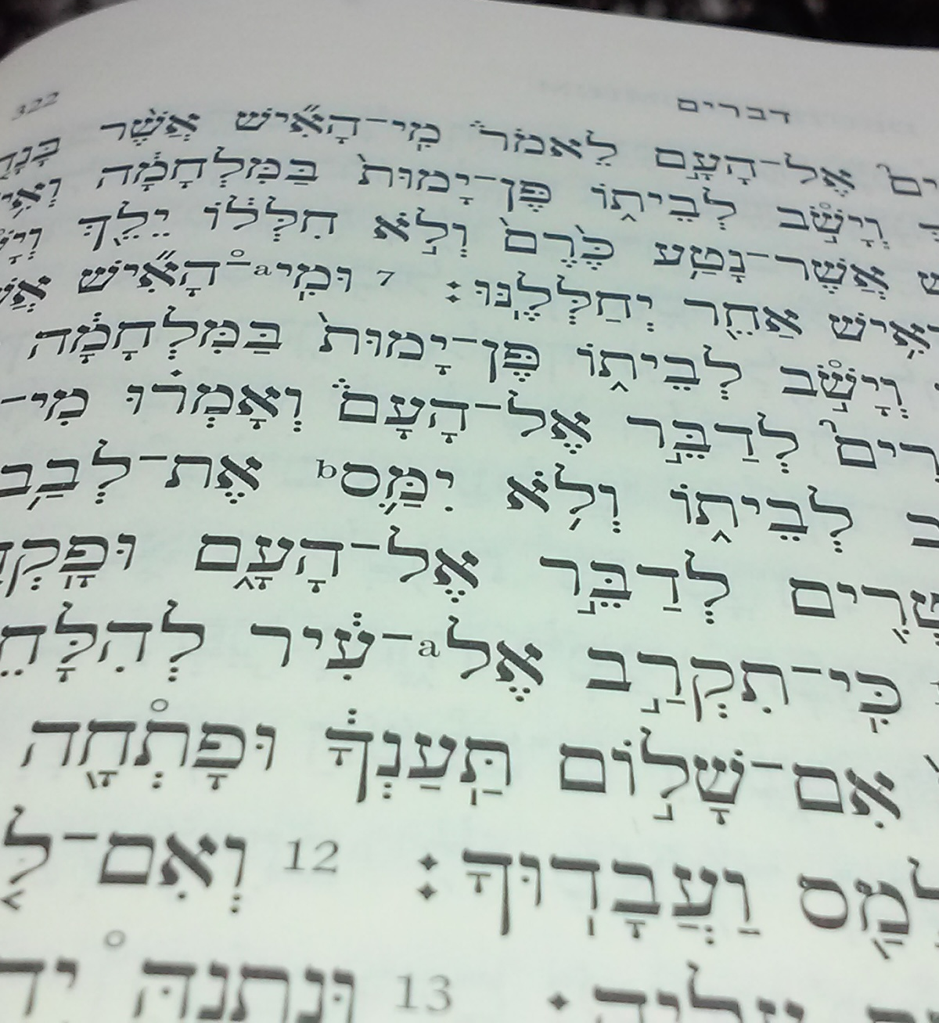
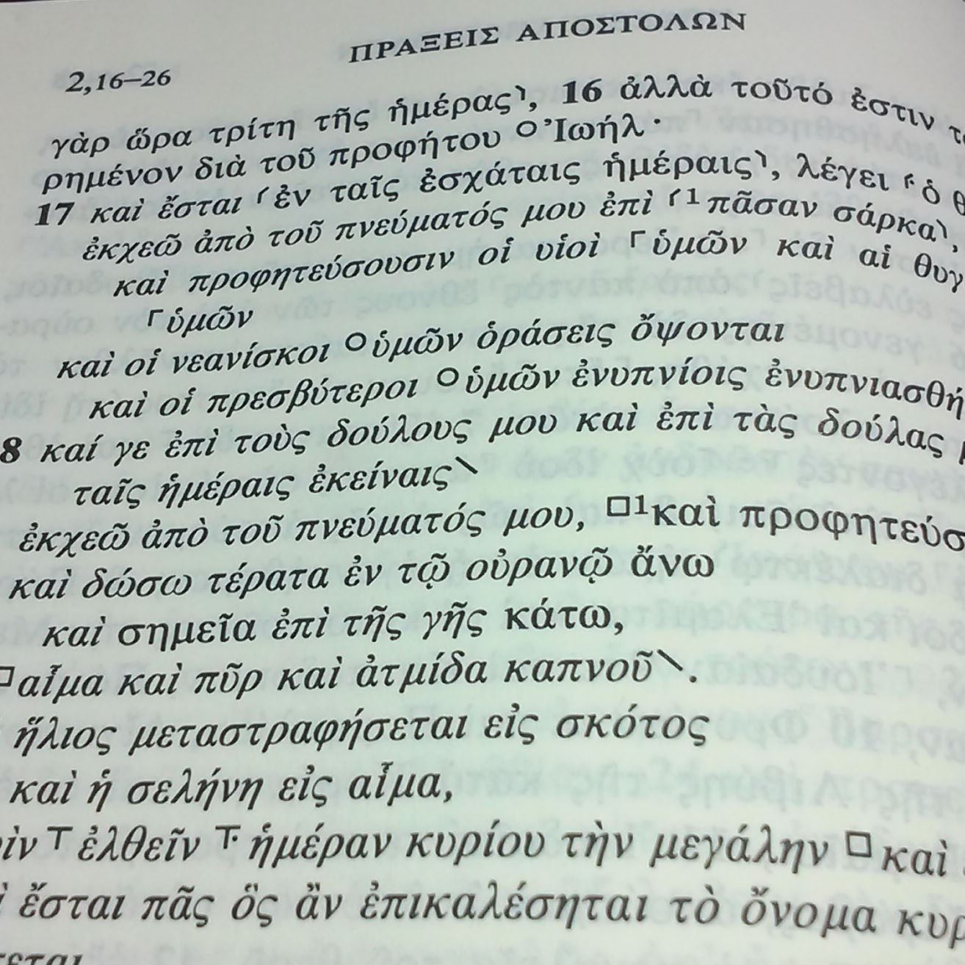
Textual Basis
Original Languages of Scripture
OT: Classical Hebrew*
  *Aramaic Portions of the OT
    Genesis 31:47 (2 words)
    Jeremiah 10:11
    Daniel 2:4-7:28
    Ezra 4:8-6:18; 7:12-26
  NT: Koine Greek
  (c. A.D. 50-100)

Slide 14
Important Translations
King James Version - A.D. 1611.
Ethiopic (Ge’ez) - 15th c. mss, transl. A.D. 400-600.
Latin Vulgate (Jerome) - c. A.D. 405.
Peshitta (Aramaic Vulgate).
  NT - c. A.D. 400-500.
  OT - c. A.D. 150-200.
Septuagint (LXX, OT in Greek) - c. 250-150 B.C

Slide 15
Peshitta (Aramaic Vulgate)
“Like all Syriac (Aramaic) versions of the NT, the Peshitta is based on Greek texts. There is no direct relation between this Syriac (i.e., Eastern Aramaic) text and Jesus’ original words in Western Aramaic.”
-Bas ter Haar Romeny, “Peshitta and Other Syriac Versions.” Pages 149 to 155 in Oxford Encyclopedia of the Books of the Bible. Edited by Michael D. Coogan. Oxford: Oxford University Press, 2011.

Slide 16
Textual Basis
To evaluate a Bible translation…
1. Read the preface or introduction.
2. Look for the following textual basis.
  OT: Masoretic Text, Biblica Hebraica (BH)
    (BHS, BHL, BHQ, HB)
  NT: Eclectic text, Nestle Aland/UBS
    (Erasmus’ TR is a 16th c. mss based on a handful of documents dated no earlier than the 10th c.)
3. Then look at specific passages in translation.

Slide 17
Textual Basis
Luke 11:2-4
Luke 11:2-4
“ So He said to them, “When you pray, say:
Our Father in heaven,
Hallowed be Your name.
Your kingdom come.
Your will be done
On earth as it is in heaven.
Give us day by day our daily bread.
And forgive us our sins,
For we also forgive everyone who is indebted to us.
And do not lead us into temptation,
But deliver us from the evil one” (NKJV).
“He said to them, “When you pray, say:
“‘Father,
hallowed be your name,
your kingdom come.
Give us each day our daily bread.
Forgive us our sins, for we also forgive everyone who sins against us.
And lead us not into temptation’” (NIV).

Slide 18
Translation Philosophy
Formal Equivalence
to
Functional Equivalence
to
Paraphrase & beyond

Slide 19
Spectrum of Translation Philosophy
Translations
Not translations
Paraphrase.
Free Interpretation.
The Message
Living Bible
Jefferson Bible
Marcion’s Canon
Passion Translation
New World Translation (JW)
LDS Edition
Paintings
Word-for-Word.
Formal Equivalence.
Emphasis on grammar of original language.
KJV & NKJV
NASB
NRSV
ESV
NET Bible Notes
Thought-for-Thought.
Functional/Dynamic Equivalence.
Emphasis on readability in target language
NIV, NIrV
NAB
HCSB, CSB
CEB
New Jerusalem Bible
NLT
NET Bible

Slide 20
“All translation is an act of interpretation”
traduttore, traditore
Every translator makes decisions in order to make a source text understandable
in a target language.
For example, the following slide shows John 3:16 in its original Greek, preserving the original Greek word sequence. The English glosses beneath each Greek word help give a sense of the Greek word order.
This is an interlinear approach to translation and is what a “literal” translation would look like, notwithstanding the trickier question of whether each gloss most appropriately conveys the sense of the Greek words as they are used together.

Slide 21
Οὕτως γὰρ ἠγάπησεν ὁ θεὸς τὸν κόσμον
Therefore for he loved the God the world
ὥστε τὸν υἱὸν τὸν μονογενῆ ἔδωκεν
that the son the unique he gave
ἵνα πᾶς ὁ πιστεύων εἰς αὐτὸν
so that all the believers in him
μὴ ἀπόληται ἀλλʼ ἔχῃ ζωὴν αἰώνιον.
not perish but may have life eternal.
(John 3:16, author’s own glosses)

Slide 22
“All translation is an act of interpretation”
traduttore, traditore
Every translator makes decisions in order to make a source text understandable
in a target language.
There is a range of interpretive decisions that still fall within the act of “translation.”
At some point, the interpretive decisions are so great that the result is no longer a translation but is a paraphrase or a something inspired by its source text.

Slide 23
Spectrum of Translation Philosophy
Translations
Not translations
Paraphrase.
Free Interpretation.
The Message
Living Bible
Jefferson Bible
Marcion’s Canon
Passion Translation
New World Translation (JW)
LDS Edition
Paintings
Word-for-Word.
Formal Equivalence.
Emphasis on grammar of original language.
KJV & NKJV
NASB
NRSV
ESV
NET Bible Notes
Thought-for-Thought.
Functional/Dynamic Equivalence.
Emphasis on readability in target language
NIV, NIrV
NAB
HCSB, CSB
CEB
New Jerusalem Bible
NLT
NET Bible

Slide 24
Translation Philosophy
Psalm 11:1-3
Psalm 11:1-3
“In the Lord I take refuge;
how can you say to my soul,
“Flee like a bird to your mountain,
for behold, the wicked bend the bow;
they have fitted their arrow to the string
to shoot in the dark
at the upright in heart;
if the foundations are destroyed,
what can the righteous do? (ESV)
“I trust in the Lord for protection.
So why do you say to me,
“Fly like a bird to the mountains for safety!
The wicked are stringing their bows
and fitting their arrows on the bowstrings.
They shoot from the shadows
at those whose hearts are right.
The foundations of law and order have collapsed. What can the righteous do?” (NLT).

Slide 25
Theological Location
The best check against individual blinders and biases is to work in groups.
Bible Translations reflect the decisions of their translators.
Ask yourself
Who translated it?
How many people were involved in translation and what kind of oversight was there? Note that more is not necessarily better.

Slide 26
Theological Location
15 translators
115 translators
NIV
The text of the NIV is entrusted to the Committee on Bible Translation (CBT), a self-governing body of 15 evangelical Bible scholars. No outside group—no publisher or commercial entity—can decide how the NIV is translated.” –thenivbible.com
“This hundred-member team, which shares a common commitment to the truth of God's Word and to historic Christian orthodoxy, is international in scope and includes leaders in many denominations.”
–ESV Preface
ESV
111 translators
25 translators
CEB
“The scholars involved with the Common English Bible translation represent a unique diversity of denominational backgrounds, gender, and culture.” -commonenglishbible.com
“Seventeen were teachers at DTS; and of the remaining six, five were students at DTS.”
-bible-researcher.com, reviewing the NET Bible
NET
130 translators
100+ translators
NKJV
The international team who worked on this version was made up of conservative scholars, editors, and laity representing a broad cross- section of Bible-oriented Christianity.”
–thomasnelsonbible.com
“More than 100 scholars from 17 denominations participated in the translation and review of the HCSB (2004) … Ten biblical scholars from nine colleges and seminaries and a variety of denominations provide oversight for the Christian Standard Bible” -csbible.com
CSB

Slide 27
Theological Location
Romans 16:1
Romans 16:1
“I commend to you our sister Phoebe, a servant of the church at Cenchrae” (ESV),
“I commend to you our sister Phoebe, a deacon of the church in Cenchrae” (NIV).
Romans 16:7
Romans 16:7
“Greet Andronicus and Junia, my kinsmen and my fellow prisoners. They are well known to the apostles, and they were in Christ before me” (ESV).
“Greet Andronicus and Junia, my fellow Jews who have been in prison with me. They are outstanding among the apostles, and they were in Christ before I was” (NIV).

Slide 28
Theological Location
“The ESV was first published in 2001. It changed about 8% of the RSV, or about 60,000 words. The remaining 92% is the RSV, much of which is simply “the best of the best” of the KJV tradition.
The ESV translation committee removed every trace of liberal influence that had caused such criticism from evangelicals when the RSV was first published in 1952. For example, Isaiah 7:14 was changed back to say, “Behold, the virgin shall conceive and bear a son.” Psalm 2:12 once again says, “Kiss the Son,” and Psalm 45:6 is once again a Messianic prediction that says, “Your throne, O God, is forever and ever.” The important theological term “propitiation” has been restored to Romans 3:25, Hebrews 2:17; and 1 John 2:2 and 4:10.” (Wayne Grudem, “The Advantages of the English Standard Version (ESV) Translation,” Wayne Grudem, 2012. https://www.waynegrudem.com/advantages-of-the-esv)
“Behold, a young woman shall conceive and bear a son, and shall call his name Immanuel” (Isa 7:14b, RSV).
“Beyond, the virgin shall conceive and bear a son, and shall call his name Immanuel” (Isa 7:14b, ESV)
“Serve the LORD with fear, with trembling kiss his feet, lest he be angry, and you perish in the way: for his wrath is quickly kindled. Blessed are all who take refuge in him” (Ps 2:11-12, RSV).
“Serve the LORD with fear, and rejoice with trembling. Kiss the son, lest he be angry, and you perish in the way, for his wrath is quickly kindled. Blessed are all who take refuge in him (Ps 2:11-12, ESV).
“Your divine throne endures for ever and ever. Your royal scepter is a scepter of equity” (Ps 45:6, RSV).
“Your thron, O God, is forever and eve. The scepter of you rkingdom is a scepter of uprightness” (Ps 45:6, ESV).
Another big philosophical issue that drove the ESV’s is its complementarian philosophy on gender roles and how that is reflected in their translation of biblical texts.

Slide 29
Three Questions
to ask when evaluating any Bible translation
Textual
Basis
Translation
Philosophy
Theological
Location

Slide 30
Textual Criticism
Before we translate to a target language, what are the original words in the source language?
1. What are the oldest, best preserved physical copies of the Bible that we have? (External Evidence)
2. Which variant provides the best explanation for the other variants? (Internal Evidence)
a. Shorter reading.
b. More difficult reading.

Slide 31

Autographs & Textual Variants
What happened to the autographs?
We have ancient hand-copies that go back pretty far but are still 100 years removed from the originals for the NT, and hundreds of years removed for the OT.
When two or more copies disagree on the exact wording or spelling, it’s called a “textual variant.”
To an oral-tradition culture, variants were less problematic.

Slide 32
Oral-Culture Attitudes to Writing
I have much to write you, but I do not want to do so with pen and ink. I hope to see you soon, and we will talk face to face (1 John 13-14).
(cf. also Acts 15:31; 1 Thess 5:27; Col 4:16; 1 Tim 4:13, 15, 16; Rev 1:3; Clement 19:1)

Slide 33
Oral-Culture Attitudes to Writing
Porphyry,
on the transmission of the Oracles of Apollo
For I myself call the gods to witness, that I have neither added anything, nor taken away from the meaning of the responses, except where I have corrected an erroneous phrase, or made a change for greater clearness, or completed the metre when defective, or struck out anything that did not conduce to the purpose; so that I preserved the sense of what was spoken untouched, guarding against the impiety of such changes, rather than against the avenging justice that follows from the sacrilege.”
(via Eusebius, Preparation for the Gospel, 4.7) c.323 C.E.

Slide 34

Textual Variants
Some variants are accidental, some intentional. But we have so many manuscripts that we can catch them by comparing copies.
According to Kurt and Barbara Aland, The Text of the New Testament (rev. ed.; Transl. Errol F. Rhodes; Grand Rapids: Eerdmans, 1989), 29-30)
  62.9% of the Greek NT is variant-free (7,947 verses; 4,999 words)
  Highest Percentage of variant frequency
    Mark, 556 variants (10.3/page)
    John 567 variants (8.5/page)
    Luke 637 variants (6.9/page0
    Matthew 567 variants (6.8/page)
    2 Peter 39 variants (6.5/page)

Slide 35
You’ve Found a Textual Variant, Now What?
Make the best case for the most original reading.
External Evidence + Internal Evidence
External: The reading attested by the highest-quality evidence is probably most original.
Internal: The reading that best explains the other readings is probably the most original.

Slide 36
External Evidence
The reading attested by the highest-quality evidence is probably most original.

Slide 37
External Evidence
Focuses on the physical nature of the extant manuscripts (mss):
  Antiquity (age)
    Papyrus & Parchment
    Majuscules (upper-case) & Minuscules (lower-case)
  Geographical Diversity
  Textual Family

Slide 38
Manuscript Witnesses of the OT
Autographs (Hebrew & some Aramaic)
Greek Translation: Septuagint (LXX) [c.300-200 bc]
Dead Sea Scrolls (DSS) [c. 150 bc – ad 70]
Aramaic Targums [ad 500-1000]
Aleppo Codex (Aaron ben Moses ben Asher) [c. ad 930]
Codex Leningradensis [c. ad 1008]
Samaritan Pentateuch [ad 1100, though text from may reflect 200-100 bc]
Masoretic Text (MT) = Codex Leningradensis, with guidance from the Aleppo Codex & DSS

Slide 39
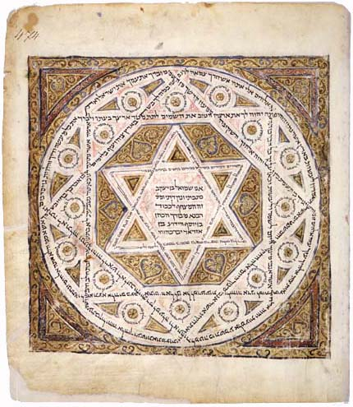
Modern Hebrew Bible in Print
Biblia Hebraica Stuttgartensia (BHS)
  Based on Codex Leningradensis, it includes Masoretic notes & textual variants suggested by DSS. Published in 1977.
BHS is the 4th edition of BHK (Biblia Hebraica Kittel, 1906), all based on Codex Leningradensis.
The forthcoming 5th edition will be called BHQ (Biblia Hebraica Quinta).
Modern Bible Translations are based on the BHS

Slide 40
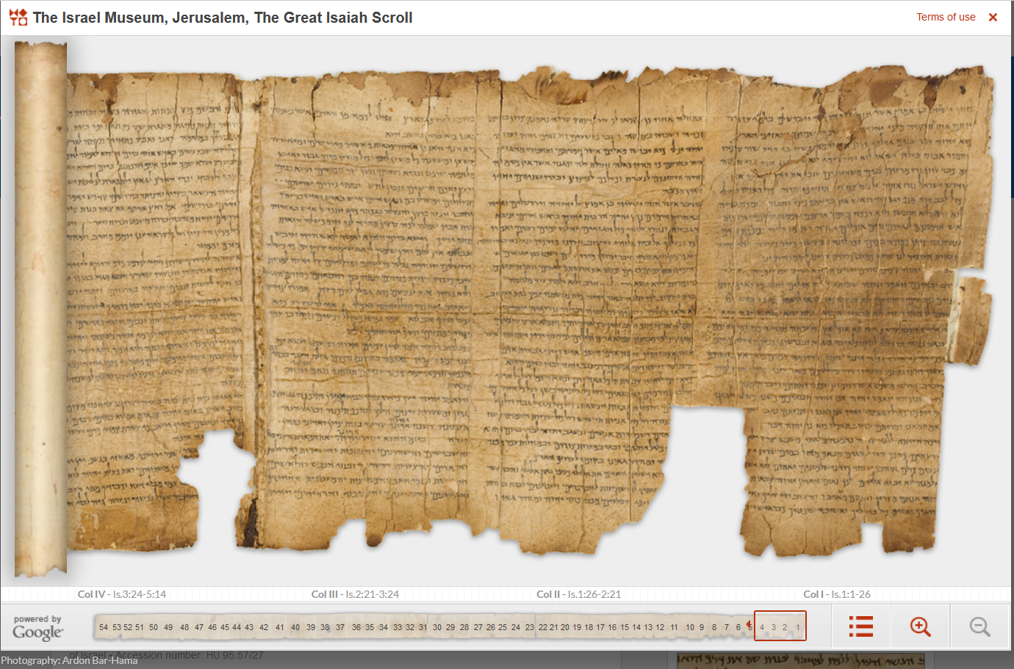
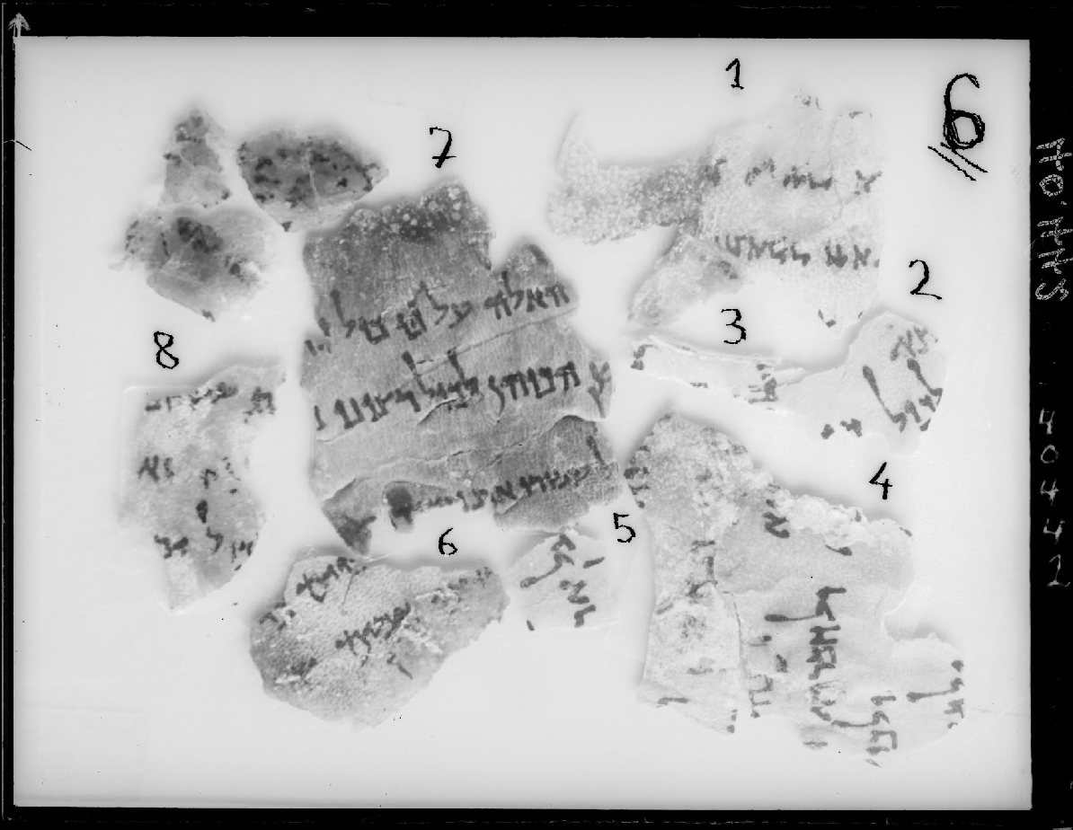
Dead Sea Scrolls – Genesis Fragments
1Q1, 1Q24, 1Q29
The Digital Dead Sea Scrolls http://dss.collections.imj.org.il/isaiah

Slide 41
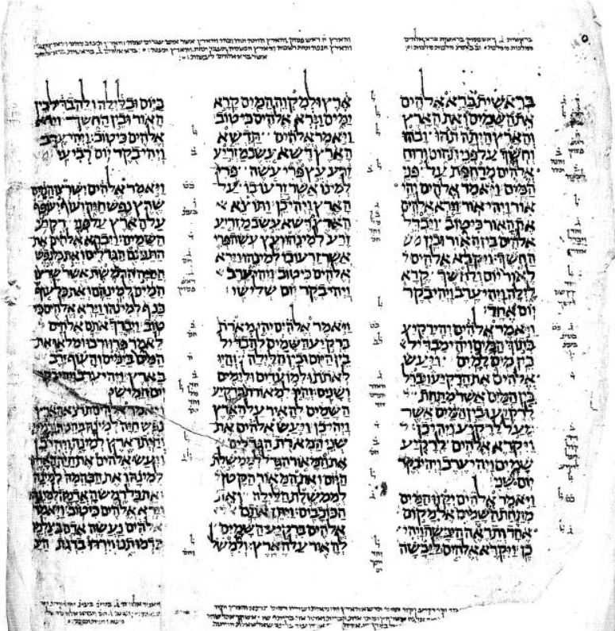
Codex Leningradensis

Slide 42
Manuscript Witnesses of the NT
Autographs (c.AD 50-100) – in Greek
Latin Vulgate (c. AD 280) –translated into Latin
Desiderius Erasmus GNT, published 1516, aka Textus Receptus (TR)
  7 codices, dating from 11th-15th century (most from 12th c.)
  1611 KJV used Erasmus’ Textus Receptus as the basis of its translation.
1700s onwards, thousands of GNT manuscripts were found
  Everyone else uses the eclectic text which is the GNT based on evaluating these thousands of Biblical manuscripts.

Slide 43
Manuscript Witnesses of the NT
Autographs (c.AD 50-100) – in Greek
Latin Vulgate (c. AD 280) –translated into Latin
Desiderius Erasmus GNT, published 1516, aka Textus Receptus (TR)
  7 codices, dating from 11th-15th century (most from 12th c.)
1700s onwards, thousands of GNT manuscripts were found
  1895, Adolf Deissmann’s Bible Study (1895) established “Holy Ghost Greek” was just “Koine (common) Greek”

Slide 44
Modern Greek New Testament (GNT) in Print
1. Nestle-Aland 28 (NA28) – 2014
2. United Bible Societies 5 (UBS5) – 2014
Both free to read at Deutsche Bibelgesellschaft online: https://www.academic-bible.com/en/online-bibles/about-the-online-bibles/
3. SBL GNT - 2010
W/H, Tregelles, NIVGNT (UBS/NA+), Byzantine Text: https://sblgnt.com/about/introduction/
4. Tyndale House Greek New Testament (THGNT) - 2018
https://www.thegreeknewtestament.com/ (Tregelless+)

Slide 45
Manuscript Witnesses of the NT - Summary
Autographs (c.AD 50-100) – in Greek
Latin Vulgate (c. AD 280) –translated into Latin
Desiderius Erasmus GNT, (1516), aka Textus Receptus (TR), 7 codices from 11th-12th c. A.D,
Karl Lachmann, (1831), Majuscules, early Fathers, “back to 4th c.”
Tischendorf’s GNT, (1869-1872), Codex Sinaiticus (א), 64 Uncials, 1 Papyrus, some Minuscules
Samuel Tregelles (1857-1879)
Westcott & Hort, (1881), Codex Vaticanus (B)
Eberhard Nestle (1898), compared (Tischendorf + WH), tiebreaker was Weiss (1894-1900)
Nestle-Aland 28 (NA28) – 2012
SBL GNT [W/H, Tregelles, NIVGNT (UBS/NA+), Byzantine Text] - 2012
United Bible Societies 5 (UBS5) – 2014
Tyndale House Greek New Testament (THGNT) (Tregelles+) - 2018
Textus Receptus (TR)/ Majority Text = Erasmus’ GNT (1516)
Eclectic Text = Best available mss (as of 2012)

Slide 46
Chapter & Verse Additions
Archbishop Steven Langton &
Cardinal Hugo de Sancto Caro (1227-48) - Chapters
Santi Pagnini (1470-1541) - Verses
Robert Estienne (1551) -Verses
Geneva Bible (1560) – 1st to use chapters & verses

Slide 47
Manuscript Witnesses of the NT - Summary
Autographs (c.AD 50-100) – in Greek
Latin Vulgate (c. AD 280) –translated into Latin
Desiderius Erasmus GNT, (1516), aka Textus Receptus (TR), 7 codices from 11th-12th c. A.D,
Karl Lachmann, (1831), Majuscules, early Fathers, “back to 4th c.”
Tischendorf’s GNT, (1869-1872), Codex Sinaiticus (א), 64 Uncials, 1 Papyrus, some Minuscules
Samuel Tregelles (1857-1879)
Westcott & Hort, (1881), Codex Vaticanus (B)
Eberhard Nestle (1898), compared (Tischendorf + WH), tiebreaker was Weiss (1894-1900)
Nestle-Aland 28 (NA28) – 2012
SBL GNT [W/H, Tregelles, NIVGNT (UBS/NA+), Byzantine Text] - 2012
United Bible Societies 5 (UBS5) – 2014
Tyndale House Greek New Testament (THGNT) (Tregelles+) - 2018
Textus Receptus (TR)/ Majority Text = Erasmus’ GNT (1516)
Eclectic Text = Best available mss (as of 2012)

Slide 48
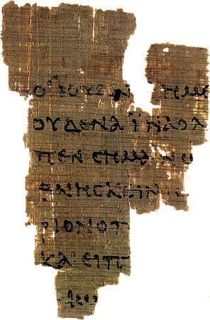
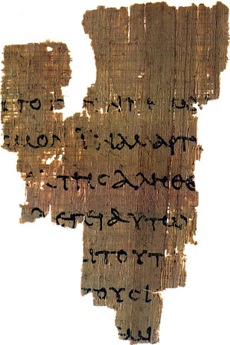
Autographs
P 52 (John Rylands Library Papyrus)
(John 18:31-33, 37, 38)
c. 125 C.E.
Handwritten on papyrus.

Slide 49
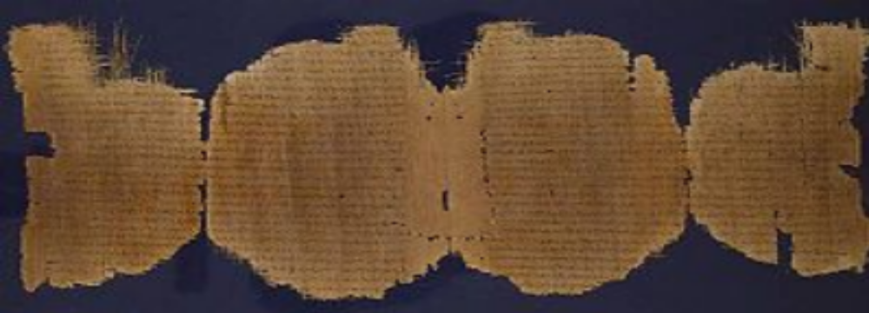

P 45 (c. 250 CE) GLuke

Slide 50
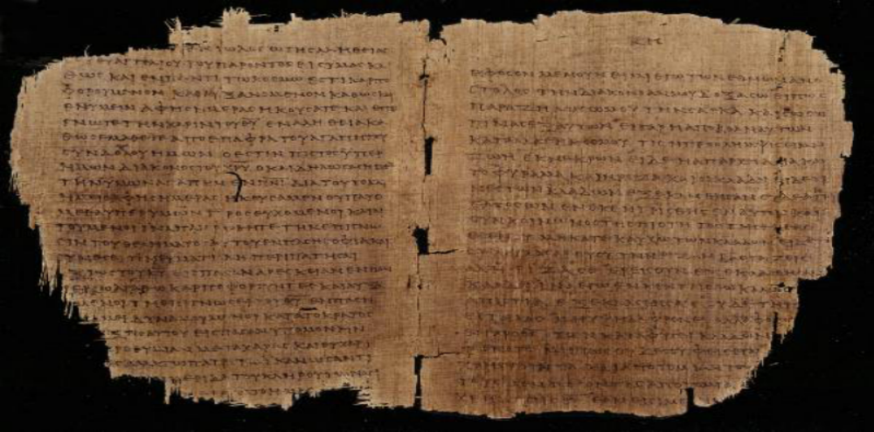
P 46 (c.200 CE) Romans

Slide 51
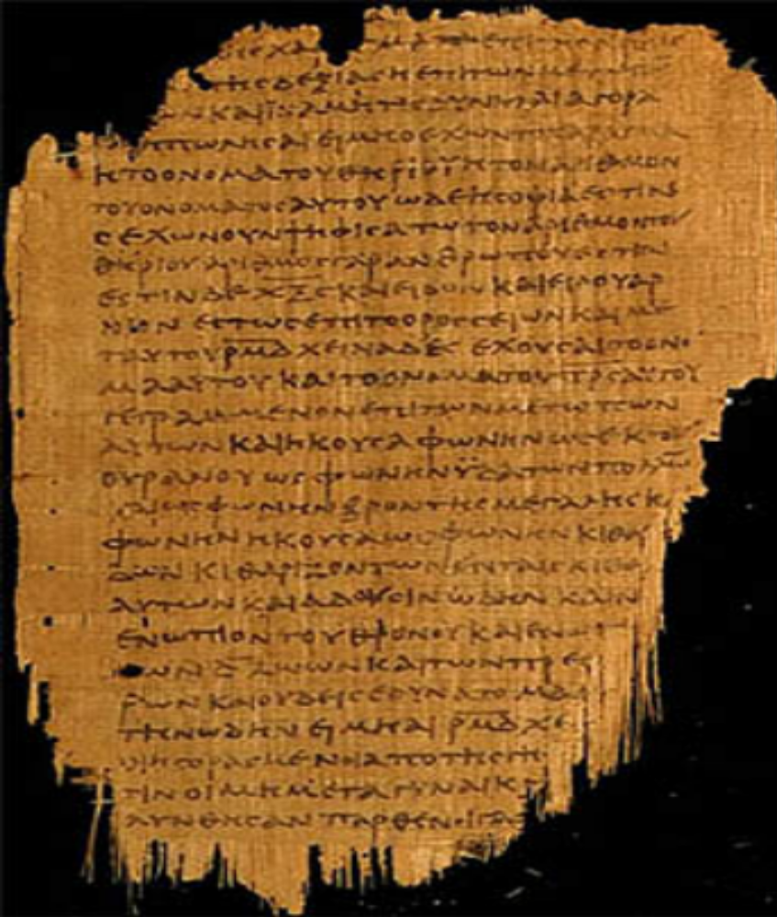
P 47 c. 250 CE

Slide 52
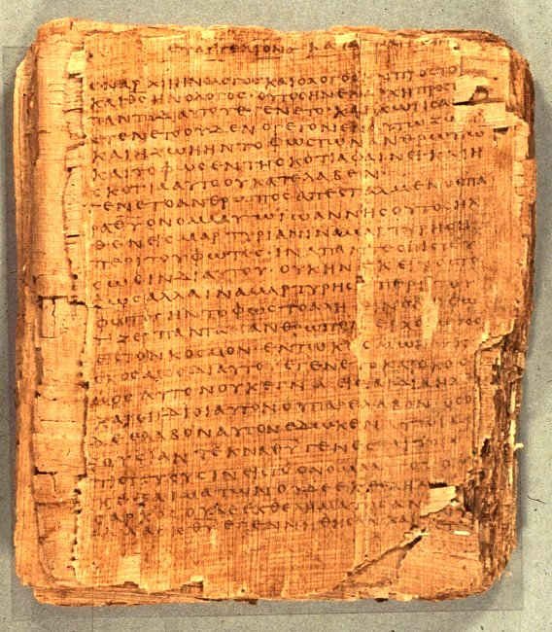
P 66 (Papyrus Bodmer 2) - 75 leaves, 150 pages extant,
Contains most of the Gospel of John ( Date: c. AD 200)

Slide 53
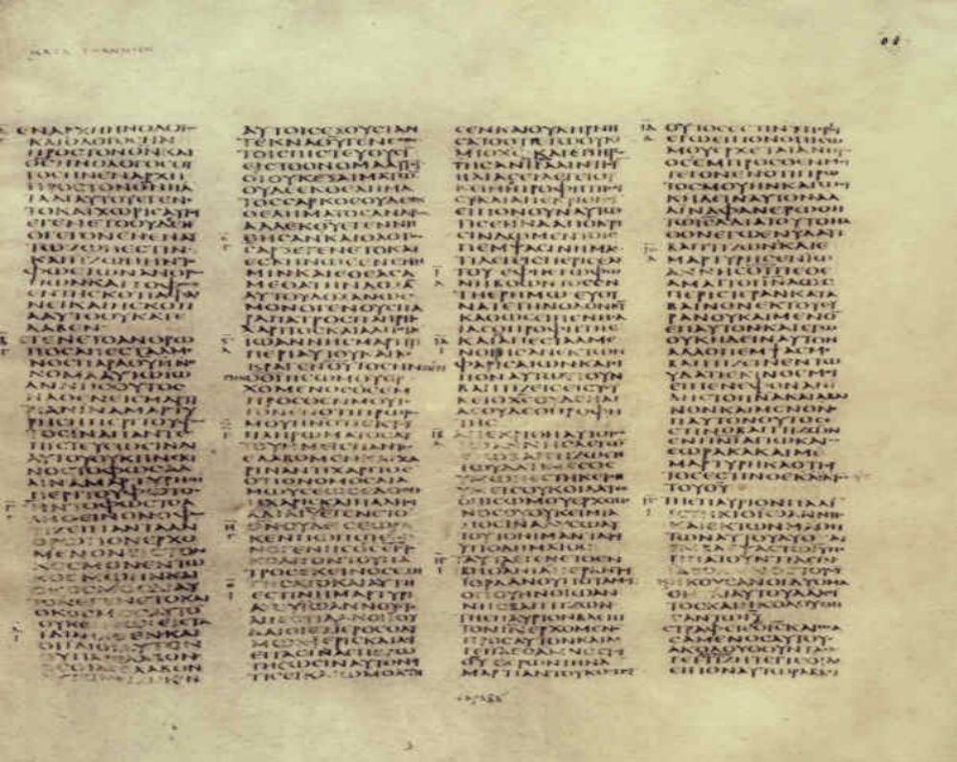
Codex Sinaiticus א c. 350 CE

Slide 54
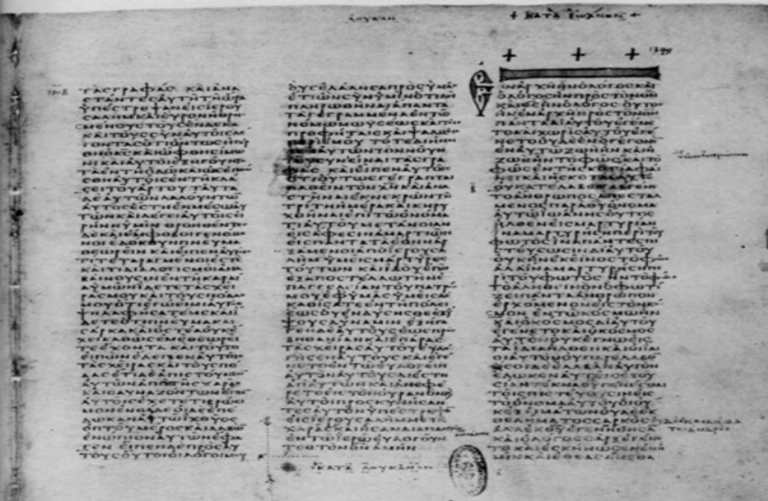
Codex Vaticanus (B) (c. 325-50 CE)

Slide 55
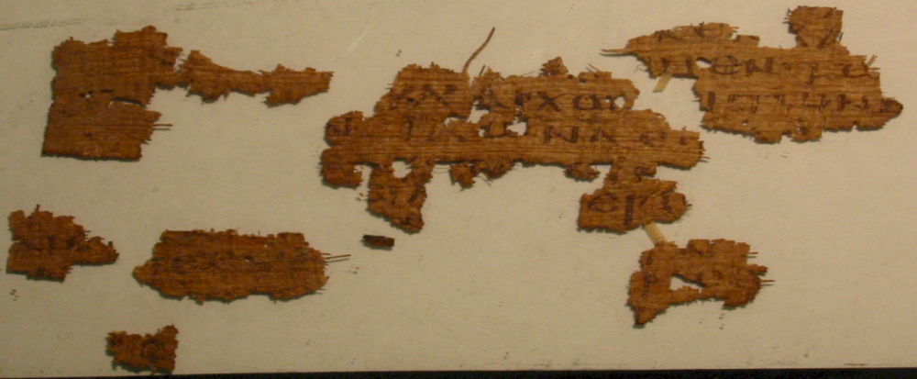
P21 (Oxyrhyncus Papyri 1227) recto
Matt 12:24-26, 31-33
4th/5th c.
http://faculty.bbc.edu/rdecker/classes/p21.htm

Slide 56
External Evidence
Antiquity (age)
Geographical Diversity
Textual Family

Slide 57
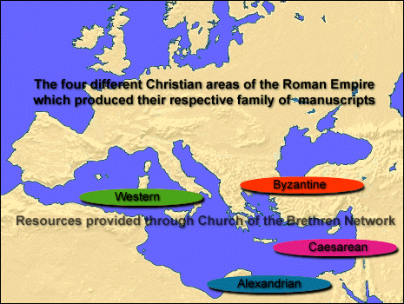
Text Families MapNASA Mediterranean World

Slide 58
External Evidence
Antiquity (age)
Geographical Diversity
Textual Family
See “Major NT Textual Witness” handouts for abbreviations

Slide 59
Internal Evidence
The reading that best explains the other readings is probably the most original.
lectio difficilio potior – The more difficult reading is the preferred reading.
lectio brevior lectio potior – The shortest reading is the preferred reading
See “TC Principles” handout for more detailed lists of principles.

Slide 60
Examples & Resources
Mark 16:9-20 – Longer Ending of Mark
John 7:53-8:11 – pericope adulterae
1 John 5:7-8 – comma Johanneum
Matt 17:21; 24:36; Mark 1:14, 41; 9:23; Luke 10:42; 22:43-44; John 1:28; Rom 5:1; 1 Cor 14:34-35; Eph 1:1; 5:30; Col 4:15; 1 Thess 2:7; Phil 3:12-13; Heb 2:7; 1 John 1:4c; 2:20, 23; 5:7-8; Rev 13:7, 18.
The NET Bible (Bible.org/NebBible.org) has a whole series of footnotes on whether there is a text-critical issue (tc: text-critical note) or a translation issue (tn: translator’s note). It also has sn footnotes, study notes that explain historical background issues, theological issues, and cross references.
Bruce Metzger, A Textual Commentary on the Greek New Testament (UBS4). 2nd ed. Stuttgart: United Bible Societies, 1994.
BibTheo.com/TextualCriticism

Slide 61
Contents
Introduction to Translation vs. Textual Criticism
Bible Translation Theory
Introduction to Textual Criticism

