Slide 1
Academic Research
Day 5

Slide 2
Contents
Finalize Working Bibliography
Summarize Topics
Practical Theology, Quantitative Research, & Your Dissertation
Final Thoughts

Slide 3
Finalize Working Bibliography

Slide 4
Finalize Working Bibliography
Get to 40 resources
If at 40, keep searching for more & then find top 40
Share resources that may be relevant to colleagues

Slide 5
Summary of Dissertations

Slide 6
Dissertation Summary & Brainstorm
Take turns:
  5 minute summary of your dissertation
  Include XYZ statements, “I am studying X…”
  Take notes on class questions and suggestions for your dissertation project.

Slide 7
Practical Theology & Qualitative Research
Smith, Kevin G. 2011. “Integrated Theology: A Key to Training Thinking Practitioners.” Conspectus: The Journal of the South African Theological Seminary 12, no. 09: 185-216. https://journals.co.za/doi/pdf/10.10520/EJC28181
Swinton & Mowat, “Introduction” & “Part 1,” Pages xi-xvi, 3-96
In preparation for post-session online assignments

Slide 8
“Integrated Theology: A Key to Training Thinking Practitioners”
By Kevin G. Smith

Slide 9
Integrated Theology
Author’s goal is to propose a method of theological training for the church rather than just for the academy. “The article contends that developing integrated models of theological reflection and research is essential is we are to train students for pastoral ministry, where they need to be well-rounded theological thinkers rather than research specialists in a narrow sub-discipline.”
The author is exploring different ways to approach “Practical Theology.”

Slide 10
Integrated Theology
Don Browning (1993)
“The view of theology I have outlined should not be seen as simply a subspeciality called practical theology. On the contrary, it is my proposed model for theology as such. I will be claiming that Christian theology should be seen as practical through and through and at its very heart. Historical, systematic, and practical theology (in the more specific sense of the term) should be seen as subspecialities of the larger more encompassing discipline called practical theology” (Browning, via Smith, “Integrated” 187-188).
“Central to Browning’s vision of ho e ought to do theology is his belief that all theology moves from practice to theory and back to practice (a practice-theory-practice model). Browning contrasts his approach with that of theologians like Stanley Hauerwas, David Tracy, and especially Karl Barth (1936:47–70), who use a theory to practice model” (Smith, 188)

Slide 11
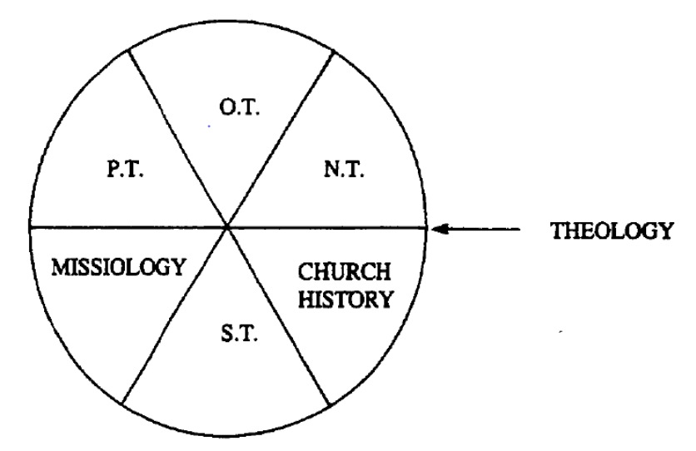
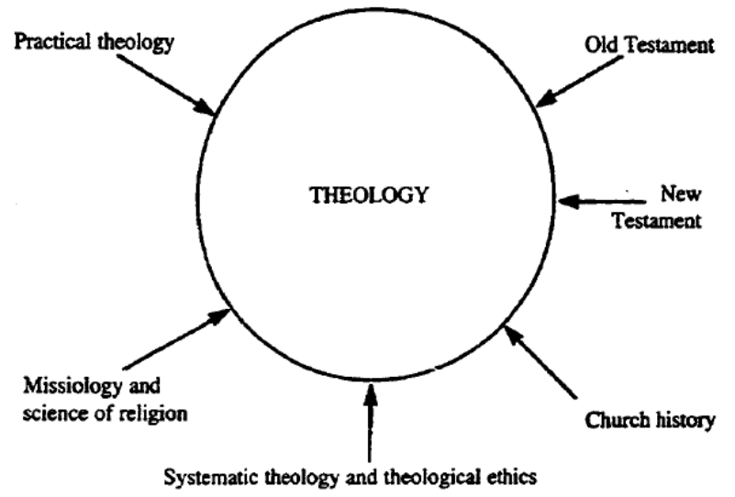
Integrated Theology
Louis Heyns and Hennie Pieterse (1990)
“Theology should not be subdivided into independent fields of study to the extent that it becomes no more than the aggregate of all these sub-disciplines. A field of study is not a section of theology; it is a particular perspective on theology. … theology is an indivisible whole (Heyns and Pieterse 1990:5, italics added)” (Smith, 189).

Slide 12
Integrated Theology
Jurgens Hendricks (University of Stellenbosch)
“In other words, the hermeneutical-correlational method analyses texts and contexts and brings them into ‘dialogue’ with one another The goal is hat Fo ler ( 995:6–7) calls a ‘fusion of t o horizons’—the way in which the interpreted social reality of the faith community and the interpreted normative texts come together ‘to provide vision and guidance for an anticipated future’ (Hendriks 2004:30)” (Smith, 193).

Slide 13
Integrated Theology
Richard Osmer (2008, Princeton University)
“Enter Schleiermacher (1830), who argued that theology should be reorganised into three specialised fields: philosophical theology (104–119), historical theology (120–186), and practical theology (187–219). Philosophical theology would use the methods of philosophical research, historical theology (which subsumed biblical studies and church history) the methods of historical research, and practical theology could apply the scientific findings of other disciplines to the life of the church, especially the clerical ministry. (If he had been writing after the rise of the social sciences, he would likely have conceptualised the nature and methods of practical theology differently ) Schleiermacher’s goal was to show that theology is indeed a scientific discipline which rightly belongs in the modern research university, largely because it uses accepted scientific methods of research” (Smith, 194).

Slide 14
Integrated Theology
Richard Osmer (2008, Princeton University)
“Although Schleiermacher’s three-fold division did not prevail, Osmer believes that it led directly to the division of theology into four subdisciplines: biblical studies, systematic theology, church history, and practical theology. Osmer (2008:§2795) notes that this is the birthplace of the encyclopaedic model of theology, which has four major characteristics:
1. Theology is divided into specialized, relatively autonomous fields.
2. Each field pursues its distinctive tasks along the lines of a modern research discipline, with a specialized language, methods of inquiry, and subject matter.
3. The goal of theological scholarship is the production of new knowledge.
4. The specific task of practical theology is to relate the scholarship of the other theological disciplines to the work of clergy and congregations” (Smith, 194).

Slide 15
Integrated Theology
Richard Osmer (2008, Princeton University)
“In summary, Osmer has argued for the abolition of the silo mentality that the encyclopaedic model produces. He envisages all theological sub-disciplines becoming more interdisciplinary and more practical in their approach. He offers a model of practical theology that is heavily weighted towards dialogue with other disciplines, though it is insufficiently focused on biblical exegesis for my preferences. Osmer rightly argues that the kind of interdisciplinary, dialogical model he has proposed is much better equipped for teaching Christian leaders to think theologically and holistically.” (Smith, 196).

Slide 16
Practical Theology, Qualitative Research, &
Your Dissertation
Swinton & Mowat discussion
Discuss Practical Theology
Discuss Qualitative Research
  Qual vs. Quant (philosophy/interpretation vs. numbers)
Discuss the role of each in your particular project
Notes:
T., you have a 3 page printout of the notes to use for this discussion.

Slide 17
Final Thoughts

Slide 18
Final Thoughts
What questions do you have about the class topics?
What questions did you have on day 1 that were not answered yet?
Final thoughts and suggestions
Working Bibliography due by the end of the day

Slide 19
Contents
Finalize Working Bibliography
Summarize Topics
Practical Theology, Quantitative Research, & Your Dissertation
Final Thoughts

