Slide 1
Academic Research
Day 4

Slide 2
Contents
Roberts, “Mastering the Academic Style”
Evaluating Resources (revisited)
Primary Sources for Biblical Studies
Conversations, part 1
Working Bibliography
Conversations, part 2

Slide 3
Roberts, “Mastering the Academic Style”
Pages 111-121

Slide 4
Common Writing Problems (p. 113)
Organization
  Rambling
  Lack of focus
  Irrelevant details
Paragraphs
  Short paragraphs
  Overly-long paragraphs
  Every ides should relate to the structure of the argument
Quotations
  Excessive quoting

Slide 5
Writing Tips (p. 114-121)
Tip 1: Write in a Conversational Tone
Tip 2: Trim Excess Words
Tip 3: Use Short Sentences Rather than Long
Tip 4: Write Clear, Well-Constructed Paragraphs
Tip 5: Use the Active Voice (or, be intentional about Active & Passive Voice use)
Tip 6: Use Transitional Words and Phrases (aka, “seam sentences/literary seams”)
Tip 7: Simplify Your Vocabulary (use technical terms to clarify, not obfuscate)
Tip 8: Use Quotations Sparingly

Slide 6
Evaluating Sources, revisited
Northwestern University (Chicago, Illinois, USA)
Research Guides: Navigating the Research Process
https://libguides.northwestern.edu/start-research

Slide 7
Evaluating Resources (Northwestern U)
CONTENT
What does it say? What is its main point or argument? Relevance to your topic? What new information, facts, or opinions does it include?
Where did you find it? Where was it published?
When was it written? Within the past few days, weeks, or years? Is it historical? Has its information changed over time?
Who created this information? What are their credentials?
Why does this source exist? Is its purpose to inform, persuade, or entertain?
How does it incorporate data or evidence? What kinds of evidence?
CONTEXT
What is the audience for this source? General readers, people who work in a specific field, academics? Does it assume previous knowledge?
Where can you find other information about this topic?
When was this information last updated? Has it been revised, redacted, or challenged?
Who is missing from the conversation? Does it include opposing viewpoints, marginalized voices, or global perspectives?
Why do you need this information? Is it for an academic assignment, work project, personal decision-making, or to share with others?*
How did the information find you? Was it through a relevance-ranked search, social media algorithm, advertising cookie, or press release?
*Sources that may be appropriate for sharing with others, deepening personal understanding, or decision-making may not be appropriate for an academic assignment or work presentation. When in doubt, check with your librarian or professor for more guidance!
Adapted from Beyond the Source created by the DePaul University Libraries.

Slide 8
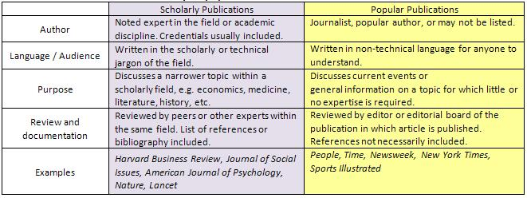
Evaluating Resources (Northwestern U)

Slide 9
Primary Sources for Biblical Studies

Slide 10
Primary Sources
Review difference between “primary” and “secondary” sources.
See BibTheo.com/Bibliography/#anet for a fuller list.
The primary source for Biblical studies is the Bible. Consider that:
  We are reading translations, not the original words of Scripture.
  Textual criticism helps determine what the original wording of Scripture was.
  The OT was originally written in Hebrew (Hebrew Bible), later translated into Greek (Septuagint; aka LXX), and then Christians added the Greek documents of the New Testament.

Slide 11

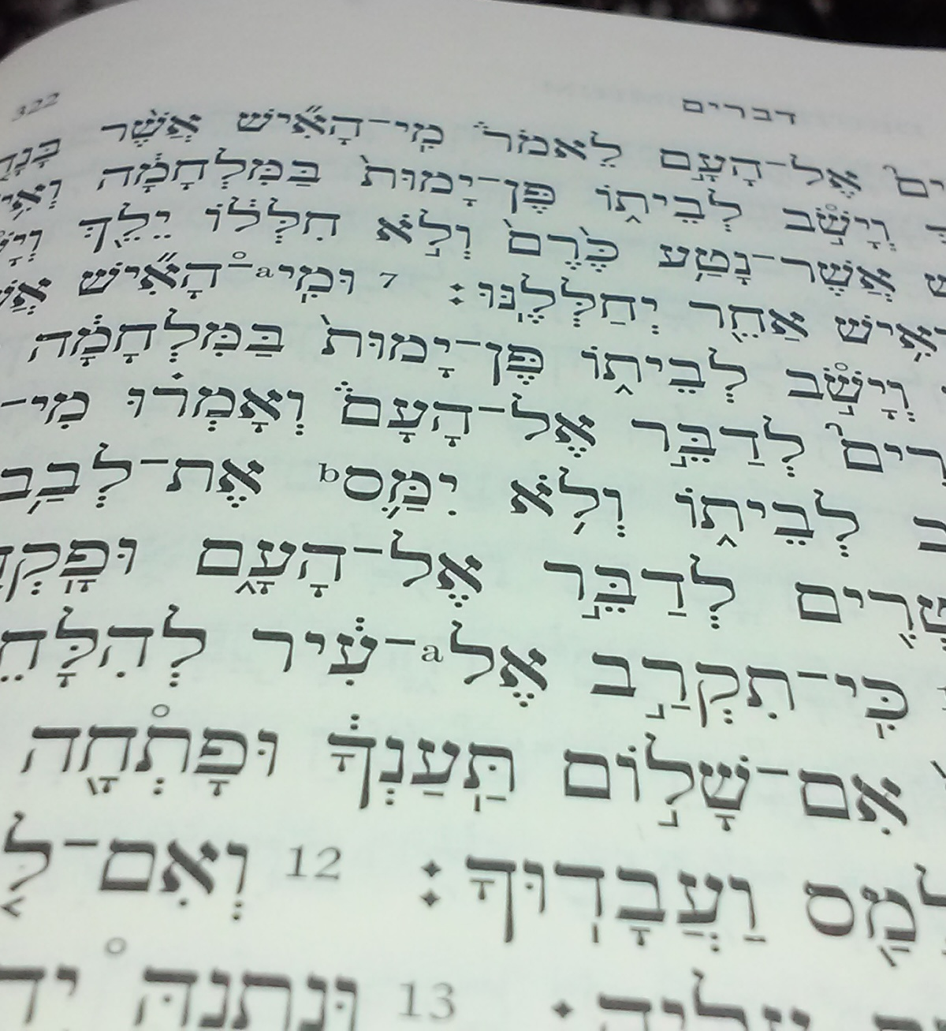
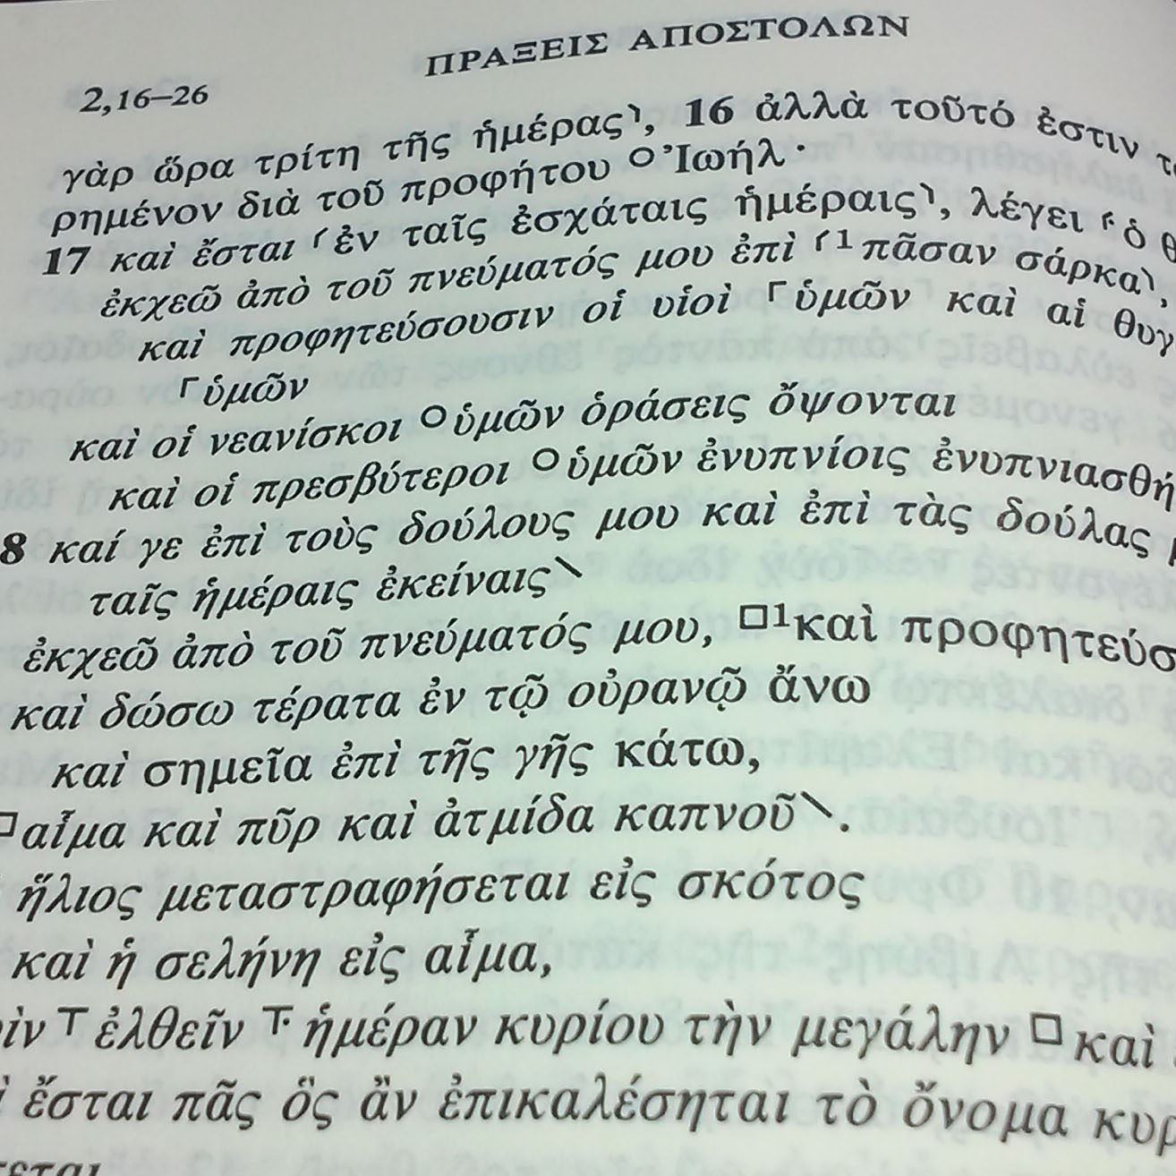
Textual Basis
Original Languages of Scripture
OT: Classical Hebrew*
  *Aramaic Portions of the OT
    Genesis 31:47 (2 words)
    Jeremiah 10:11
    Daniel 2:4-7:28
    Ezra 4:8-6:18; 7:12-26
  NT: Koine Greek
  (c. A.D. 50-100)

Slide 12

Important Translations
King James Version - A.D. 1611.
Ethiopic (Ge’ez) - 15th c. mss, transl. A.D. 400-600.
Latin Vulgate (Jerome) - c. A.D. 405.
Peshitta (Aramaic Vulgate).
  NT - c. A.D. 400-500.
  OT - c. A.D. 150-200.
Septuagint (LXX, OT in Greek) - c. 250-150 B.C

Slide 13
Peshitta (Aramaic Vulgate)
“Like all Syriac (Aramaic) versions of the NT, the Peshitta is based on Greek texts. There is no direct relation between this Syriac (i.e., Eastern Aramaic) text and Jesus’ original words in Western Aramaic.”
-Bas ter Haar Romeny, “Peshitta and Other Syriac Versions.” Pages 149 to 155 in Oxford Encyclopedia of the Books of the Bible. Edited by Michael D. Coogan. Oxford: Oxford University Press, 2011.

Slide 14
Textual Basis
To evaluate a Bible translation…
1. Read the preface or introduction.
2. Look for the following textual basis.
  OT: Masoretic Text, Biblica Hebraica (BH)
    (BHS, BHL, BHQ, HB)
  NT: Eclectic text, Nestle Aland/UBS
    (Erasmus’ TR is a 16th c. mss based on a handful of documents dated no earlier than the 10th c.)
3. Then look at specific passages in translation.

Slide 15
Primary Sources
While the primary source of biblical studies is the Bible, be aware of the complexity involved in which translation you are reading and of the original textual basis for that translation.
In our discipline, “primary sources” for the Old Testament include “Ancient Near Eastern (ANE)” sources, and for the New Testament include “(1st century) Greco-Roman” resources.

Slide 16
Primary Sources: ANE Literature
Arnold, Bill T. and Bryan E. Beyer, eds. Readings from the Ancient Near East: Primary Sources for Old Testament Study. Grand Rapids: Baker Academic, 2002.
Chavalas, Mark W., ed. Women in the Ancient Near East. Routledge Sourcebooks for the Ancient World. New York: Routledge, 2014.
———-, ed. The Ancient Near East: Historical Sources in Translation. Blackwell Sourcebooks in Ancient History. Malden: Blackwell Publishing, 2006.
Coogan, Michael D. A Reader of Ancient Near Eastern Texts: Sources for the Study of the Old Testament. Oxford: Oxford University Press, 2012.
Coogan, Michael D. and Mark S. Smith, eds. Stories from Ancient Canaan. 2nd edition. Louisville: Westminster John Knox, 2012.
Dietrich, Manfried, Oswald Loretz, and Joaquin Sanmartin. Die keilalphabetischen Texte aus Ugarit, Ras Ibn Hani und anderen Orten (The Cuneiform alphabetic texts from Ugarit, Ras Ibn Hani and other places). 3rd enlarged edition. Münster: Ugarit-Verlag, 2013. (KTU, English abbreviation CAT)
Hallo, William W., ed. The Context of Scripture. 3 vols. Leiden: Brill, 1997-2002. Volume 1: Canonical Compositions from the Biblical World; Volume 2: Monumental Inscriptions from the Biblical World; Volume 3: Archival Documents from the Biblical World. Leiden: Brill, 1997-2000. (COS)
Hays, Christopher B. Hidden Riches: A Sourcebook for the Comparative Study of the Hebrew Bible and Ancient Near East. Louisville: Westminster John Knox, 2014.
Pritchard, James B., ed. The Ancient Near East: An Anthology of Texts and Pictures. Princeton: Princeton University Press, 2010. (ANET)
Sparks, Kenton. Ancient Texts for the Study of the Hebrew Bible: A Guide to the Background Literature. Peabody: Hendrickson, 2005.
Walton, John H. Ancient Israelite Literature in its Cultural Context: A Survey of Parallels between Biblica and ancient Near Eastern Texts. Grand Rapids: Regency Reference Library, 1990.

Slide 17
Primary Sources: 2nd Temple Literature
Chapman, David W. and Andreas J. Köstenberger, ”Jewish Intertestamental and Early Rabbinic Literature; An Annotated Bibliographic Resource,” JETS 43 (2000): 577-618.
Cohen, Shaye J.D. From the Maccabees to the Mishnah. 3rd edition. Louisville: Westminster John Knox, 2014.
Feldman, L.H. Jewish Life and Thought Among Greeks and Romans: Primary Readings. Minneapolis: Fortress, 1996.
Helyer, Larry R. Exploring Jewish Literature of the Second Temple Period: A Guide for New Testament Students. Downers Grove: InterVarsity, 2002.
Nickelsburg, George W.E., Jewish Literature Between the Bible and the Mishnah. Philadelphia: Fortress, 1981.
Stone, Michael E., ed. Jewish Writings of the Second Temple Period. CRINT 2. Philadelphia: Fortress, 1984.

Slide 18
Primary Sources: OT Apocrypha & Pseudepigrapha
deSilva, David A. The Jewish Teachers of Jesus, James, and Jude: What Earliest Christianity Learned from the Apocrypha and Pseudepigrapha. Cambridge: Oxford, 2012.
———-. Introducing the Apocrypha: Message, Context, and Significance. Grand Rapids: Baker, 2002.
Kirby, Peter. “Early Jewish Writings.” Online: www.earlyjewishwritings.com
  Includes access to free, online versions of the Deuterocanonical Literature, Pseudepigrapha, Philo, and Josephus.
Metzger, Bruce M. ”Introduction to the Apocrypha.” Pages xi-xxii in the Oxford Annotated Apocrypha. Expanded and revised edition. Edited by Bruce M. Metzger. New York: Oxford University Press, 1977.
Reddish, Mitchell G., ed. Apocalyptic Literature: A Reader. Peabody: Hendrickson, 1995.
Sparks, H.F.D., The Apocryphal Old Testament. Oxford: Oxford University Press, 1984.
Wills, Lawrence M. Introduction to the Apocrypha: Jewish Books in Christian Bibles. New Haven: Yale University Press, 2021.
Gurtner, Daniel M. Introducing the Pseudepigrapha of Second Temple Judaism: Message, Context, and Significance. Grand Rapids: Baker, 2020.
Charlesworth, James H. The Old Testament Pseudepigrapha. 2 vols. Garden City: Doubleday, 1985.

Slide 19
Primary Sources: Septuagint (LXX)
Aitken, James K., ed. T&T Clark Companion to the Septuagint. New York: T&T Clark, 2015.
Jobes, Karen H. and Moises Silva. Invitation to the Septuagint. 2nd edition. Baker: Grand Rapids, 2015.
Ross, William A. and W. Edward Glenny, eds. T&T Clark handbook of Septuagint Research. New York: T&T Clark, 2021.
Septuagint Commentary Series. Boston: Brill.
Tov, Emmanuel, The Text-Critical Use of the Septuagint in Biblical Research: Completely Revised and Expanded Third Edition. Winona Lake: Eisenbrauns, 2015
Texts of the Septuagint
Pietersma, Albert and Benjamin G., eds. A New English Translation of the Septuagint and the Other Greek Translations Traditionally Included under that Title. New York: Oxford University Press, 2007. Online: http://ccat.sas.upenn.edu/nets/edition/
Brenton, Lancelot Charles Lee. The Septuagint Version of the Old Testament: English Translation. London: Samuel Bagster and Sons, 1870.
Rahlfs, A. and Robert Hanhart, eds. Septuaginta. Stuttgart: Deutsche Bibelgesellshaft, 2006. Online: https://www.academic-bible.com/en/online-bibles/septuagint-lxx/read-the-bible-text/
Septuaginta: Vetus Testamentum Graecum Auctoritate Academiae Scientiarum Gottingensis editum. Göttingen: Vandenhoeck & Ruprecht, 1931-1990.

Slide 20
Primary Sources: Dead Sea Scrolls (DSS)
Charlesworth, James, ed. The Bible and the Dead Sea Scrolls, 3 vols. Waco: Baylor University Press, 2006.
Magness, Jodi. The Archaeology of Qumran and the Dead Sea Scrolls. Grand Rapids: Eerdmans, 2002.
Schiffman, Lawrence H. and James C. VanderKam. Encyclopedia of the Dead Sea Scrolls. Oxford: Oxford University Press, 2000.
VanderKam, James. The Dead Sea Scrolls and the Bible. Grand Rapids: Eerdmans, 2012.
———-. The Dead Sea Scrolls Today. 2nd edition. Grand Rapids: Eerdmans, 2010.
Vermes, Geza. The Dead Sea Scrolls: Qumran in Perspective. Revised edition. Philadelphia: Fortress, 1997.
Texts of the DSS
Charlesworth, James H., et al., The Dead Sea Scrolls: Hebrew, Aramaic and Greek Texts with English Translations. Princeton Theological Seminary Dead Sea Scrolls Project 6B. Tübingen: Mohr Siebeck; Louisville, 2002.
“Dead Sea Scrolls,” Google Cultural Institute.” Online: https://www.google.com/intl/en-GB/culturalinstitute/about/deadseascroll/
“Dead Sea Scrolls Electronic Library.” Online: http://referenceworks.brillonline.com/browse/dead-sea-scrolls-electronic-library-biblical-texts. This resource is behind a paywall.
“The Digital Dead Sea Scrolls.” Online: http://dss.collections.imj.org.il/
Discoveries in the Judean Desert (DJD).
García Martínez, Florentino and Eibert J. C. Tigchelaar, eds. The Dead Sea Scrolls Study Edition. 2nd ed. 2 vols. New York: Brill, 2019.
García Martínez, Florentino. The Dead Sea Scrolls Translated: The Qumran Texts in English. 2nd ed. Grand Rapids: Eerdmans, 1996.
“The Leon Levy Dead Sea Scrolls Digital Library.” Online: https://www.deadseascrolls.org.il/?locale=en_US
Vermes, Geza, The Dead Sea Scrolls in English. 7th rev. ed. New York: Penguin, 2012.

Slide 21
Primary Sources: Josephus, Philo, & NT Apocrypha
Kirby, Peter. “Early Jewish Writings.” Online: www.earlyjewishwritings.com
  Includes access to free, online versions of the Deuterocanonical Literature, Pseudepigrapha, Philo, and Josephus.
Mason, Steve. Josephus and the New Testament. 2nd edition. Peabody: Hendrickson, 2002..
Thackeray, H. St. J., et al., Josephus. 10 vols. LCL. Cambridge: Harvard University Press, 1926-1965.
Whiston, W. The Works of Josephus: Complete and Unabridged. Peabody: Hendrickson, 1987.
Colson, F.H., et al. Philo. 12 vols. LCL. Cambridge: Harvard University Press, 1929-1953.
Yonge, C.D. The Works of Philo: Complete and Unabridged. Peabody: Hendrickson, 1993.
Elliot, J.K. The Apocryphal New Testament. Oxford: Clarendon, 1993.
Schneemelcher, Wilhelm. New Testament Apocrypha. Louisville: Westminster/John Knox, 1991-1992.

Slide 22
Primary Sources: Greco-Roman Literature
“the Internet Classics Archive.” Online: http://classica.mit.edu/index.html
“Perseus Digital Library.” Online: http://www.perseus.tufts.edu
“Thesaurus Linguae Graecae: A Digital Library of Greek Literature.” Online: https://stephanus.tlg.uci.edu/
“LacusCurtius: Into the Roman World.” Online: http://penelope.uchicago.edu/Thayer/E/Roman/Texts/home.html
“The Latin Library.” Online: http://www.thelatinlibrary.com
Loeb Classical Library. Harvard University Press.
Barrett, C.K., ed. The New Testament Background: Writings from Ancient Greece and Roman Empire that Illuminate Christian Origins. Rev. ed. San Francisco: HarperSanFrancisco, 1995.
Betz, H.D. The Greek Magical Papyri in Translation, Including the Demotic Spells. 2nd ed. Chicago: University of Chicago Press, 1996.
Elwell, Walter A. and Robert W. Yarbrough, Readings from the First-Century World: Primary Sources for New Testament Study. Grand Rapids: Baker 1998.
Evans Craig A. Ancient Texts for New Testament Studies: A Guide to the Background Literature. Peabody: Hendrickson, 2005.
Feldman, L.H. Jewish Life and Thought Among Greeks and Romans: Primary Readings. Minneapolis: Fortress, 1996.
Smith, Daniel Lynwood. Into the World of the New Testamnt: Greco-Roman and Jewish Texts and Contexts. London: T&T Clark, 2015.

Slide 23
Primary Sources: Apostolic Fathers
Holmes, Michael W. The Apostolic Fathers: Greek Texts and English Translations. 3rd edition. Grand Rapids: Baker, 2007.
Roberts, Alexander, and James Donaldson, eds. The Ante-Nicene Fathers. 1885-1887. 10 vols. Reprint. Peabody, Mass.: Hendrickson, 1994.
Schaff, Philip, ed. The Nicene and Post-Nicene Fathers. 1886-1889. 14 vols. Reprint. Peabody, Mass.: Hendrickson, 1995.
www.ccel.org “Christian Classica Ethereal Library” This is library of full-text resources, from the time of the apostles onwards.
www.earlychristianwritings.com, by Peter Kirby, includes access to free, online versions of the NT Apocrypha, Gnostic Literature, and Early Church Fathers

Slide 24
Conversations, part 1
Review and Q&A

Slide 25
Review and Q&A
Review what this class is about
Review what we have covered so far since Day 1
Open Discussion: Q&A

Slide 26
Working Bibliography

Slide 27
Working Bibliography
In light of everything we have covered and worked on so far, take time to add to your working bibliograhy

Slide 28
Conversations, part 2
Discuss working bibliography
Further Q&A

Slide 29
Contents
Roberts, “Mastering the Academic Style”
Evaluating Resources (revisited)
Primary Sources for Biblical Studies
Conversations, part 1
Working Bibliography
Conversations, part 2

