Slide 1
Academic Research
Day 3

Slide 2
Contents
Develop Taxonomy of Biblical Research
Word Studies
General & Specific Tools for Biblical Research in Accordance
Theological Research & the Use of Accordance

Slide 3
Develop Taxonomy of Biblical Research

Slide 4
Develop Taxonomy of Biblical Research
Individual work (10 min): What are the main categories of resources for biblical research for your dissertation topic?
  Consider primary sources & secondary sources
  Consider the different categories within Biblical studies
  Consider the different categories relevant to your social science component
Partners/Groups (10 min): Work with your partners/groups to help them brainstorm more sources.
Class Discussion (15 min): Share your project and major resources and the rest of us will help you brainstorm resources.

Slide 5
Word Studies – Philosophy

Slide 6
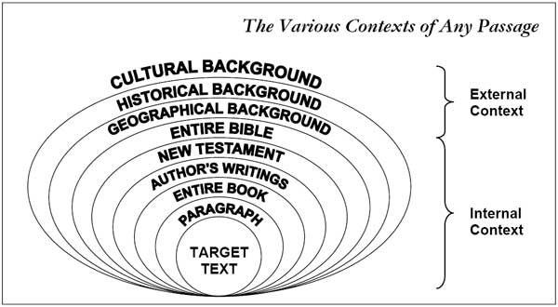
Hermeneutical Circles:
Language is embedded in culture
Ben Dubow, “The Hermeneutical Spiral,” Online: https://faithautopsy.wordpress.com/2010/01/11/blog2010111the-hermeneutical-spiral-html/

Slide 7
Hermeneutical Circles
“For I know the plans I have for you,” declares the Lord, “plans to prosper you and not to harm you, plans to give you hope and a future” (Jer 29:11).
Linguistic Context:
  “For I know the plans I have for you (עֲלֵיכֶ֖ם, plural, y’all),” declares the Lord, “plans to prosper you and not to harm you (עֲלֵיכֶ֖ם, plural, y’all), plans to give you hope and a future” (Jer 29:11 NIV).
Historical & Literary Context:
  Jeremiah 29:1 – letter from Jeremiah to exiles in Babylon
  Jeremiah 29:4 – Word of God “to all those I carried into exile form Jerusalem to Babylon.”
  Jeremiah 29: 8 – “Don’t let the prophets and diviners among you deceive you. Do not listen to the dream you encourage them to have. They are prophesying lies to you in my name. I have not sent them,” declares the LORD.”
  Jeremiah 29:10 – “When seventy years are completed for Babylon, I will come to you an fulfill my good promise to bring you back to this place” [i.e., from Babylon to Jerusalem].

Slide 8
Hermeneutical CircleS
Ben Dubow, “The Hermeneutical Spiral,” Online: https://faithautopsy.wordpress.com/2010/01/11/blog2010111the-hermeneutical-spiral-html/

Slide 9
Discourse Analysis
Discourse analysis is a broad category of study that focuses on communication in its own context.
For literature, it includes studying how words are used in their cultural context.
Going beyond facile appeals to a dictionary, discourse analysis considers the relationship between speaker and audience, their roles in their social context, and a variety of other issues that impact communication.
For now, we will focus on the most basic elements of communication: author, text, & audience.

Slide 10

Discourse Analysis
Author – Text – Audience

Slide 11

Discourse Analysis
Ancient Author – Text – Audience
Modern Researchers

Slide 12
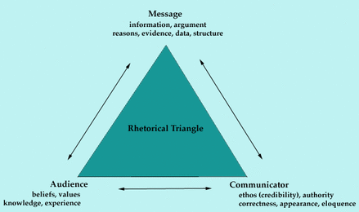
(Aristotelian) Rhetorical Triangle
Author – Text – Audience

Slide 13
Communication is Complex
What you mean to say.
What you think you said.
What you actually said.
What the audience heard.
What the audience thinks they heard.
What the audience thinks about what they heard you say.

Slide 14
Word Studies as Discourse Analysis
This all suggests that word studies cannot simply be appeals to a dictionary (lexicon).
Words only have meaning in context of who uses them and how they are used.
Words do not have inherent meaning. Meaning can be fluid and always depends on “context, convention, and circumstance” (Stephen Fry).
When interpreting a foreign language as it was used thousands of years ago, you have to be extra cautious about assuming too much.

Slide 15
Aγαπη (Agape) why agape doesn’t just mean Godly love.
Gottfried Quell and Ethelbert Stauffer, “ἀγαπάω, ἀγάπη, ἀγαπητός,” TDNT 21 (1964)
Ceslas Spicq, “ἀγάπη “, TLNT 8-22. (1994)
  Eros is for passionate, sensual love.
  Phileo is for friendship, good will.
  Storge is for parental, familial love.
  Agape is for demonstrations of love, God’s love for us, divine love, our love for God.

Slide 16
Aγαπη (Agape)
Moisés Silva, Christopher A Beetham, eds., “ἀγαπάω,” CIDNTTE, 9-13. Logos. (NIDNTTE 2014, CNIDNTTE 2021)
“Woe to you Pharisees, because you love (vb. agapao) the most important seats in the synagogues and respectful greetings in the marketplaces” (Luke 11:43).
“they [teachers of the law and Pharisees] love (vb. phileo) the place of honor at banquets and the most important seats in the synagogues” (Matt 23:6).
“Do your best to come to me quickly, for Demas, because he loved (vb. agapao) this world, has deserted me and has gone to Thessalonica. (2 Tim 4:10a)
“Do not love (vb. agapao) the world or anything in the world. If anyone loves (vb. agapao) the world, love (n. agape) for the Father is not in them” (1 John 2:15).
“It remains true that in the vast majority of its NT occurrences, [the verb] ἀγαπάω is used with ref. to a distinctive Christian virtue, but this fact witnesses to the significance of the theological concept, not to any positive qualities inherent in the word itself. In partic. it is worthy of note that the NT never uses the noun ἀγάπη in negative contexts. Rather, its meaning always seems related to the phrase ἡ ἀγάπη τοῦ θεοῦ, “the love of God” (whether in the subj. gen. sense, “God’s love for us,” or in the obj. gen. sense, “our love for God”), incl. the love for fellow believers—and even for one’s enemies—that the presence of God evokes” (Silva, “ἀγαπάω” CIDNTTE, 11).

Slide 17
Aγαπη (Agape)
Moisés Silva, Christopher A Beetham, eds., “ἀγαπάω,” CIDNTTE, 13. Logos.
“The human response to God’s saving act is described by Paul mostly as πίστις G4411 (“faith”) or γνῶσις G1194 (“knowledge”), but also freq. as ἀγάπη (cf. 1 Cor 8:3; Eph 3:19)…
It has become commonplace—not only in popular lit. but in scholarly treatments as well—to say that Gk. has three words for “love,” each of which has a clearly distinguishable meaning: ἔρως (vb. ἐράω) supposedly has a negative connotation and indicates a desire for personal satisfaction, so that it is often applied to sexual matters (this word group is totally absent in the NT); φιλία G5802 (vb. φιλέω G5797) is said to be a somewhat neutral and colorless term, referring primarily to friendships and family relations; ἀγάπη and ἀγαπάω, finally, signify a self-giving attitude that seeks the best for others, even if unlovable.
This approach is problematic, however. Not only does it give an oversimplified picture of the Gk. vocabulary—it is also inaccurate in several respects. To begin with, Gk. has more than just three words whose use can come within the broad category of “love,” such as ἀντέχω G504 (mid.; see ἔχω G2400), ἐπιθυμία G2123 (vb. ἐπιθυμέω G2121), ἐπιπόθησις G2161 (vb. ἐπιποθέω G2160), ἵμερος (vb. ἱμείρω), κολλάω G3140, πόθος (vb. ποθέω), σπλάγχνον G5073 (pl.), and στοργή (vb. στέργω).”

Slide 18
Aγαπη (Agape)
Erao [vb. of eros] is “heavenly, divine” in Philo, Virt. 1.55
Phileo can be friendship, but also “but it can also be applied to Jacob’s strong love for his son Joseph (37:4 [= ἀγαπάω in v. 3]), to a person’s love for wisdom (Prov 29:3), to the love for parents (Matt 10:37), to God the Father’s love for the Son (John 5:20), to Jesus’s deep love for Lazarus (11:3 [= ἀγαπάω in v. 5], 36), to the Father’s love for the disciples (16:27), to the love for the Lord that is required to avoid a curse (1 Cor 16:22), to Christian brotherly love (Titus 3:5), and to the risen Lord’s love for his people (Rev 3:19)” (Silva, eds., “ἀγαπάω,” CIDNTTE, 13. Logos).

Slide 19
Aγαπη (Agape)
Agapao & Phileo can be interchangeable
“The disciple whom Jesus loved” (ἠγάπα John 13:23; 21:7, 20; ἐφίλει 20:2).
“The Father loves the son” (ἀγαπᾷ John 3:35; φιλεῖ 5:20)
Agapao “to negative expressions of love” (John 3:19; 12:43)
Phileo to divine love (John 5:20; 16:27)
“For the Father loves (phileo) the Son and shows him all he does. Yes, and he will show him even greater works than these, so that you will be amazed” (John 5:20)
No, the Father himself loves (phileo) you because you have loved (phileo) me and have believed that I came from God.

Slide 20
AγAπη (Agape)
John 21:15-17
Jesus to Peter, “Do you love (agapao) me?” (21:15)
Peter to Jesus, “you know that I love (phileo) you” (21:15)
Jesus to Peter, “Do you love (agapao) me?” (21:16)
Peter to Jesus, “you know that I love (phileo) you” (21:16)
Jesus to Peter, “Do you love (phileo) me?” (21:17)
Peter to Jesus, “you know that I love (phileo) you” (21:17)
Conversation was probably in Aramaic
Few church fathers commented on difference
Euphony (cf. feed my lambs, take care of my sheep, feed my sheep)

Slide 21
All words are made-up

Slide 22
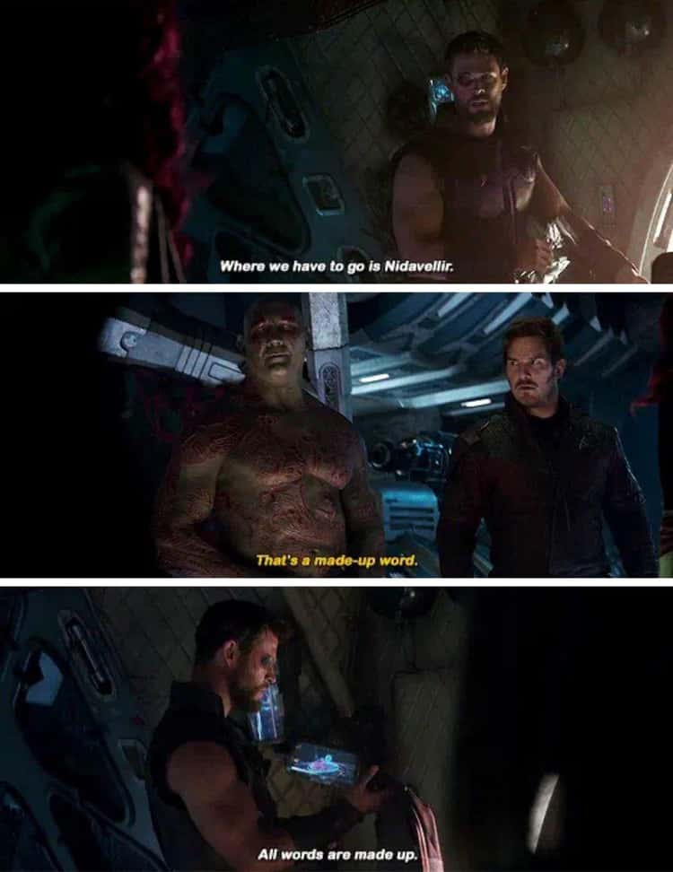
How do words work?
Thor: Where we have to go is Nidavellir.
Drax: That’s a made-up word.
Thor: All words are made up.
The Avengers: Infinity War. Directed by Andy Russo and Joe Russo. Marvel Studios. Movie. Walt Disney Studios Motion Pictures, 2018.

Slide 23
How do words work? Language is fluid.
“French is sloppy Latin”*
  *not really
Words do not contain inherent meaning.
They only have meaning because groups of people agree to ascribe meaning to them.

Slide 24
Klein, Blomberg, Hubbard, Introduction to Biblical Interpretation, 218.
“Each statement must be understood according to its natural meaning in the literary context in which it occurs.”
“A text without a context may be a pretext (for a prooftext).”
“The smaller the passage being studied, the greater the chance of error.”

Slide 25
Even Onomatopoeia
Def: Words that sound like what they represent.
E.g., “buzz,” “pop,” “splash,” “hiss.”

Slide 26
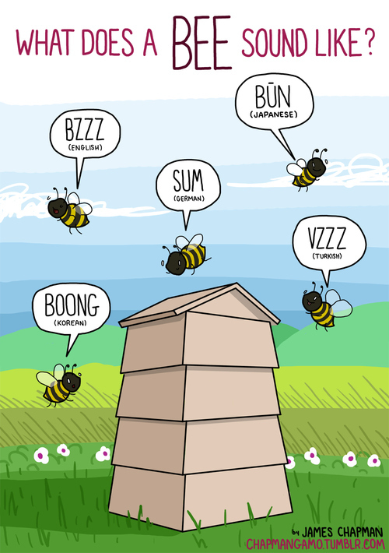
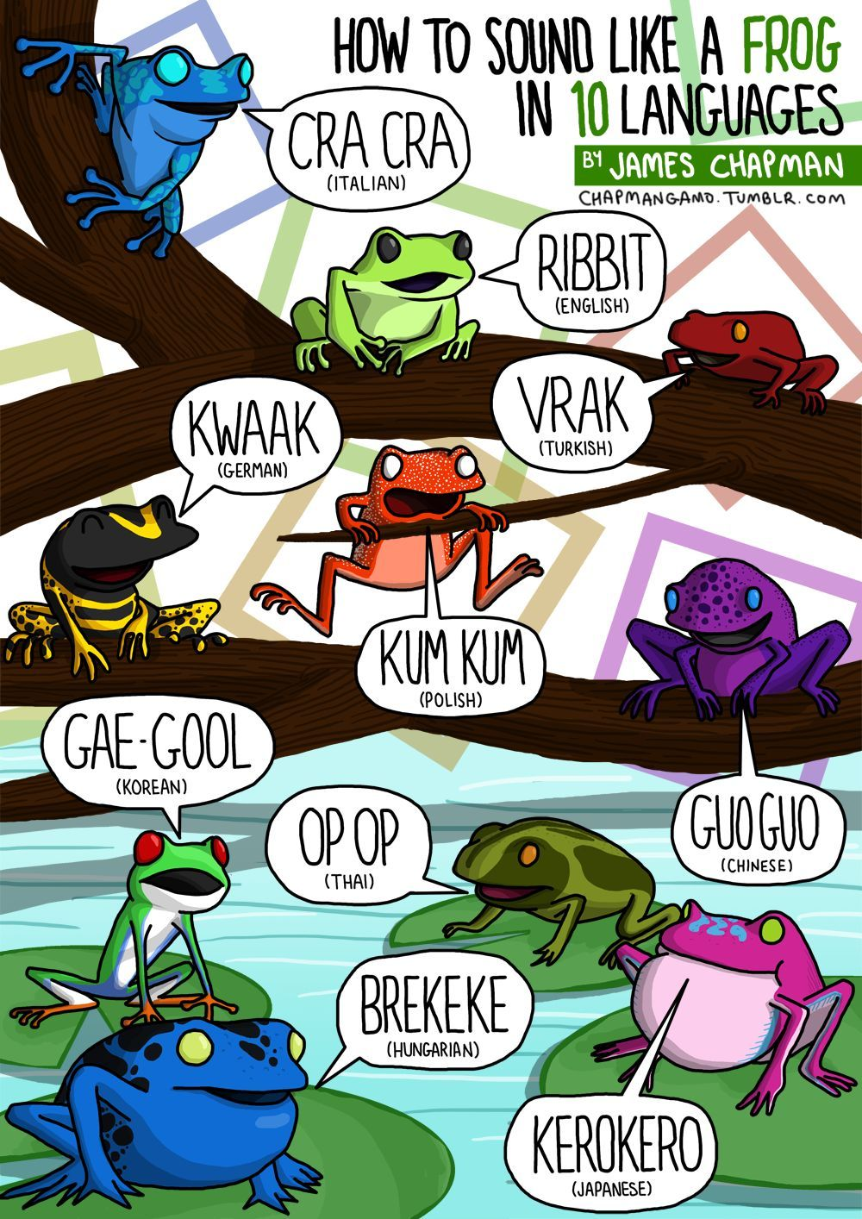

Slide 27
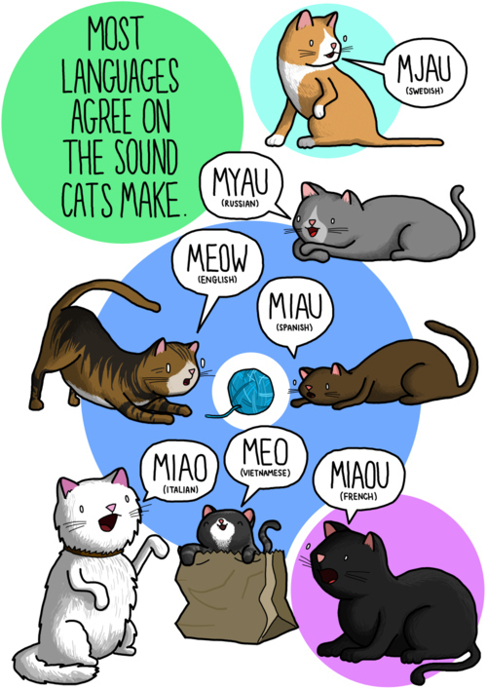


Slide 28

Chapman, James. Sounds All Around: A Guide to Onomatopoeias Around the World. Kansas City, MO: Andrews McMeel, 2020

Slide 29
Meaning is on the Level of Discourse, not Individual Words

Slide 30

Meaning is on the level of discourse, not words

Slide 31
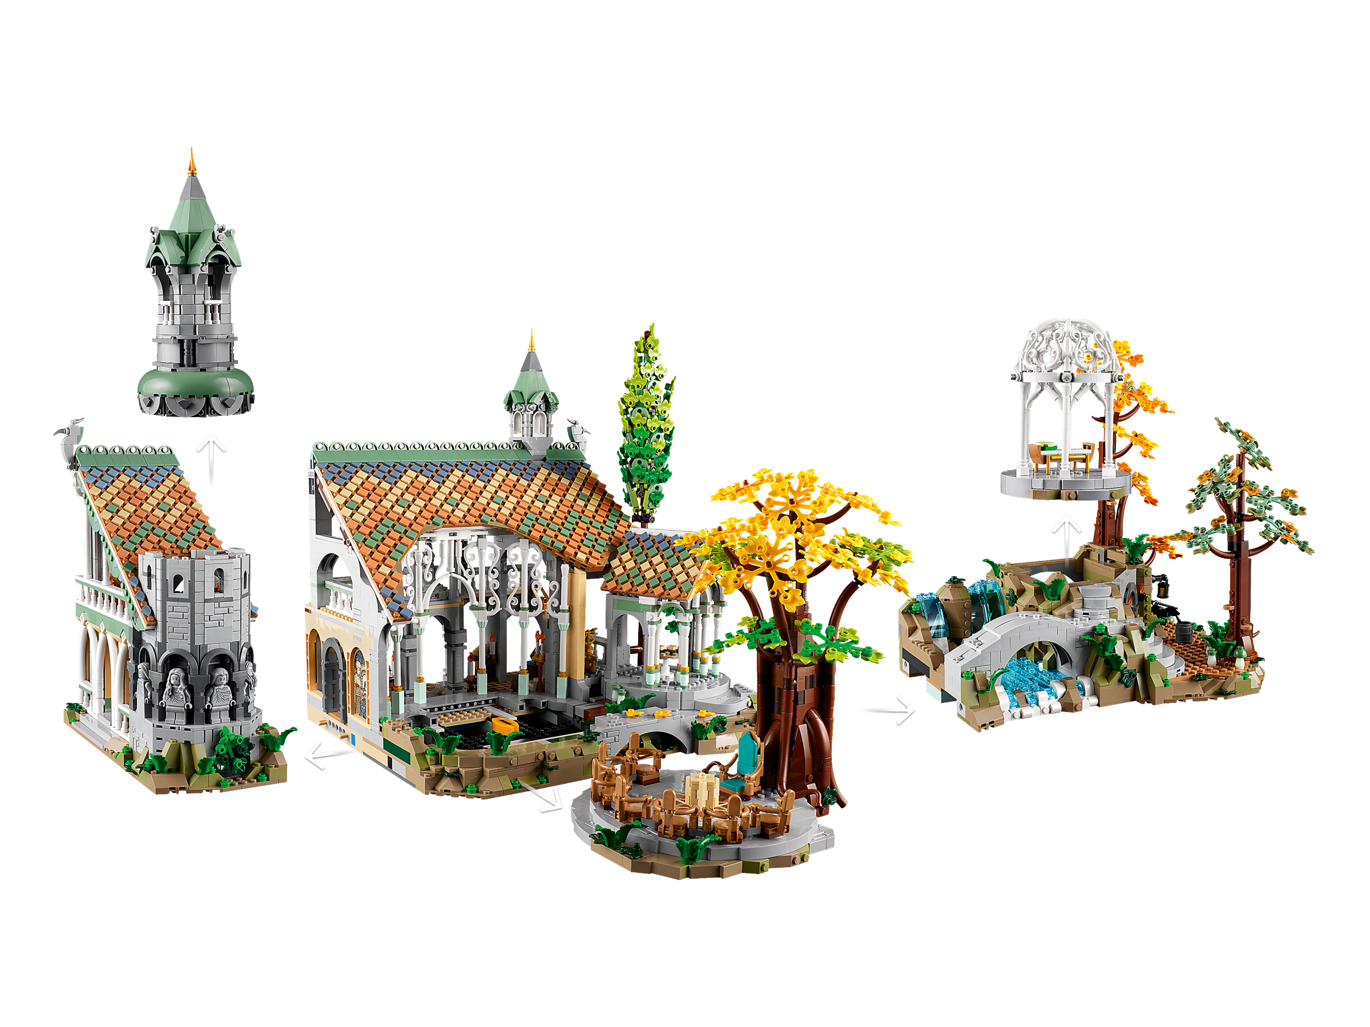
Meaning is on the level of discourse, not words

Slide 32
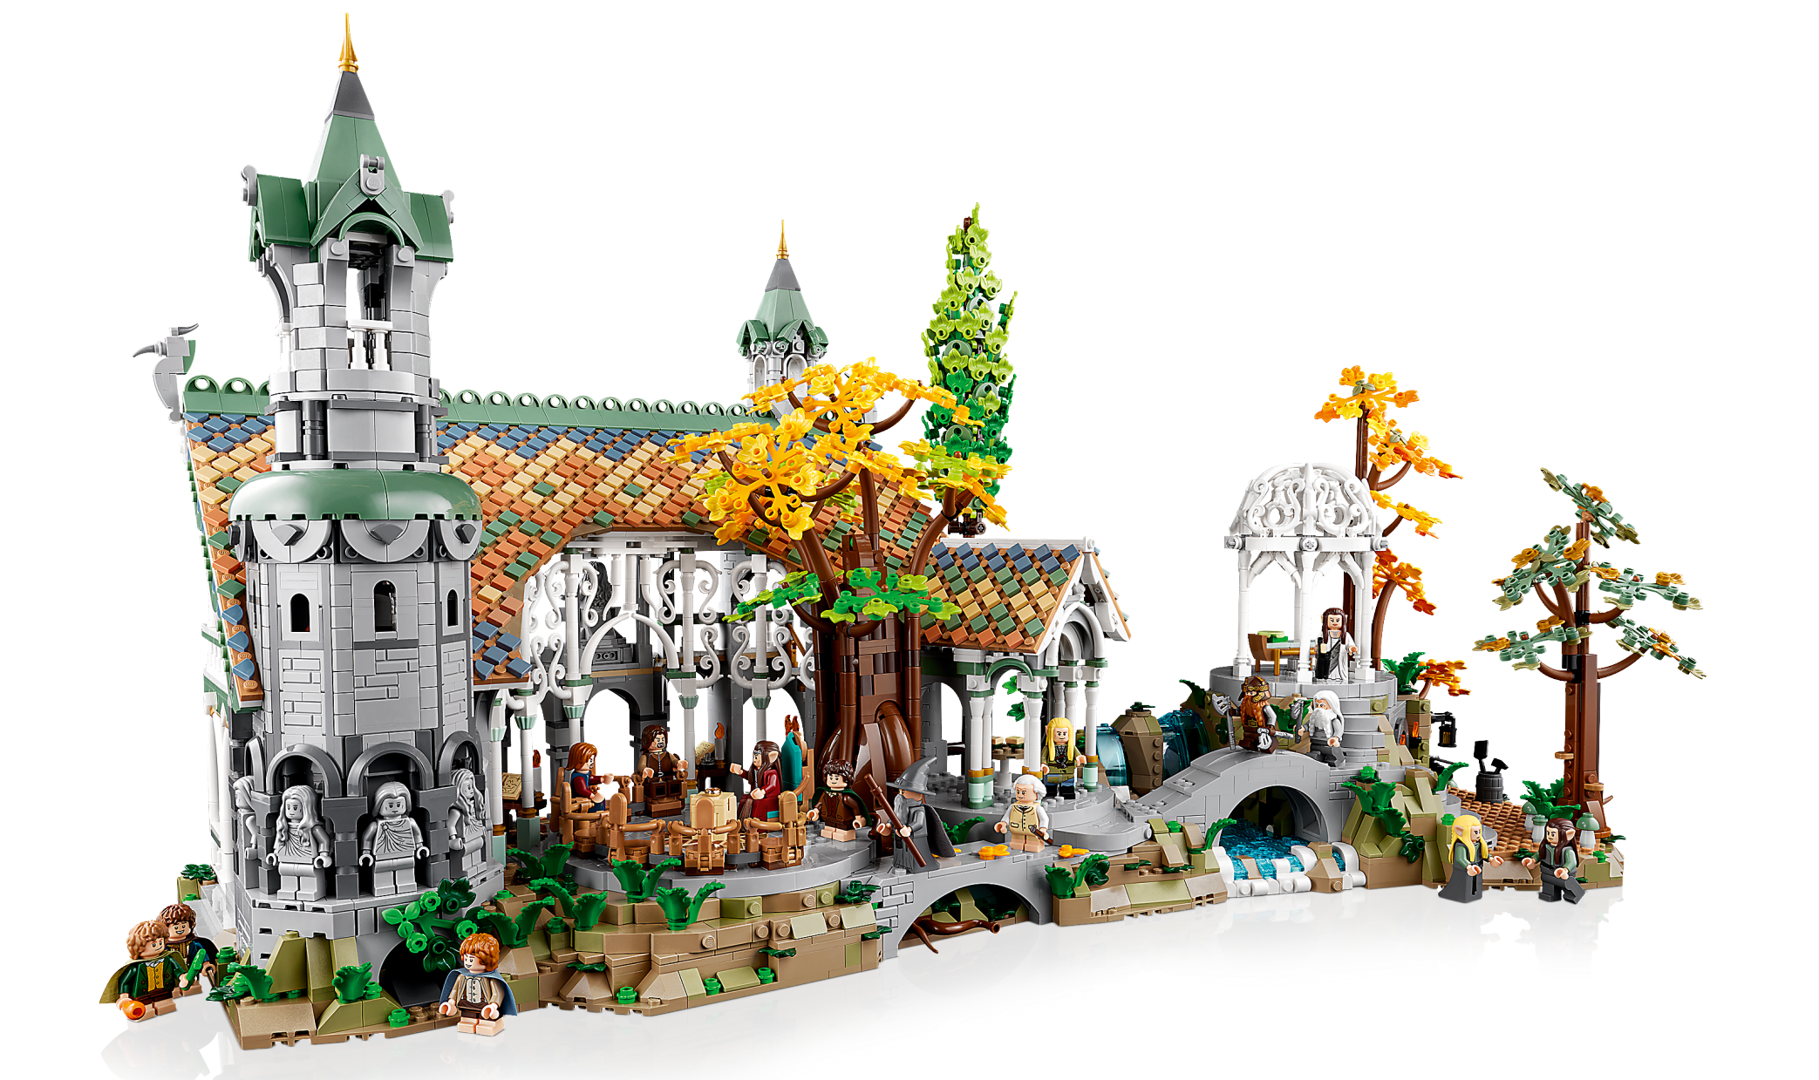
“Context, convention and circumstance are all” –Steven Fry

Slide 33
Discourse, part 1
Modern Researchers
Ancient Author → Text → Audience + Cultural Context

Slide 34
Discourse, part 2
Modern Researchers
Ancient Author → Text → Audience + Cultural Context
Word studies focus on the text.
Good word studies pay attention t to all components of discourse.

Slide 35
“Proper” Language &
Registers of Language
Which was first, written language or spoken language?
Who determines what is proper and improper?
Are prescriptivists (“should”) or descriptivists (“does”) more correct?
Code-switching & registers of language
  *https://drsaraheaton.wordpress.com/2012/05/22/language-register-and-why-it-matters-or-why-you-cant-write-an-academic-paper-in-gangsta-slang/

Slide 36
Five Registers of Language
1. Frozen Register – Miranda Rights, Wedding Vows, Memorized Prayers
2. Formal Register – Formal Settings, School, Speeches. Impersonal, Technical, No Contractions.
3. Consultative Register – Conversational Formal. Student to teacher. Patient to Doctor. Employee to Employer.
4. Casual Register – Informal Settings, Among Friends/Peers. Colloquial, Vernacular, Slang, “Plain Language.”
5. Intimate Register – Close Settings. Among Family, Closest Friends, & Lovers.

Slide 37
“Code Switching” between registers
1. Frozen Register – Miranda Rights, Wedding Vows, Memorized Prayers
2. Formal Register – Formal Settings, School, Speeches. Impersonal, Technical, No Contractions.
3. Consultative Register – Conversational Formal. Student to teacher. Patient to Doctor. Employee to Employer.
4. Casual Register – Informal Settings, Among Friends/Peers. Colloquial, Vernacular, Slang, “Plain Language.”
5. Intimate Register – Close Settings. Among Family, Closest Friends, & Lovers.

Slide 38
Retrospect & Prospect
Language is Complex.
Communication involves context, convention, and circumstance.
Communication can involve combinations of verbal, non-verbal, & written means.
Think of communication as discourse, and discourse determines meaning.
Biblical word-studies account for all relevant aspects of discourse, both ancient and modern. Word-studies are an effort in translation.
If you cannot translate from the original languages of Scripture, then you cannot do a proper word-study without extra layers of caution and effort.

Slide 39
Word Studies - Tools

Slide 40
Using Dictionaries & Lexicons
Dictionaries & Lexicons both provide definitions for words.
Dictionaries are more wide-ranging, while lexicons focus on specific sets of words.
Dictionaries & Lexicons both tell you how words have been used, not what they should mean.
Dictionaries & Lexicons are descriptivist, not prescriptivist.
Word meaning is determined by context, not by dictionaries.
Red Flag: “The ____ dictionary defines ____ as…”

Slide 41
Two Types of Word Studies
Type 1: Generalized Word Studies.
  Studies all the ways that a word has been used in the Bible & the broader Biblical cultures (Ancient Near East for the OT, Greco-Roman-Jewish for the NT). Provides a definitive accounting of how the word was used.
Type 2: Words in a Moment of Discourse.
  Focuses on how a word was used in a specific Bible passage. Engages the first type of study, but focuses on a word in a specific context.
You are not equipped to do the first type of study, but you can engage the second type if you are careful and have the right tools.

Slide 42
Diachronic & Synchronic
“French is sloppy Latin”
Diachronic linguistic analysis [ ]
Synchronic linguistic analysis [ ]

Slide 43
Denotation & Connotation
Dog: “any of a large and varied group of domesticated canines…”
(Collins Dictionary)
Dog: “contemptible person; lively or rakish person; traitor; unattractive person” (OED)
Dog = pet, companion; dangerous animal; food
Other example words: Rock, Hot, Cool, Dead, Hip…

Slide 44
Two Types of Dictionaries & Lexicons
NT Dictionaries/Lexicons: Provide glosses & raw data
  BDAG (Bauer), LN (Louw-Nida), Moulton-Milligan, Liddell-Scott, Mounce, Strong’s*
NT Theological Dictionaries/Lexicons: Explain the glosses and data.
  NIDNTTE (Silva), NIDNTT (Brown), TLNT (Spicq), EDNT (Balz/Schneider)
NB, neither type tell you what words should mean, but only describe how they have been used by specific people groups in specific contexts. Use them for their data, not for an appeal to authority.

Slide 45
5. Steps to a Word Study

Slide 46





1. Pick a word in a verse. Find that word in its original language.
2. Find all the places in Scripture where the word was used.
Advanced: Find places in the cultures around scripture where the word was used.
3. Read representative places in Scripture where the word was used.
Advanced: Read all the places in Scripture where the word was used.
4. Fill out a working semantic field (definitions) of the word.
Take notes on the broad range of meaning in the cultures around Scripture.
Take notes on how the word appears to have been used by the biblical author.
5. Research more lexicons, dictionary articles, commentaries & studies to help inform your understanding of the word.
6. Revise your notes on the word’s broad semantic field.
Focus on how the context of the passage shaped the word’s meaning.

Slide 47
Word in Original Language
Find Word’s Occurrence in Scripture
Notes on Semantic Field
Notes on Context of Passage
Read Word’s Occurrence in Scripture
More Lexicons, Commentaries, Dictionary Articles, Studies
Revise Notes on the Word

Slide 48
Word Study: Practice
Read the lexicon handouts together and work as a class to practice the key components of a word study.
Files are also posted to www.BibTheo.com/PAThS.

Slide 49
General & Specific Tools for Biblical Research in Accordance

Slide 50
Tools for Biblical Research in Accordance
See class demonstration
Notes:
See “Accordance 2023 Espinoza” ppts in PAThS folder

Slide 51
Theological Research & the Use of Accordance

Slide 52
Accordance
See class demonstration

Slide 53
Contents
Develop Taxonomy of Biblical Research
Practical Theology & Qualitative Research
Word Studies
General & Specific Tools for Biblical Research in Accordance
Theological Research & the Use of Accordance
Workshop

Slide 54
Workshop, Day 3
Build your bibliography with 20-30 more potential resources
Form new groups of 2-3 new people (2-3 minutes)
Take 2 minutes for each person to share the topic/s you are researching. (6-8 minutes)
As a group, take 5 minutes per person to brainstorm potential search terms & biblical passages for each person in the group, that could help that person as they look for resources. (15 minutes)
Look for and record the bibliographic data for at least 20-30 usable resources. (90 minutes)

