Slide 1
Fundamentals of
Academic Research

Slide 2
Contents
Fundamentals of Academic Research
Intellectual Humility (Dunning/Kruger Effect)
How to Judge a Book by its Cover
How to Pre-Read for Better Reading
Turabian, “Constructing Your Argument,” “Drafts”
Roberts, “Organizing Yourself”
Biblical & Theological Research, Part 1
Roberts, “Reviewing the Literature”
Machi & McEvoy, “Introduction”
Gilbert, et al., eds, Chapters 6-8
Taxonomy of Resources – Intro & Journals
Biblical & Theological Research, Part 2
Taxonomy of Resources – Commentaries & Bible Software

Slide 3
Fundamentals of Academic Research

Slide 4
The Dunning-Kruger Effect
On Intellectual Humility

Slide 5
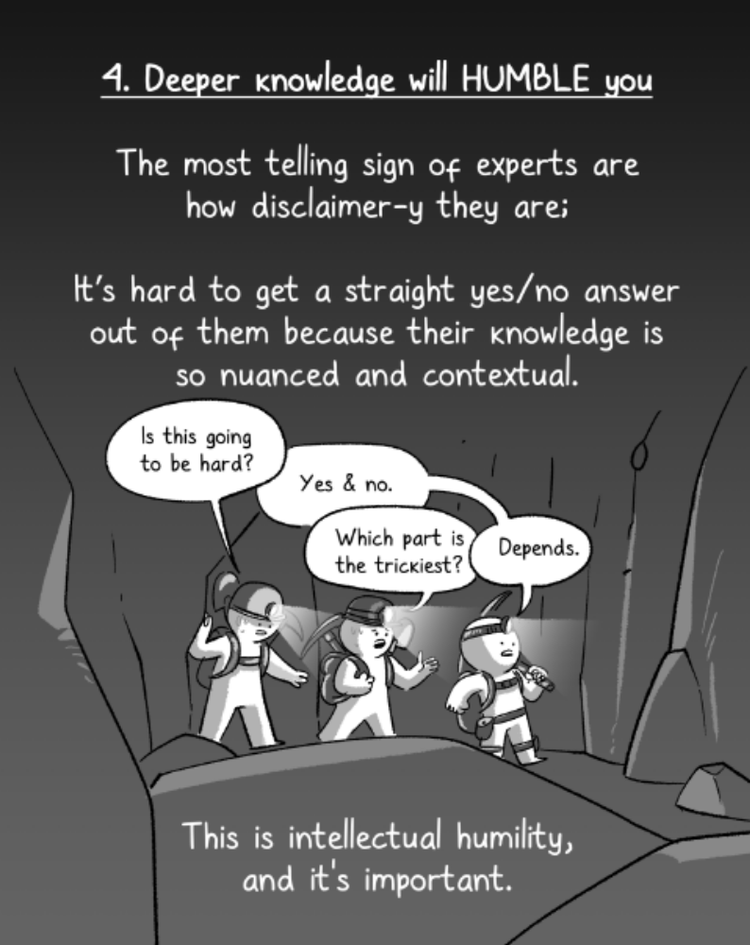
He Ruiming “The Dangers of Short Form Content” The Woke Salaryman. 11 March 2022. Online.

Slide 6
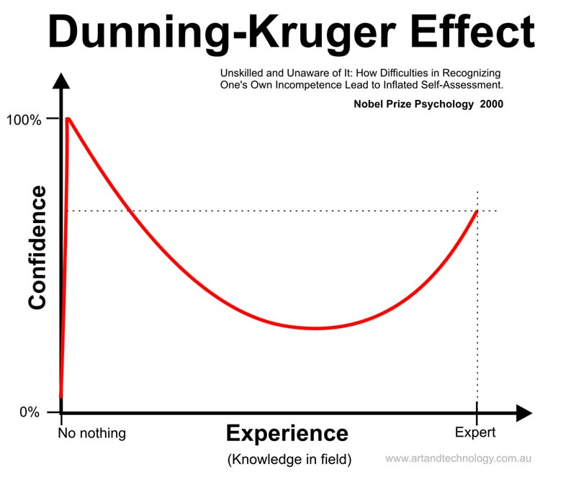
Know nothing

Slide 7
How to Judge a Book by its Cover

Slide 8
Front Cover
Size (~6x9 most common)
Title
Author
Picture
Color
What draws the eye?

Slide 9
Back Cover
Summary
Review
Who are the reviewers?
What draws the eye?

Slide 10
Dustjacket & Spine
What type of information is included? Reviews, Summary, Author Biography?

Slide 11
Publishing House & Date
Publishing houses have target markets.
Note the original publication date
NB: Not date of that edition, but original date of content
  E.g., Matthew Henry’s Commentary written in early 1700s, not 2010.
NB: if a translation, look for original date in original language

Slide 12
Table of Contents
Organization
How descriptive are titles?
Guess the general content & steps of argument

Slide 13
Indices
Bibliography
Authors
Topic
Glossary

Slide 14
Flip through the book
Headings
Subheadings
Pictures
Charts, Tables
Chapter summaries
B & W or Color ink?
Type of paper
Font size

Slide 15
Scan the Preface/Introduction
Will often find entire outline and summary
Look for words like first, second, third or chapter one, chapter two

Slide 16
If book is useful
Find academic book reviews in academic journals
Type the TOC

Slide 17
How to Pre-Read a Book
or an article

Slide 18
Why Pre-Read?
A hike is better when you first look at a map.
Gestalt
The more you know about your reading journey ahead of time, the more efficient you will be when you read.

Slide 19
How to Pre-Read a Book (or resource)
Find review articles of that book from academic journals.
  Pay attention to who is writing & publishing the review
Read the book’s Preface, Introduction, Conclusion.
  For an article, read the abstract, the opening paragraph & closing pargraph
Write/Type an outline of the book/article (next slide)

Slide 20
I.
A.
1.
a.
i.
or
1.
1.1
1.1.1
1.1.1.1
1.1.1.1.1.
(Use whatever organizational system you want, just keep the headings & sub-heading organized)

Slide 21
Turabian,
“Constructing your Argument,”
“Planning a First Draft,” &
“Drafting Your Paper”
Pages 51- 65, 66-74, 75-85

Slide 22
Constructing your Argument
“[A research argument] is more like a conversation with a community of receptive but skeptical colleagues. Such readers won’t necessarily oppose your claims (although they might), but they also won’t accept them until the see good reasons based on reliable evidence and until you respond to their questions and reservations” (Turabian, 52).
Formal, evidence-based research paper.
  Argument from evidence, not an argument from authority.
  Advance an idea, don’t just catalog other people’s opinions.
  Unlike a sermon, you cannot rely on shared beliefs with the audience.
  Support every assertion with evidence.

Slide 23
Constructing your Argument
“When you make a research argument, therefore, you must lay out your reasons and evidence so that your readers can consider them; then you must imagine both their questions and your answers” (Turabian, 52).
State and evaluate your claim.
Support your claim with reasons and evidence.
Acknowledge and respond to anticipated questions and objections.
Establish the relevance of your reasons. (Turabian, 51-55)

Slide 24
Planning a First Draft & Drafting your Paper
Turabian, 66-74, & 75-85
See PAThS Style Guide

Slide 25
Roberts, “Organizing Yourself”
Pages 67-74

Slide 26
Organizing Yourself
Organize your Workspace
Organize your Time
  Gantt chart (see Roberts, Appendix A (p. 200)
  Workflow system (paper, calendar, Microsoft OneNote, etc.)
Working Smart
  Work During Times That You Are Most Productive. (morning, night, afternoon…)
  Learn to Say No.
  Schedule Frequent “Joy Breaks” (e.g., Pomodoro Method: 45 min work / 15 min break)
  Know Your Timewasters
  Reward Your Efforts
Maintain Balance
  Take Care of Your Body
  Increase Family Support

Slide 27
Biblical & Theological Research, Part 1

Slide 28
Biblical Canon
Organizing the Primary Sources

Slide 29

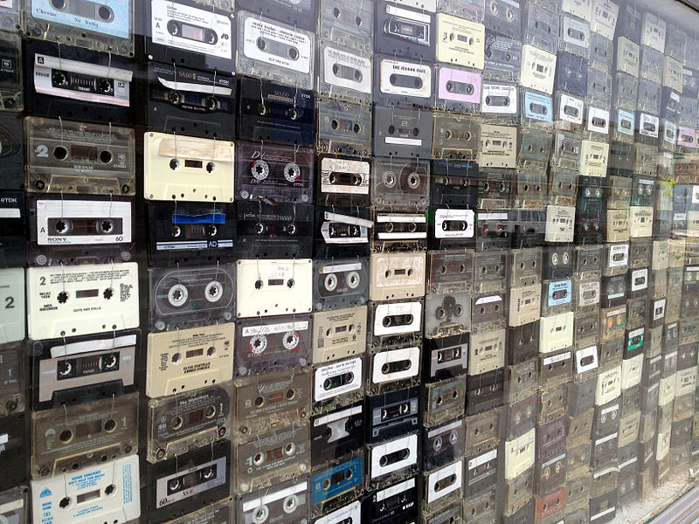
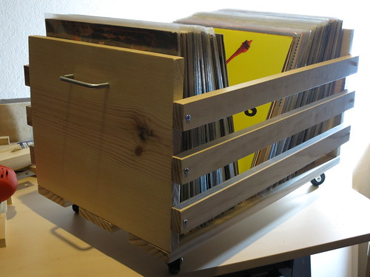
The Bible as a Mixtape, Playlist, or Book of Books
Slidehood.com

Slide 30
On Thinking the Biblical Canon
Can organize the books of the Bible by author, by genre, by theme, by chronology, by plot (Genesis-to-Revelation), etc.
Thinking of different ways to organize the Bible helps provide organizing principles for relating biblical passages to one another.
E.g., by canonical genre:
  Pentateuch, Historical Books, Poetry & Wisdom, Prophets
  Gospels & Acts, Letters, Revelation
    Or: Synoptic Gospels, Johannine Literature, Pauline Letters, General Letters, Apocalyptic Literature

Slide 31
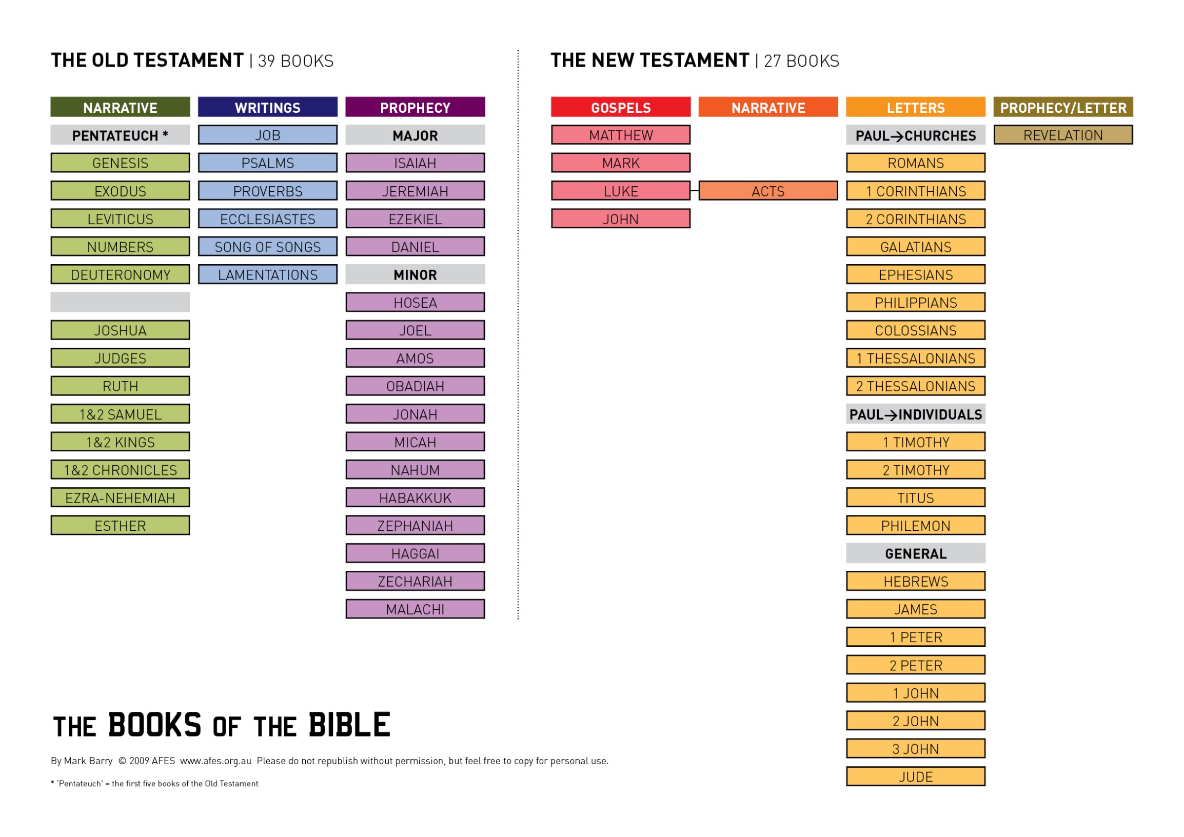

Slide 32
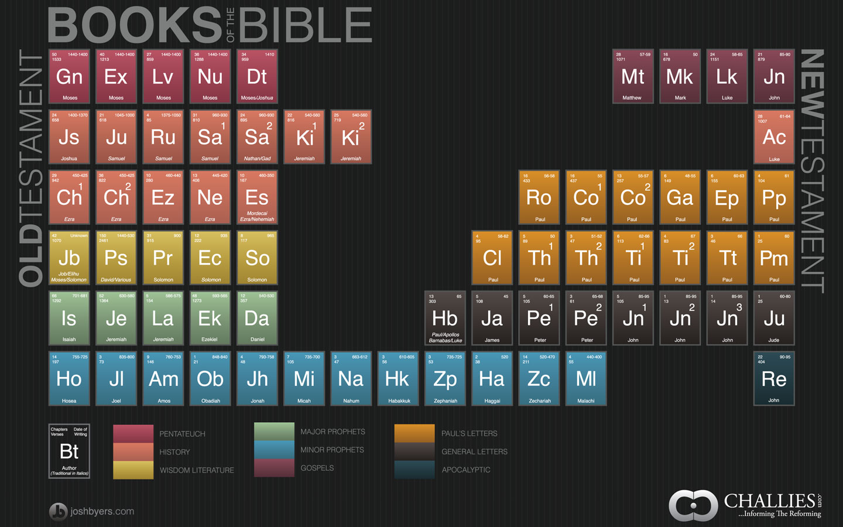

Slide 33
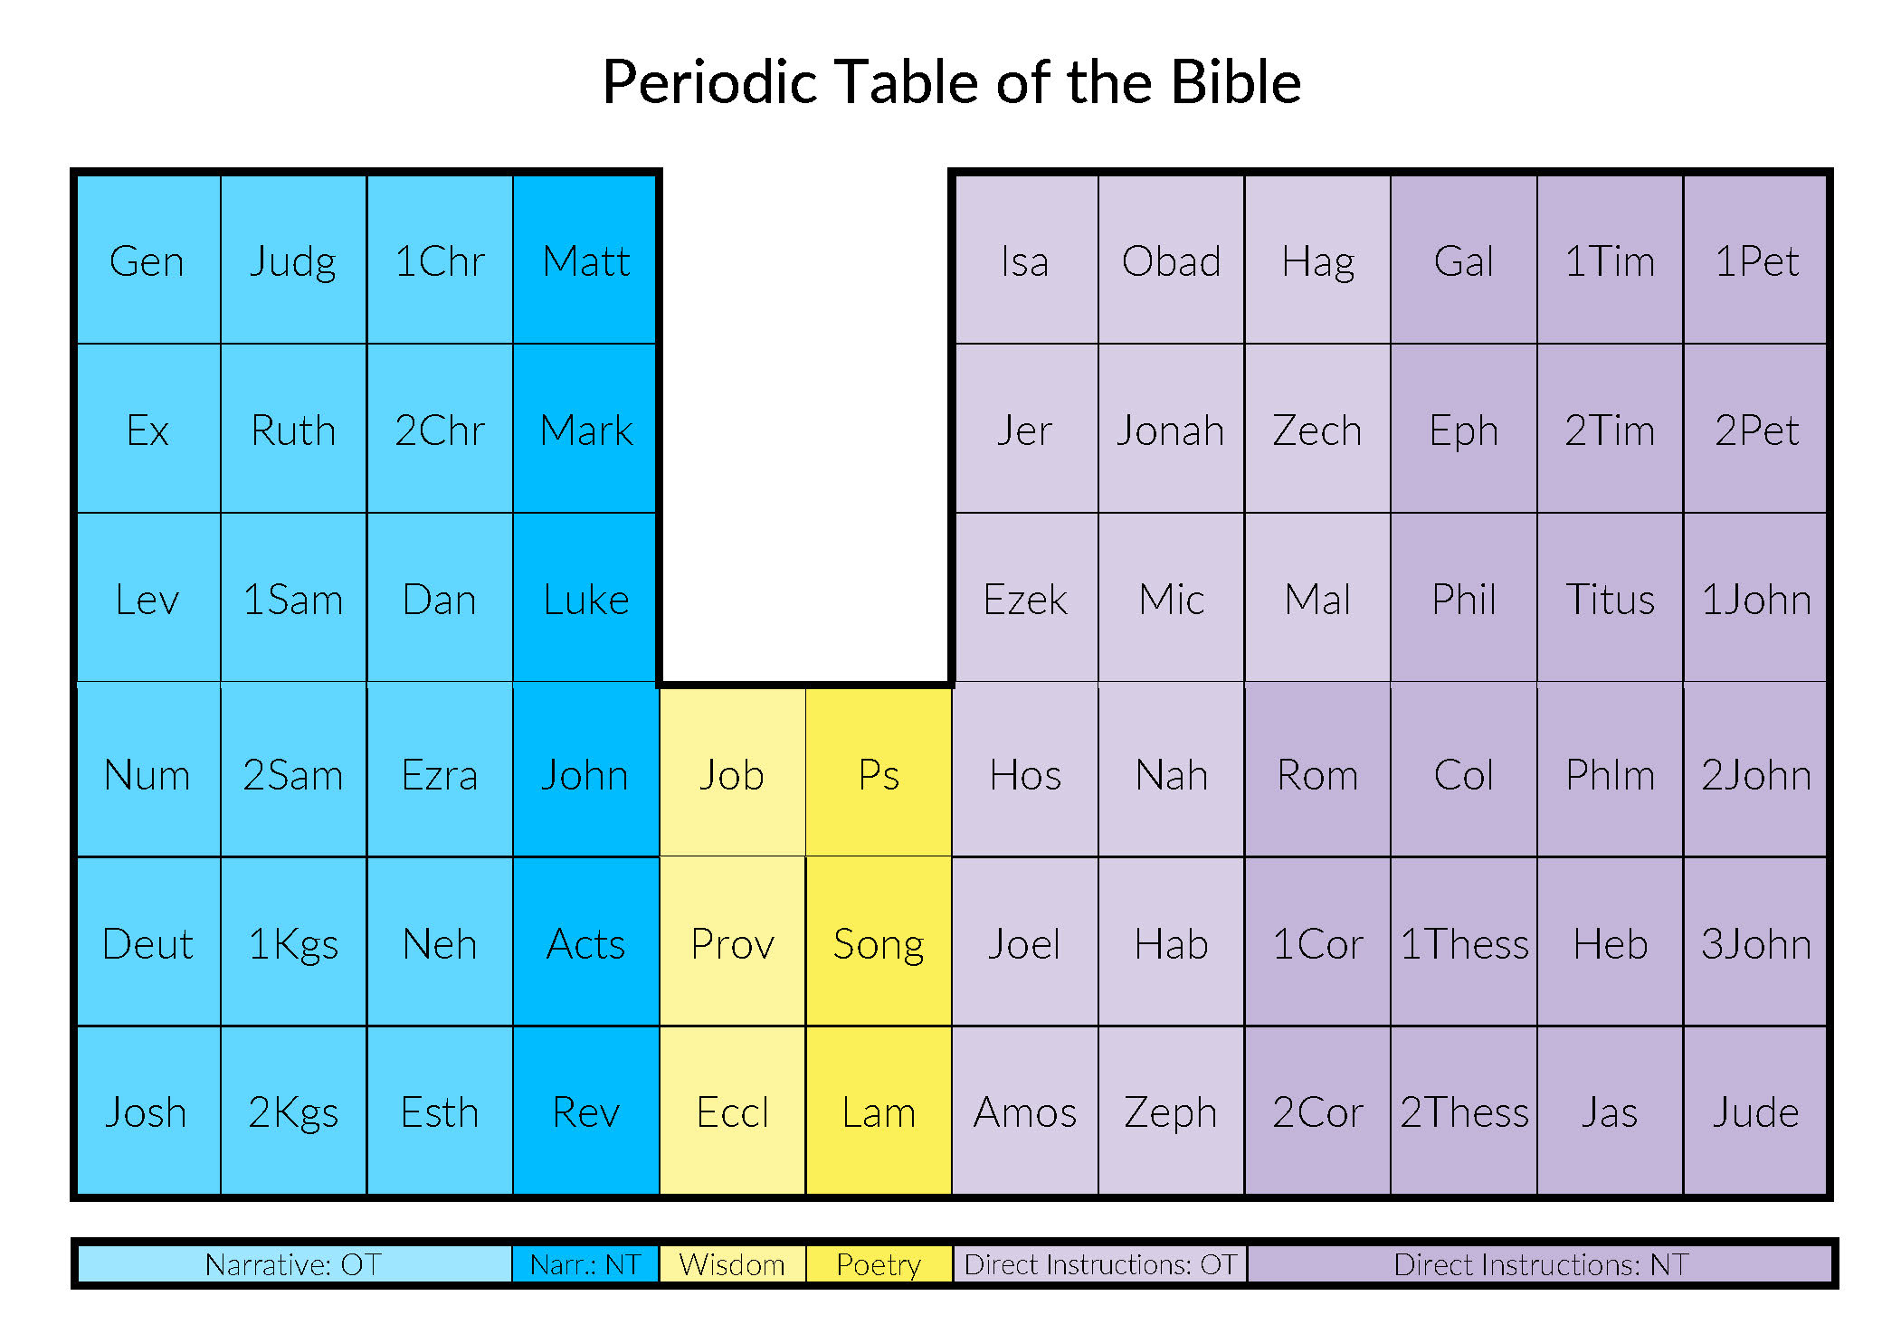

Slide 34
On Thinking of the Biblical Canon
Familiarity with the constituent parts of the biblical canon will help you think about the types of academic resources that can help your research.
Main Components of a Theological Education
  Biblical Studies
  Systematic Theology
  Christian Ethics
  Church History
  Practical Theology
What other approaches or disciplines belong on this list?

Slide 35
Roberts, “Reviewing the Literature”
Pages 85-110

Slide 36
Literature Review
Status Quaestionis – Literature Review / Forschungsbericht / Survey of Scholarship
  “Survey the existing literature on the topic, indicate and evaluate a range of views and approaches to that topic, and identify gaps or disagreements in the literature that merit further research. The literature review goes beyond summarizing existing research and analyzes, synthesizes, and historicizes distinct views, methodologies, and schools of thoughts” (“The Literature Review/Forschungsbericht,” Graduate Program Handbook. German Department at Georgetown University. Online: https://german.georgetown.edu/graduate/handbook)
  “According to Creswell (2008), ‘A literature review is a written summary of journal articles, books, and other documents that describe the past and current state of information; organizes the literature into topics; and documents a need for a proposed study’” (Roberts, 86).

Slide 37
Literature Review (Roberts, 88-106)
Step 1: Identify key words or descripts
Step 2: Create a search query
Step 3: Identify relevant literature sources
Step 4: Search the literature and collective relevant materials
Step 5: Critically read and analyze the literature
Step 6: Synthesize the literature
Step 7: Organize the literature
Step 8: Write the literature review

Slide 38
Literature Review: Advice (Roberts, 106-110)
Be Thorough
Write with Authority
  “Start each paragraph with the point you wish to make followed by studies and examples that illustrate and enhance your point” (Roberts, 107)
Critique Rather than Just Report the Literature
Avoid Excessive Use of Quotations
Be Selective
Be Careful not to Plagiarize [see BibTheo.com/Plagiarize]
Critique the Literature; Don’t Duplicate It
Rely on a Mix of Primary & Secondary Sources

Slide 39
Machi & McEvoy, “Introduction”
Pages 1-15

Slide 40
“A literature review is a written document that presents a logically argued case founded on a comprehensive understanding o the current state of knowledge about a topic of study. This case establishes a convincing thesis to answer the study’s question” (Machi & McEvoy, 5).
Simple Literature Review: When the purpose is to “argue a position about the current state of knowledge on a topic”
Complex Literature Review: When the purpose is to “review the literature to uncover a research problem for further study” (Ibid., 3)

Slide 41
Lit Review Model (Machi & McEvoy, 8)
1. Select a Topic
2. Develop Tools of Argumentation
3. Search the Literature
4. Survey the Literature
6. Write the Review
5. Critique the Literature
Builds on steps 1-5 to communicate results of research
Specifies a problem
Build the findings of the case
Explores & catalogues relevant data
Logically arrange evidence to defend status quaestionis
Interpret findings of how status quaestionis answers research question.
Form the case’s conclusions

Slide 42
Gilbert, et al., eds. “Chapters 6-8”
Pages 30-46

Slide 43
Chapter 6, “The Library in Interdisciplinary Research”
Major Types of Resources
Books
Journal Articles
Professional Data Bases (EBSCO, ATLA, Academic Search Complete, etc.)
Scholarly Research Papers
Keyword search & Boolean search (“and,” “not,” “or”).
Discussion Question: What are some examples of each type of resource for each of your research projects?

Slide 44
Chapter 8, “Primary & Secondary Sources”
Primary Sources
Secondary Sources
Discussion Question: What are some examples of primary & secondary sources for your research topics?”

Slide 45
Taxonomy of Resources:
Introductions, Dictionaries, & Journals
BibTheo.com/Bibliography
BibTheo.com/Journals

Slide 46
BibTheo.com/Bibliography
Online Bibliography Guides
Introductions
  OT Introductions
  NT Introductions
Dictionaries
  Bible Dictionaries
  IVP Bible Dictionary Series
Commentaries
  Introductory Commentaries
  Technical Commentaries
  Specialized Commentaries
Journals
  Abstracts & Out-of-Print Journals
  Journal Indices
  Journal Indexing and Abstracting Services
Monographs and Book Series
Socio-Historical Studies
Atlases
Literary Analysis
Linguistic Analysis (Lexicons & Concordances)
Primary Sources (Ancient Texts)
  Ancient Near Eastern Texts
  Introduction to Jewish Literature
  OT Apocrypha
  OT Pseudepigrapha
  Septuagint (LXX)
  Dead Sea Scrolls (DSS)
  Josephus
  Philo
  NT Apocrypha
  Greco-Roman Literature
  Numismatics (Coins)
  Apostolic Fathers
Resources to Avoid in a Research Paper

Slide 47
Introductions

Slide 48
Introductions
Oxford Bibliographies https://www.oxfordbibliographies.com
Oxford Reference https://www.oxfordreference.com/
Oxford Scholarship Online https://academic.oup.com/oxford-scholarship-online
“Introduction to…
  …New Testament”
  …Old Testament”
  …Theology”
  …Biblical Interpretation.”
  https://BibTheo.com/bibliography/#ot & https://BibTheo.com/bibliography/#nt
  Hill, Andrew E. and John H. Walton. A Survey of the Old Testament. 3rd Edition. Grand Rapids: Zondervan, 2009.
  Burge, Gary M. and Gene L. Green. The New Testament in Antiquity: A Survey of the New Testament within Its Cultural Contexts. 2nd edition. Grand Rapids: Zondervan, 2020.
  Wright, N.T. and Michael F. Bird, The New Testament and Its World: An Introduction to the History, Literature, and Theology of the First Christians. Grand Rapids: Zondervan, 2019.

Slide 49
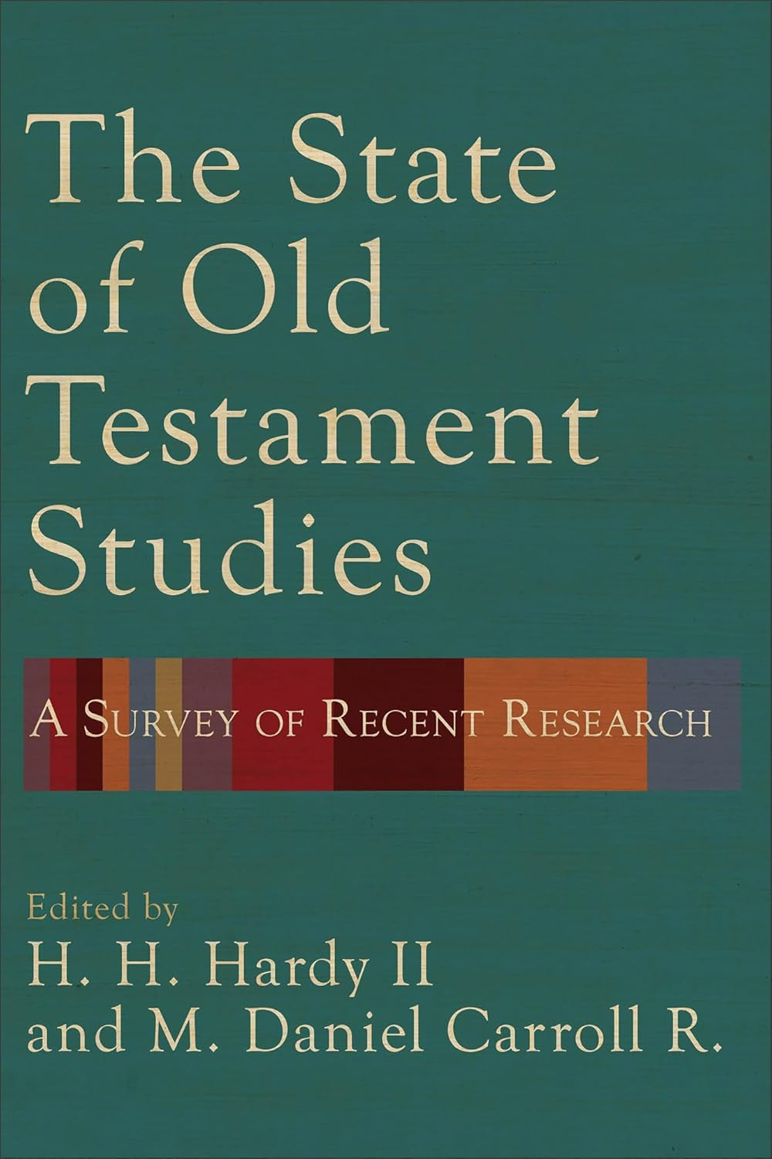
Introductions
Hardy, H. H. II and M. Daniel Carroll R., eds. The State of Old Testament Studies: A Survey of Recent Research. Grand Rapids: Baker, 2024.

Slide 50

Introductions
Gupta, Nijay K. A Beginner’s Guide to New Testament Studies: Understanding Key Debates. Grand Rapids: Baker, 2020.

Slide 51
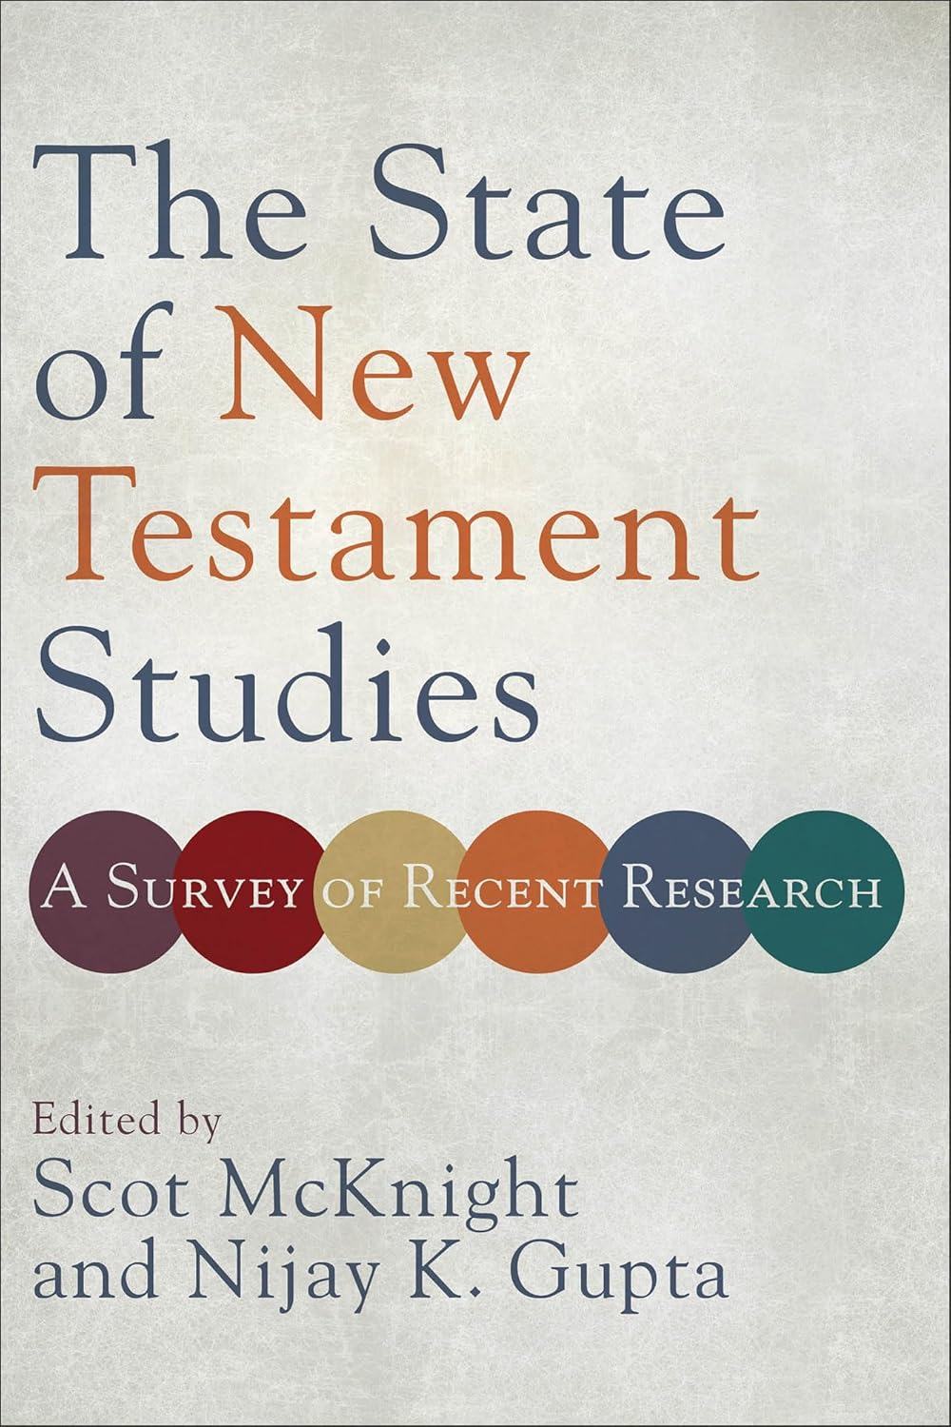
Introductions
McKnight, Scot and Nijay K. Gupta, eds. The State of New Testament Studies: A Survey of Recent Research. Grand Rapids: Baker, 2019

Slide 52
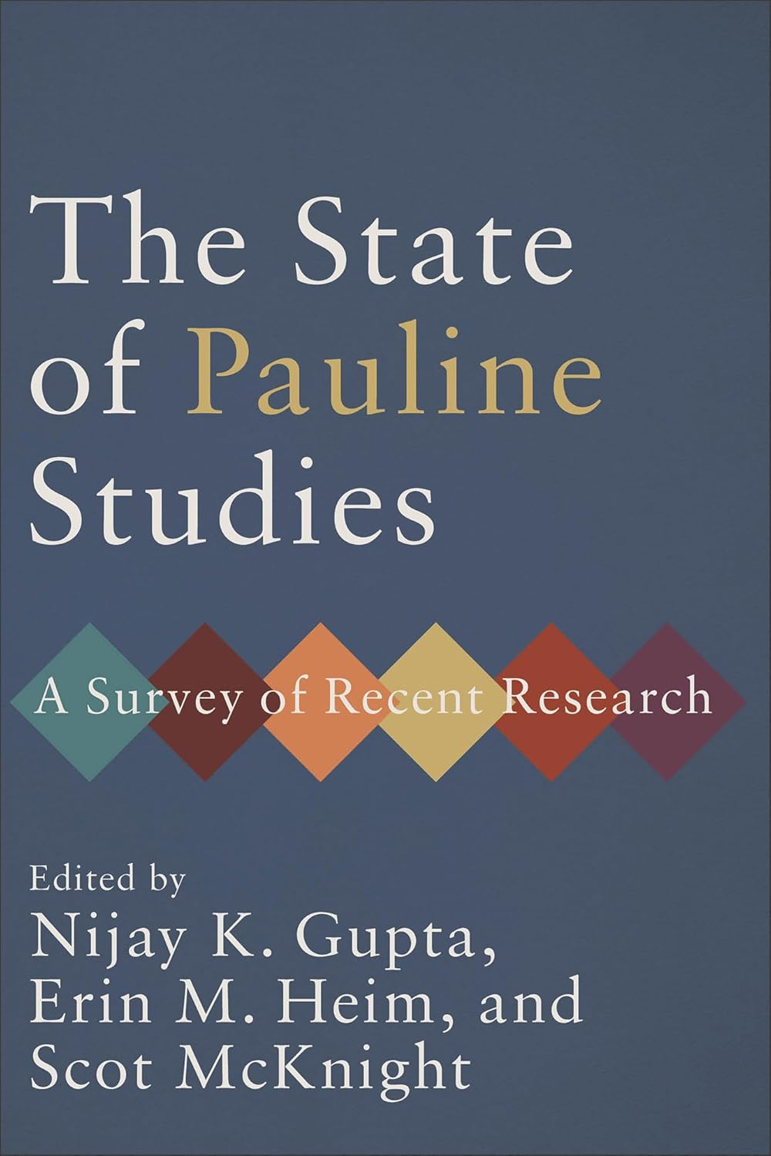
Introductions
Gupta, Nijay K., Erin M. Heim, and Scot McKnight, eds. The State of Pauline Studies: A Survey of Recent Research. Grand Rapids: Baker, 2024.

Slide 53
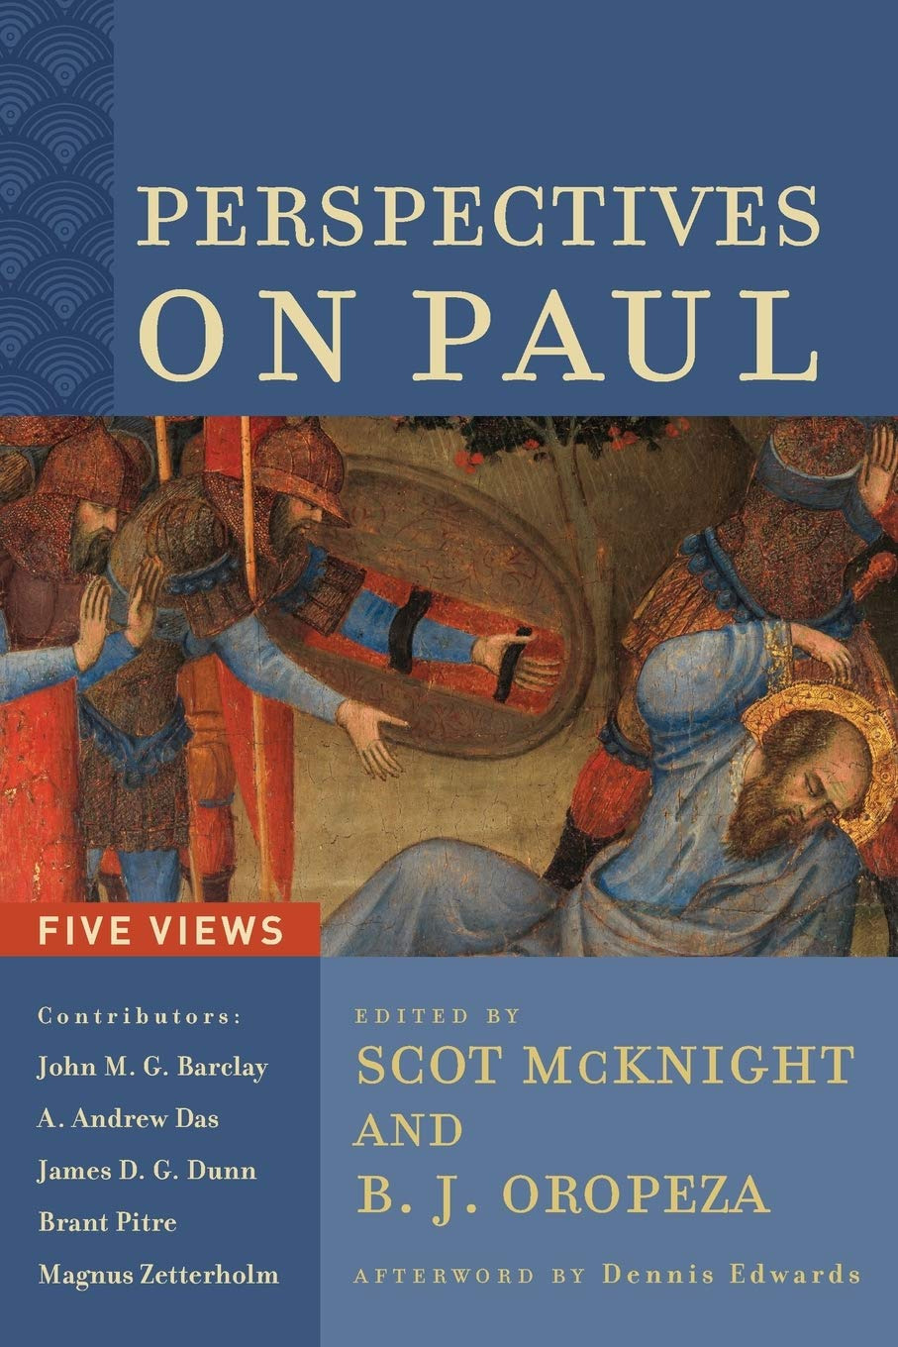
Introductions
McKnight, Scot and B. J. Oropeza, eds. Perspectives on Paul: Five Views. Grand Rapids: Baker, 2020.

Slide 54
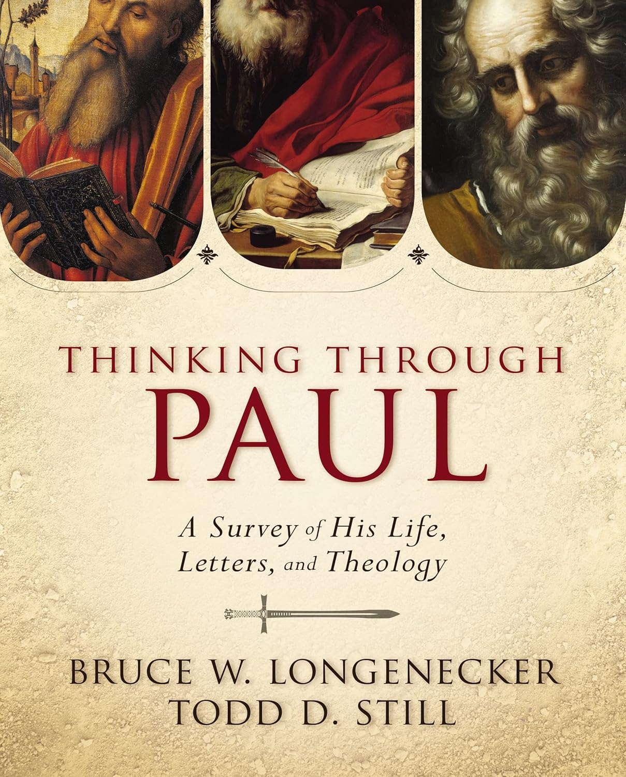
Introductions
Longenecker, Bruce W. and Todd D. Still, Thinking Through Paul: A Survey of His Life, Letters, and Theology. Grand Rapids: Zondervan, 2014.

Slide 55
Dictionaries & Encyclopedias

Slide 56
Dictionaries & Encyclopedias
In Biblical & Theological Studies, dictionaries and encyclopedias are functionally equivalent. They are not language dictionaries (we call those lexicons), but both contain short articles and both can be single-volume or multi-volume sets.
To confuse things further, some lexicons have “dictionary” in the title. Examples are:
Silva, Moisés, New International Dictionary of New Testament Theology and Exegesis. 5 vols. Grand Rapids: Zondervan, 2014. (NIDNTTE)
  Brown, Colin. The New International Dictionary of New Testament Theology. Exeter: Grand Rapids, 1975-1978. (NIDNTT) *but see Silva (above) for the updated & revised edition.
Richards, Lawrence O. Expository Dictionary of Bible Words. Grand Rapids: Zondervan, 1985.
VanGemeren, W.A. New International Dictionary of Old Testament Theology and Exegesis. Carlisle: Paternoster, 1997. (NIDOTTE)

Slide 57
Dictionaries & Encyclopedias
Dictionaries/Encyclopedias for Biblical Studies
Cross, F.L., and E.A. Livingstone, ed. Oxford Dictionary of the Christian Church. 3rd ed. Oxford: Oxford University Press, 1997.
Freedman, D.N., ed. Eerdmans Dictionary of the Bible. Grand Rapids: Eerdmans, 2000.
Freedman, D.N., ed. Anchor Yale Bible Dictionary. 6 vols. New Haven: Yale University Press, 2008. (AYBD)
Hammond, N.G.L., and H.H. Scullard, eds. Oxford Classical Dictionary. Oxford, 1970. (OCD)
Powell, Mark Allan, ed. HarperCollins Bible Dictionary. Revised and updated. 3rd ed. New York: HarperCollins, 2011.
Sakenfeld, Katharine Doob, ed. The New Interpreter’s Dictionary of the Bible. 5 vols. Nashville: Abingdon, 2009. (NIDB)
Dictionaries/Encyclopedias for Theological Studies
Dyrness, William A. and Veli-Matti Kärkkäinen, Global Dictionary of Theology: A Resource for the Worldwide Church. Downers Grove: InterVarsity, 2008.
Vanhoozer, Kevin J., ed. Dictionary for Theological Interpretation of the Bible. Grand Rapids: Baker, 2005.
Wolfe, Brendan N., ed al. (eds). St Andrews Encyclopedia of Theology. 2022- . n.p. www.saet.ac.uk
Zalta, Edward N., ed. The Stanford Encyclopedia of Philosophy. The Metaphysics Research Lab, Philosophy Department, Stanford University. n.p. https://plato.stanford.edu/

Slide 58
Dictionaries & Encyclopedias
Alexander, T.D., and D.W. Baker, eds. Dictionary of the Old Testament: Pentateuch. Downers Grove: InterVarsity, 2002.
Arnold, Bill T. and H.G.M. Williamson, eds. Dictionary of the Old Testament: Historical Books. Downers Grove: InterVarsity, 2005.
Longman, Tremper III., ed. Dictionary of the Old Testament: Wisdom, Poetry & Writings. Downers Grove: InterVarsity, 2008.
Boda, Mark J. and Gordon McConville, eds. Dictionary of the Old Testament: Prophets. Downers Grove: InterVarsity, 2012.
Green, Joel B., S. McKnight, & I. H. Marshall, eds. Dictionary of Jesus and the Gospels. 2nd edition. Downers Grove: InterVarsity, 2013.
Hawthorne, G. & R.P. Martin, eds. Dictionary of Paul and his Letters. Downers Grove: InterVarsity, 1993.
Martin, R.P. and P.H. Davids, eds. Dictionary of the Later New Testament & Its Developments. Downers Grove: InterVarsity, 1997.
Evans, C.A. and S.E. Porter, eds. Dictionary of New Testament Background. Downers Grove: InterVarsity, 2000.
Reid, Daniel G., ed. The IVP Dictionary of the New Testament: A One-Volume Compendium of Contemporary Biblical Scholarship. Downers Grove: InterVarsity, 2004. [From the Preface, "The IVP Dictionary of the New Testament is a one-volume compilation of essential articles found in a series of dictionaries published by InterVarsity Press: Dictionary of Jesus and the Gospels, Dictionary of Paul and His Letters, Dictionary of the Later New Testament and Its Developments, and Dictionary of New Testament Background." ]

Slide 59
Journal Articles

Slide 60
Journal Articles
Journal articles are the most cutting-edge resources because they have the shortest distance between submission and publication.
Journal articles typically:
  Summarize chapters or ideas that are part of a larger book or project that the author is working on,
  Serve as a place to try out new ideas to see what the academic response is,
  Respond to ideas from another journal article.

Slide 61
Journal Abstracts
Abstracts precede articles themselves
Some journals consist entirely of abstracts
  ATLA Religion Index One: Periodicals
  Book Review Index, Gale Research Co.
  Bulletin signaletique
  Christian Periodical Index
  Current Book Review Citations
  Elenchus Bibliographicus Biblicus
  Ephemerides Theologicae Lovanienses: Elenchus Bibliographicus
  Internationale Zeitschriftenschau fur Bibelwissenschaft und Grenzgebiete
  Mosher Periodical Index
  National Periodical Library
  New Testament Abstracts
  Old Testament Abstracts
  Religious and Theological Abstracts
  Theologische Literaturzeitung (ThLZ)
  University Microfilms Inc.
  Zeitschrifteninhaltsdienst Theologie: Indicies Theologici

Slide 62
Journals
Are they peer-reviewed?
When were they founded, by whom, and for what purpose?
Are they online-only or do they have a print version?
Try to answer these questions for the following publications:
  Journal of Biblical Literature (JBL)
  Journal for the Study of the New Testament (JSNT)
  Journal for the Study of the Old Testament (JSOT)
  Catholic Biblical Quarterly (CBQ)

Slide 63
Journals
Asian Journal of Pentecostal Studies (AJPS)
Biblica
Biblical Theology Bulletin (BTB)
Bibliotheca Sacra
Bulletin of the American Schools of Oriental Research (BASOR)
Catholic Biblical Quarterly (CBQ)
Christian History Magazine
Early Christianity
Ephemerides Theologicae Lovanienses (ETL)
Éstudios Bíblicos
Études théologiques et religieuses
Ex Auditu
Filología Neotestamentaria
Harvard Theological Review (HTR)
Hebrew Bible and Ancient Israel (HEBAI)
Horizons in Biblical Theology
Interpretation: A Journal of Bible and Theology (Interp)
Journal for the Study of the New Testament (JSNT)
Journal for the Study of the Old Testament (JSOT)
Journal of Biblical and Pneumatological Research (JBPR)
Journal of Biblical Literature(JBL)
Journal of Early Christian Studies (JECS)
Journal of Pentecostal Theology (JPS)
Journal of the Evangelical Theological Society (JETS)
Journal of Greco-Roman Christianity and Judaism (JGRChJ)
Journal of the Jesus Movement in Its Jewish Setting (JJMJS)
Journal of Theological Interpretation
Near Eastern Archaeology (NEA)
Neotestamentica
New Testament Studies (NTS)
Novum Testamentum (NovT)
Pneuma: The Journal of the Society for Pentecostal Studies
Revue Biblique
Scandinavian Journal of the Old Testament
Scottish Journal of Theology
Semeia (ran from 1972-2002)
Studia Theologica: Nordic Journal of Theology
Theologische Rundschau (ThR)
Theologiesche Zeitschrift (ThZ)
Trinity Journal
Vetus Testamentum
The Westminster Theological Journal (WTJ)
Zeitschrift für Antikes Christentum/Journal of Ancient Christianity (ZAC)
Zeitschrift für Die Alttestamentliche Wissenschaft (ZAtW)
Zeitschruft für Die Neuentestamentliche Wissenschaft (ZNtW)
Zeitschrift für Kirchengeschichte (ZKG)
Zeitschrift für Neuere Theologiegeschiche/Journal For the History of Modern Theology (JHMTH)
Zeitschrift für Theologie und Kirche (ZThK)

Slide 64
Taxonomy of Resources –
Commentaries, Monographs, & Do Not Use
BibTheo.com/Bibliography
BibTheo.com/Commentaries
Bible Software

Slide 65
Commentaries

Slide 66
Evaluating Commentaries
The strengths & limitations of biblical commentaries: opinions & evidence
“Is the commentary by a reputable author with a reputable academic qualification?”
“Is the commentary produced by a reputable academic publisher?”
“Is the commentary part of a series? Is the series edited by a professional?”
“Is the commentary endorsed (look at the back cover) by respected academics?”
“Does the series description offer a specific type of methodology for the commentary?”

Slide 67
Evaluating Commentaries
How do you use a commentary?
“First, make sure you look at not just the exegetical and theological opinions of the commentary write but especially their evidence. How do they support their claims?”
“Secondly, use commentaries to broaden your horizons.”
“Thirdly, if you are a Christian, I would want you not just to use commentaries to acquire information and establish your views but also as opportunities to grow in your own faith.” (Gupta, NT Commentary Guide)

Slide 68
Different Types of Commentaries
Single-Author Commentaries
One-Volume Commentaries
Multiple-Volume Commentaries
Unsuitable for Research (usually free online)

Slide 69
Types of Commentaries
  Espinoza
  Introductory Commentaries
  Technical Commentaries
  Specialized Commentaries
  Gupta
  Technical:
  Semi-Technical
  Non-Technical
  Perspective
  Discussion Question
  What categories would you use to organize different commentaries?

Slide 70
Books About Commentaries
Carson, D.A.. New Testament Commentary Survey. 7th ed. Grand Rapids: Baker, 2013.
Evans, John F. A Guide to Biblical Commentaries and Reference Works. 10th ed. Grand Rapids: Zondervan, 2016.
Glynn, John. Commentary and Reference Survey: A Comprehensive Guide to Biblical and Theological Resources. 10th ed. Grand Rapids: Kregel, 2007.
Gupta, Nijay K. The New Testament Commentary Guide: A Brief Handbook for Students and Pastors. Bellingham, WA: Lexham, 2020.
Longman, Tremper III. Old Testament Commentary Survey. 5th ed. Grand Rapids: Baker, 2013.

Slide 71
Books About Commentaries
Free Online Recommendations (use the following keywords to find online):
  “Denver Seminary Old Testament Exegesis Bibliography” (updated annually)
  “Denver New Testament Exegesis Bibliography” (updated annually)
Bibliografia Basilare Dell'A.T. (Old Testament Basic Bibliography), by Pontifico Instituto Biblico
Bibliografia Basilare Dell N.T. (New Testament Basic Bibliography), by Pontifico Instituto Biblico
Dyer, John. “Best Commentaries.” BestCommentaries.com.

Slide 72
Introductory Commentaries see BibTheo.com/bibliography for a longer list
Revised Expositor’s Bible Commentary (REBC): Old Testament | New Testament
Interpretation
New American Commentary (NAC): Old Testament | New Testament
The NIV Application Commentary (NIVAC): OT Set 1 | OT Set 2 | NT | Translated into Spanish as Comentario bíblico con aplicación NVI
New Interpreter’s Bible (NIB)
Gaventa, Beverly Roberts and David Peterson, eds. The New Interpreter’s Bible One-Volume Commentary. Nashville: Abingdon, 2010.
Brown, Raymond E., et al., eds. New Jerome Bible Commentary. London: Geoffrey Chapman, 1995.
The New Testament For Everyone
The Old Testament For Everyone
Barton, John, and John Muddiman. Oxford Bible Commentary. New York: Oxford University Press
Sheffield Biblical Guides (New Testament Guides & Old Testament Guides)
Tyndale OT Commentaries & Tyndale NT Commentaries

Slide 73
Technical Commentaries see BibTheo.com/bibliography for a longer list
Anchor Yale Bible Commentary (AYBC)/ [old name:] Anchor Bible (AB)
Baker Exegetical Commentary on the New Testament (BECNT)
Black’s New Testament Commentary (BNCT)
Eerdmans Critical Commentary (ECC)
Hermeneia
International Critical Commentary (ICC)
Jewish Publication Society Bible Commentaries (JPS)
New Cambridge Bible Commentary
New International Commentary on the New Testament (NICNT)
New International Commentary on the Old Testament (NICOT)
New International Greek Testament Commentary (NIGTC)
New Testament Library (NTL)
Old Testament Library (OTL)
Paideia
Pillar New Testament Commentary (PNTC)
Word Biblical Commentary (WBC)
Socio-Rhetorical Commentary (SRC)
Zondervan Exegetical Commentary on the New Testament (ZECNT)
Zondervan Exegetical Commentary on the Old Testament (ZECOT)

Slide 74
Specialized Commentaries see BibTheo.com/bibliography for a longer list
The category of “Specialized Technical Commentaries” is used here for commentaries that are written primarily for students and scholars. The term “Specialized” is used with caution since no commentary series is written from a neutral perspective, so all commentaries are, in a sense, “specialized”. Nevertheless, the term is used here to recognize commentaries that are written from an intentionally located position, or that write with a specialized technical focus that is in addition to the (often European) grammatico-historical emphasis of the “Technical Commentaries” list.

Slide 75
Specialized Commentaries see BibTheo.com/bibliography for a longer list
Adeymo, Tokunboh, ed. Africa Bible Commentary: A One-Volume Commentary. Grand Rapids: Zondervan, 2006.
Africa Bible Commentary Series
Page, Hugh R., Jr., ed. The Africana Bible: Reading Israel’s Scriptures from Africa and the Africa Diaspora. Minneapolis: Fortress, 2009.
Asia Bible Commentary
Ancient Christian Commentary on Scripture
Massey, James, ed. One Volume Dalit Bible Commentary: New Testament. New Delhi, India: Centre for Dalit/Subaltern Studies, 2010.
Massey, James, ed. One Volume Dalit Bible Commentary: Old Testament. New Delhi, India: Centre for Dalit/Subaltern Studies, 2015.
Melcher, Sarah J., Mikeal C. Parsons, and Amos Yong, eds. The Bible and Disability: A Commentary. Studies in Religion, Theology, and Disability. Waco: Baylor University Press, 2017.
Wiley Blackwell Bible Commentaries

Slide 76
Specialized Commentaries see BibTheo.com/bibliography for a longer list
Commentary on the New Testament Use of the Old Testament (CNTOT)
Boring, Eugene M., Klaus Berger, and Carsten Colpe. Hellenistic Commentary to the New Testament. Nashville: Abingdon, 1995.
Kroeger, Catherine Clark and Mary J. Evans. The IVP Women’s Bible Commentary. Downers Grove: InterVarsity, 2002.
Jewish Publication Society Bible Commentaries
Reading the New Testament in Color: A Multiethnic Commentary on the New Testament.
Wintle, Brian, ed. South Asia Bible Commentary: A One-Volume Commentary on the Whole Bible. Grand Rapids: Zondervan, 2015.
New Testament Theology & Old Testament Theology (Cambridge)
Word Biblical Themes
True to Our Native Land: An African American New Testament Commentary
Wisdom Commentary
Also see the bibliographies at: BibTheo.com/FeministTheology, BibTheo.com/BlackTheology, BibTheo.com/LatinoTheology, BibTheo.com/AsianTheology,
BibTheo.com/Majority (Majority World Theology) BibTheo.com/NAT (Native American Theology), and BibTheo.com/DisabilityTheology.

Slide 77
Monographs & Essay Collections

Slide 78
Monographs & Essay Collections
“Monographs” are used here as a catch-all term for books that are not Introductions, Dictionaries, Encyclopedias, or Commentaries.
Some books are by one author, others are by multiple authors, but they are all working on the entire books together.
  E.g., E. Randolf Richards and Richard James, Misreading Scripture with Individualist Eyes: Patronage, Honor, and Shame in the Biblical World. Downers Grove: InterVarsity, 2020.

Slide 79
Monograph Series
Ancient Near East Monographs
Beihefte zur Zeitschrift für die alttestamentliche Wissenschaft
Beihefte zur Zeitschrift für die neutestamentliche Wissenschaft
Cashiers de la Revue biblique
Catholic Biblical Quarterly Monograph Series
Études Biblique
Jahrbuch für biblische Theologie
Library of New Testament Studies (LNTS)
  Formerly known as Journal for the Study of the New Testament Supplement Series (JSNTSup)
Paternoster Biblical Monographs
Society for New Testament Studies Monograph Series
Society of Biblical Literature Monograph Series (1946-2001) (2002-)
Society of Biblical Literature: various book series
Writings from the Ancient World Supplement Series
Writings from the Greco-Roman World Supplement Series

Slide 80
Monographs & Essay Collections
“Essay Collections” are any book where chapters are written by different individual authors.
The editor/s would be credited in the bibliography, but you might cite a specific chapter by that chapter’s author/s in the footnotes/in-text citation.
A Festschrift is a birthday essay collection usually written for someone’s 65th birthday, with chapters written by former students and colleagues on topics of interest to the birthday person of honor.

Slide 81
Do Not Use
Resources unsuitable for doctoral research

Slide 82
What Not to Use for academic research
Two disqualifying characteristics of the following literature
1. Out of date
2. Never intended to bear the weight of technical research.
a. Sources are rarely cited, so you cannot follow-up on the research.
b. Main interpretive options are not discussed. Book’s own interpretations are not put in context of other options.
c. Supporting details for author’s interpretation are rarely given or mentioned only vaguely.
www.BibTheo.com/Unsuitable.
The list on the webpage and on the following slides are not exhaustive.

Slide 83
1. Barnes, Albert, New Testament Notes, 1832.
2. Clarke, Adam. Adam Clarke’s Commentary on the Bible, 1831.
3. Easton, Matthew George. Easton’s Bible Dictionary, 1893, 1894, 1897.
4. Geneva Study Bible, 1560.
5. Gill, John. Exposition of the Bible, 1746-63.
6. Henry, Matthew, Matthew Henry Commentary on the Whole Bible, 1706, 1708-10, 1811.
7. Jamieson, Robert, A.R. Fausset, David Brown. Commentary Critical and Explanatory on the Whole Bible, 1871.
8. Johnson, Barton Warren. People’s New Testament, 1891.
9. Lange, Johann Peter. Philip Schaff, transl. Commentary on the Holy Scriptures: Critical, Doctrinal, and Homiletical, 1867-1900.
10. Orr, James, ed. International Standard Bible Encyclopedia,1915.
11. Smith, William. Smith’s Bible Dictionary, 1863.
12. Spence, H.D.M. and Joseph S. Exell, The Pulpit Commentary, 1909-1919.

Slide 84
1. Constable, Thomas. Thomas Constable’s Notes on the Bible. Fort Worth: Tyndale Seminary Press, 2010-2022.
2. Guzick, David. David Guzik’s Bible Commentary.
3. Halley, Henry Y. Halley’s Bible Handbook. 1924.
4. McGee, J. Vernon. Genesis through Revelation. Through the Bible with J. Vernon McGee. Nashville: Thomas Nelson, 1998.
5. Swindoll, Charles R. Swindoll’s Living Insights New Testament Commentary. Tyndale, 2014-2020.
5.Wiersbe, Warren. The Wiersbe Bible Commentary: The Complete New Testament in One Volume and The Complete Old Testament in One Volume. Colorado Springs, CO: David C. Cook, 2007; Wiersbe, Warren. The Bible Exposition Commentary. Colorado Springs, CO: David C. Cook, 2002. “Be” series, 1972-2004.
6. Any Study Bible.

Slide 85
The Internet & Bible Software

Slide 86
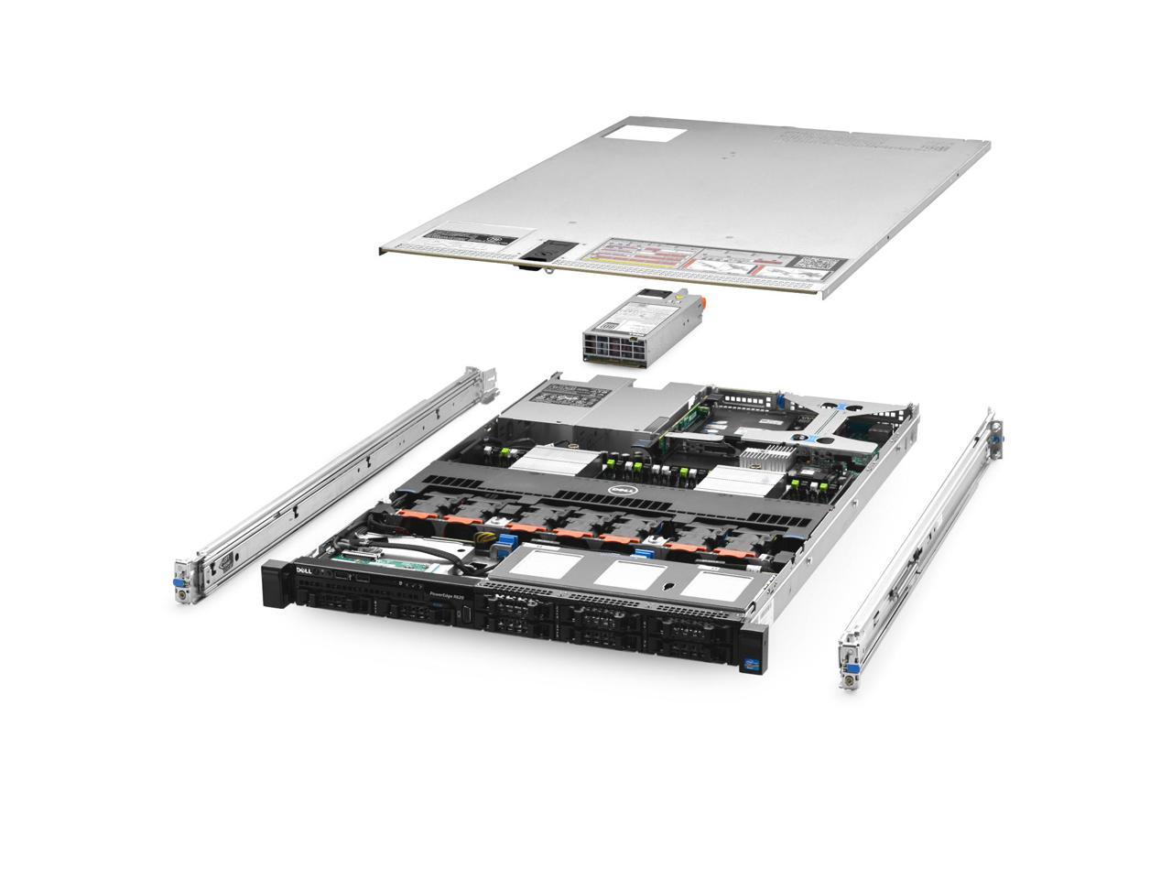

Single Rack Server Data Center

Slide 87
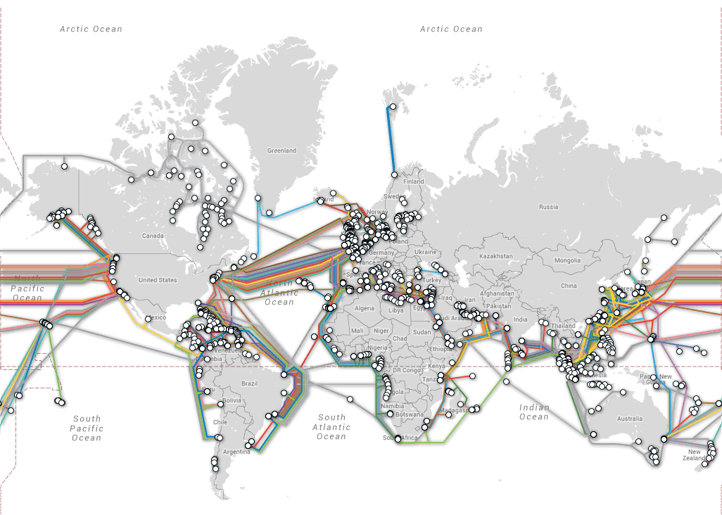

Undersea Cable Undersea Cable Map

Slide 88
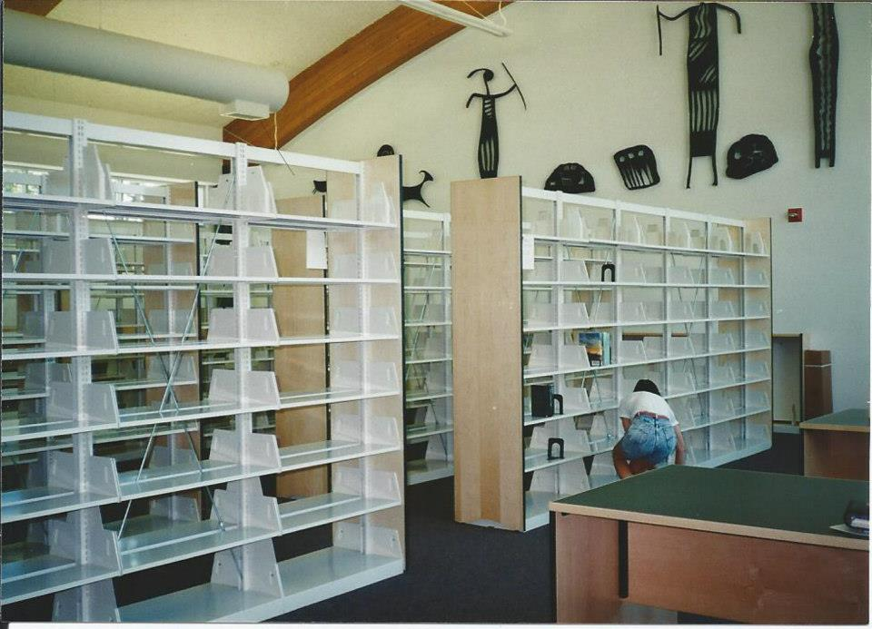
Bible Software is just an empty bookshelf that will find the books you paid to put on the shelf.

Slide 89
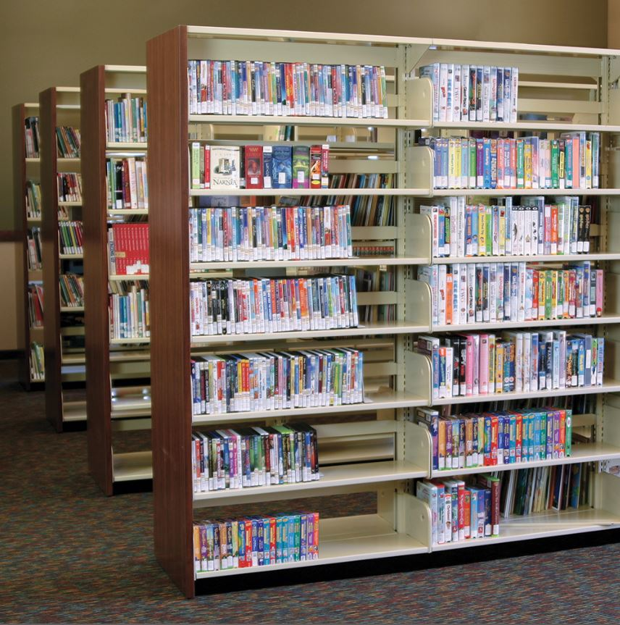
The quality of Bible Software is only based on the quality of books in your shelf

Slide 90
Bible Software can quickly search for words or ideas in all the books you put on its shelf. And it can help you organize your notes. But Bible Software is not a magical tool that does your research for you.

Slide 91
Bible Software
Accordance (https://accordancebible.com/)
Logos (https://www.logos.com/)
Logos Academic Basic (https://www.logos.com/product/195533/logos-9-academic-basic)
  Free for students & faculty enrolled in Logos’ Academic Discount Program
Logos Free Book of the Month (https://www.logos.com/free-book-of-the-month)
Eerdmans’ blog Eerdword (https://eerdword.com/)
Twitter (e.g., https://Twitter.com/NijayKGupta; /ZondervanAcademic; /EerdmansBooks; /LanghamPub)

Slide 92
Workshop, Day 2
Build a bibliography of 10 potential sources
Form groups of 2-3 people. (2-3 minutes)
Take 2 minutes for each person to share the topic/s you are researching. (6-8 minutes)
As a group, take 5 minutes per person to brainstorm potential search terms & biblical passages for each person in the group, that could help that person as they look for resources. (15 minutes)
Look for and record the bibliographic data for at least 10 usable resources. (30 minutes)
Meet your group and:
  Brainstorm and record at least 5 questions that will help a researcher evaluate the quality of their resources. Save these questions for tomorrow.
  Take turns and share the 10 best resources that each of you found. Discuss potential strengths and weakness of your resources. (45 minutes)
Continue to look for quality resources (as time allows)

