Slide 1
What is a Dissertation?

Slide 2
Contents
Pre-Session Assignment: X, Y, & Z (discussion)
Tyndale Journal Key Questions for Peer Review
What is a Dissertation? Matt Might’s Guide to a Ph.D.
What is a Dissertation? Turabian & Roberts

Slide 3
Pre-Session Dissertation Assignment
X, Y, & Z

Slide 4
Discussion Question
Pre-Session Assignment: Dissertation Analysis
Step 4 of the assignment asked you to describe your two dissertations using this formula:
“This dissertation studied X,
because it wanted to find out Y,
so that it can help others understand Z.”

Slide 5
Tyndale Journal
“Tyndale Bulletin Peer Review: The Key Questions”
TyndaleBulletin.org. Online: 7 July 2022.

Slide 6
Key Questions for Peer-Reviewers
1. “Please provide a summary of the author’s essay: What is the essay’s thesis and/or purpose? What are its supporting arguments? What are the main data used to make the arguments?
  The main body of the paper should itself be constructed in such a way that readers can follow without undue effort how the argument unfolds, and can see how each paragraph serves the argument. Carefully crafted headings and subheadings are invariably highly beneficial, and authors should take care to ensure that their case is developed in a logical sequence without unnecessary duplication.”

Slide 7
Key Questions for Peer-Reviewers
2. “Is the author’s argument valid and true? Are the data interpreted correctly? Were the arguments made on the basis of the data logical? If not, please explain with reference to particular segments of the article.
  With this set of questions, reviewers are asked to consider whether the central claims of the article stand up to scrutiny. Authors need to ensure that their approach is methodologically sound, and that the argument itself is free from fallacies and non sequiturs…when engaging biblical material (and of course other ancient documents) it is crucial that the primary sources are handled with appropriate care, and that authors show awareness of the relevant technical questions .”

Slide 8
Key Questions for Peer-Reviewers
3. “Had the author engaged unfairly or uncharitably with any other authors or their arguments?
  Whilst scholarly disagreement—indeed sometimes very sharp disagreement—is of course inevitable in academic discourse, we believe this should be done in a way that is courteous and respectful…It is also crucial that the arguments of other scholars are not misrepresented; indeed to do so seriously undermines the credibility of an author’s own claims. Thus a charitable approach to the work of others, seeking to understand them as fully as possible before critiquing them, is essential. ”

Slide 9
Key Questions for Peer-Reviewers
4. “Has the author failed to engage with any relevant scholarly literature? If so, please cite it.
  The concern here is…whether there is any secondary literature not addressed by the author that would make a substantive difference to the article, or indeed undermine the thesis being advanced. Authors should therefore aim to acknowledge and to interact proactively with alternative viewpoints on the question under discussion. If there are significant counterarguments in the secondary literature of which the author shows no knowledge, an outcome of revise and resubmit is the best that can be expected.”

Slide 10
Key Questions for Peer-Reviewers
5. “What is the contribution to knowledge that is made in this paper?

Slide 11
Summary of Key Questions for Peer-Review
“Please provide a summary of the author’s essay: What is the essay’s thesis and/or purpose? What are its supporting arguments? What are the main data used to make the arguments?”
“Is the author’s argument valid and true? Are the data interpreted correctly? Were the arguments made on the basis of the data logical? If not, please explain with reference to particular segments of the article.”
“Had the author engaged unfairly or uncharitably with any other authors or their arguments?”
“Has the author failed to engage with any relevant scholarly literature? If so, please cite it.”
“What is the contribution to knowledge that is made in this paper?”

Slide 12
What is a Dissertation?
On Intellectual Humility & Intellectual Curiosity
1. The More You Know by Instagram @WeThinkDeeply
2. The Illustrated Guide to a Ph.D. by Matt Might @ Matt.might.net

Slide 13
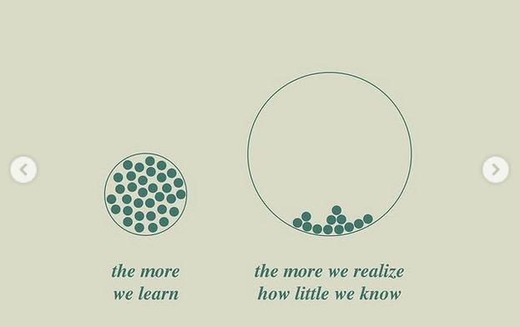
Instagram @wethinkdeeply, July 17, 2025.

Slide 14
What is a Dissertation?
The Illustrated Guide to a Ph.D.
Matt Might
Matt.might.net

Slide 15
Sum of human knowledge

Slide 16
Elementary-Jr. High
(5-13 year olds)

Slide 17
High School
(13-18 year olds)

Slide 18

University
(4 year Bachelor’s Degree, Usu. 18-22 year olds)

Slide 19

Graduate School,
Master’s Degree

Slide 20

Doctoral Candidate

Slide 21
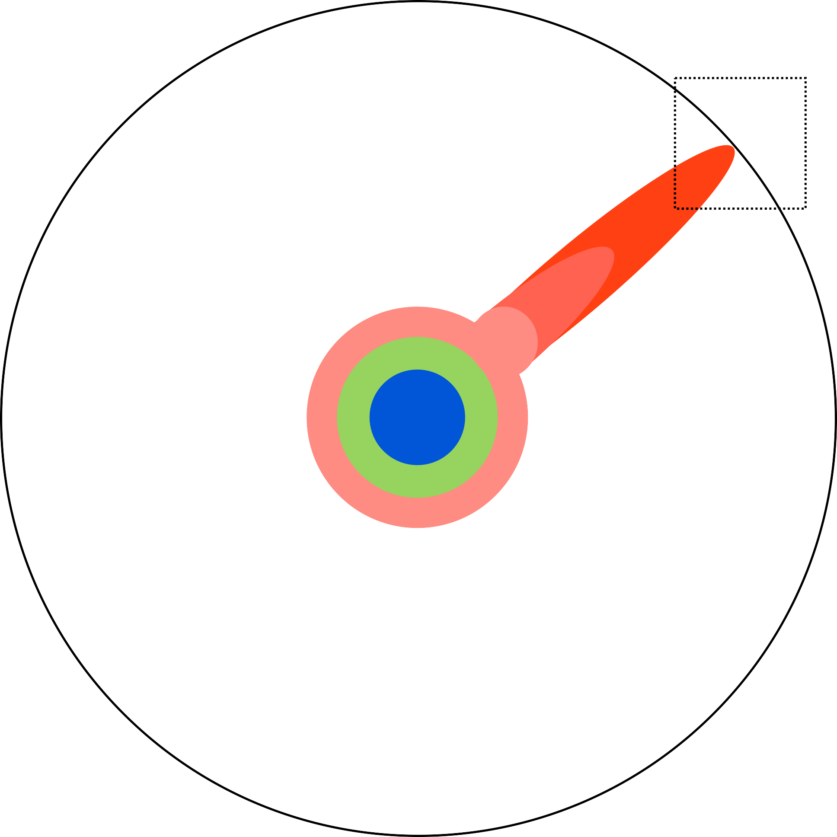
Doctoral Candidate

Slide 24
Dissertation

Slide 26
Dissertation

Slide 27

Ph.D.
Keep Pushing

Slide 28
What is a Dissertation?
Turabian, 3-9
Roberts, 18-25

Slide 29
What is a Dissertation?
What is Research? (Turabian)
“Answering a question by obtaining information” (Turabian, 5).
“A process of systematic inquiry to answer a question that not only the researcher but also others want to solve” (Turabian, 5).
“Research-based writing differs from other kinds of persuasive writing: it must rest on shared facts that readers accepts at truths independent of your feelings and beliefs. Your readers must be able to follow your reasoning from evidence they accept to the claim you draw from it” (Turabian, 6).

Slide 30
What is Research? (Turabian)
Research is a conversation that you have with your readers, based on the conversations you’ve had with others. The quality of those latter conversations impacts the quality of the conversation that you are qualified to have with your readers.
“Conversation” in this context refers to everything you read and everything you write.
Whenever you read, you are having a silent, asynchronous conversation with the author of that resource. This is why discernment of resources is so important.
“This is why our formula—I am working on X to find out Y so that others can better understand Z—is so powerful: because it makes informing others the end of research” (Turabian, 8).
  “Here is something that will help you remedy a situation that troubles you” (Practical Problems, Applied Research)
  “Here is something that will help you better understand something you care about” (Conceptual Problems, Pure Research)

Slide 31
What is a Dissertation? (Roberts)
“A doctoral dissertation is a formal document that demonstrates your ability to conduct research that makes an original contribution to theory or practice” (Roberts, 18).
“The term original, according to the Council of Graduate Schools (2002), ‘implies some novel twist, fresh perspective, new hypothesis, or innovating method that makes the dissertation project a distinctive contribution’” (Roberts, 18).

Slide 32
What is a Dissertation?
A dissertation is a researcher’s analysis based on thorough familiarity with the current status quaestionis (state of the question) and based on competent handling of the relevant data.
Status Quaestionis – Literature Review / Forschungsbericht / Survey of Scholarship
  “Survey the existing literature on the topic, indicate and evaluate a range of views and approaches to that topic, and identify gaps or disagreements in the literature that merit further research. The literature review goes beyond summarizing existing research and analyzes, synthesizes, and historicizes distinct views, methodologies, and schools of thoughts” (“The Literature Review/Forschungsbericht,” Graduate Program Handbook. German Department at Georgetown University. Online: https://german.georgetown.edu/graduate/handbook)
Relevant Data
  What does your dissertation cover, what are the constituent parts, & what data informs each part?

Slide 33
What is Dissertation Research?
Part 1: Perspectives on Research

Slide 34
What is Dissertation Research?
Perspectives on Research
“You only know at the end, what is the fastest way from the beginning” (CPG Grey, Someone Dead Ruined My Life…Again.” YouTube). (https://bibtheo.com/paths)
Researchers don’t know enough in the beginning to know exactly what to read, exactly what to write, or exactly how it will all go together.
Go where the research takes you, but also step back and maintain your bearing.
There is a continual engagement of the hermeneutic circle: Our understanding of an idea is based on our understanding of each constituent part, and our understanding of each constituent part is based on our understanding of the big idea.

Slide 35

Hermeneutical Circle / Spiral
Hermeneutical Circle
Big Idea
Detail
Big Idea
Detail

Slide 36
Discussion Questions
What is a dissertation, in general?
What do you want your dissertation to be?
  “I am working on X to find out Y so that others can better understand Z.”
  “Here is something that will help you remedy a situation that troubles you” (Practical Problems, Applied Research)
  “Here is something that will help you better understand something you care about” (Conceptual Problems, Pure Research)

Slide 37
Contents
Turabian, “Defining a Project”, 10-24.
Roberts, “Choosing a Dissertation Topic,” 45-52.
Espinoza, “Stages of Research,” BibTheo.com/research
Gilbert, et al., eds. “Unit 2,” 78-120.

Slide 38
Turabian, “Defining a Project”
Pages 10-24

Slide 39
Defining a Project (Turabian)
“Research projects would be much easier if we could march straight through these [following] steps. But you will discover that the research process is not so straightforward. Each task overlaps with others, and frequently you must go back to an earlier one. The truth is, research is messy and unpredictable. But that’s also what makes it exciting and ultimately rewarding” (Turabian, 11).
Find a Question in Your Topic
Understand Research Problems
  “I am working on X, because I want to find out Y, so that I can help others understand Z.”
Propose a Working Hypothesis
  “Once you have a question, imagine some plausible answers…at this stage don’t worry whether they’re right. That comes later…If one answer seems promising, call it your working hypothesis and use it to guide your research.”
Build at Storyboard to Plan and Guide Your Work
Join or Organize a Writing Group

Slide 40
Roberts, “Choosing a Dissertation Topic”
Pages 45-52

Slide 41
Choosing a Dissertation Topic
“The most effective and efficient ways to select a topic are the following:
  Become steeped in the relevant literature.
  Engage in discussions with faculty and other scholars in your field.
  Write about your topic to help crystallize and organize your understanding.
  Commonly, students consider three to five potential topics before finally settling on one. Scrapping a topic and starting over at least once is the norm” (Roberts, 47).
(Discussion Question) What are some ways that you might discover your own research topic?

Slide 42
Choosing a Dissertation Topic
“The basic purpose of a dissertation is to demonstrate that you can do acceptable research in your field. It is not your life’s work” (Ogden, Completing Your Doctoral Dissertation, 39, via Roberts, 49).
A dissertation “topic must have the potential to do at least one of the following: Uncover new facts or principles, challenge existing truths or assumptions, afford new insights int little-understood phenomena, or suggest new interpretations of known facts that can alter people’s perceptions of the world around them” (Madson, Successful Dissertations, 38, via Roberts, 49).
“It needs to hold your interest for a long time.
It must be manageable in size.
It must have the potential to make an original and significant contribution to knowledge.
It must be doable within your time frame and budget.
It has to have obtainable data.
It has not already been sufficiently researched.
It should be acceptable to your advisor and committee members” (Roberts, 49-50).

Slide 43
Espinoza, “Four Stages of Research & Writing”
https://BibTheo.com/Research

Slide 44


Slide 45
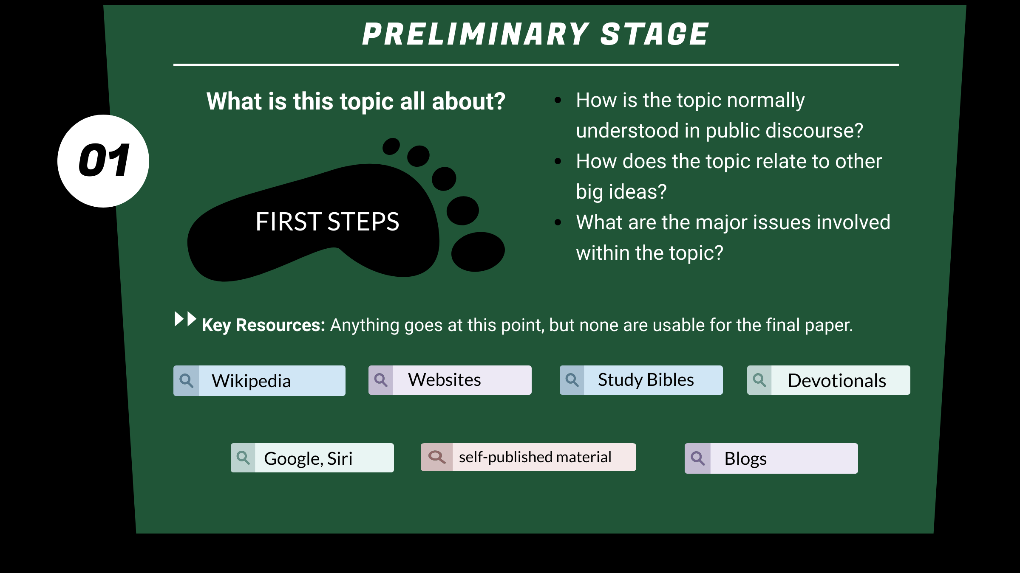

Slide 46
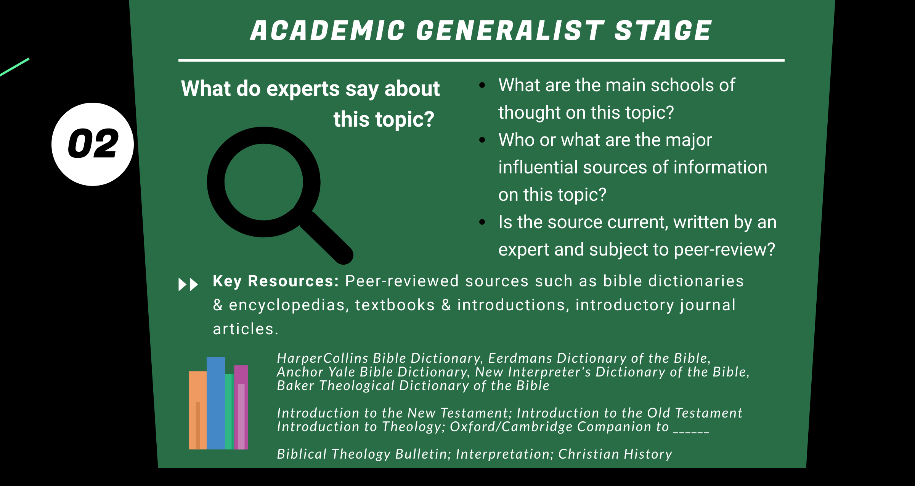

Slide 47
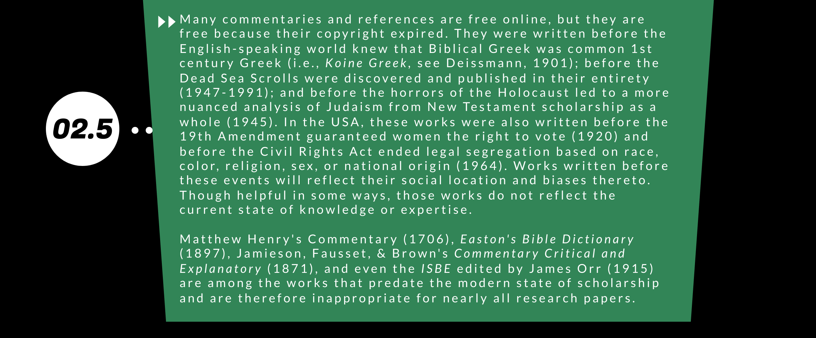
For an updated list of common resources that are unsuitable for academic research, see https://BibTheo.com/Unsuitable.

Slide 48
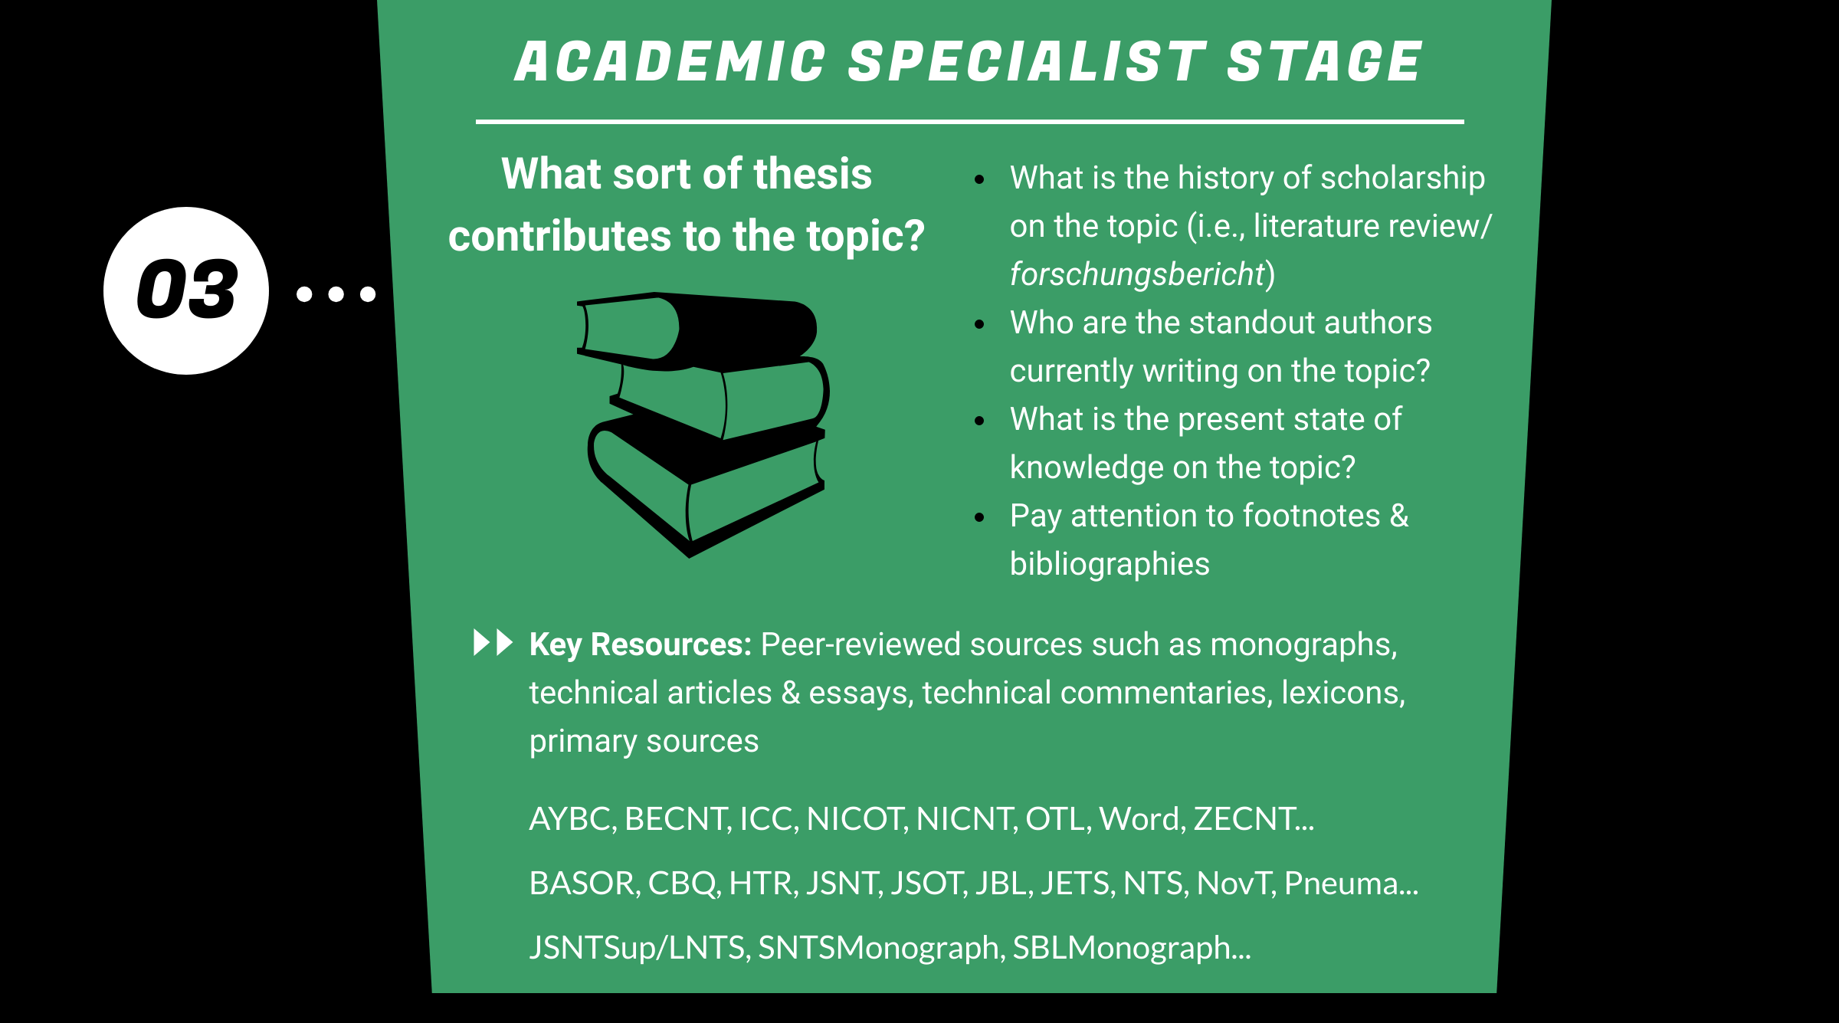

Slide 49
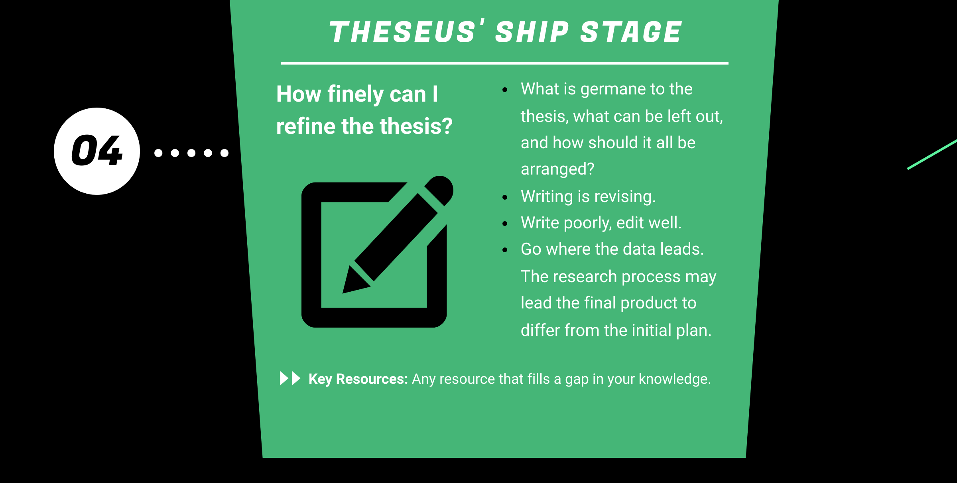

Slide 50
Stages of Research, review
Preliminary Stage (First Steps, or “Anything Goes, Nothing Stays”
Academic Generalist Stage
Academic Specialist Stage
Revision Stage (Theseus’ Ship Stage)
“Writing is revising.”
(Donald M. Murray, The Craft of Revision. 5th ed. Boston: Wadsworth, 2003)

Slide 51
Stages of Research, review
Discussion Question: Does anyone have a biblical passage that is relevant to your dissertation topic? We’ll brainstorm types of resources at each stage that might relate.
Preliminary Stage
Academic Generalist Stage
Academic Specialist Stage
Revision Stage (Theseus’ Ship Stage)

Slide 52
Gilbert, et al., eds. “Unit 2”
Pages 78-120

Slide 53
Missiological Research, unit 2
14. Introduction to Biblical & Theological Research (P. Lewis)
15. Doing Theology Missiologically (D. Rance)
16. Biblical Hermeneutics (P. Lewis)
17. Biblical Theology (P. Lewis)
18. Historical Theology (C. Self)
19. Systematic Theology (P. Lewis)
20. Contextual Theology (A. Johnson & P. Lewis, w/ W. Newberry)
21. Narratives, Narrative, and Narrative Theology (P. Lewis)

Slide 54
Missiological Research, unit 2
14. Introduction to Biblical & Theological Research (P. Lewis)
  See Appendices 15 “Guidelines for Biblical & Theological Research” & 16 “Using Indices & Abstracts for Biblical & Theological Research”
15. Doing Theology Missiologically (D. Rance)
  Intentionally includes one’s faith in the motive and application of one’s research.

Slide 55
Missiological Research, unit 2
16. Biblical Hermeneutics (P. Lewis)
  The exegesis & interpretation of Scripture (cf. exegesis vs. eisegesis), usu. verse by verse.
17. Biblical Theology (P. Lewis)
  Builds on Biblical exegesis and applies it to “a larger scale—either in terms of an entire book, a corpus, a testament, or in terms of a theme” (Missiological, 78). Does not systemize theological dogma, but leads the text speak for itself.
18. Historical Theology (C. Self)
  Reception history of theological ideas as they develop over time.
19. Systematic Theological (P. Lewis)
  Builds on biblical hermeneutics, biblical theology, & historical theology to systematize and apply theological insight to philosophical ideas.

Slide 56
Missiological Research, unit 2
20. Contextual Theology (A. Johnson & P. Lewis, w/ W. Newberry)
  “The emphasis lies on the cultural context and cultural engagement in which the theology is constructed” (Missiological, 79). Significantly overlaps with Practical Theology & Social Location Theology.
21. Narratives, Narrative, and Narrative Theology (P. Lewis)
  Narrative Criticism is an exegetical tool that focuses on the narrative qualities of biblical texts. Narrative Theology “focuses on the narrative dynamics of theology and the Christian life” (Ibid.)

Slide 57
Discussion Question
Does anyone have a specific biblical passage that is relevant to their dissertation topic? As a class, will discuss how one might approach that passage using the following methods:
  15. Doing Theology Missiologically (D. Rance)
  16. Biblical Hermeneutics (P. Lewis)
  17. Biblical Theology (P. Lewis)
  18. Historical Theology (C. Self)
  19. Systematic Theological (P. Lewis)
  20. Contextual Theology (A. Johnson & P. Lewis, w/ W. Newberry)
  21. Narratives, Narrative, and Narrative Theology (P. Lewis)

Slide 58
Contents (review)
Turabian, “Defining a Project”, 10-24.
Roberts, “Choosing a Dissertation Topic,” 45-52.
Espinoza, “Stages of Research,” BibTheo.com/research
Gilbert, et al., eds. “Unit 2,” 78-120.

Slide 59
What is Dissertation Research?
Part 2: Types of Resources

Slide 60
Contents (review)
He Ruming, “The Dangers of Short Form Content.”
Turabian, “Sources”
Evaluating Sources for Reliability
Turabian: Engaging Your Sources
Arguments from Authority vs. Arguments from Data
Artificial Intelligence & Research

Slide 61
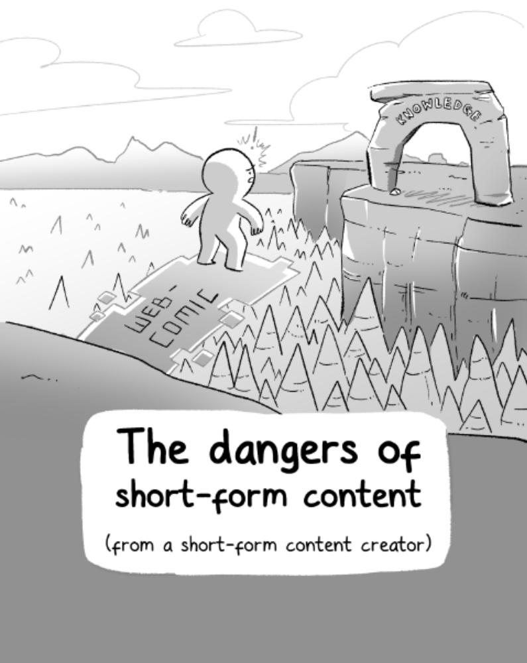
He Ruiming “The Dangers of Short Form Content” The Woke Salaryman. 11 March 2022. Online.

Slide 62
This discussion is about:
where information comes from,
how information is produced, &
how to be discerning about what you consume and what you produce.

Slide 63
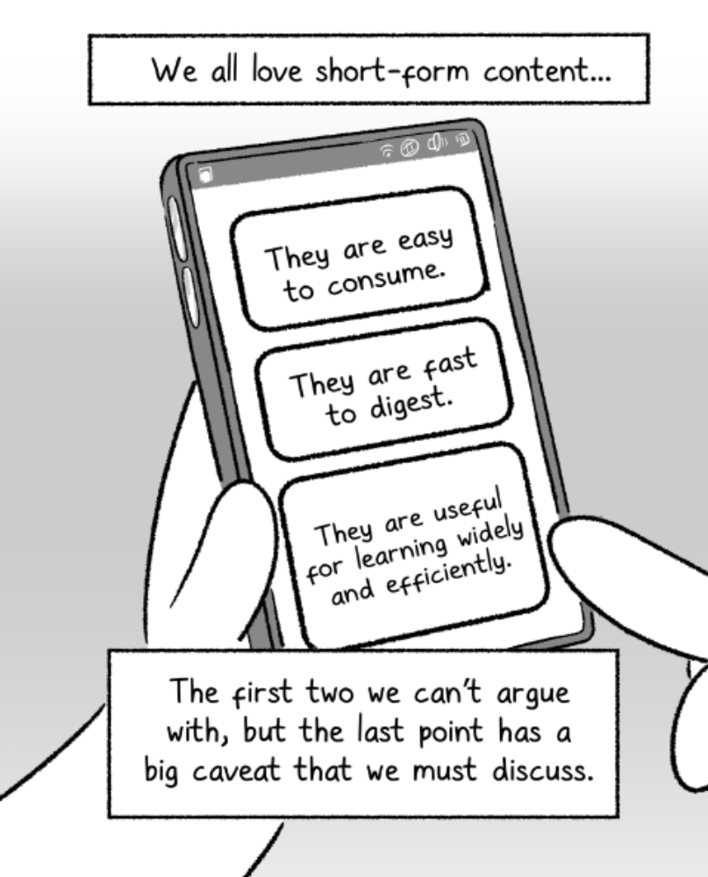
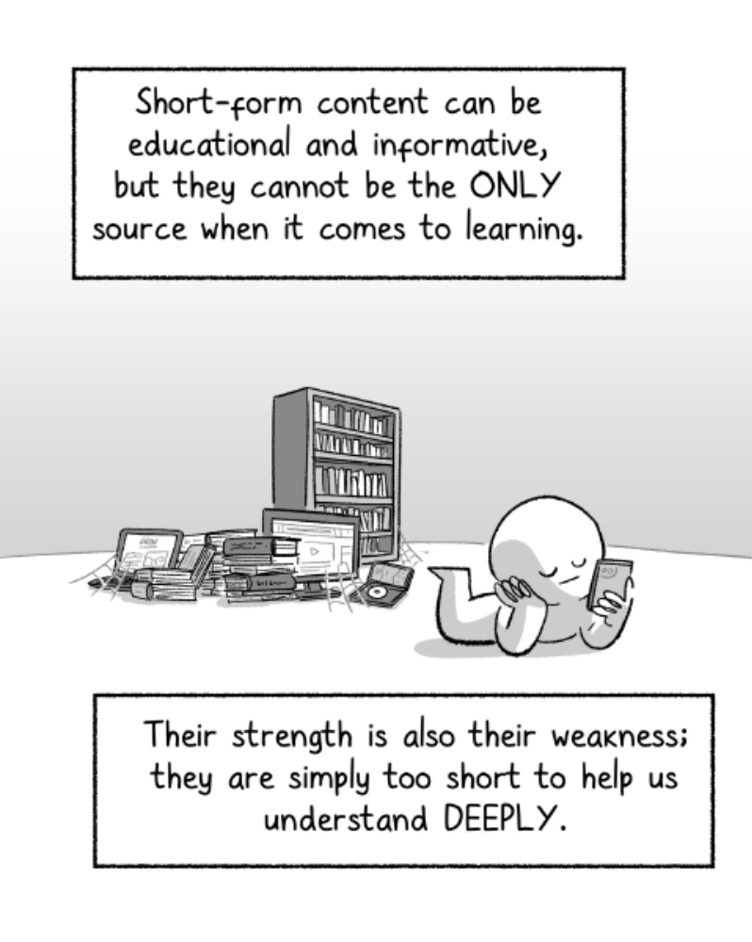
Photo Title
Photo Title

Slide 64
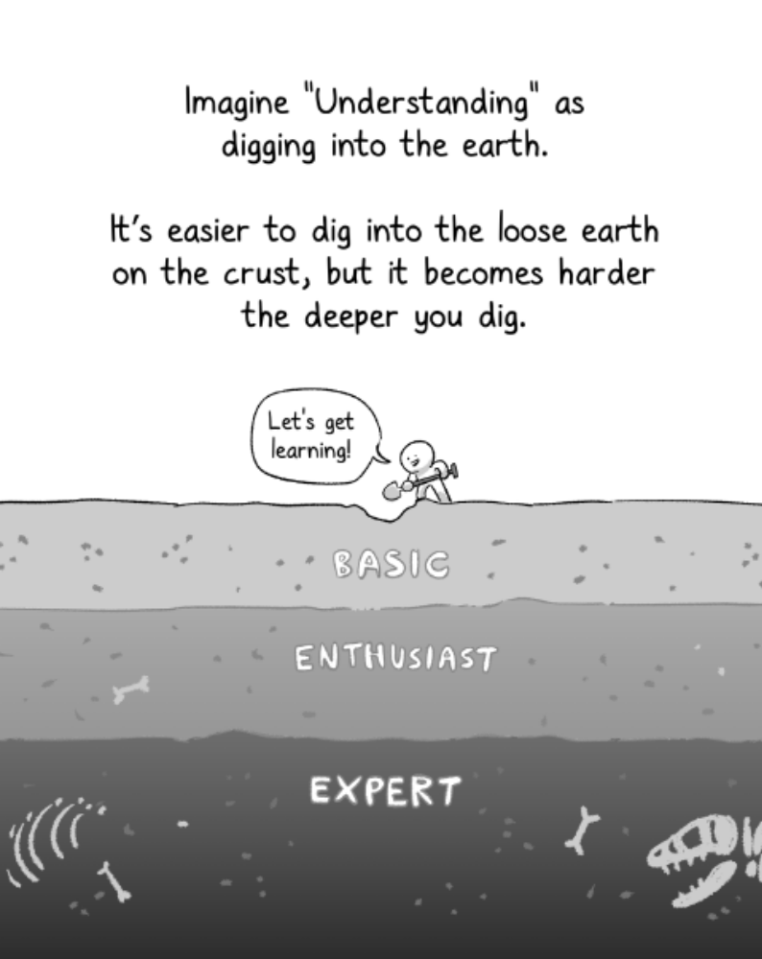
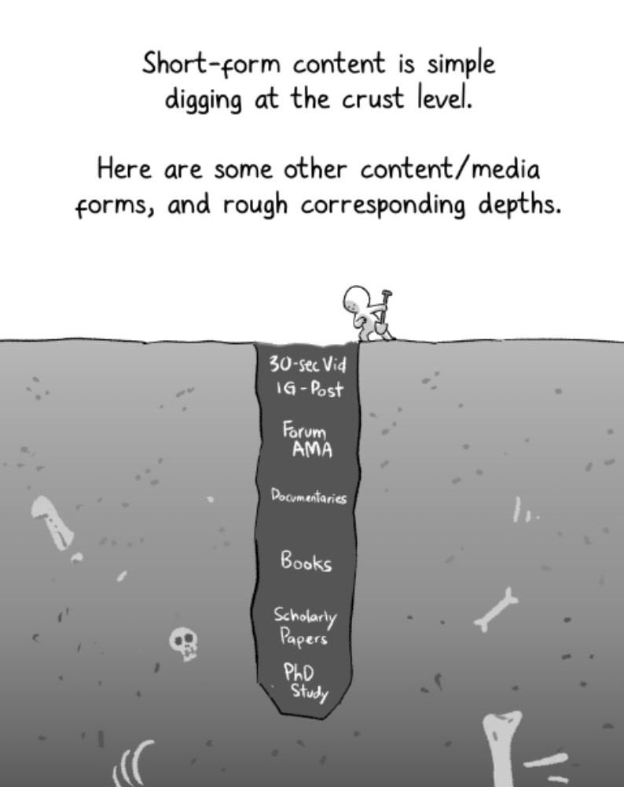
Photo Title
Photo Title

Slide 65
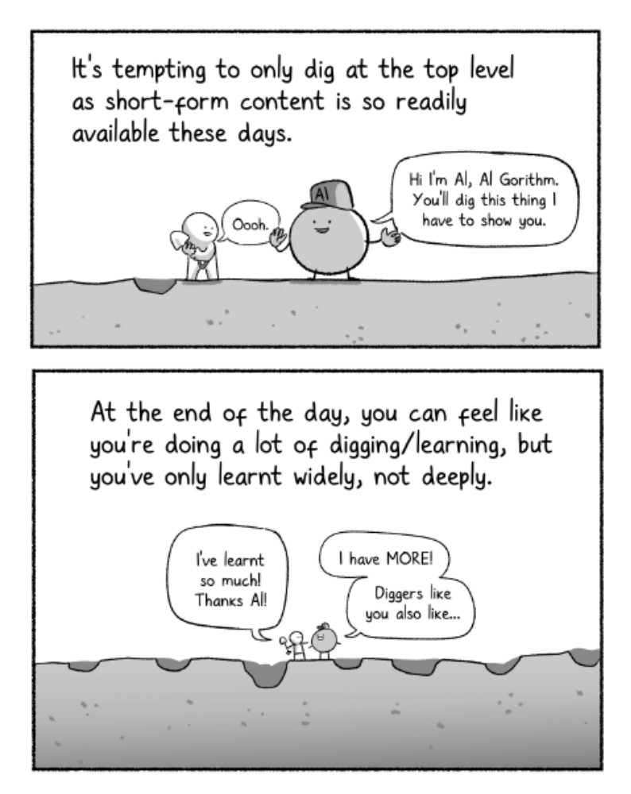
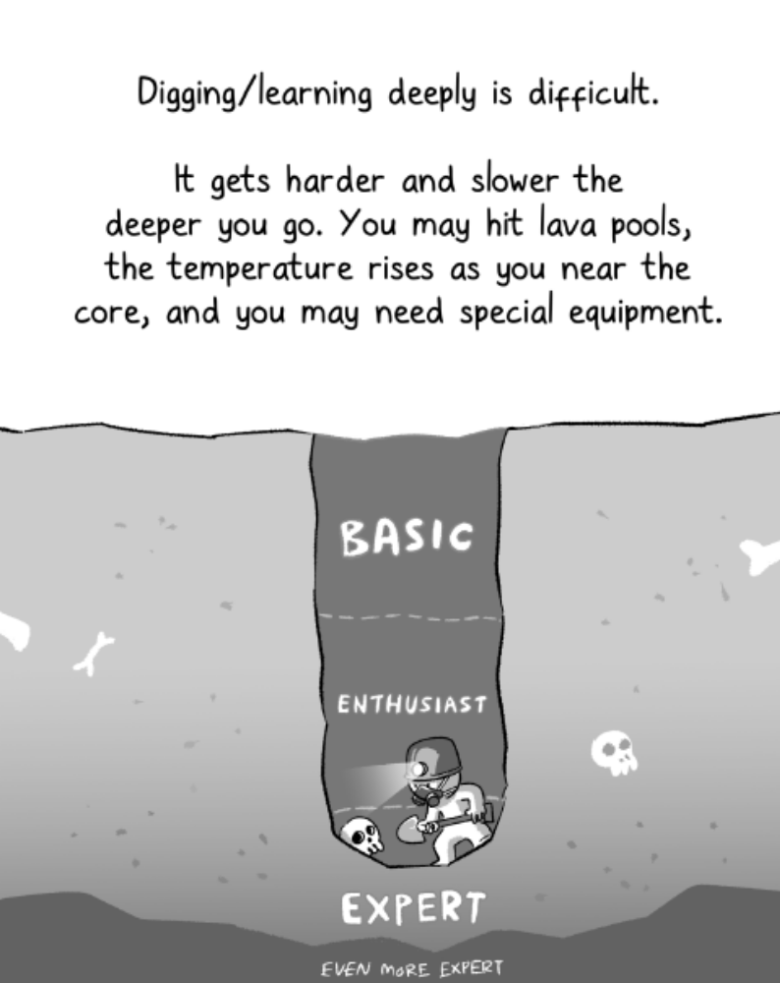
Photo Title
Photo Title

Slide 66
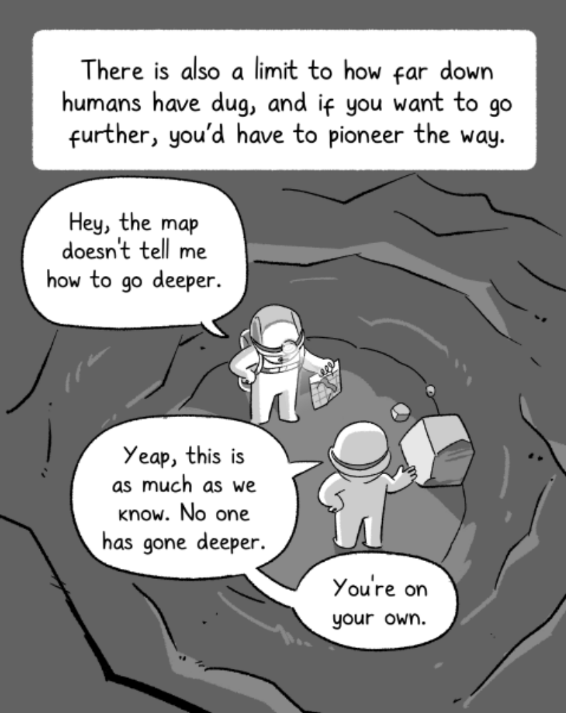
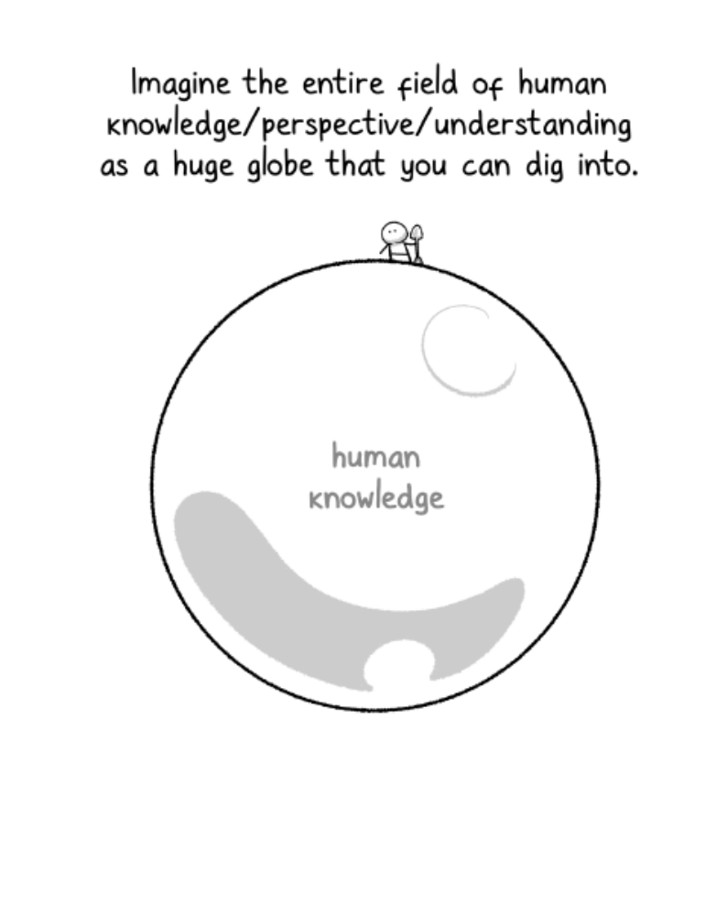
Photo Title
Photo Title

Slide 67
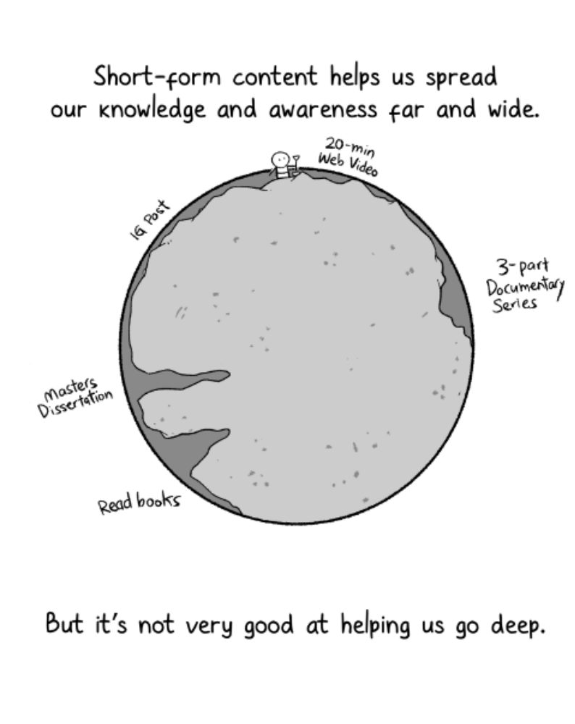
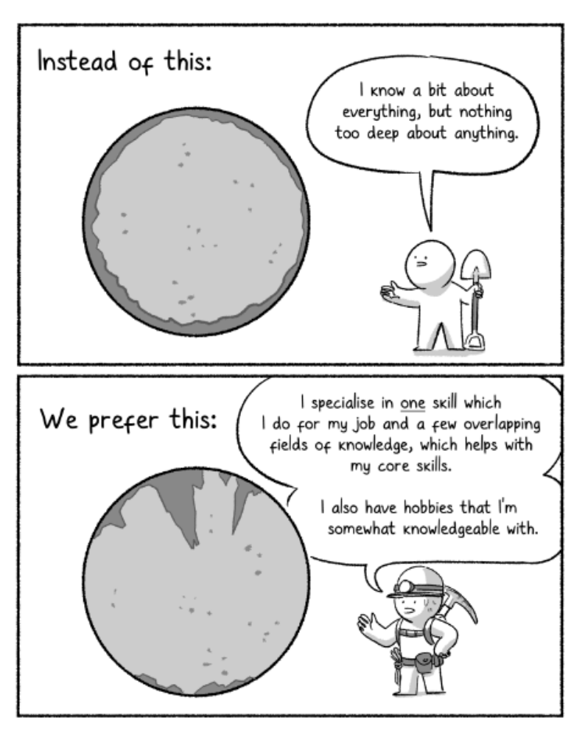
Photo Title
Photo Title

Slide 68
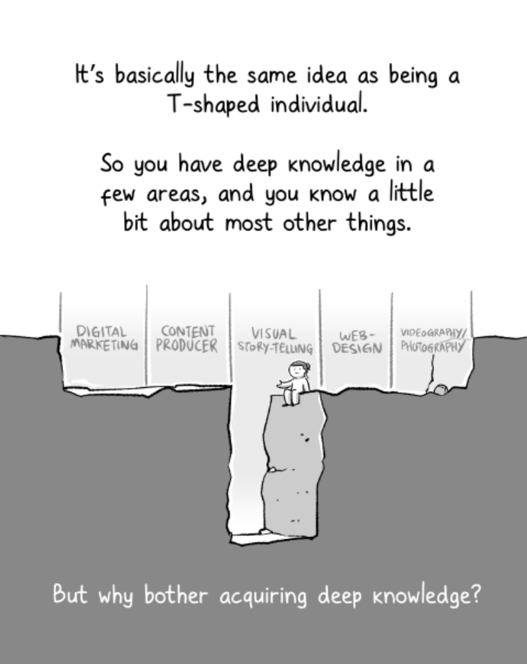
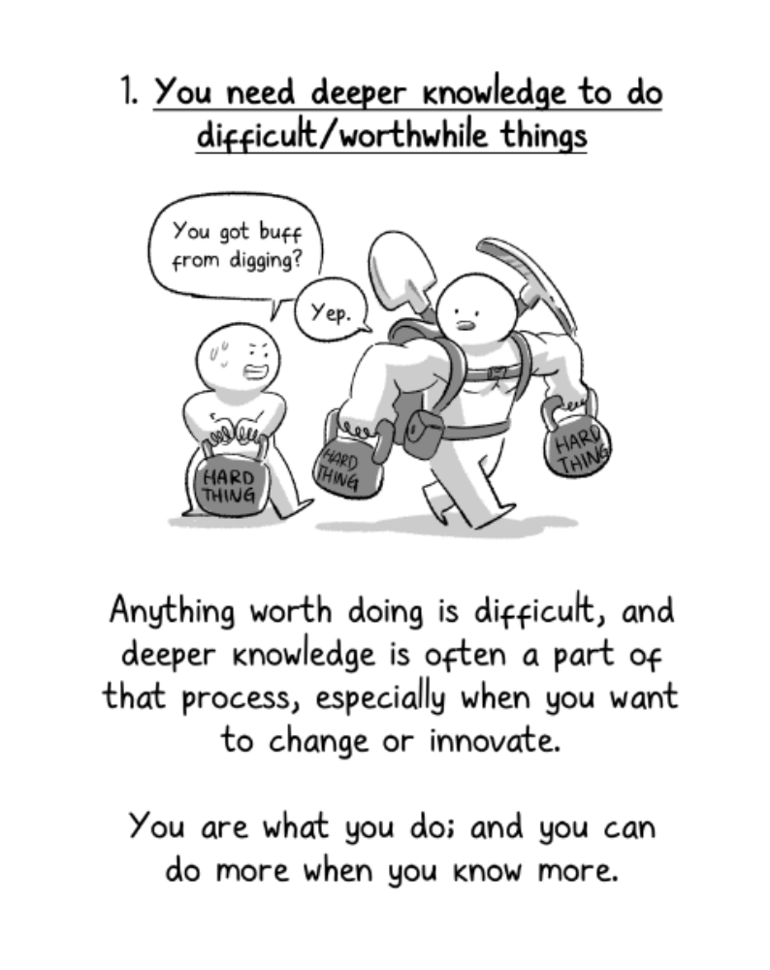
Photo Title
Photo Title

Slide 69
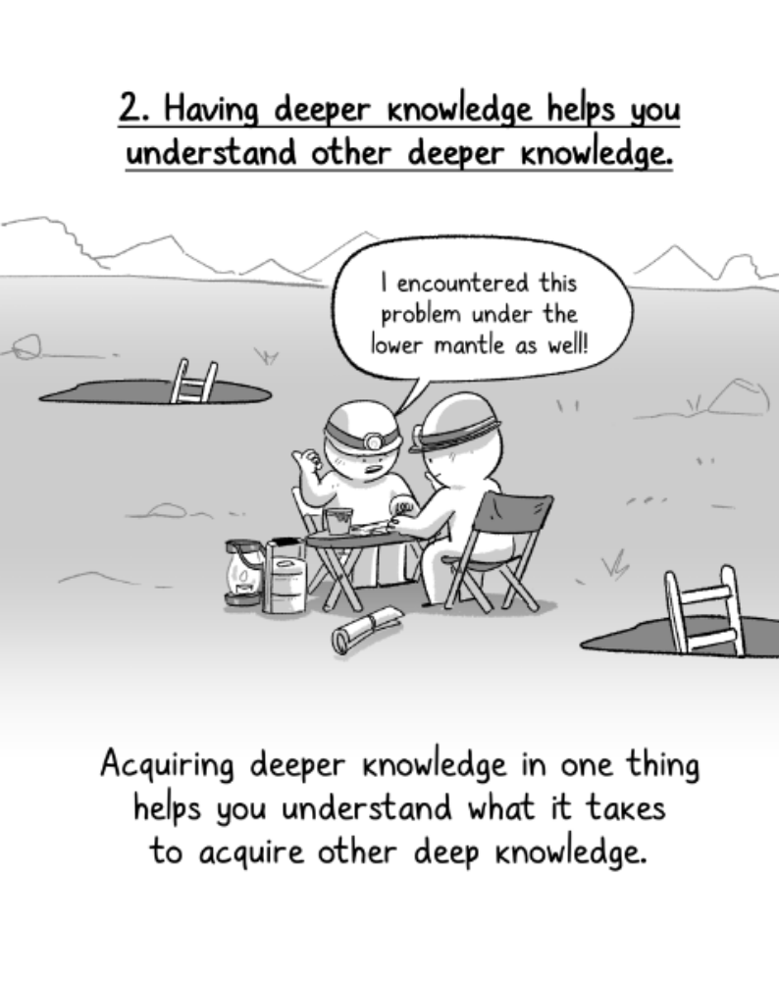
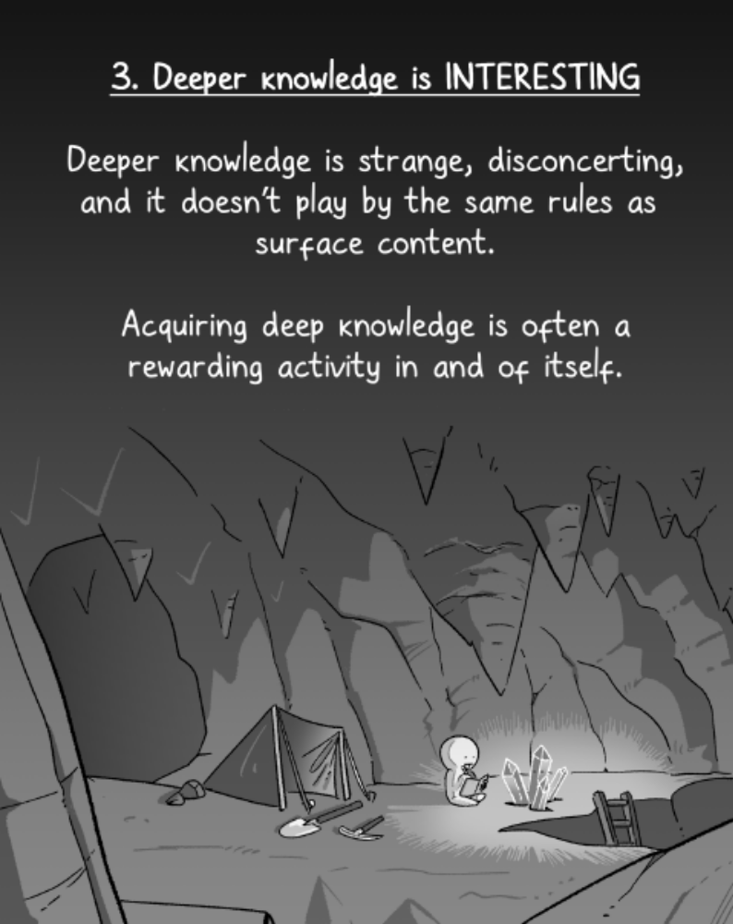
Photo Title
Photo Title

Slide 70
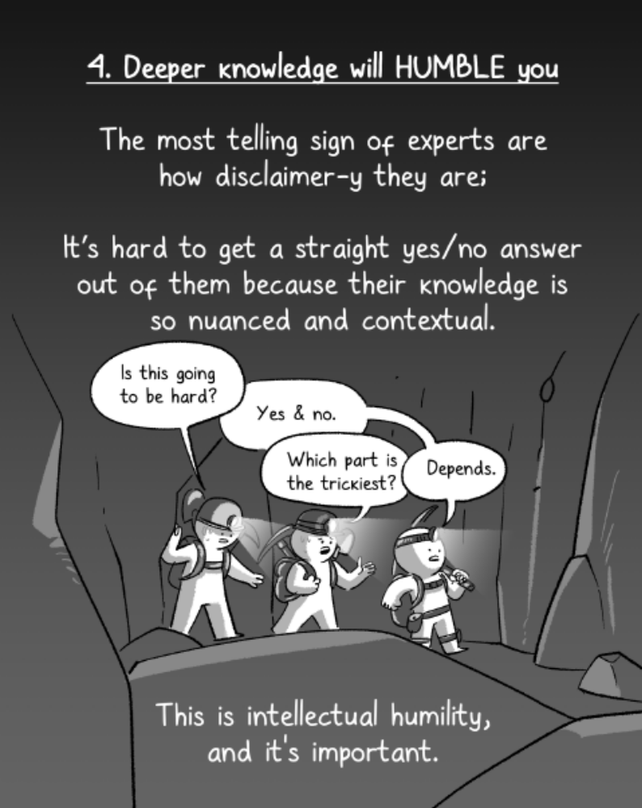
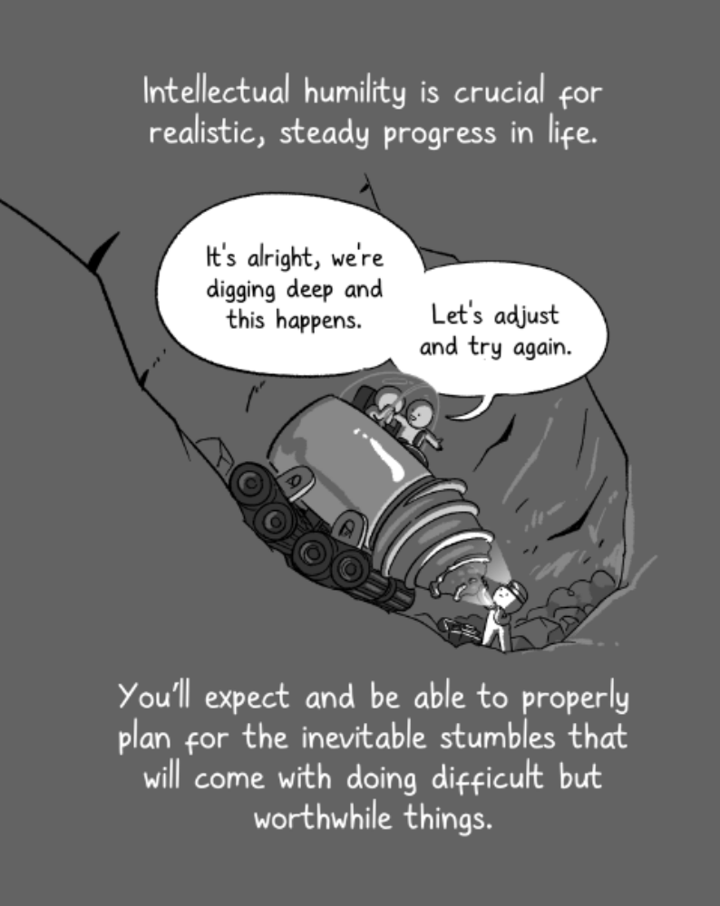
Photo Title
Photo Title

Slide 71
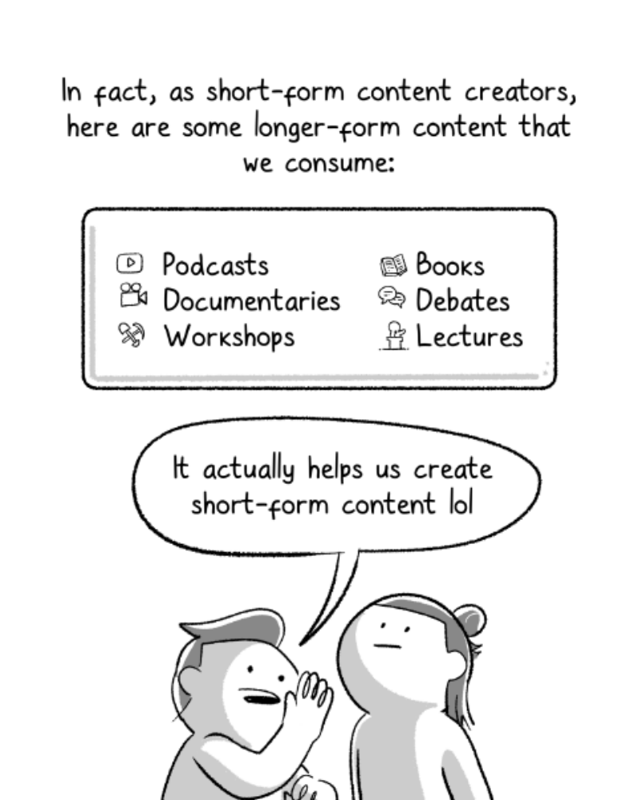
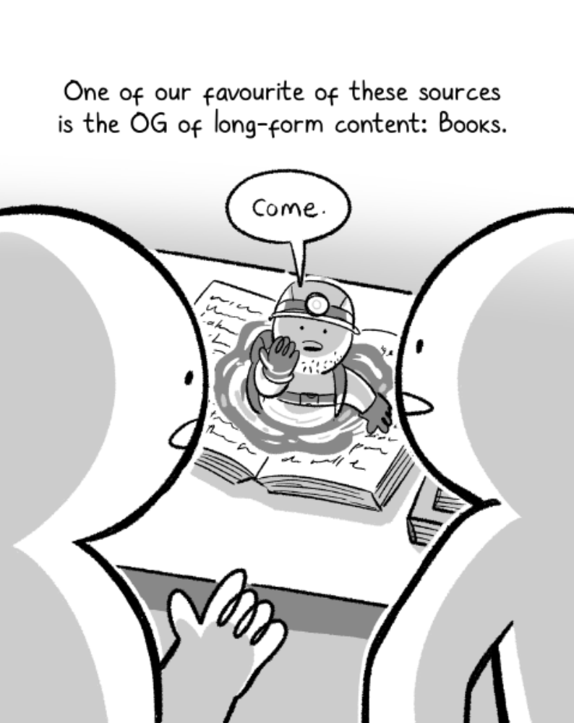
Photo Title
Photo Title

Slide 72
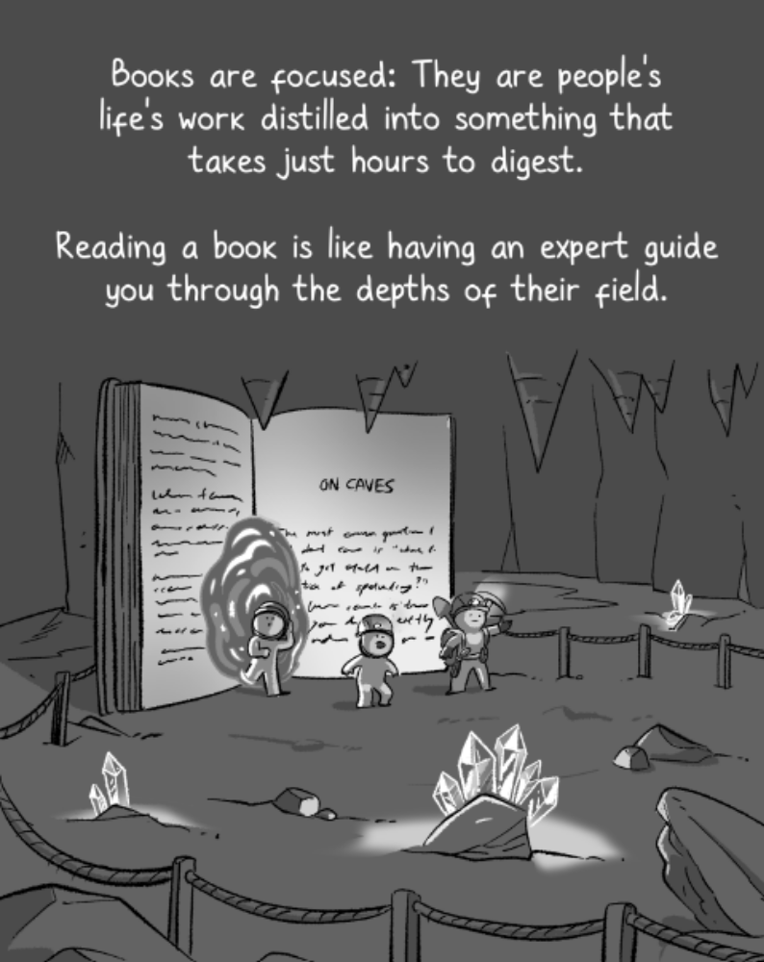
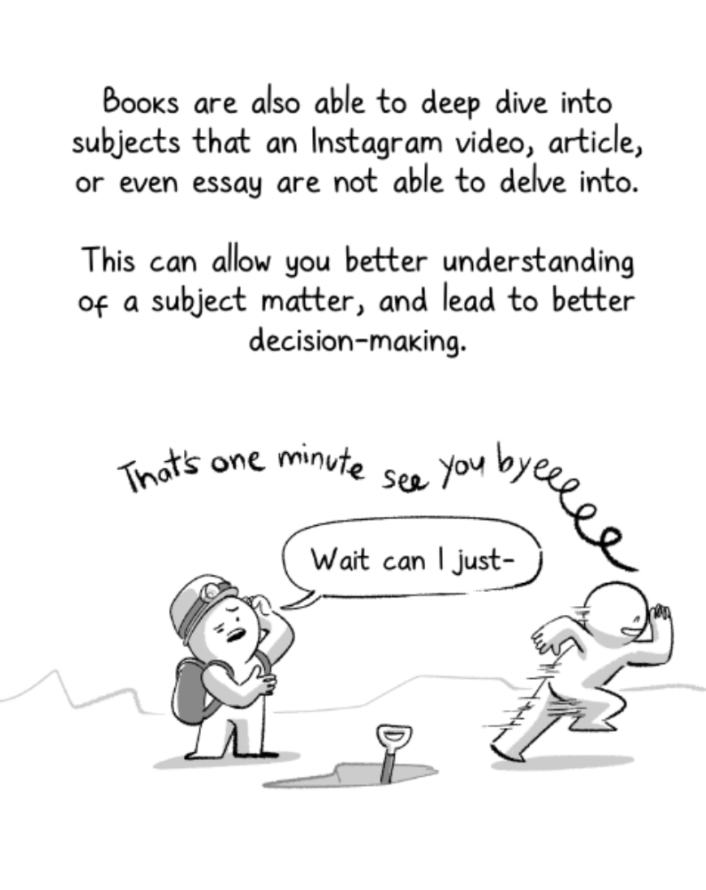
Photo Title
Photo Title

Slide 73
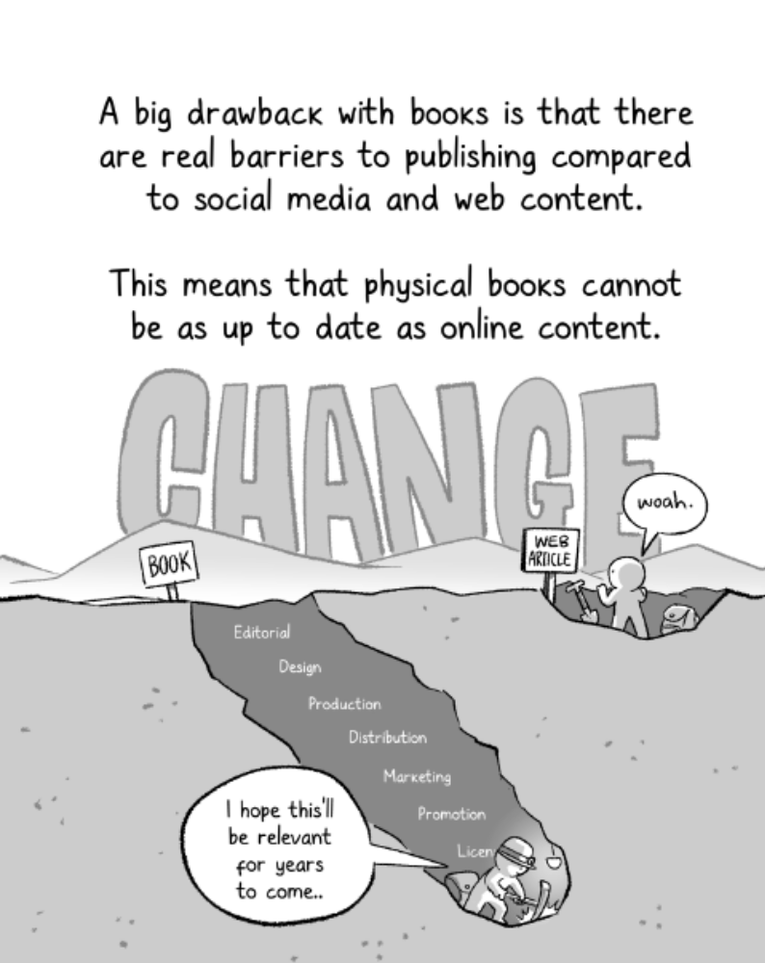
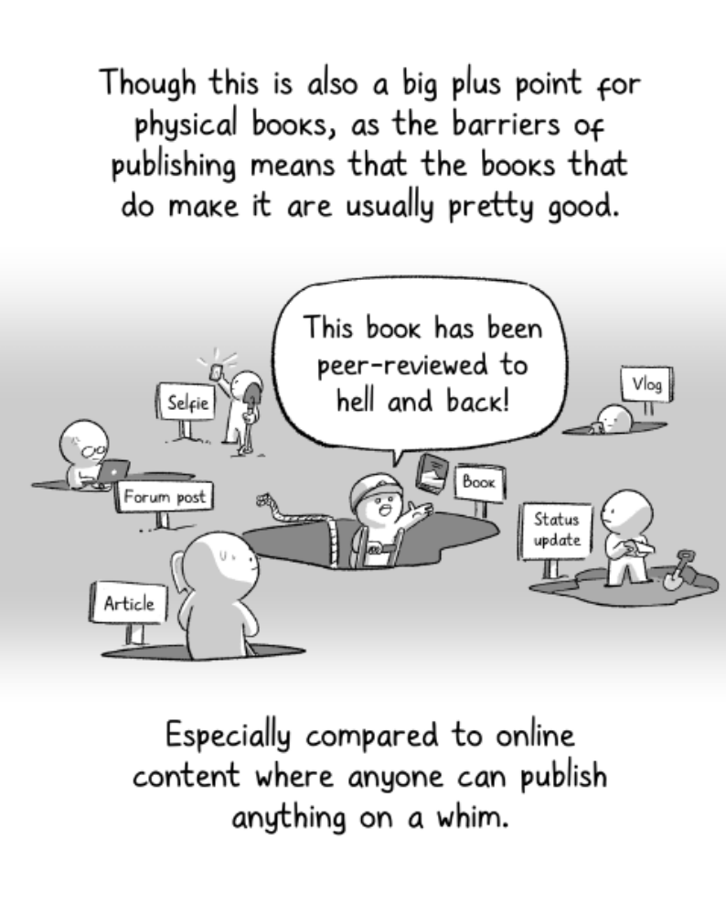
Photo Title
Photo Title

Slide 74
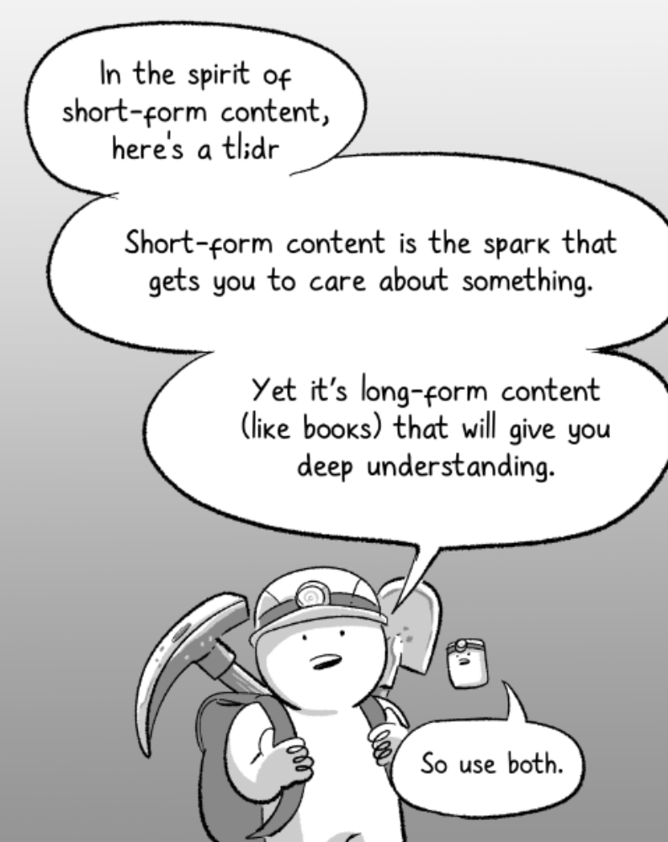

Slide 75
Where would you classify the following resources (Basic, Enthusiast, or Expert)?
Dissertation
Book
Journal Article
Dictionary Article
Web-based resources (blog, website, Video on social media/self-published)

Slide 76
Not all resources are of the same quality.
Dissertation (for which university?)
Book (Publisher, year, audience?)
Journal Article (journal, Year, audience?)
Dictionary Article (Publisher, Year, audience?)
Web-based resources (blog, website, Video on social media/self-published)
Additional Questions
What system produced the work?
What data does the author bring to the discussion?
How much has the author engaged the status quaestionis?

Slide 77
Discussion Questions:
How would you know if a resources is basic, enthusiast, or Expert?
What questions do you ask to help discern the merits of the resources you are reading?

Slide 78
Turabian, “Sources”
“Finding Useful Sources” & “Engaging Sources,” pages 25-27, 38-50.

Slide 79
Three Kinds of Resources
Primary Sources – “Consult Primary Sources for Evidence”
  “Primary sources are ‘original’ materials that provide you with the ‘raw’ data or evidence you will use to develop, test, and ultimately justify your hypothesis or claim. In history, primary sources are artifacts or documents that come directly from the period you are studying: letters, diaries, objects, maps, even clothing. In literature or philosophy, your main primary sources are usually the texts you are analyzing, and your data are the words on the page” (Turabian, 26).
Secondary Sources – “Read Secondary Sources to Learn from Other Researchers”
  “Secondary sources are books, articles, papers, or reports that are based on primary sources and intended for scholarly or professional audiences…The body of secondary sources in a field is sometimes called that field’s literature. The best secondary sources…have been peer reviewed, meaning tat they were vetted by experts in the field before they were published. Secondary sources also include specialized encyclopedias and dictionaries that offer essays written by scholars in the field” (Ibid.).
Tertiary Sources – “Read Tertiary Sources for Introductory Overviews”
  “Tertiary sources are books and articles that synthesize secondary sources for general readers. They include textbooks, encyclopedias, and dictionaries, as well as articles in publications for broad audiences” (Turabian, 29).

Slide 80
Secondary Sources
Use Secondary Sources to Learn from Other Researchers:
  “To keep up with current research.
  To find other points of view.
  To find models for your own research and analysis.” (Turabian, 27).
    You can use evidence found in other resources only if you can’t track down the original resources. In the footnote, cite the original source, then “via,” then cite the source in which you found that source.
The difference between “primary” and “secondary” sources depends on your topic of study. E.g., Martin Luther’s writings on scripture are secondary sources, unless you are studying Martin Luther or the Reformation, in which case his writings would be considered primary sources.

Slide 81
Research Tips
Follow bibliographic trails (Turabian, 31).
  When you find a useful resource, pay special attention to the footnotes & bibliography and then track down sources that are important to the discussion.
  Journal articles, theses, & dissertations often begin with a literature review.
Take careful notes, including all required bibliographic details.
  Accidental plagiarism is still plagiarism.
  See https://BibTheo.com/plagiarism for further guidance.
  Always use quotation marks (“ “) and in-text citation/footnote if the words are not yours.

Slide 82
Evaluating Sources for Reliability (Turabian, 33-35, cf. DeLonn Rance, “Doing Theology Missiologically.” Pages 84-87 in Gilbert, Johnson, & Lewis, Missiological Research )
“Is the source published by a reputable press?
Is the book or article peer reviewed?
Is the author a reputable scholar?
  Are they speaking in their area of study?
  Not everything they write is academically oriented, and even the best scholars have blind spots.
If the source is available only online, is it sponsored by a reputable organization?
Is the source current?
  Look for the date of the original words, not just when it was preprinted or published online.
If the source is a book, does it have notes and a bibliography?
If the source is a book, has it been well reviewed?
Has the source been frequently cited by others?
If the source is a website, does it include bibliographic data?
If the source is a website, does it approach its topic judiciously?”

Slide 83
Discussion: What Other Issues Affect Reliability?
“Is the source published by a reputable press?
Is the book or article peer reviewed?
Is the author a reputable scholar?
  Are they speaking in their area of study?
  Not everything they write is academically oriented, and even the best scholars have blind spots.
If the source is available only online, is it sponsored by a reputable organization?
Is the source current?
  Look for the date of the original words, not just when it was preprinted or published online.
If the source is a book, does it have notes and a bibliography?
If the source is a book, has it been well reviewed?
Has the source been frequently cited by others?
If the source is a website, does it include bibliographic data?
If the source is a website, does it approach its topic judiciously?” (Turabian, 33-35).

Slide 84
Engaging your Sources (Turabian)
“Read generously to understand, then critically to engage” (Turabian, 38).
You can’t truly disagree with someone until you understand why they think what they think.
Whether you agree or disagree with your sources, keep your emotions in check.
“Record exact quotations for these purposes:
  The quoted words are evidence that backs up your [argument].
  The words are form an authority you plan to rely on or challenge.
  The words are strikingly original or so compelling that the quotation can frame the rest of your discussion.
  The words express a claim that you disagree with, and to be fair you want to state it exactly.” (Turabian, 44)
Quotations should not advance the argument of the paper for you.

Slide 85
On Arguments: from Authority vs. from Data
An argument from authority assumes that an idea is true because it was published in an authoritative resource (i.e., primary, secondary, or tertiary literature).
An argument from evidence (data) will engage with the literature but will focus on data that is presented in the literature.
E.g., How do you know who wrote Philippians? Ephesians? Luke?

Slide 86
What About AI?
AI (Artificial Intelligence) is a vast topic.
For research, we are focusing on generative AI large language learning technologies (LLM) such as ChatGPT (OpenAI), Claude (Anthropic), DeepSeek (DeepSeekAI), Grok (xAI), Gemini (Google), Copilot (Microsoft) and their role in higher education (AIEd).
Introductions to generative AI:
  George Lawton, “What is GenAI? Generative AI Explained,” TechTarget. Techtarget.com. https://www.techtarget.com/searchenterpriseai/definition/generative-AI
  “What id Generative AI?” McKinsey & Company. April 2, 2024. https://www.mckinsey.com/featured-insights/mckinsey-explainers/what-is-generative-ai
  Museum of Science. “What is AI” YouTube. https://youtu.be/NbEbs6I3eLw?si=LRnRdyYHtWXECXck
  CGP Grey. “How Ais, like ChatGPT, Learn” YouTube. https://youtu.be/R9OHn5ZF4Uo?si=hdEkTI05mqaYFNIy
  CGP Grey. “How AI, Like ChatGPT, *Really* Learns,” YouTube. https://youtu.be/wvWpdrfoEv0?si=MWJ4azgWOLL3NWsW

Slide 87
AIEd #1. Training Data
AI LLMs were trained on digital material.
  Publicly available online material that it did not pay for.
  Licensed digital content that it did pay for.
  Human interaction and continual improvements.

Slide 88
AIEd #1
The online training material that it did not pay for may be characterized as “stolen content.” From the UK House of Lords: Communications and Digital Select Committee: OpenAI-written evidence (LMM0113) [https://committees.parliament.uk/writtenevidence/126981/pdf/.
[House of Lords] “4. Copyright: Please could you explain your position on the use of copyrighted works in LLM [large language models] training data? What are the options for building models without using copyrighted data?”
[OpenAI] “OpenAI’s large language models, including the models that power ChatGPT, are developed using three primary sources of training data: (1) information that is publicly available on the internet, (2) information that we license from third parties, and (3) information that our users or our human trainers provide. Because copyright today covers virtually every sort of human expression–including blog posts, photographs, forum posts, scraps of software code, and government documents–it would be impossible to train today’s leading AI models without using copyrighted materials [italics added]. Limiting training data to public domain books and drawings created more than a century ago might yield an interesting experiment, but would not provide AI systems that meet the needs of today’s citizens.”

Slide 89
AIEd #2. Spicy Autocorrect
Based on the training material, AI LLMs organize words based on how often they were found together and makes guesses on what words should come next. It sounds like human-like thinking but it is not.
This is similar to the autocorrect feature on our phones and devices.
Dr. Rumman Chowdhury (founder of Humane Intelligence) has characterized generative AI as “Spicy autocorrect,” which characterizes AI not as human thinking but as “a sophisticated application of predictive text” (Lorena O’Neil, “These Women Tried to Warn Us About AI” Rolling Stone 12 Aug 2023. https://www.rollingstone.com/culture/culture-features/women-warnings-ai-danger-risk-before-chatgpt-1234804367/)

Slide 90
AIEd #3. Currency
Training data for AI was not only limited to digitally-available information, but it is not current. E.g., as of June 2025, ChatGPT4 was trained on information up to April 2025.
Some chat bots will “google search” for more current information if you ask for it.

Slide 91
AIEd #4. Hallucinations
AI results will “hallucinate” sources. For example, it will cite articles that don’t exists. The author and journal and article title may be real, but the article was not written by that scholar in that journal.
This issue speaks to the importance of mastering your material and citing your sources.
I have personally caught students using AI to write an essay because they cited hallucinated sources.

Slide 92
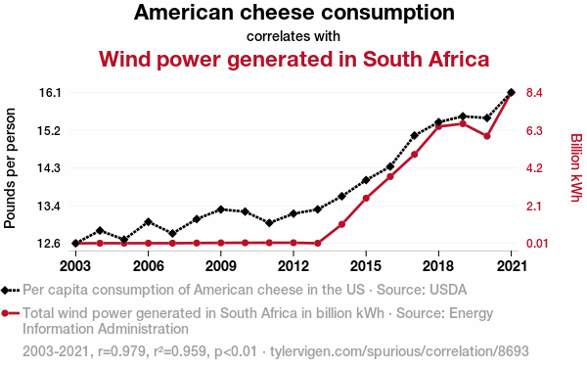
AIEd #5. Correlation ≠ Causation
“Correlation does not imply causation.” Cum hoc ergo propter hoc fallacy.
Two variables that do not always relate to each other in a cause-and-effect relationship.

Slide 93
AIEd #5. Correlation ≠ Causation
Because AI is designed to predict text based on where those words occurred in its training data, it tends to identify meaningful patters between unrelated things.

Slide 94
AIEd #6. Bias
AI is not neutral.
AI is trained on human data, so will reflect the biases and prejudices of the humans who coded it, trained it, and continue to fund it.

Slide 95
AIEd #7. Using AI in Research?
AI is good for noticing patters in a specific set of data. If you control the data and know how to manage the AI search inquiries, it can be a helpful tool.
AI chat bots are still so new (2022) and they are constantly adapting, so standards and peer-reviewed evaluation of them for research is in its beginning stages.
How do you think AI chat bots should be used in your research?

Slide 96
AIEd #7. Using AI in Research?
AI is good for noticing patters in a specific set of data. If you control the data and know how to manage the AI search inquiries, it can be a helpful tool.
How do you think AI chat bots should be used in your research?
  First Steps/Anything Goes, Nothing Stays.
  As a way to track down sources.
  Or not at all.
  Are they primary, secondary, tertiary sources, or some other type of resource?

Slide 97
AIEd: Recent Research – Wharton Study
Melumad, Shiri and Jin Ho Yun. “Experimental Evidence of the Effects of Large Language Models versus Web Search on Depth of Learning (January 20, 2025). The Wharton School Research Paper. https://dx.doi.org/10.2139/ssrn.5104064
  Abstract: “The effects of using large language models (LLMs) versus traditional web search on depth of learning are explored. Results from four online and laboratory experiments (N = 4,591) lend support for the predictions that when individuals learn about a topic from LLMs, they tend to develop shallower knowledge than when they learn through standard web search, even when the core information in the results is the same. This shallower knowledge accrues from an inherent feature of LLMs—the presentation of results as syntheses of information rather than individual search links—which makes learning more passive than in standard web search, where users actively discover and synthesize information sources themselves. In turn, when subsequently forming advice on the topic based on what they learned, those who learned from LLM syntheses (vs. standard search results) feel less invested in forming their advice and, more importantly, create advice that is sparser, less original—and ultimately less likely to be adopted by recipients. Implications of the findings for recent research on the benefits and risks of LLMs are discussed.”

Slide 98
AIEd: Recent Research – MIT Study
Kosmyna, Natalia, et al. “Your Brain on ChatGPT: The Accumulation of Cognitive Debt when Using an AI Assistant for Essay Writing Task” PrePrint Paper. Jun 10, 2025. https://doi.org/10.48550/arXiv.2506.08872, https://arxiv.org/pdf/2506.08872
  Abstract: “We assigned participants to three groups: LLM group, Search Engine group, Brain-only group, where each participant used a designated tool (or no tool in the latter) to write an essay. We conducted 3 sessions with the same group assignment for each participant. In the 4th session we asked LLM group participants to use no tools (we refer to them as LLM-to-Brain), and the Brain-only group participants were asked to use LLM (Brain-to-LLM).
  We used electroencephalography (EEG) to record participants' brain activity in order to assess their cognitive engagement and cognitive load, and to gain a deeper understanding of neural activations during the essay writing task. We performed NLP analysis, and we interviewed each participant after each session. We performed scoring with the help from the human teachers and an AI judge (a specially built AI agent).”

Slide 99
AIEd: Recent Research – MIT Study
Kosmyna, Natalia, et al. “Your Brain on ChatGPT: The Accumulation of Cognitive Debt when Using an AI Assistant for Essay Writing Task” PrePrint Paper. Jun 10, 2025. https://doi.org/10.48550/arXiv.2506.08872, https://arxiv.org/pdf/2506.08872
  Abstract: “As the educational impact of LLM use only begins to settle with the general population, in this preliminary study we demonstrate the pressing matter to explore further any potential changes in learning skills based on the results of our study. The use of LLM had a measurable impact on our participants, and while the benefits were initially apparent, as we demonstrated over the course of 4 sessions, which took place over 4 months, the LLM group's participants performed worse than their counterparts in the Brain-only group at all levels: neural, linguistic, scoring.”

Slide 100
AIEd: Recent Research – MIT Study
Kosmyna, Natalia, et al. “Your Brain on ChatGPT: The Accumulation of Cognitive Debt when Using an AI Assistant for Essay Writing Task” PrePrint Paper. Jun 10, 2025. https://doi.org/10.48550/arXiv.2506.08872, https://arxiv.org/pdf/2506.08872
  One preliminary finding is, “When individuals fail to critically engage with a subject, their writing might become biased and superficial. This pattern reflects the accumulation of cognitive debt, a condition in which repeated reliance on external systems like LLMs replaces the effortful cognitive processes required for independent thinking. Cognitive debt defers mental effort in the short term but results in long-term costs, such as diminished critical inquiry, increased vulnerability to manipulation, decreased creativity. When participants reproduce suggestions without evaluating their accuracy or relevance, they not only forfeit ownership of the ideas but also risk internalizing shallow or biased perspectives.”

Slide 101
AIEd: Recent Research – Apple Study
Shojaee, Parshin, et al., “The Illusion of Thinking: Understanding the Strengths and Limitations of Reasoning Models via the Lens of Problem Complexity” Machine Learning Research, Apple. June 2025. https://ml-site.cdn-apple.com/papers/the-illusion-of-thinking.pdf
  Abstract: “Through extensive experimentation across diverse puzzles, we show that frontier LRMs [Large Reasoning Models] face a complete accuracy collapse beyond certain complexities.”
  Conclusion: “Our findings reveal fundamental limitations in current models: despite sophisticated self-reflection mechanisms, these models fail to develop generalizable reasoning capabilities beyond certain complexity thresholds. We identified three distinct reasoning regimes: standard LLMs outperform LRMs at low complexity, LRMs excel at moderate complexity, and both collapse at high complexity… These insights challenge prevailing assumptions about LRM capabilities and suggest that current approaches may be encountering fundamental barriers to generalizable reasoning. ”

Slide 102
Contents (review)
He Ruming, “The Dangers of Short Form Content.”
Turabian, “Sources”
Evaluating Sources for Reliability
Turabian: Engaging Your Sources
Arguments from Authority vs. Arguments from Data
Artificial Intelligence & Research

Slide 103
Workshop, Day 1
Work on Checklists for Evaluating Resources
Form groups of 2-3 people. (2-3 minutes)
Take 2 minutes for each person to share the topic/s you are researching. (6-8 minutes)
As a group, take 5 minutes per person to brainstorm potential search terms & biblical passages for each person in the group, that could help that person as they look for resources. (15 minutes)
Work Individually to develop a checklist for evaluating resources. It can be a list, a flowchart, or anything else. (10 minutes)
Meet your group and (15 minutes):
  Compare your checklists.
  Combine ideas to create a guide for how to evaluate resources.
Class discussion. We will share and discuss our checklists as a class (as time allows).

