Slide 1
Ancient Arts & Crafts: Material Culture from the Biblical World
Breakout Chapel 2024
Slides available at www.BibTheo.com/Breakout

Slide 2
Material Culture: Flesh on the Bones of History
Writing Station
  Pages, Pens, & Ink
Clay Station
  Oil Lamps, Scarabs, & Cylinder Seals
Broken Pottery
  Ancient Post-It Notes

Slide 3
1) Writing Station
Papyrus, Parchment, & Pens

Slide 4
Papyrus
Plant “paper”

Slide 5


Slide 6
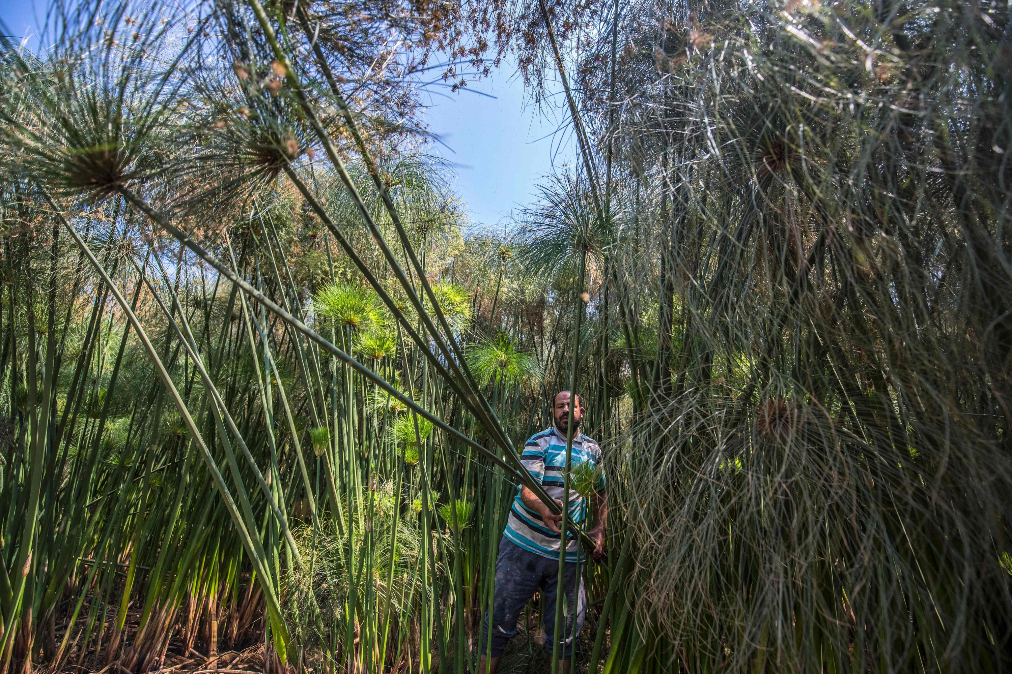
French Press Agency (APF). “Egyptian Villagers Sustain Tradition of Papyrus Making” Daily Sabah. Aug 9, 2021. https://www.dailysabah.com/arts/egyptian-villagers-sustain-tradition-of-papyrus-making/news.

Slide 7
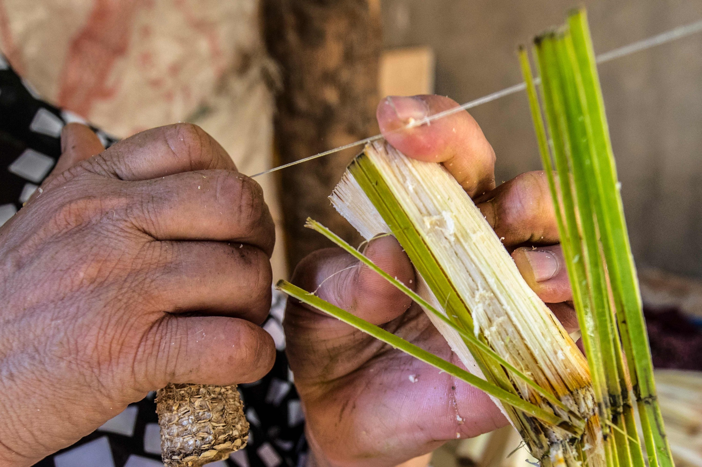
French Press Agency (APF). “Egyptian Villagers Sustain Tradition of Papyrus Making” Daily Sabah. Aug 9, 2021. https://www.dailysabah.com/arts/egyptian-villagers-sustain-tradition-of-papyrus-making/news.

Slide 8
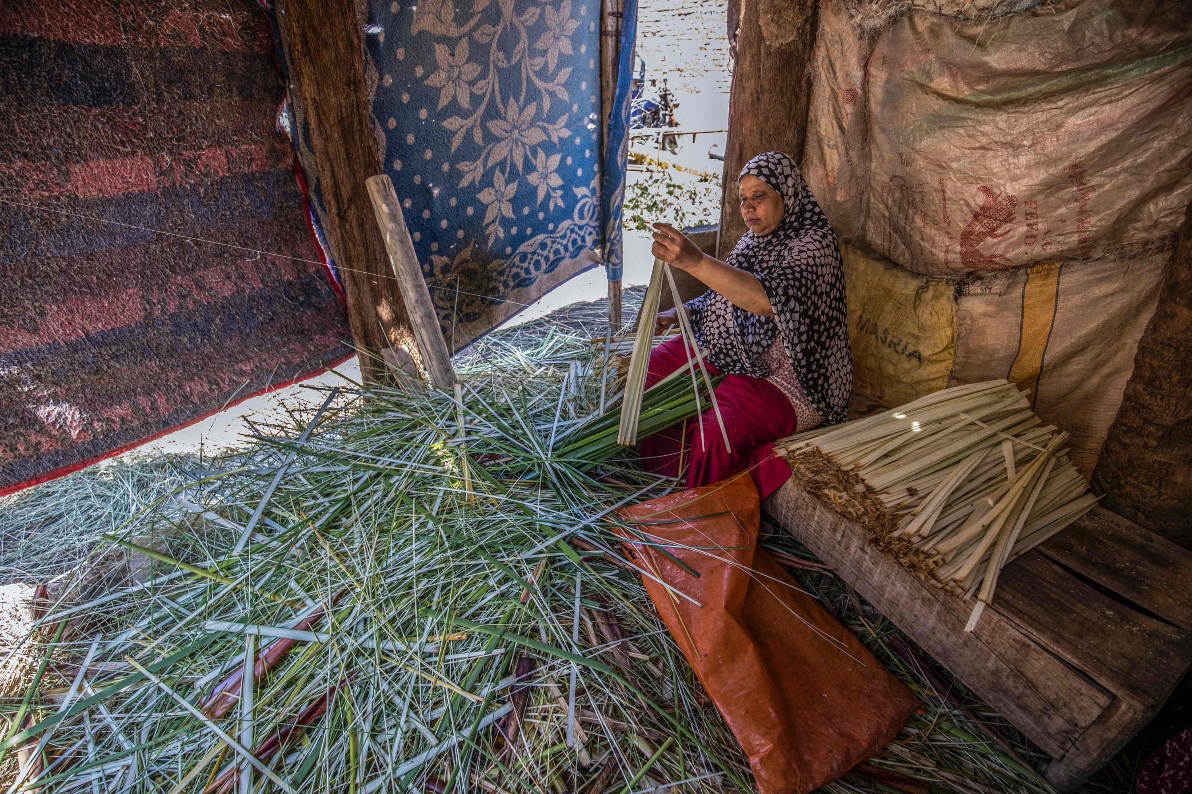
French Press Agency (APF). “Egyptian Villagers Sustain Tradition of Papyrus Making” Daily Sabah. Aug 9, 2021. https://www.dailysabah.com/arts/egyptian-villagers-sustain-tradition-of-papyrus-making/news.

Slide 9
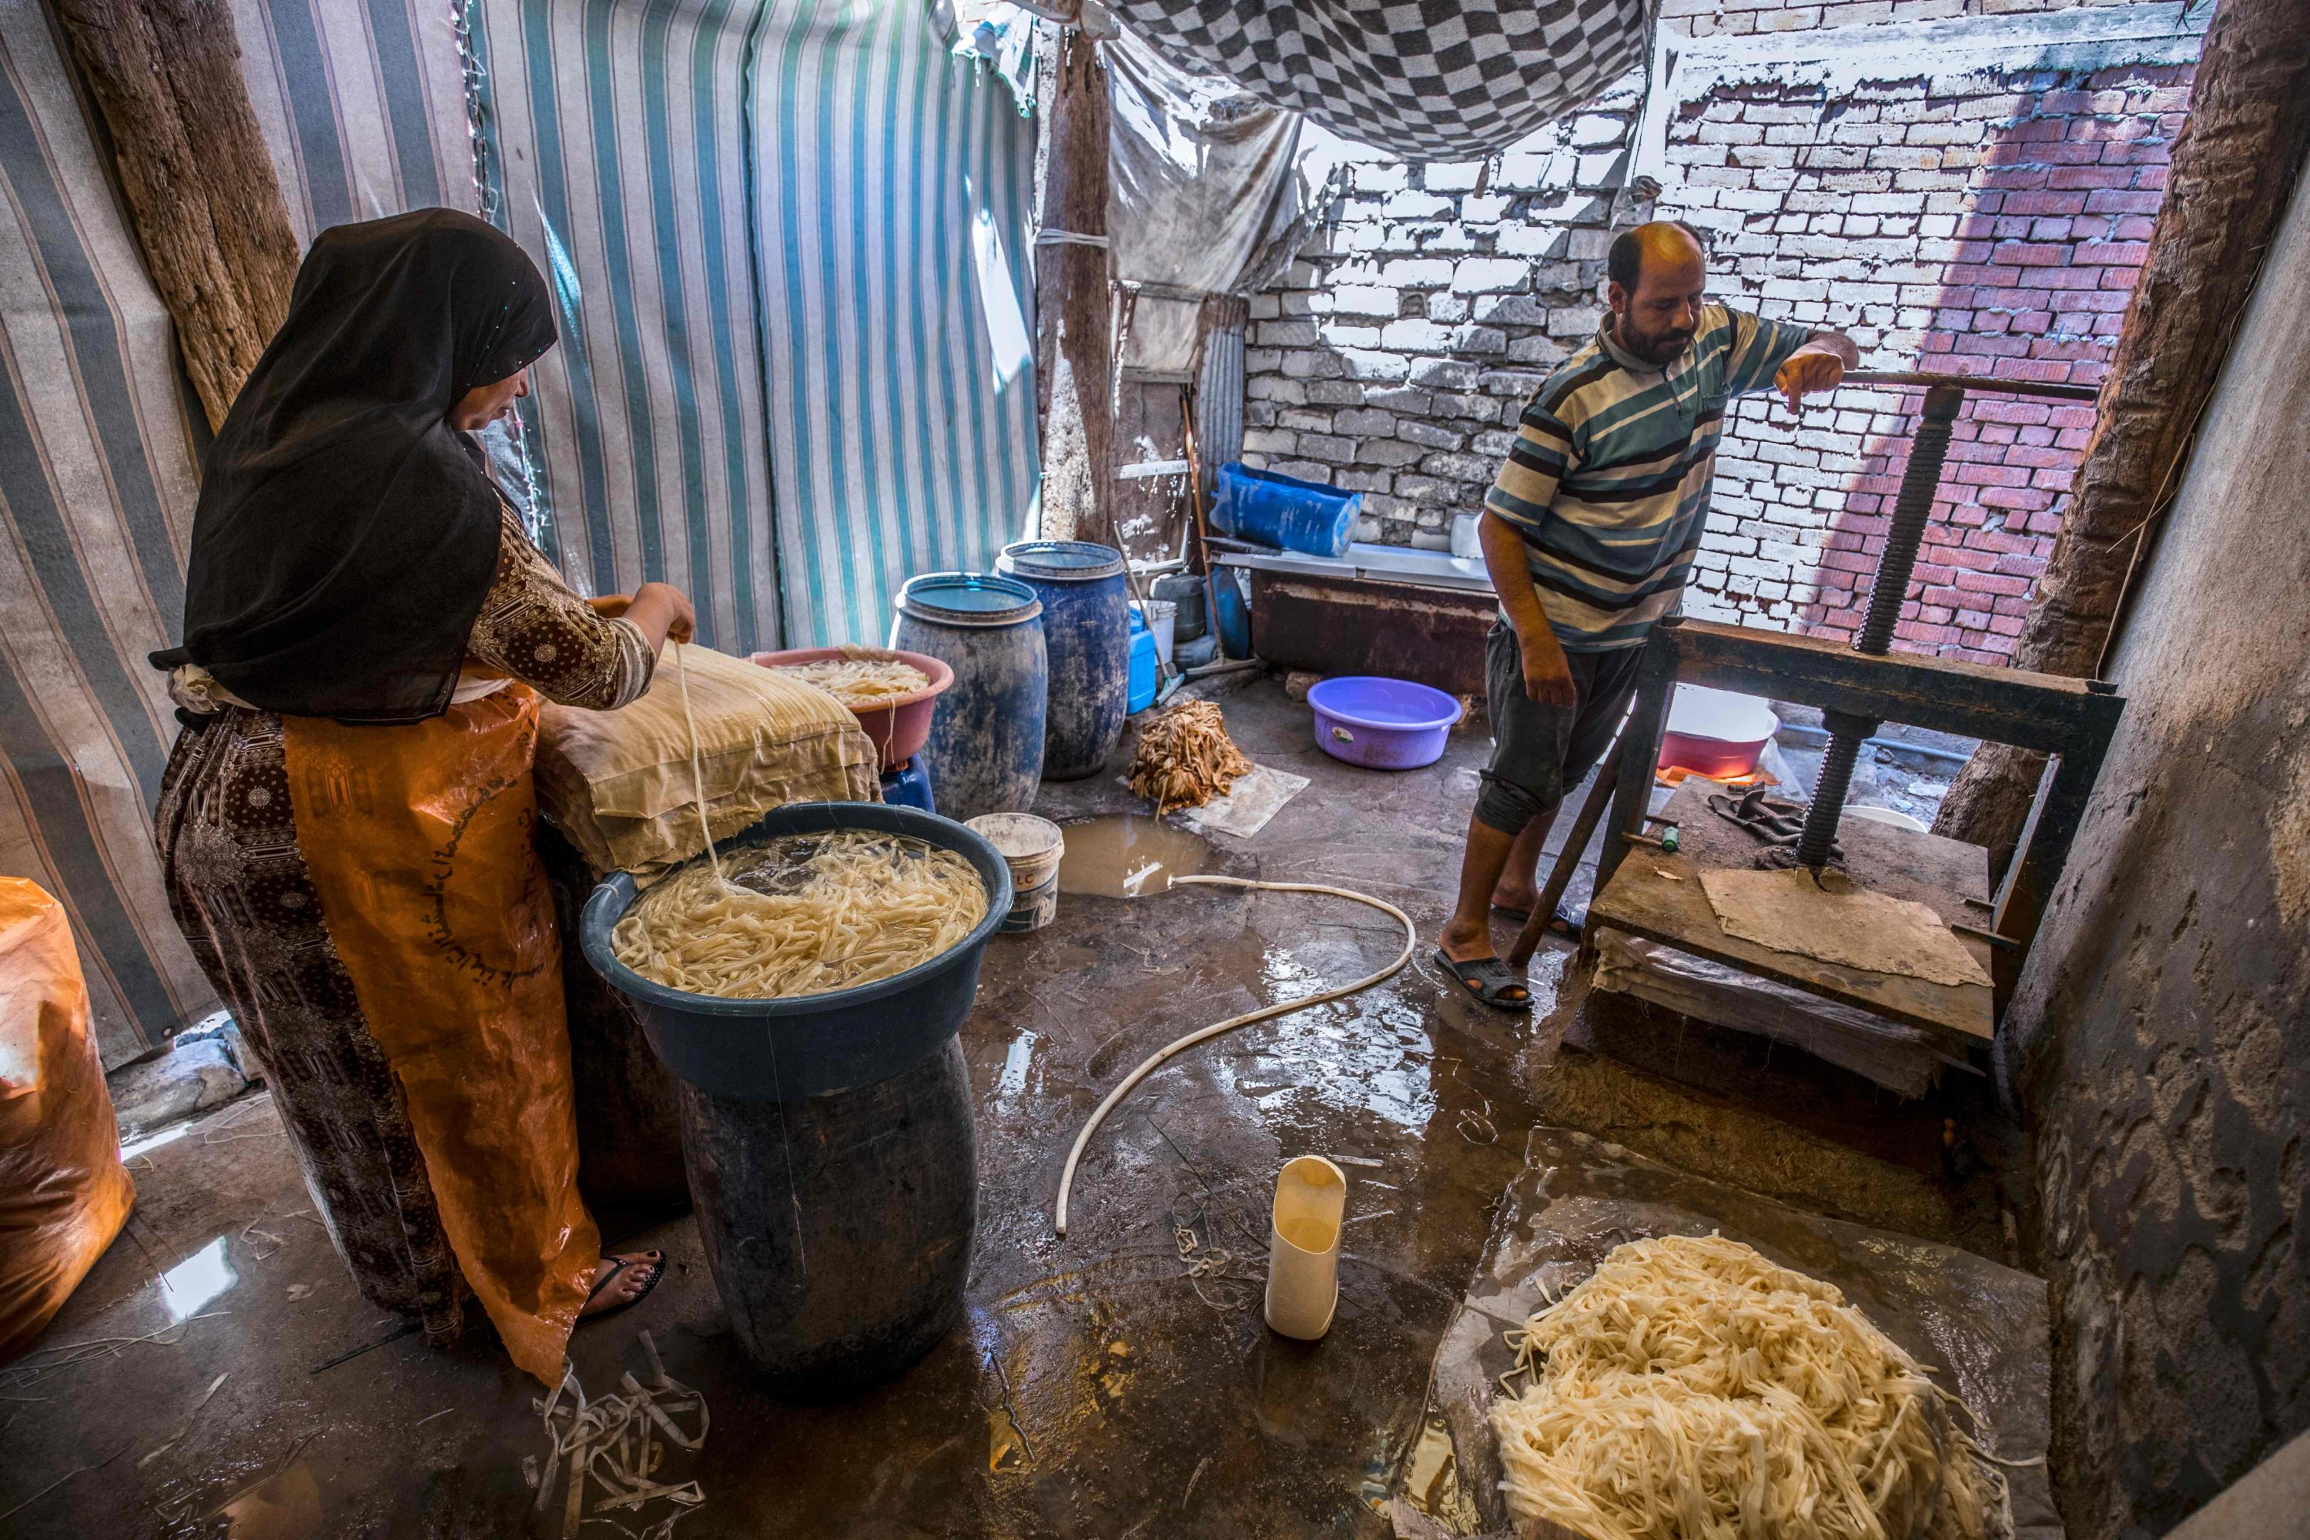
French Press Agency (APF). “Egyptian Villagers Sustain Tradition of Papyrus Making” Daily Sabah. Aug 9, 2021. https://www.dailysabah.com/arts/egyptian-villagers-sustain-tradition-of-papyrus-making/news.

Slide 10
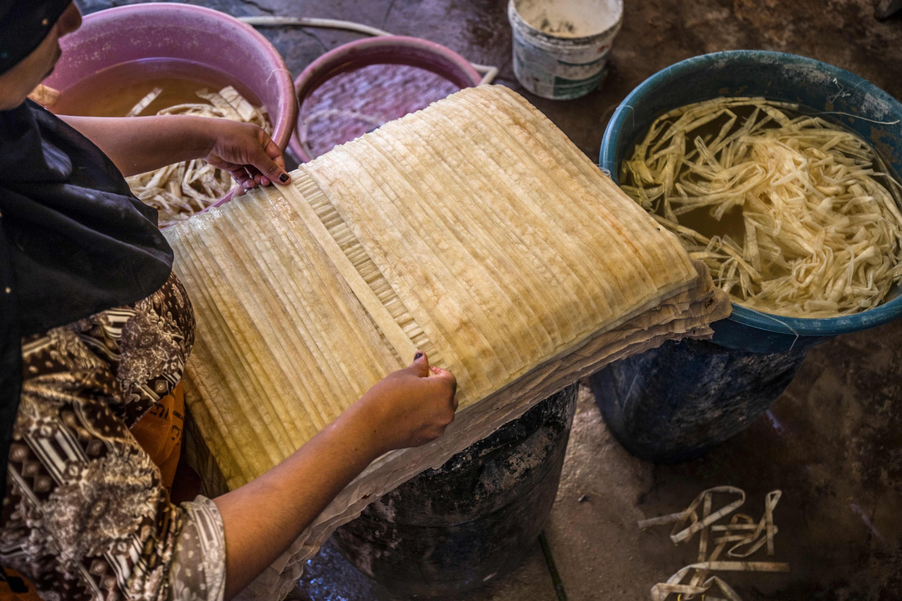
French Press Agency (APF). “Egyptian Villagers Sustain Tradition of Papyrus Making” Daily Sabah. Aug 9, 2021. https://www.dailysabah.com/arts/egyptian-villagers-sustain-tradition-of-papyrus-making/news.

Slide 11
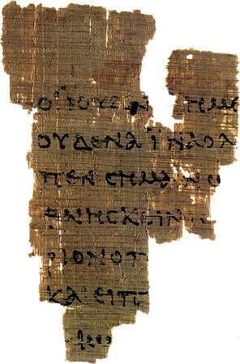
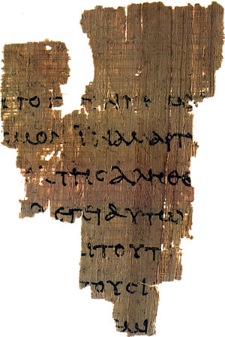
P 52 (John Rylands Library Papyrus)
John 18:31-33, 37, 38 c. AD 125

Slide 12
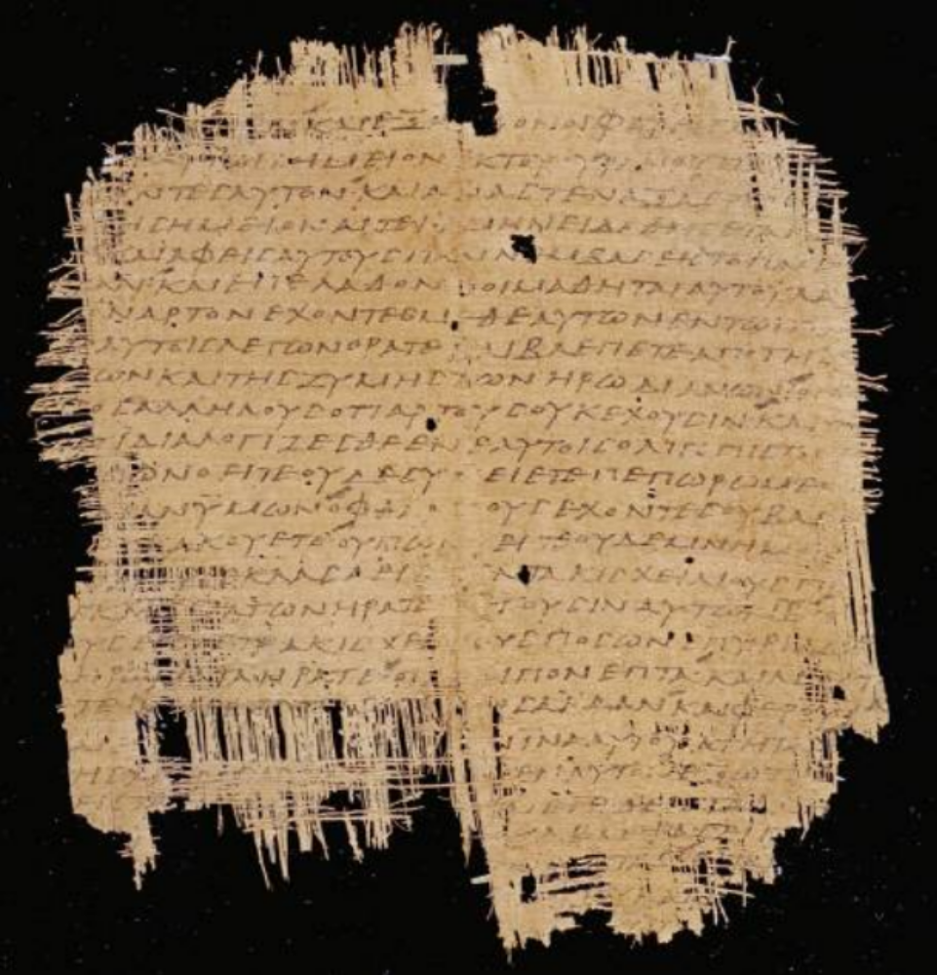
P 45 - Gospel of Mark (c. AD 250)

Slide 13
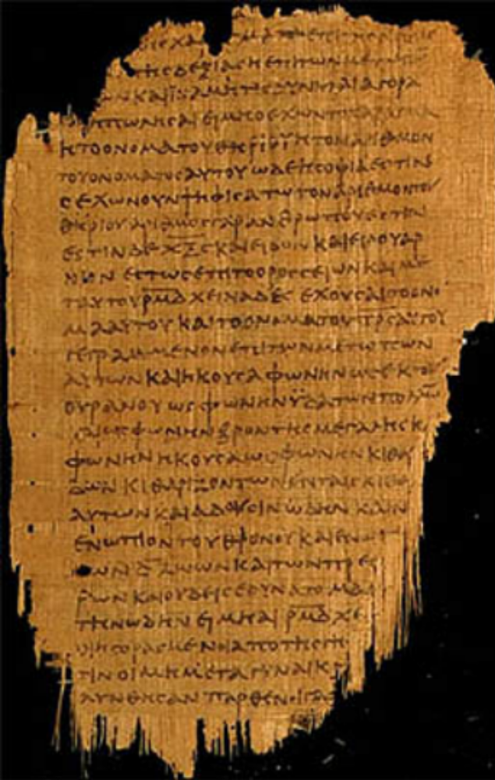
P 47 – Rev 9:10-17:2 (c. AD 250)

Slide 14
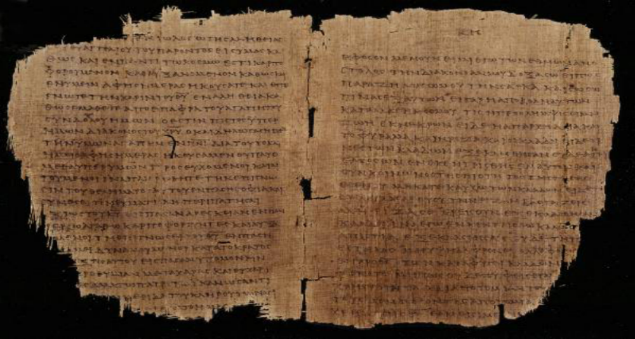
P 46-Romans (c.AD 200)

Slide 15
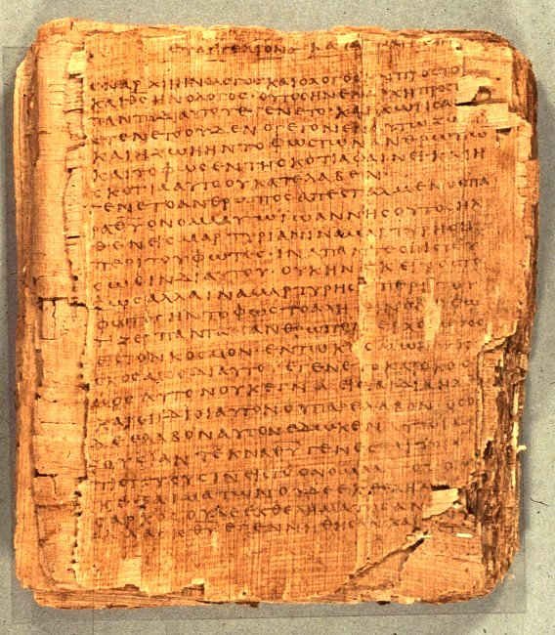
P 66 (Papyrus Bodmer 2) – Most of Gospel of John (c. AD 200)
75 leaves, 150 pages extant

Slide 16
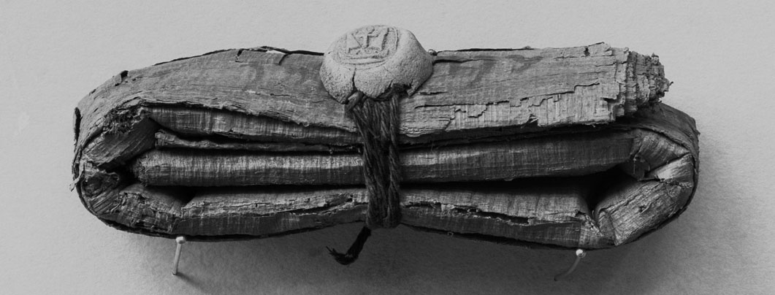
(bpk, Berlin / Aegyptisches Museum, Berlin / Art Resource, NY)
G. Walter Hansen, “Ancient Letter Writing” in The Eerdmans Companion to the Bible. Edited by Gordon D. Fee and Robert L. Hubbard. (Grand Rapids: Eerdmans, 2011), 640,

Slide 17
Parchment
Animal Skin “paper”

Slide 18
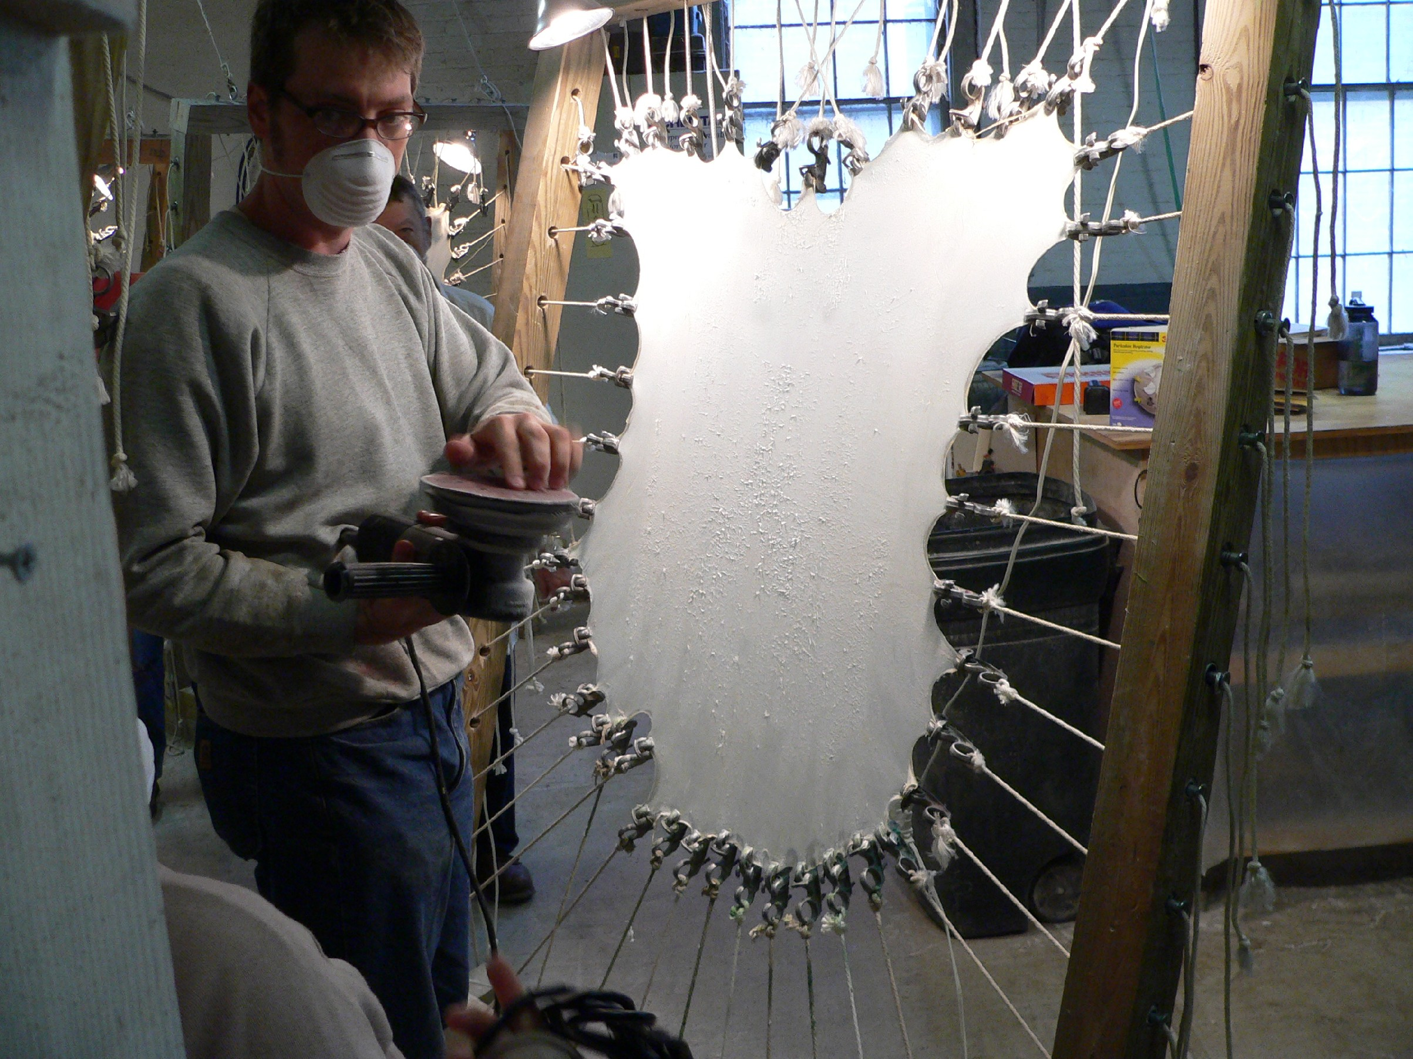
Michele Brown, “Parchment-making,” Cornell University Library Conservation, April 4, 2015, https://blogs.cornell.edu/culconservation/2015/04/03/parchment-making/

Slide 19
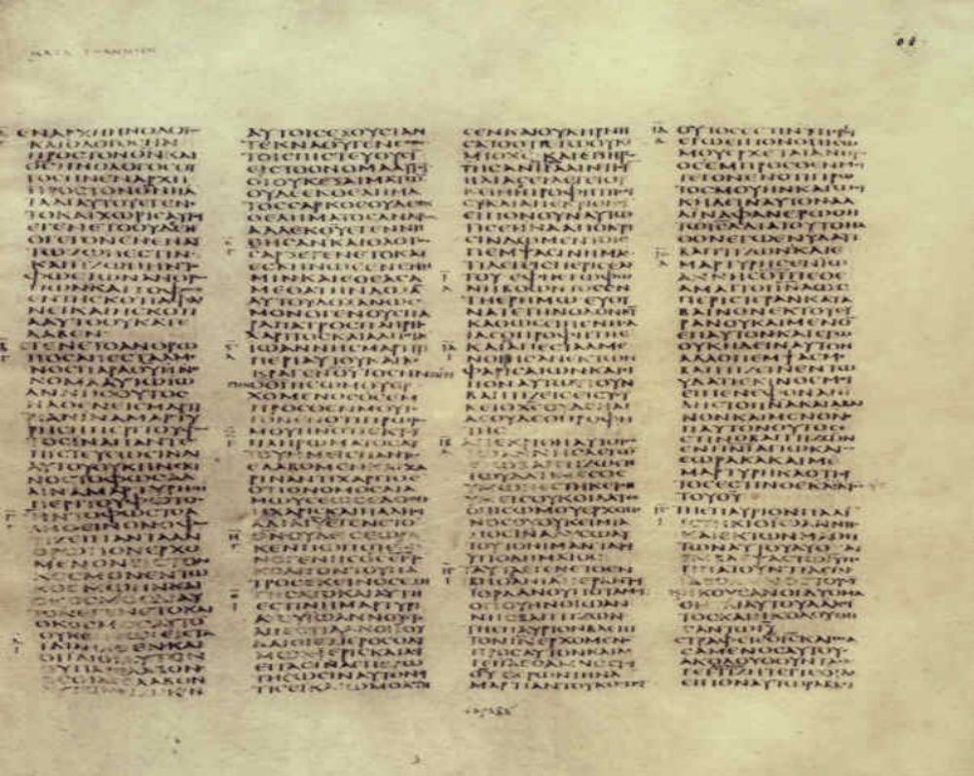
Codex Sinaiticus א c. 350 CE

Slide 20
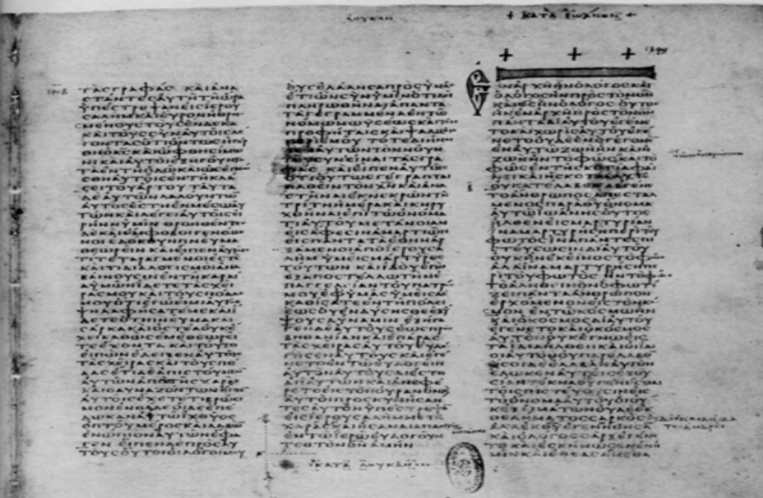
Codex Vaticanus (B) (c. 325-50 CE)

Slide 21
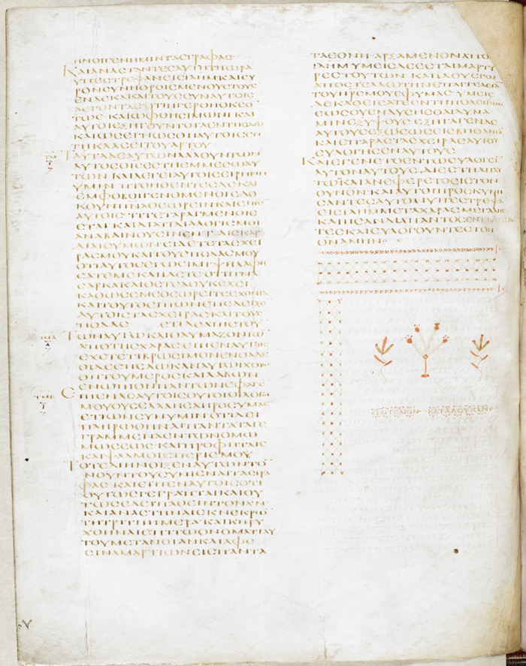
Codex Alexandrinus (A) (5th c. CE)

Slide 22
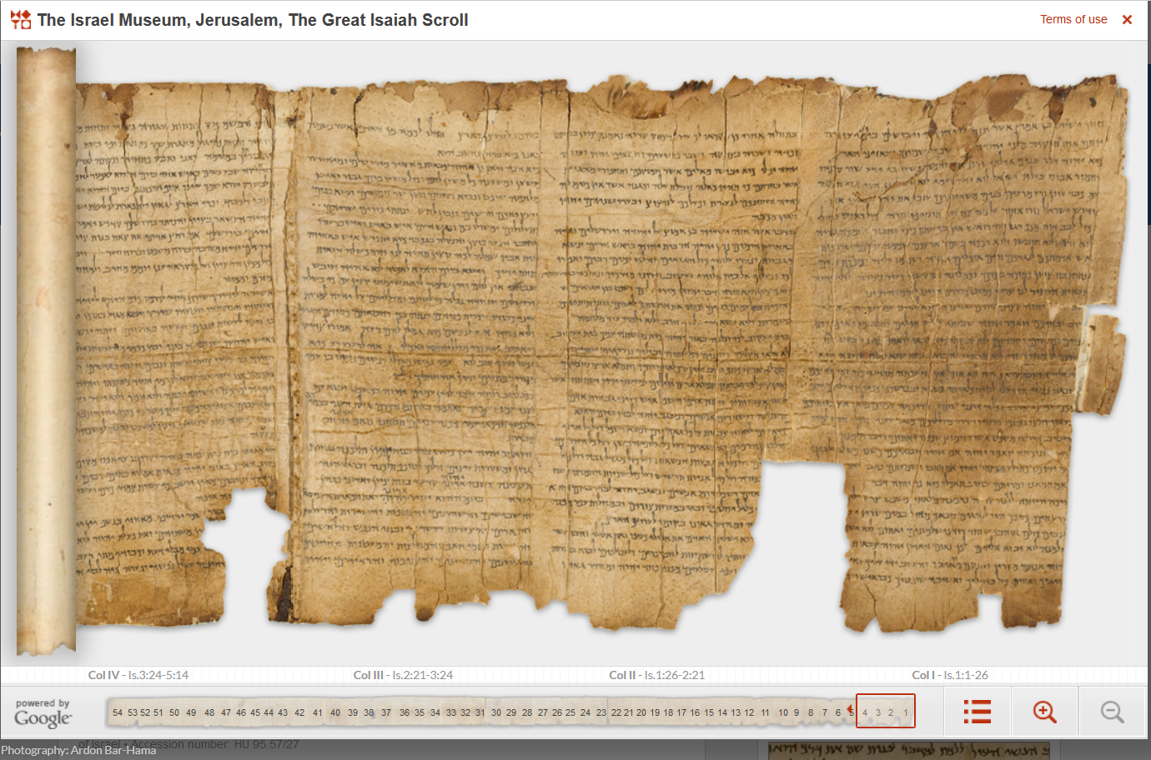
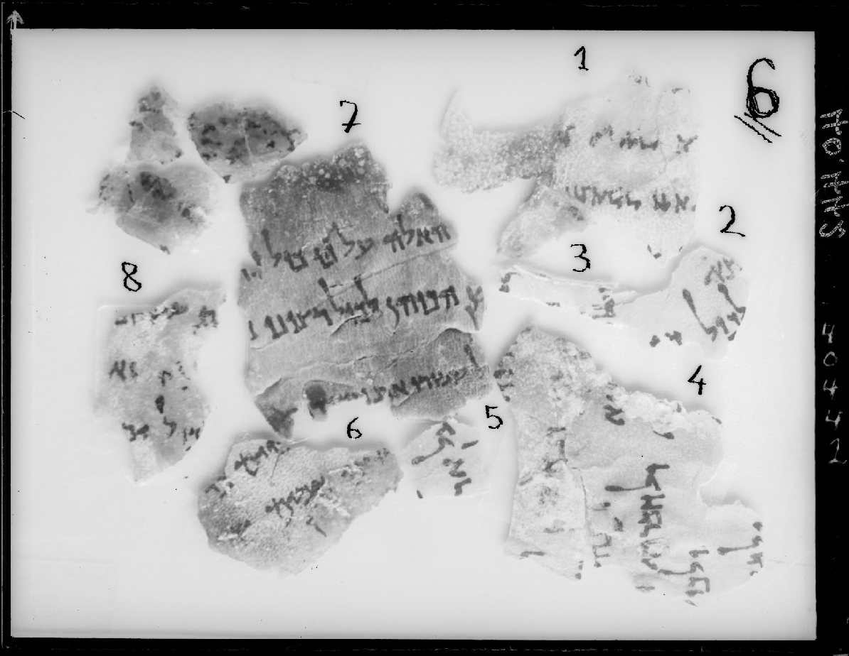
Dead Sea Scrolls – Genesis Fragments
1Q1, 1Q24, 1Q29
The Digital Dead Sea Scrolls http://dss.collections.imj.org.il/isaiah

Slide 23
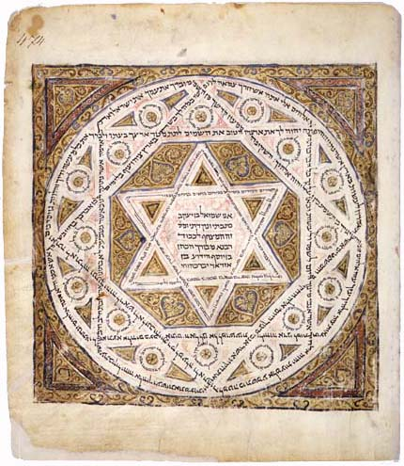
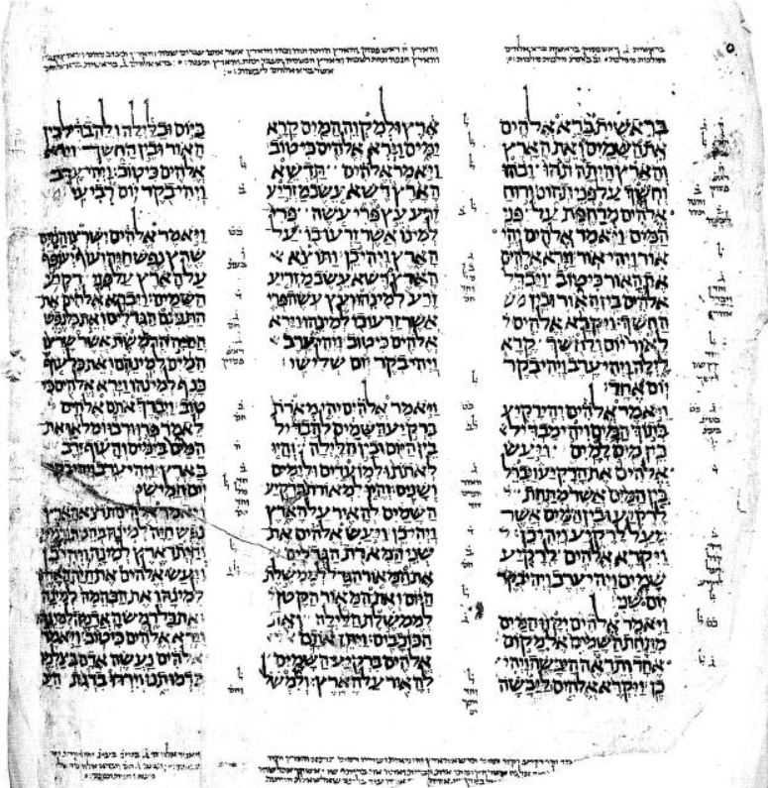
Codex Leningradensis – Hebrew Bible (c. AD 1008)

Slide 24
Writing Materials
Rush paintbrushes, Reed styluses

Slide 25
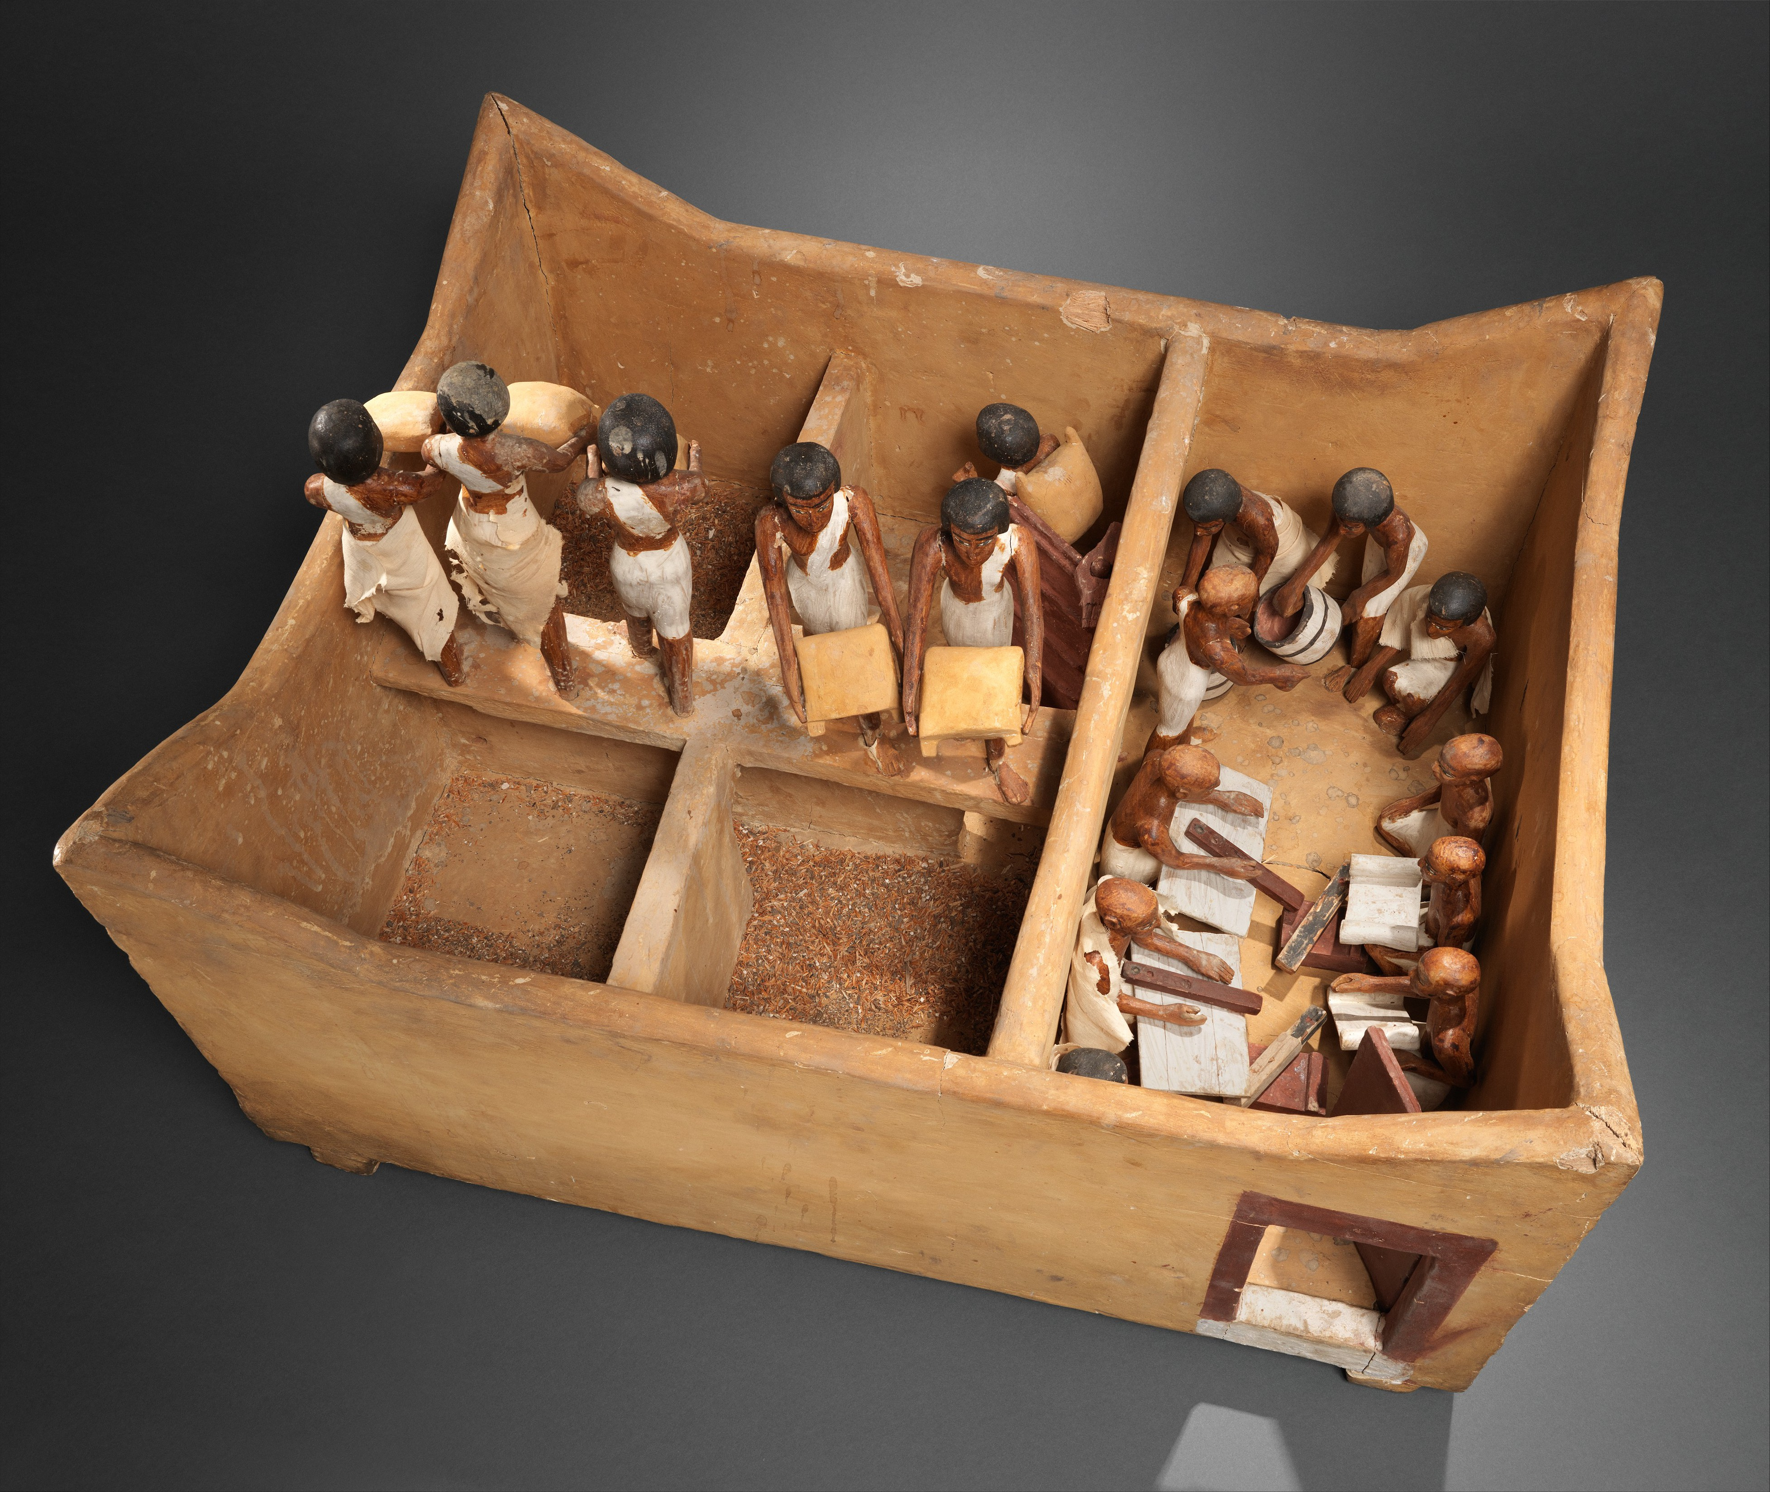
Meketre’s Model Granary
c. 1981-1975 B.C.
Metropolitan Museum of Art
Arnold, Dorothea 2005. "The Architecture of Meketre's Slaughterhouse and Other Early Twelfth Dynasty Wooden Models." In Structure and Significance in Egyptian Architecture: Thoughts on Ancient Egyptian Architecture [Festschrift Dieter Arnold], 33, pp. 27, 35, 49n195, 50 and generally pl. IV.7.

Slide 26
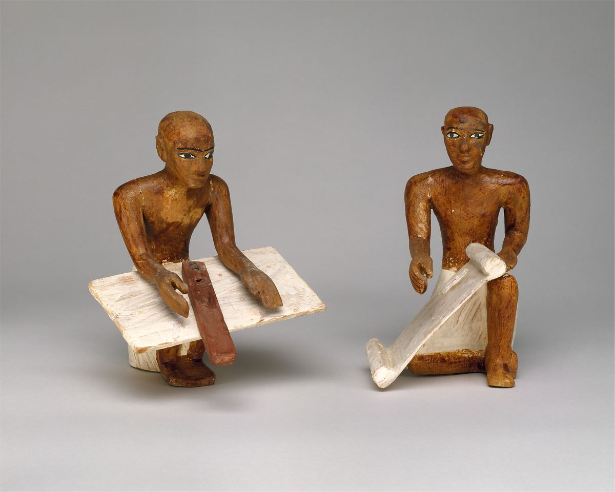
Scribes from Meketre’s Model Granary
c. 1981-1975 B.C.
Metropolitan Museum of Art
Arnold, Dorothea 2005. "The Architecture of Meketre's Slaughterhouse and Other Early Twelfth Dynasty Wooden Models." In Structure and Significance in Egyptian Architecture: Thoughts on Ancient Egyptian Architecture [Festschrift Dieter Arnold], 33, pp. 27, 35, 49n195, 50 and generally pl. IV.7.

Slide 27
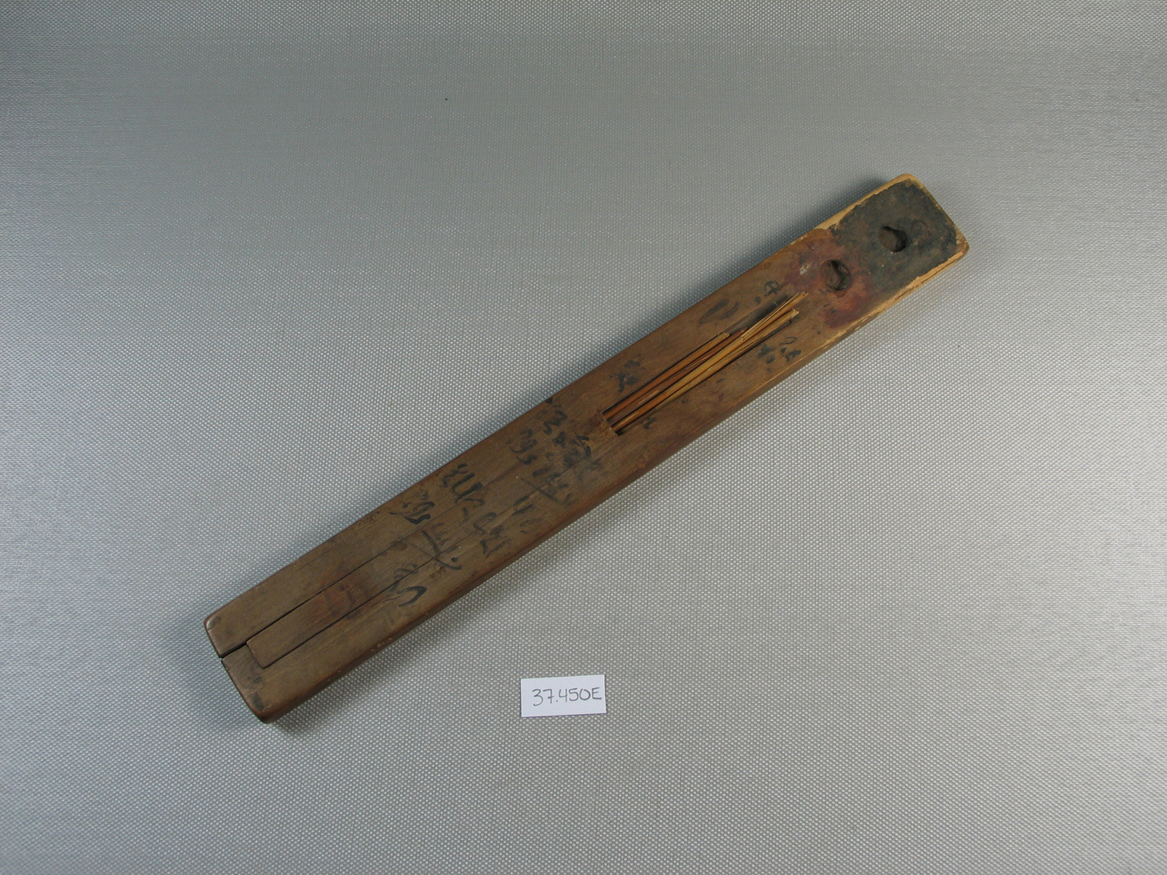
Egyptian Scribe’s Palette
Scribe's Palette with Four Reeds, ca. 1539-1075 B.C.E. Wood, reed, ink, 3/8 x 1 1/2 x 11 1/4 in. (0.9 x 3.8 x 28.5 cm). Brooklyn Museum, Charles Edwin Wilbour Fund, 37.450E. Creative Commons-BY (Photo: Brooklyn Museum, CUR.37.450E_view1.jpg)

Slide 28
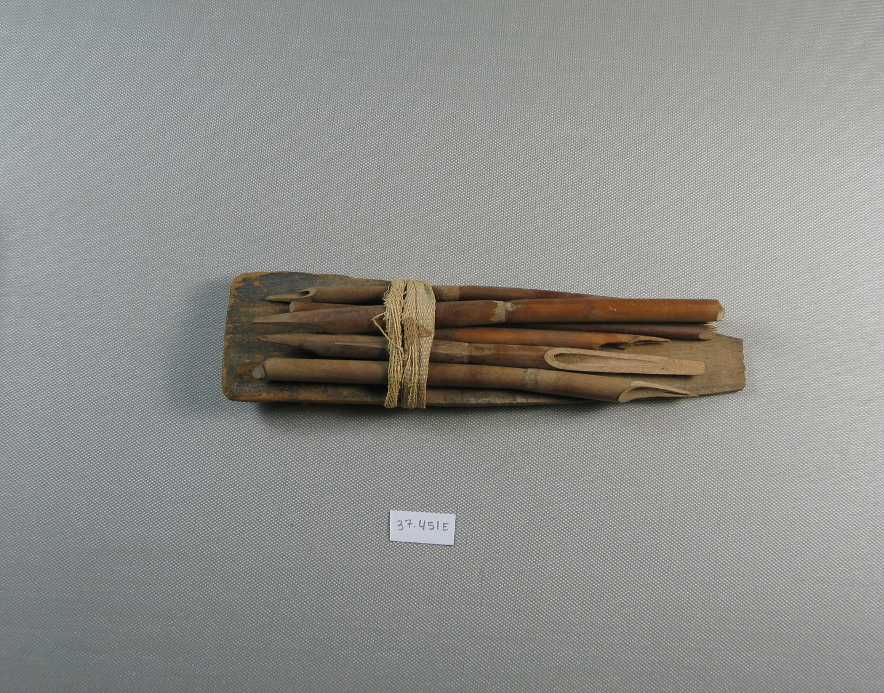
Scribe’s Stylus Bundle
Scribe's Tool Bundle, ca. 1539-1075 B.C.E., or later. Wood, reed, linen, 37.451Ea palette: 2 3/8 × 3/16 × 9 in. (6 × 0.4 × 22.8 cm). Brooklyn Museum, Charles Edwin Wilbour Fund, 37.451Ea-h. Creative Commons-BY (Photo: Brooklyn Museum, 37.451E_SL4.jpg)

Slide 29
2) Clay Station
Oil Lamps, Scarabs, & Cylinder Seals

Slide 30
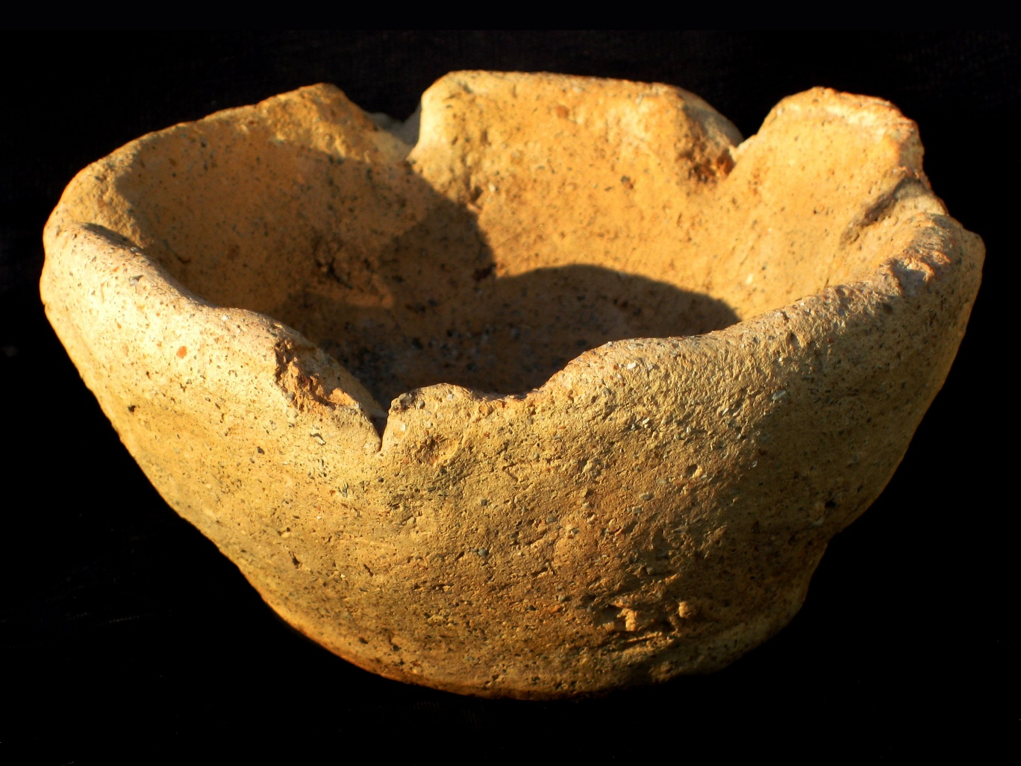
Early Bronze Age (3300-3000 bce)
6 spout
Unless otherwise noted, oil-lamp images curtesy of “Ken Baumheckel Collection of Oil Lamps,” Ancient Coin Club of Los Angeles. Online: http://www.accla.org/actaaccla/oillamps2010.html

Slide 31
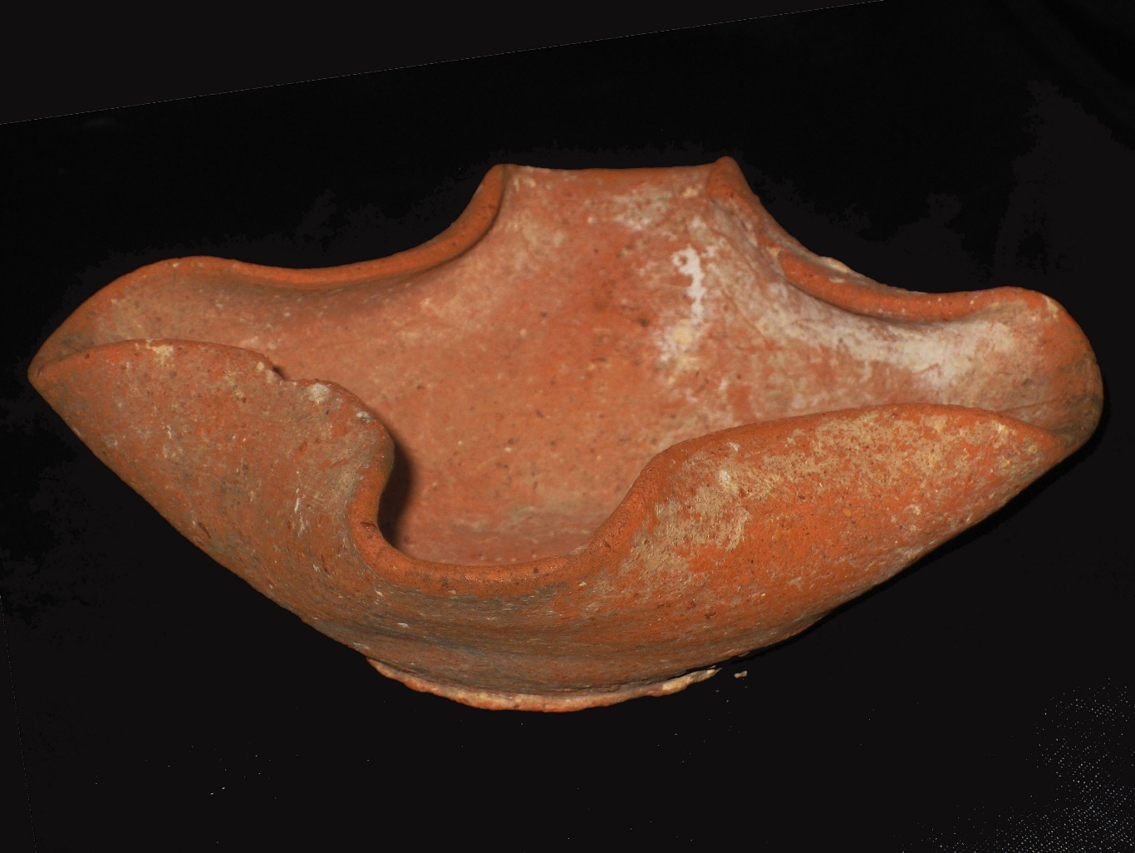
Middle Bronze Age (2200-1750)
4 spout

Slide 32
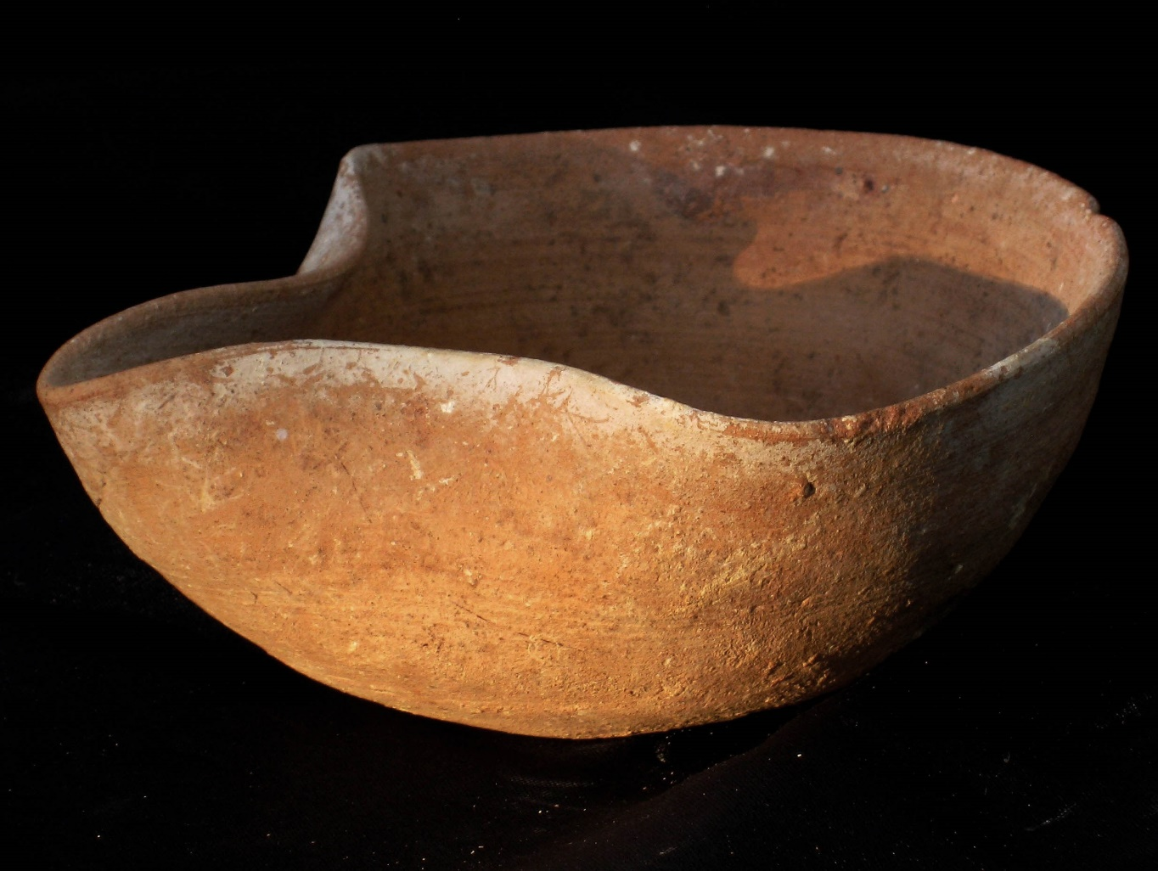
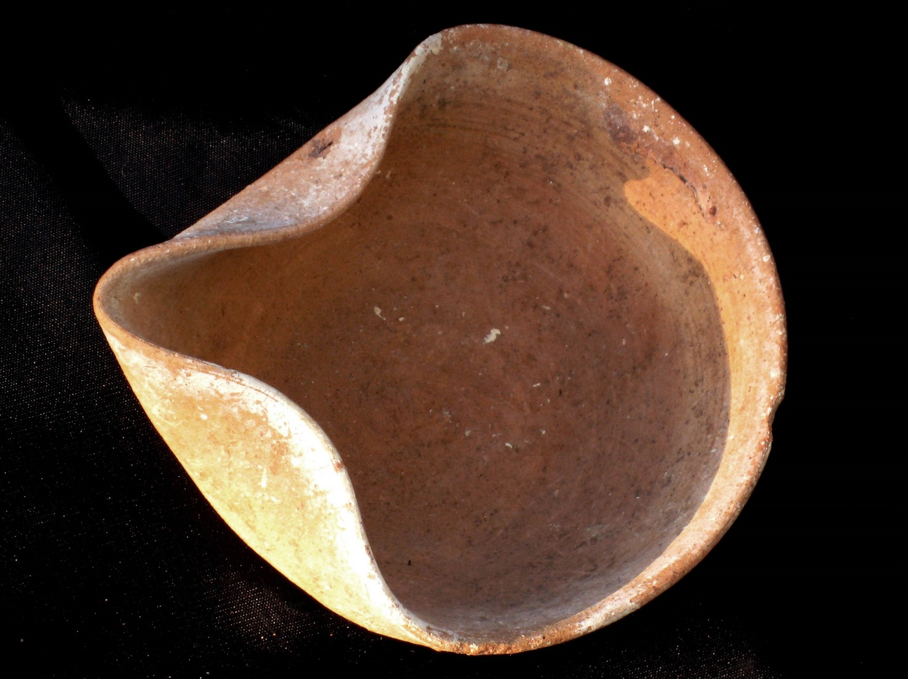
Middle Bronze Age I (2200-1750 bce)
Single spout

Slide 33
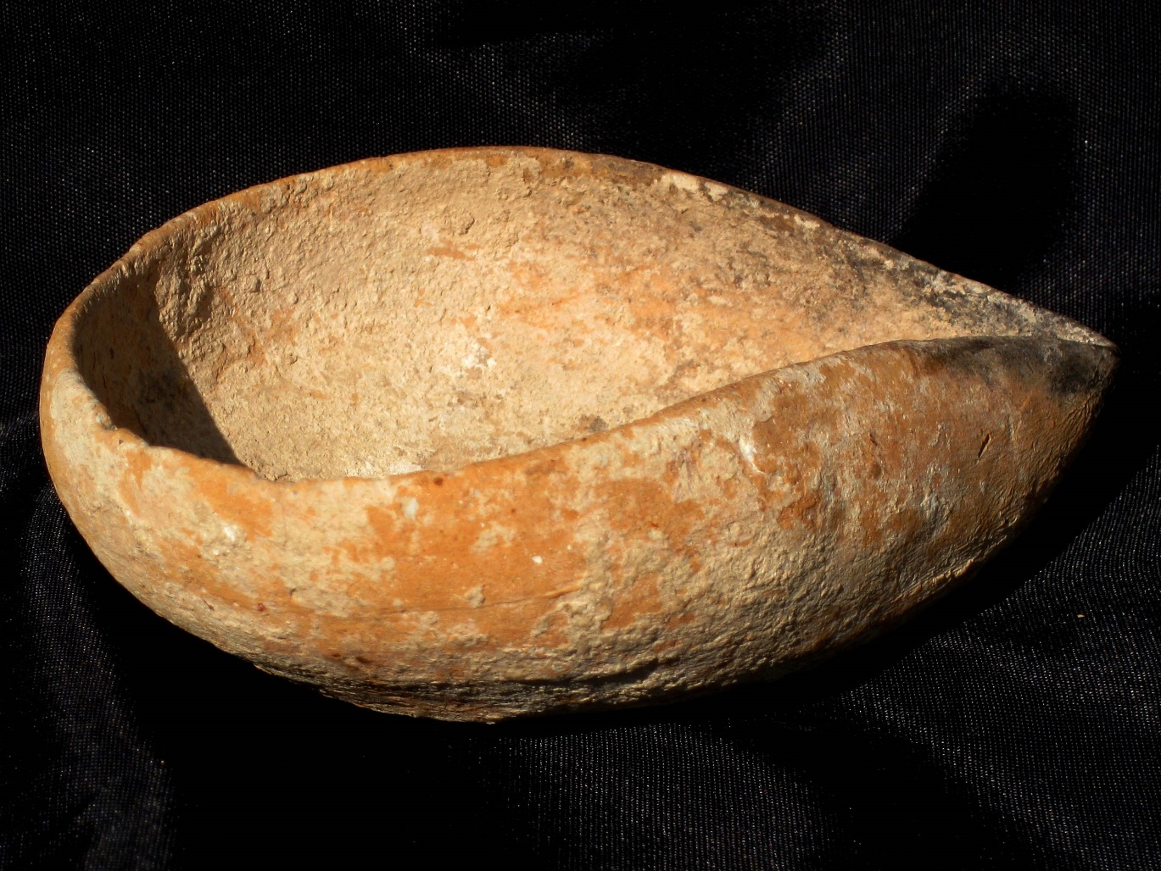
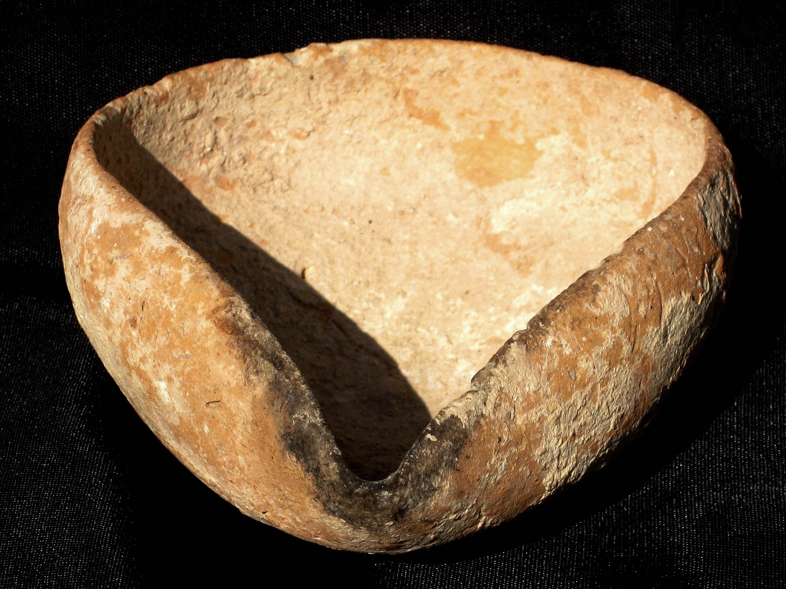
Middle Bronze Age (2200-1550 bce)

Slide 34
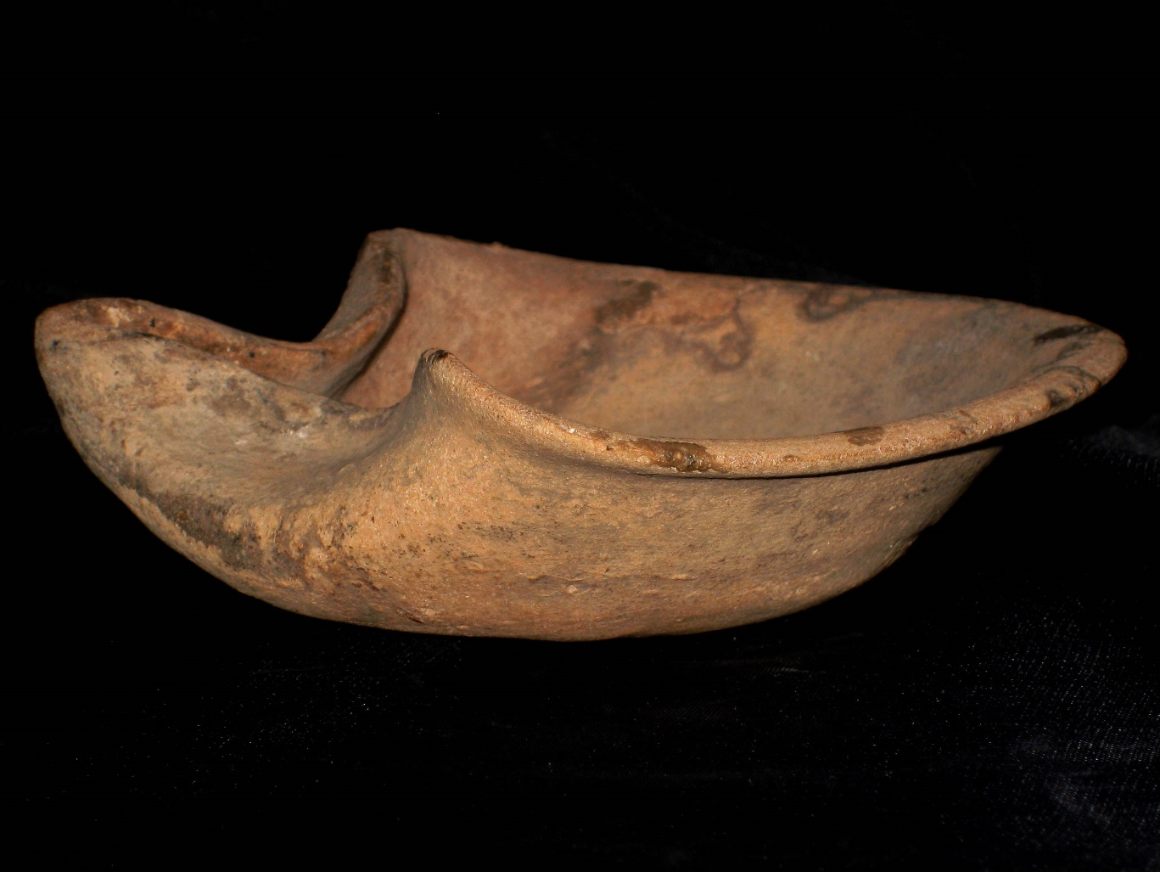
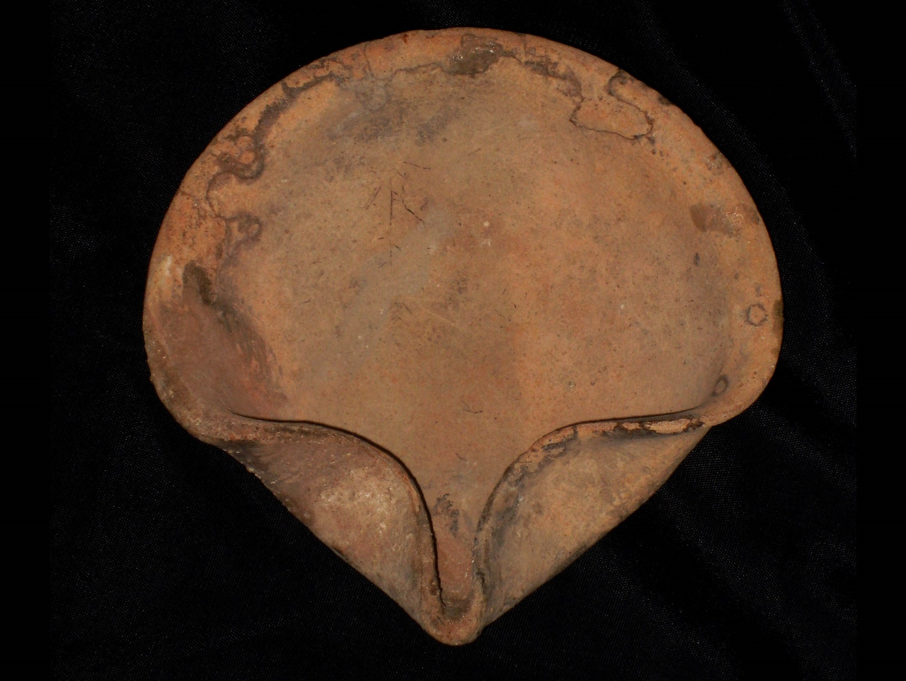
Late Bronze Age II (1400-1200 bce)

Slide 35
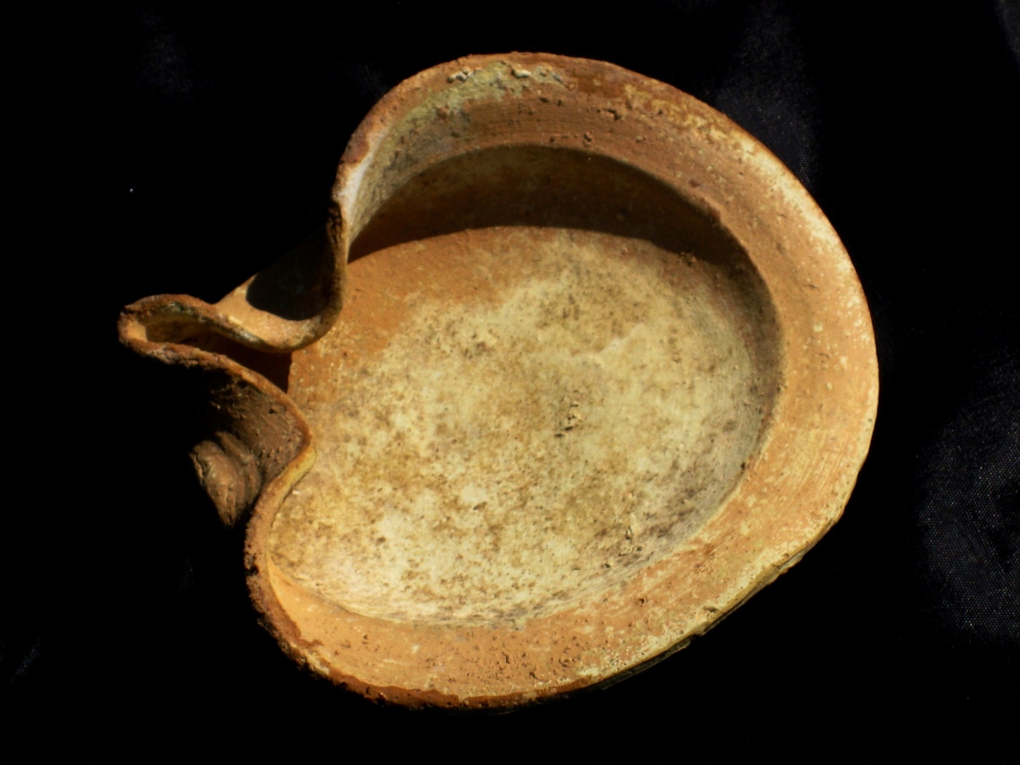
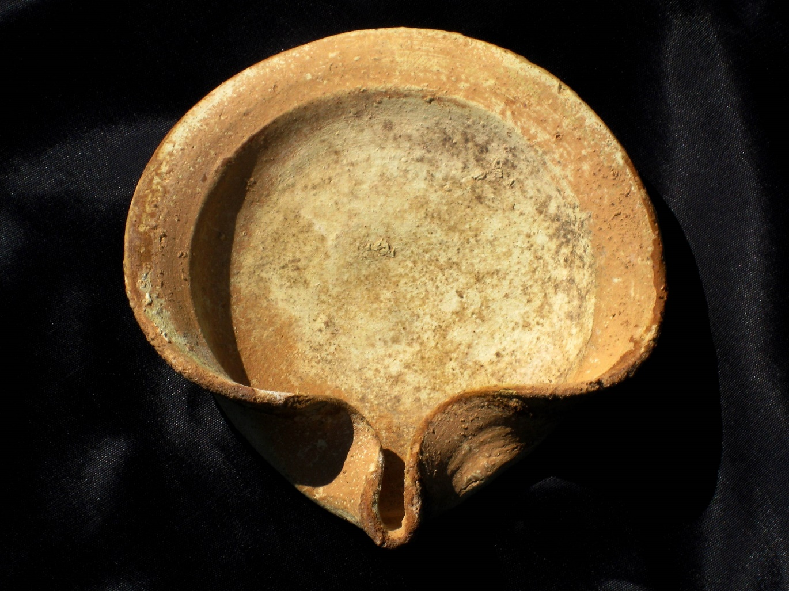
Persian Period (600-400 bce)

Slide 36
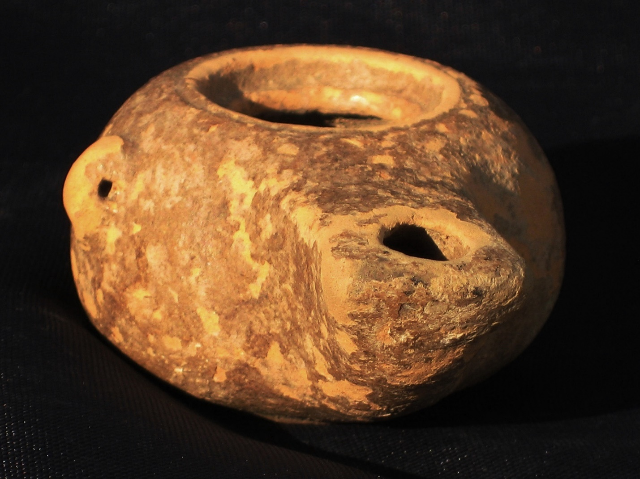
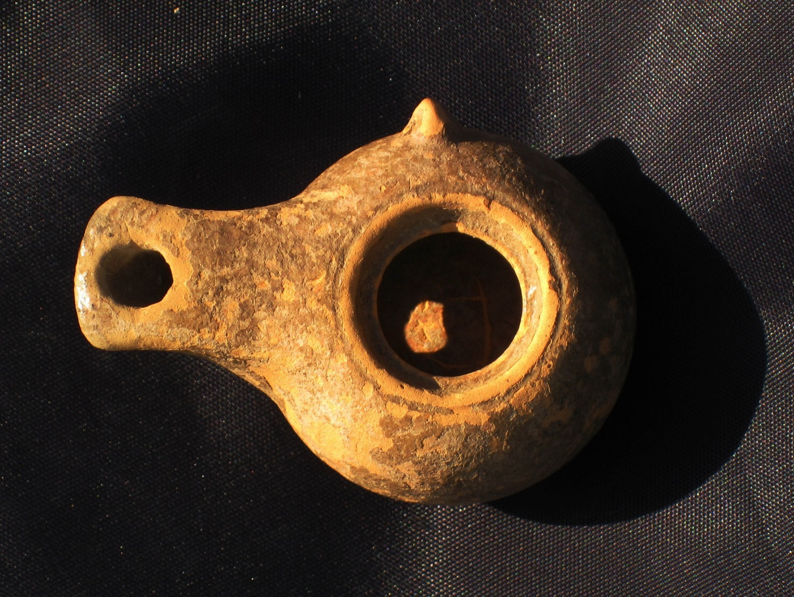
Hellenistic Wheel-made (3rd c. bce)

Slide 37
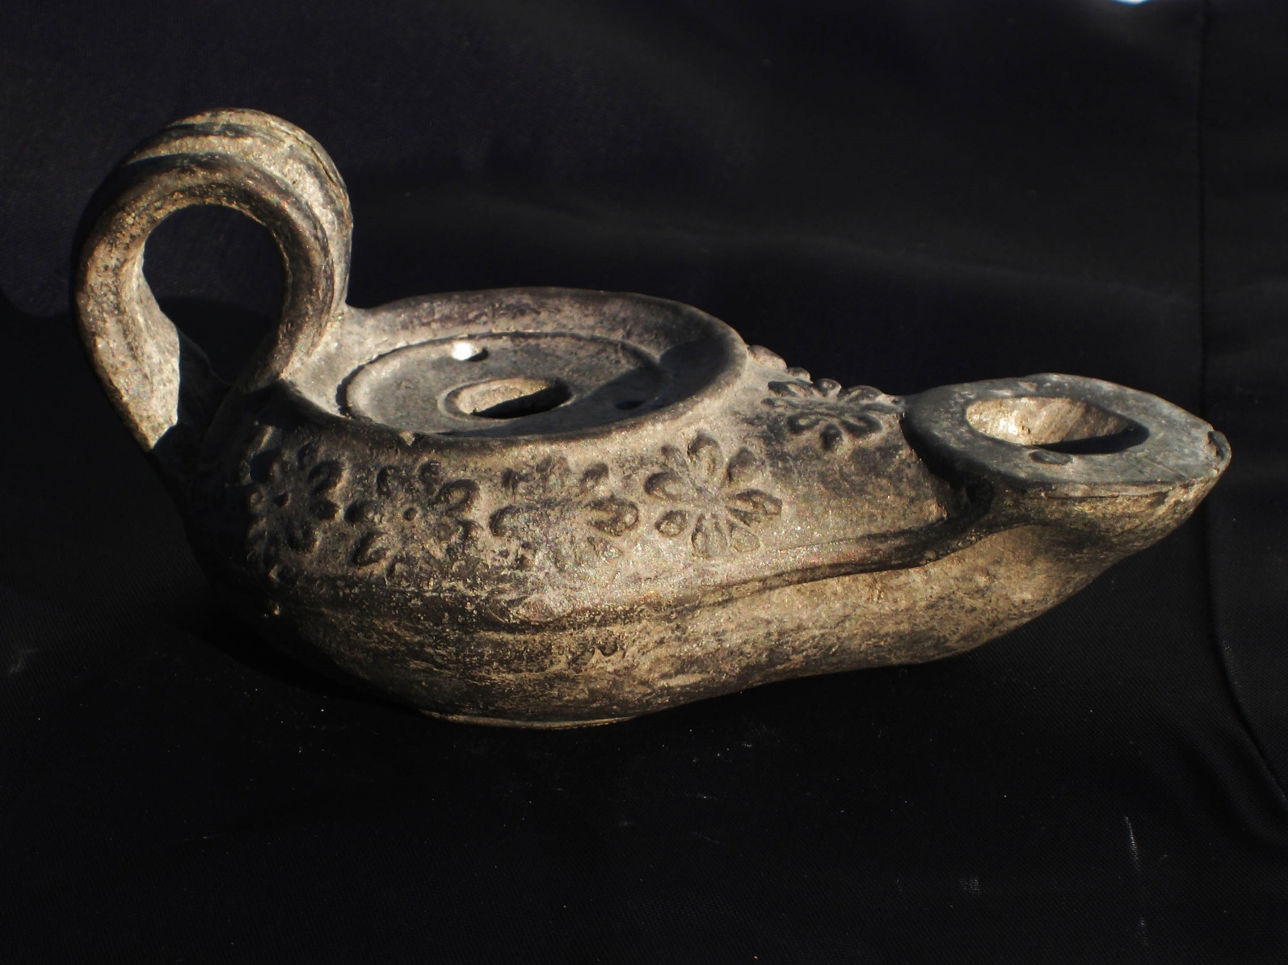
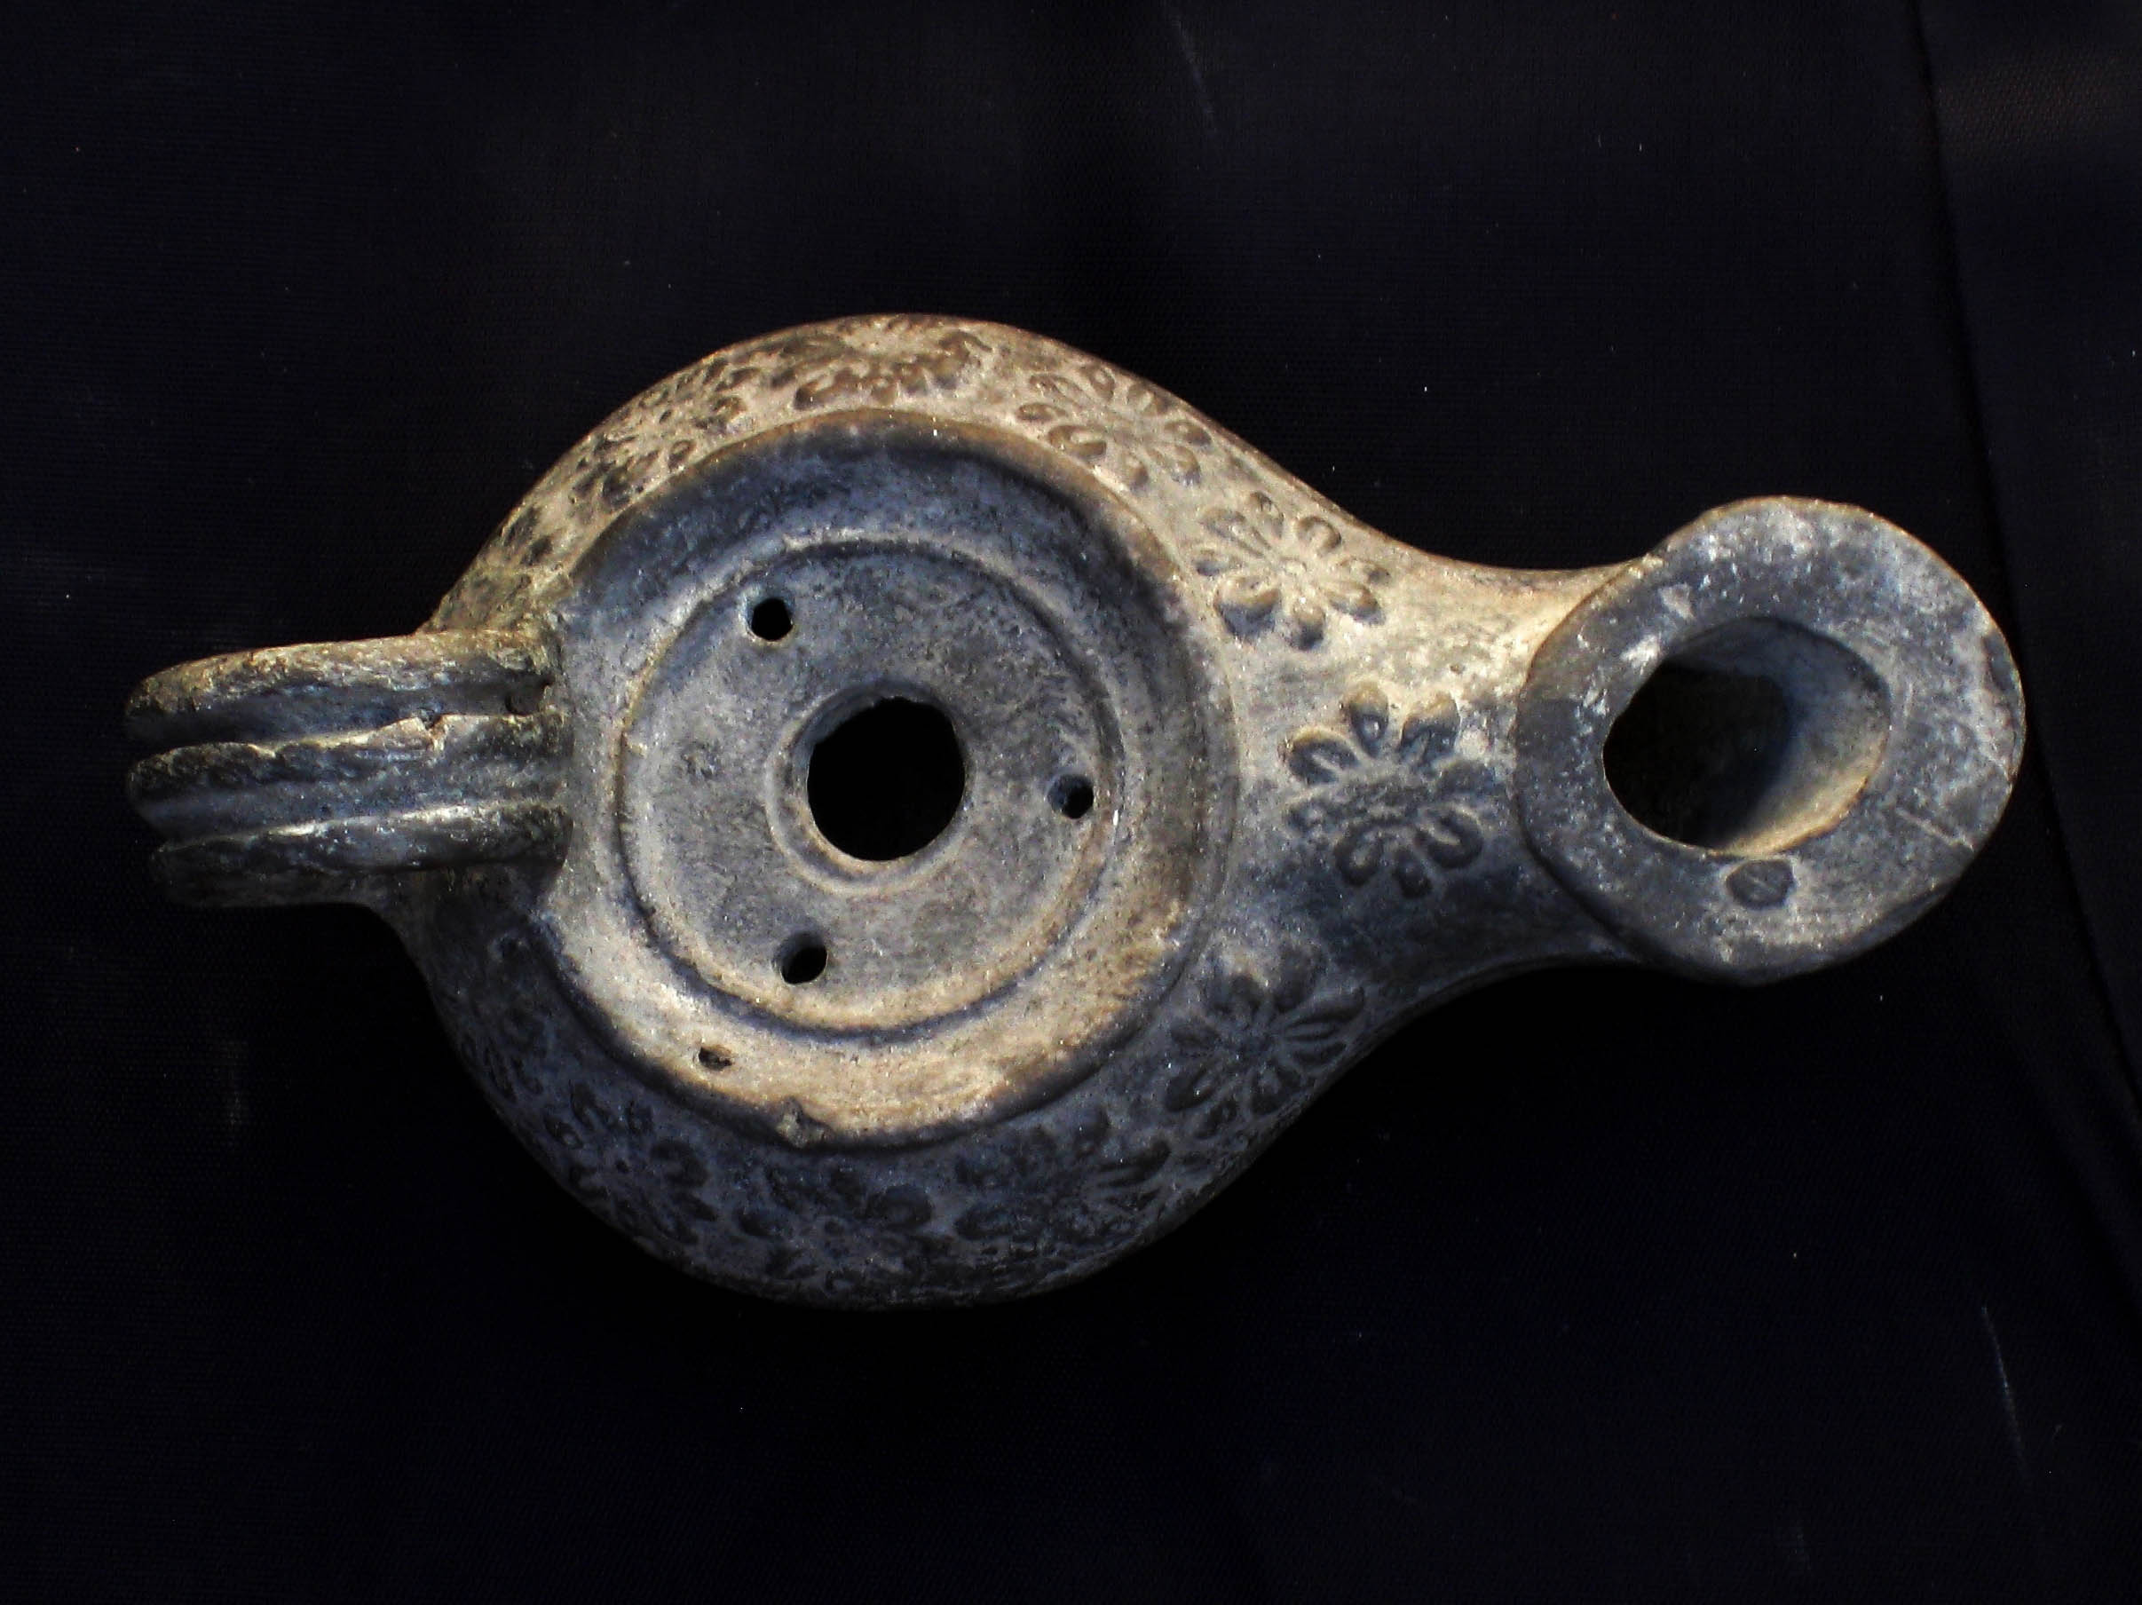
Hellenistic Mold-made (1st c. bce)

Slide 38
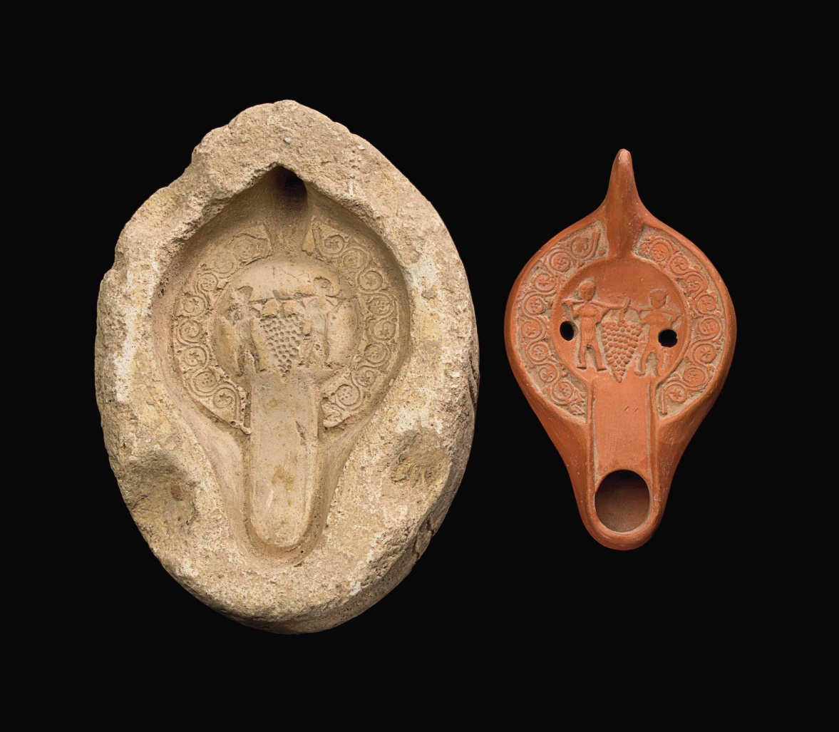
N. African Red Slip Lamp & Gypsum Mold
(4th-5th c. ce)
Christies.com

Slide 39
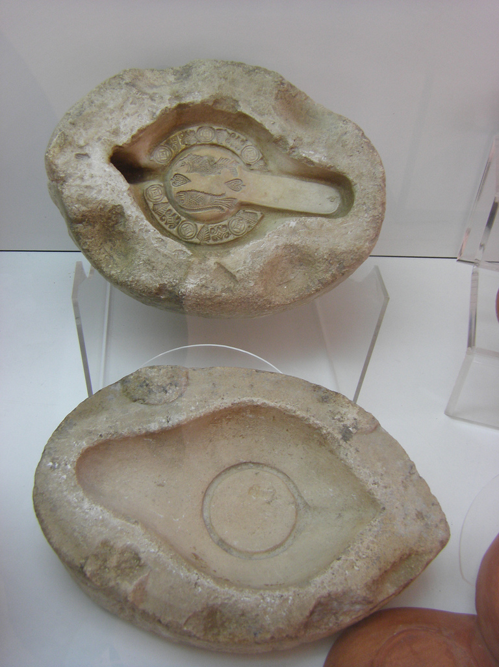
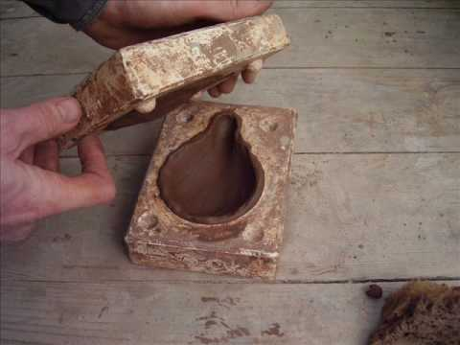
Making a Molded-lamp

Slide 40
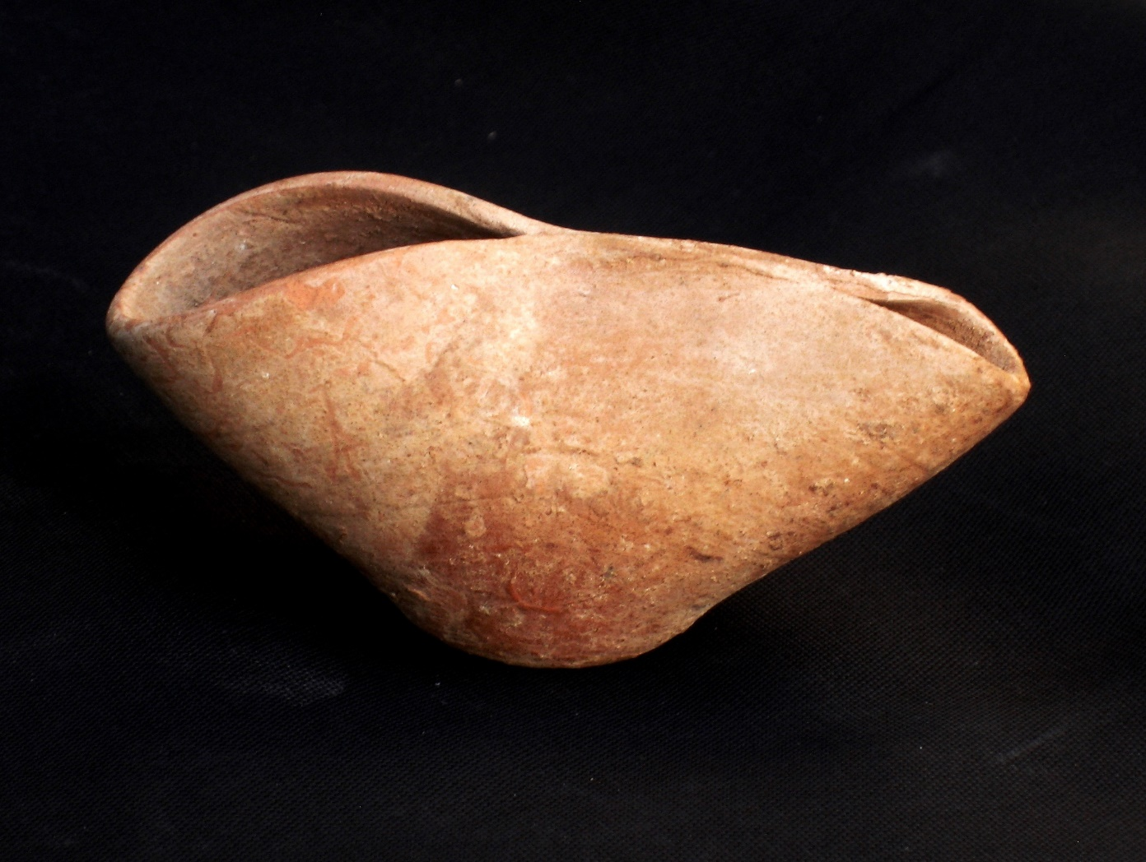
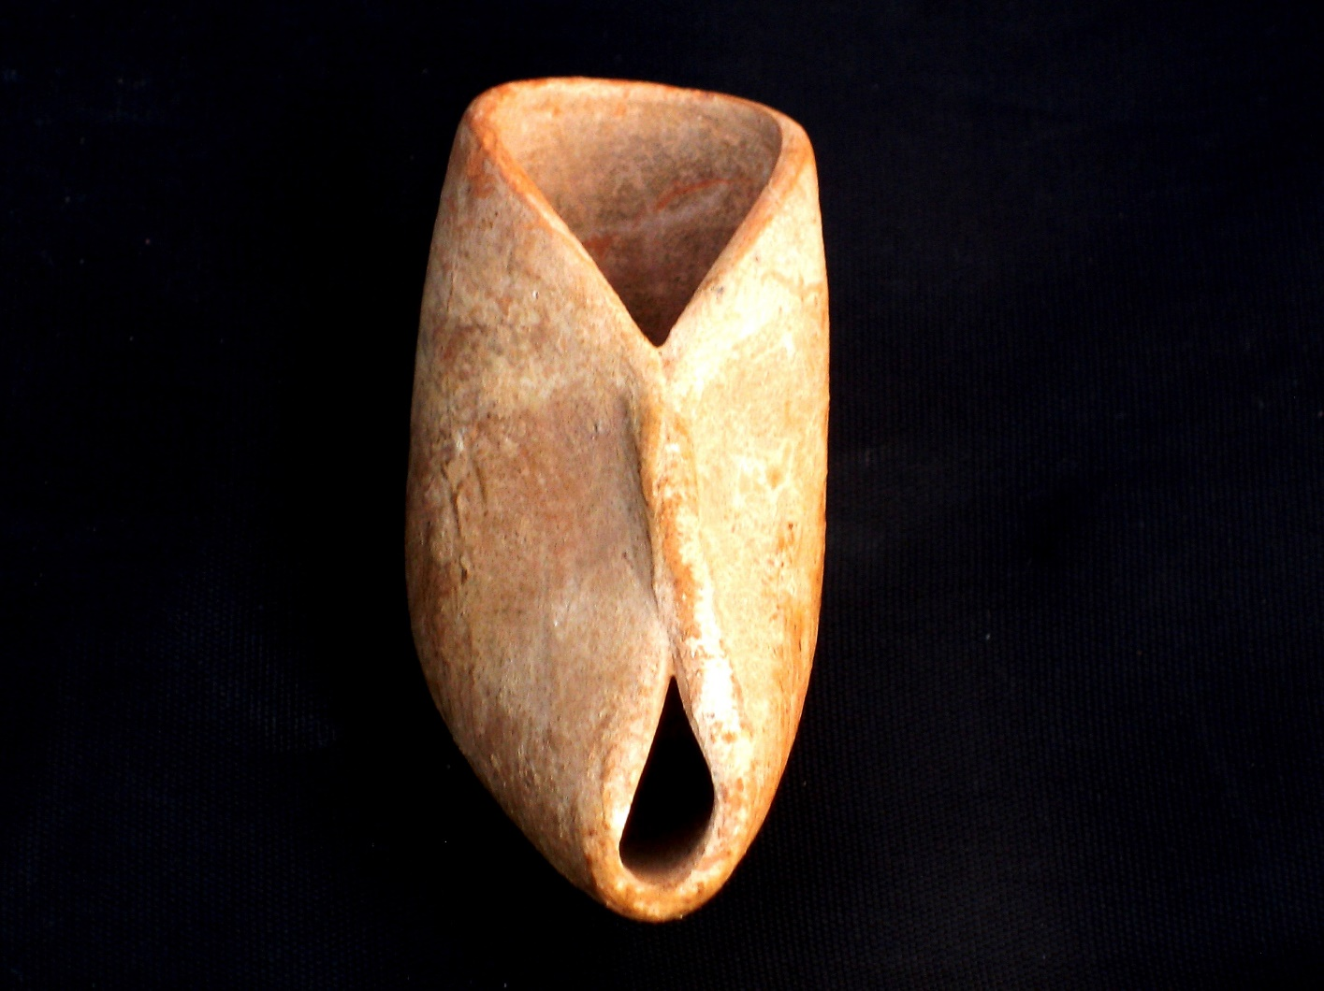
Hasmonean pinch-pot (2nd-1st c. bce)

Slide 41
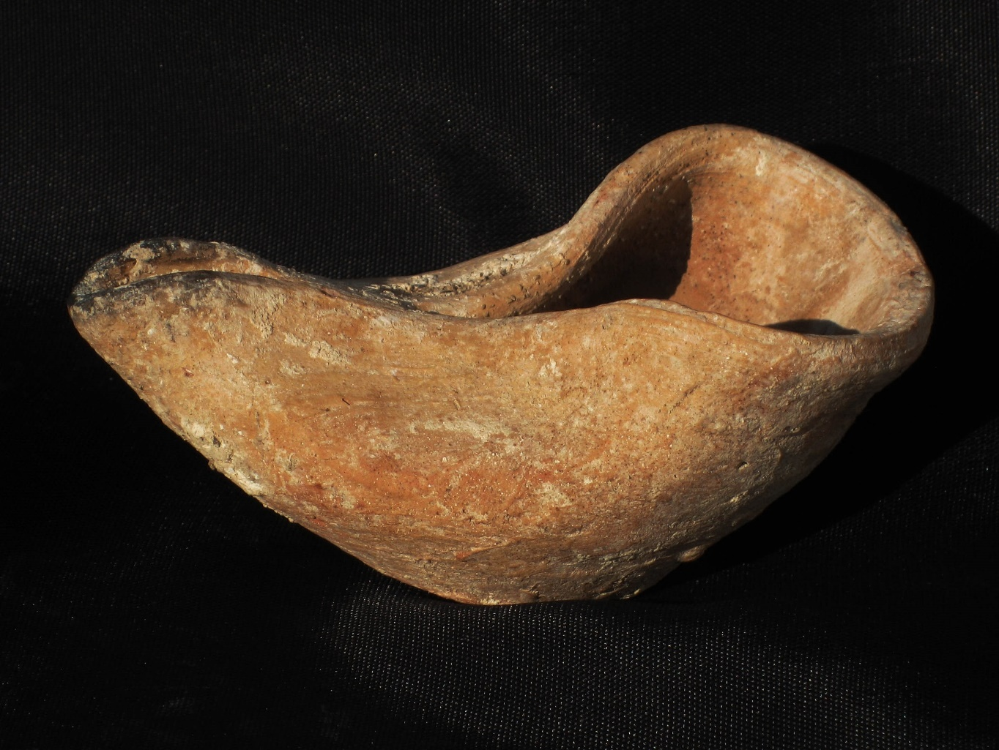
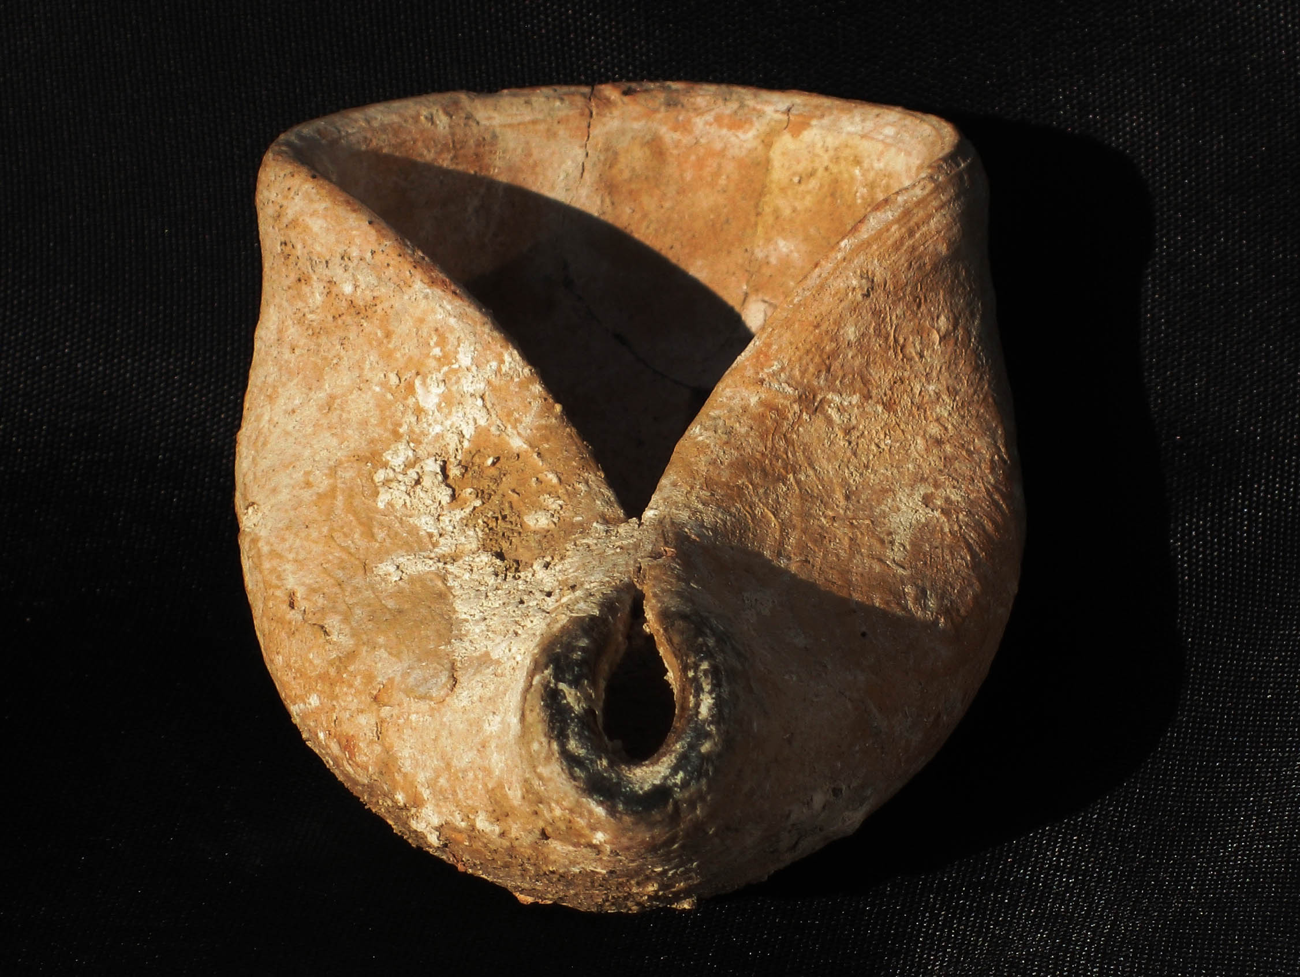
Hasmonean pinch pot (2nd-1st c. bce)

Slide 42
Herodian Oil Lamps
1st Century AD

Slide 43
Herodian Oil Lamps
1st Century AD

Slide 44
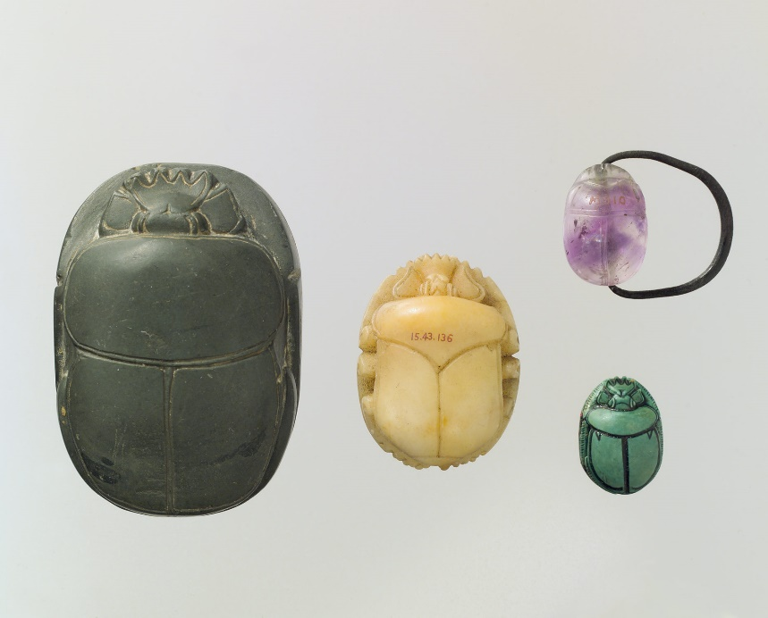
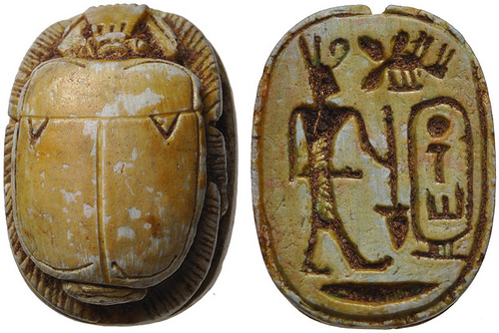
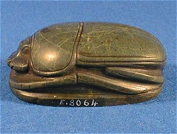
Egyptian Scarabs

Slide 45
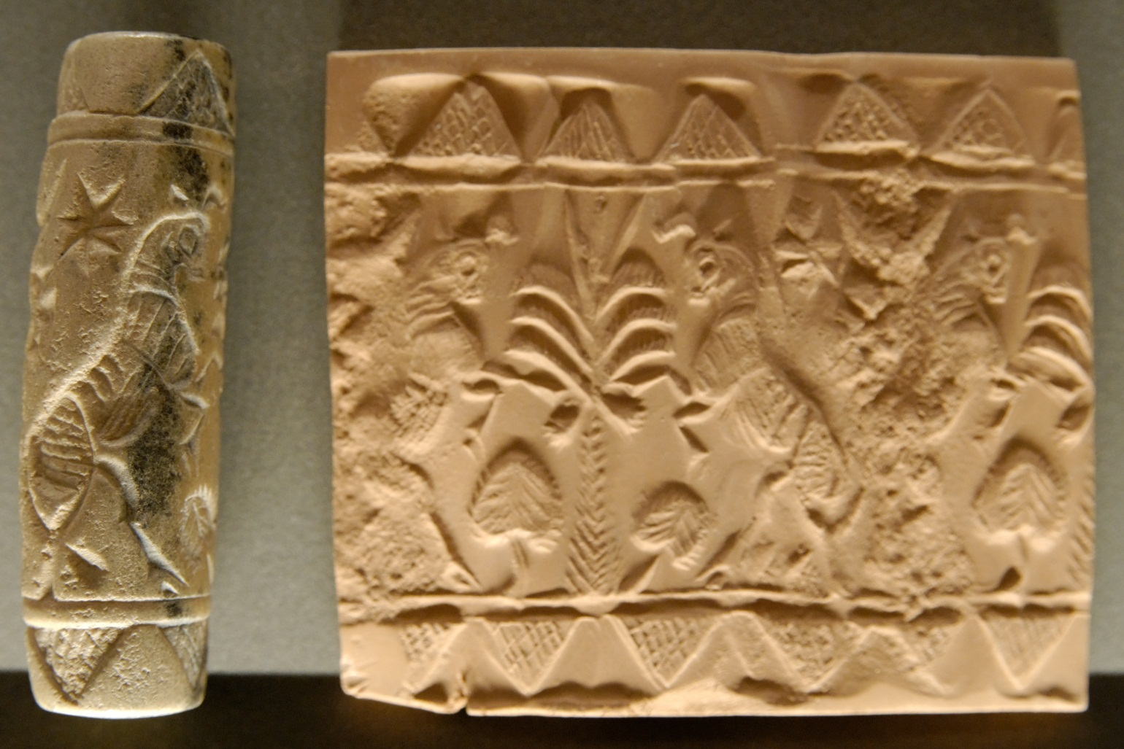
Cylinder Seals
Mesopotamia, 3rd-2nd millenia BC, Louvre Museum, commons.wikimedia.org

Slide 46
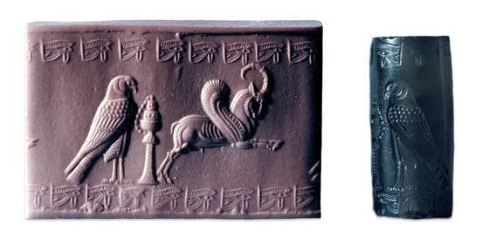
Achaemenid (Persian) Cylinder Seal, cais-soas.com

Slide 47

Cylinder seal, late Akkadian, 2250-2150 bc metmuseum.orgtoah/works-of-art/41.160.192

Slide 48

Cylinder seal, 13th c. bc, Assyrian http://www.metmuseum.org/toah/works-of-art/
1999.325.89

Slide 49

SWBTS Cylinder Seal Collection

Slide 50

SWBTS Cylinder Seal Collection

Slide 51
3) Broken Pottery Station
Ostracon (sing.)
Ostraca (pl.)

Slide 52

Ostraca (Ostracon)
Potsherd

Slide 53

New Kingdom, Dynasties 19-20, 1295-?1069 metmuseum.org

Slide 54

Tell Es-Safi/Gath dig. Philistine Bird. Gath.wordpress.com

Slide 55

Amorite Bird
Philistine Bird (sacred-texts.com)

Slide 56

Philistine Bichrome Pottery members.bib-arch.org

Slide 57

SWBTS Pottery Collection

Slide 58

"Bichrome pottery" by Peter Hagyo-Kovacs - Own work. Licensed under CC BY-SA 3.0 via Wikimedia Commons - http://commons.wikimedia.org/wiki/File:Bichrome_pottery.jpg#mediaviewer/File:Bichrome_pottery.jpg

Slide 59


Ancient Roman Pottery, ancienttouch.com

Slide 60

“Panathenic Amphora” ancientgreece.com

Slide 61

Kylix – ca. 540 to 530 BC. Hellenicfoundaion.com

Slide 62

“Herakles Attacking a Centaur” 530-520 B.C.- The J. Paul Getty Museum

Slide 63

Ancient Egypt – Predynastic Pottery, iarchives.nysed.gov

Slide 64

The Pottery of Ancient Egypt, touregypt.net

Slide 65

Vessel, Predynastic Period, metmuseum.org

Slide 66


“Jesus Fish”
Ixthus was also used with a bread wheel because each of the Greek letters in ixthus can be found along the lines in the bread wheel.
Ι
Χ
Θ
Υ
Σ
Ixthus means fish in Greek.
It’s also an acronym
ΙΗΣΟΥΣ (iesous) = Jesus
ΧΡΙΣΤΟΣ (christos) = Christ
ΘΕΟΣ (theos) = God
ΥΙΟΣ (huios) = Son
ΣΩΤΗΡ (soter) = Savior

Slide 67
This slideshow is available at www.BibTheo.com/Breakout

