Slide 2
The Family of Jesus
Matthew 1:1-17

Slide 3
Abraham was the father of Isaac,
Isaac the father of Jacob,
Jacob the father of Judah and his brothers,
Judah the father of Perez and Zerah, whose mother was Tamar,
Perez the father of Hezron,
Hezron the father of Ram,
Ram the father of Amminadab,
Amminadab the father of Nahshon,
Nahshon the father of Salmon,
Salmon the father of Boaz, whose mother was Rahab,
Boaz the father of Obed, whose mother was Ruth,
Obed the father of Jesse,
and Jesse the father of King David.
David was the father of Solomon, whose mother had been Uriah’s wife,
Solomon the father of Rehoboam,
Rehoboam the father of Abijah,
Abijah the father of Asa,
Asa the father of Jehoshaphat,
Jehoshaphat the father of Jehoram,
Jehoram the father of Uzziah,
Uzziah the father of Jotham,
Jotham the father of Ahaz,
Ahaz the father of Hezekiah,
Hezekiah the father of Manasseh,
Manasseh the father of Amon,
Amon the father of Josiah,
and Josiah the father of Jeconiah and his brothers at the time of the exile to Babylon.
After the exile to Babylon:
Jeconiah was the father of Shealtiel,
Shealtiel the father of Zerubbabel,
Zerubbabel the father of Abihud,
Abihud the father of Eliakim,
Eliakim the father of Azor,
Azor the father of Zadok,
Zadok the father of Akim,
Akim the father of Elihud,
Elihud the father of Eleazar,
Eleazar the father of Matthan,
Matthan the father of Jacob,
and Jacob the father of Joseph, the husband of Mary,
and Mary was the mother of Jesus who is called the Messiah.

Slide 4
Judah the father of Perez and Zerah, whose mother was Tamar,
Perez the father of Hezron,
Hezron the father of Ram,
Ram the father of Amminadab,
Amminadab the father of Nahshon,
Nahshon the father of Salmon,
Salmon the father of Boaz,
whose mother was Rahab,
Boaz the father of Obed,
whose mother was Ruth,
Obed the father of Jesse,
and Jesse the father of King David.
David was the father of Solomon, whose mother had been Uriah’s wife. (Matt 1:3-6)

Slide 5
Judah the father of Perez and Zerah, whose mother was Tamar,
Perez the father of Hezron,
Hezron the father of Ram,
Ram the father of Amminadab,
Amminadab the father of Nahshon,
Nahshon the father of Salmon,
Salmon the father of Boaz,
whose mother was Rahab,
Boaz the father of Obed,
whose mother was Ruth,
Obed the father of Jesse,
and Jesse the father of King David.
David was the father of Solomon, whose mother had been Uriah’s wife. (Matt 1:3-6)

Slide 6
Abraham was the father of Isaac,
Isaac the father of Jacob,
Jacob the father of Judah and his brothers,
Judah the father of Perez and Zerah,
whose mother was Tamar,
Perez the father of Hezron,
Hezron the father of Ram,
Ram the father of Amminadab,
Amminadab the father of Nahshon,
Nahshon the father of Salmon,
Salmon the father of Boaz,
whose mother was Rahab,
Boaz the father of Obed, whose mother was Ruth,
Obed the father of Jesse,
and Jesse the father of King David.
David was the father of Solomon,
whose mother had been Uriah’s wife,
Solomon the father of Rehoboam,
Rehoboam the father of Abijah,
Abijah the father of Asa,
Asa the father of Jehoshaphat,
Jehoshaphat the father of Jehoram,
Jehoram the father of Uzziah,
Uzziah the father of Jotham,
Jotham the father of Ahaz,
Ahaz the father of Hezekiah,
Hezekiah the father of Manasseh,
Manasseh the father of Amon,
Amon the father of Josiah,
and Josiah the father of Jeconiah and his brothers at the time of the exile to Babylon.
After the exile to Babylon:
Jeconiah was the father of Shealtiel,
Shealtiel the father of Zerubbabel,
Zerubbabel the father of Abihud,
Abihud the father of Eliakim,
Eliakim the father of Azor,
Azor the father of Zadok,
Zadok the father of Akim,
Akim the father of Elihud,
Elihud the father of Eleazar,
Eleazar the father of Matthan,
Matthan the father of Jacob,
and Jacob the father of Joseph,
the husband of Mary,
and Mary was the mother of Jesus
who is called the Messiah.

Slide 7
The Five Women in the Genealogy of Jesus according to Matthew

Slide 8
The Named Women in Jesus’ Genealogy
Tamar (Gen 38)
Rahab (Judg 2, 6)
Ruth (Ruth 1-4)
Uriah’s Wife (Bathsheba)
(2 Sam 11-12)
Mary (Matthew, etc.)

Slide 9
The Named Women in Jesus’ Genealogy
We want to know Jesus more
Their stories are Jesus’ story
Their stories are also our stories

Slide 10
1. Tamar

Slide 11
1. Tamar in Matt
“Judah the father of Perez and Zerah, whose mother was Tamar’”
(Matt 1:3a).

Slide 12
1. Tamar in the OT
“Judah recognized them and said, ‘She is more righteous (צָֽדְקָה) than I, since I wouldn’t give her to my son Shelah.’” (Gen 38:26).

Slide 13
1. Tamar in the OT
“Then the elders and all the people at the gate said, “We are witnesses. May the Lord make [Ruth] who is coming into [Boaz’s] home like Rachel and Leah, who together built up the family of Israel. May you have standing in Ephrathah and be famous in Bethlehem. Through the offspring the Lord gives you by this young woman,
may your family be like that of Perez, whom Tamar bore to Judah.”
(Ruth 4:11-12).

Slide 14
Widows
Widows were among the most vulnerable people in society.
Women were prevented from getting jobs easily, so could not provide for themselves if they had no husband or sons.
Most societies included provision for the vulnerable.
  E.g., Code of Hammurabi 171-173, 176a-177

Slide 15
Widows
“Do not take advantage of the widow or the fatherless. If you do and they cry out to me, I will certainly hear their cry. My anger will be aroused, and I will kill you with the sword; your wives will become widows and your children fatherless” (Ex 22:22-24).

Slide 16
Widows
“For the Lord your God is God of gods and Lord of lords, the great God, mighty and awesome, who shows no partiality and accepts no bribes. He defends the cause of the fatherless and the widow, and loves the foreigner residing among you, giving them food and clothing. And you are to love those who are foreigners, for you yourselves were foreigners in Egypt” (Deut 10:17-19).

Slide 17
Widows
Orphans, widows, & immigrants as ciphers for the most vulnerable people in society (e.g., Job 29:13; 31:16; Ps 68:5; 146:9; Prov 15:25; Isa 1:17, 23; 10:2; Jer 7:6; Ezek 22:25; Mal 3:5)

Slide 18
1. Tamar
Judah had three sons: Er, Onan, & Shelah.
Tamar married Er, Judah’s oldest son.

Slide 19
1. Tamar
Judah had three sons: Er, Onan, & Shelah.
Tamar married Er, Judah’s oldest son.
“But Er, Judah’s firstborn, was wicked in the LORD’s sight, so the LORD put him to death” (Gen 38:7).

Slide 20
1. Tamar
Levirate Marriage
(Deut 25:5-10, cf. Middle Assyrian Laws 30, 33, 43; Hittite Laws 193).
Judah + Wife = Er, Onan, Shelah (Tamar)

Slide 21
1. Tamar
Levirate Marriage
(Deut 25:5-10, cf. Middle Assyrian Laws 30, 33, 43; Hittite Laws 193).
Judah + Wife = Er, Onan, Shelah (Tamar)
Judah + Wife = Er, Onan, Shelah (Tamar)

Slide 22
1. Tamar
Levirate Marriage
(Deut 25:5-10, cf. Middle Assyrian Laws 30, 33, 43; Hittite Laws 193).
Judah + Wife = Er, Onan, Shelah (Tamar)
Judah + Wife = Er, Onan, Shelah (Tamar)
Judah + Wife = Er, Onan, Shelah (Tamar)

Slide 23
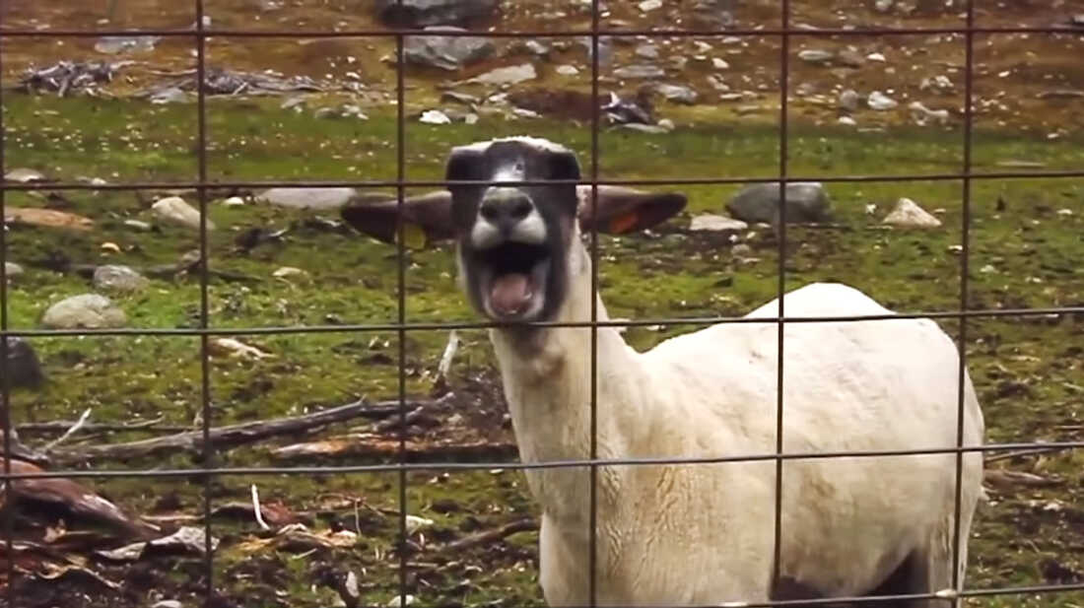
1. Tamar

Slide 24
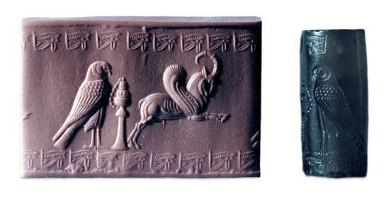

1. Tamar
=

Slide 25


Slide 26
1. Tamar
About three months later Judah was told, “Your daughter-in-law Tamar is guilty of prostitution, and as a result she is now pregnant.”
Judah said, “Bring her out and let her be burned!” (Gen 38:24).

Slide 27
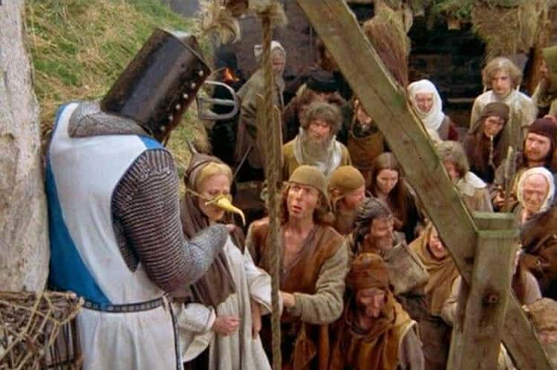
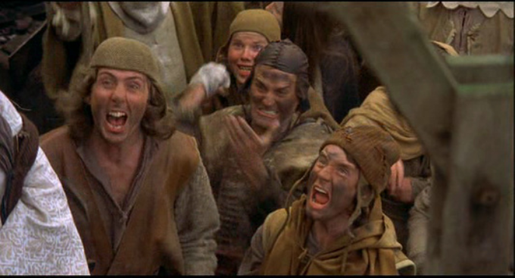

Slide 28
1. Tamar
“While they were bringing her out, she sent word to her father-in-law:
“I am pregnant by the man to whom these belong.” Then she said, “Identify the one to whom the seal, cord, and staff belong.” (Gen 38:24b-25).

Slide 29
1. Tamar

Slide 30

1. Tamar

Slide 31
1. Tamar
“Judah recognized them and said, ‘She is more righteous (צָֽדְקָה) than I, since I wouldn’t give her to my son Shelah.’” (Gen 38:26).

Slide 32

1. Tamar
“Judah recognized them and said, ‘She is more righteous (צָֽדְקָה) than I, since I wouldn’t give her to my son Shelah.’” (Gen 38:26).

Slide 33
1. Tamar
“Judah the father of Perez and Zerah, whose mother was Tamar’”
(Matt 1:3a).

Slide 34
2. Rahab

Slide 35
2. Rahab
“By faith the prostitute Rahab, because she welcomed the spies, was not killed with those who were disobedient” (Heb 11:31).

Slide 36
2. Rahab
“In the same way, was not even Rahab the prostitute considered righteous for what she did when she gave lodging to the spies and sent them off in a different direction? As the body without the spirit is dead, so faith without deeds is dead” (James 2:25-26).

Slide 37
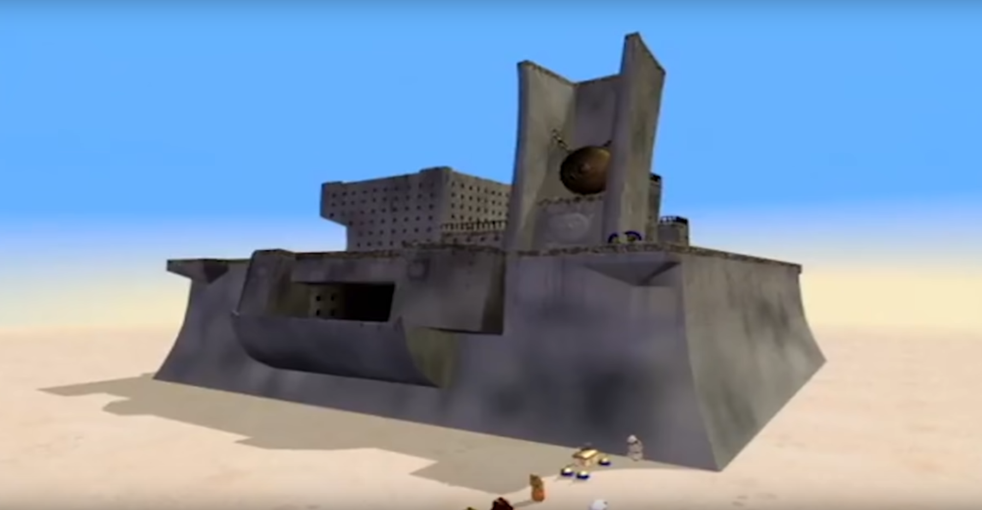
2. Rahab

Slide 38
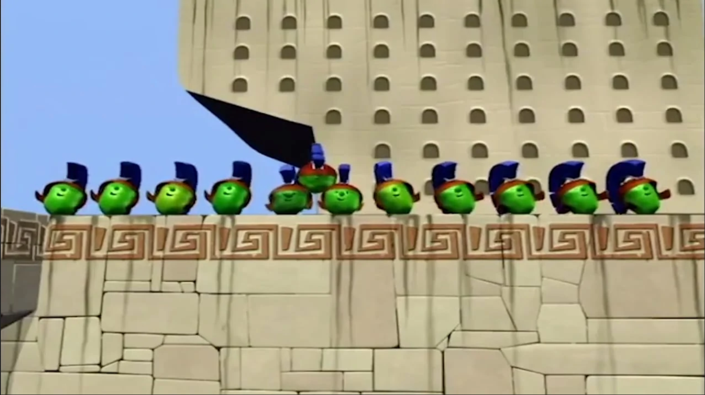
2. Rahab

Slide 39


Slide 40
2. Rahab
“When we heard of it, our hearts melted in fear and everyone’s courage failed because of you, for the Lord your God is God in heaven above and on the earth below. Now then, please swear to me by the Lord that you will show kindness (khesed, חֶסֶד) to my family, because I have shown kindness (khesed, חֶסֶד) to you. Give me a sure sign that you will spare the lives of my father and mother, my brothers and sisters, and all who belong to them—and that you will save us from death.” (Joshua 2:11-13).

Slide 41
2. Rahab
“But Joshua spared Rahab the prostitute, with her family and all who belonged to her, because she hid the men Joshua had sent as spies to Jericho—and she lives among the Israelites to this day.” (Joshua 6:25).

Slide 42
2. Rahab
“Salmon the father of Boaz, whose mother was Rahab” (Matt 1:5a).

Slide 43
3. Ruth

Slide 44
3. Ruth
“I will do for you all you ask. All the people of my town know that you are a woman of noble character” (Ruth 3:11b).
“He will renew your life and sustain you in your old age. For your daughter-in-law [Ruth], who loves you and who is better to you than seven sons, has given him birth.”(Ruth 4:15b).

Slide 45
3. Ruth
“In the days when the judges ruled, there was a famine in the land. So a man from Bethlehem in Judah, together with his wife and two sons, went to live for a while in the country of Moab” (Ruth 1:1)

Slide 46
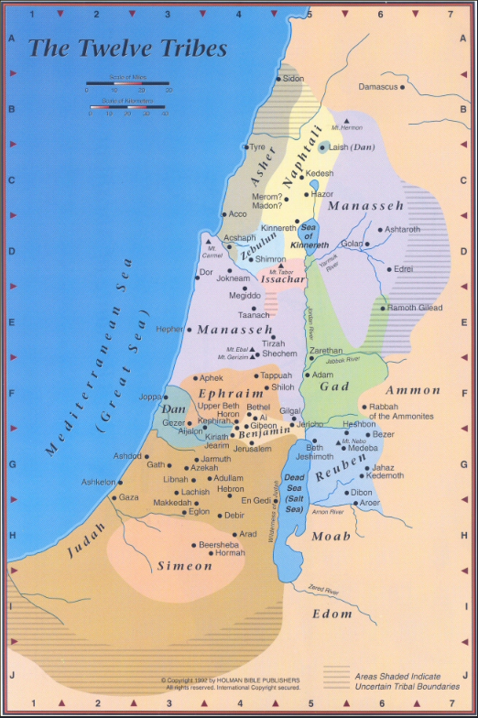

Slide 47
3. Ruth
“Again the Israelites did evil in the eyes of the Lord, and because they did this evil the Lord gave Eglon king of Moab power over Israel. Getting the Ammonites and Amalekites to join him, Eglon came and attacked Israel, and they took possession of the City of Palms. The Israelites were subject to Eglon king of Moab for eighteen years.”
(Judges 3:12-14)

Slide 48
3. Ruth
“No Ammonite or Moabite or any of their descendants may enter the assembly of the Lord, not even in the tenth generation. For they did not come to meet you with bread and water on your way when you came out of Egypt, and they hired Balaam son of Beor from Pethor in Aram Naharaim to pronounce a curse on you. However, the Lord your God would not listen to Balaam but turned the curse into a blessing for you, because the Lord your God loves you. Do not seek a treaty of friendship with them as long as you live.” (Deut 23:3-6)

Slide 49
3. Ruth
“In the days when the judges ruled, there was a famine in the land. So a man from Bethlehem in Judah, together with his wife and two sons, went to live for a while in the country of Moab” (Ruth 1:1)

Slide 50
3. Ruth
Elimelek + Naomi
Mahlon Kilion

Slide 51
3. Ruth
Elimelek + Naomi
Mahlon + Ruth Kilion + Orpah

Slide 52
3. Ruth
Elimelek + Naomi
Mahlon + Ruth Kilion + Orpah

Slide 53
3. Ruth
Naomi
Ruth Orpah

Slide 54
3. Ruth
“But Naomi said, ‘Return home, my daughters. Why would you come with me? Am I going to have any more sons, who could become your husbands? Return home, my daughters; I am too old to have another husband. Even if I thought there was still hope for me—even if I had a husband tonight and then gave birth to sons—would you wait until they grew up? Would you remain unmarried for them? No, my daughters. It is more bitter for me than for you, because the Lord’s hand has turned against me!’” (Ruth 1:11).

Slide 55
3. Ruth
Naomi
Ruth

Slide 56
3. Ruth
“But Ruth replied, “Don’t urge me to leave you or to turn back from you. Where you go I will go, and where you stay I will stay.
Your people will be my people and your God my God.
Where you die I will die, and there I will be buried. May the Lord deal with me, be it ever so severely, if even death separates you and me.’” (Ruth 1:11).

Slide 57


Slide 58
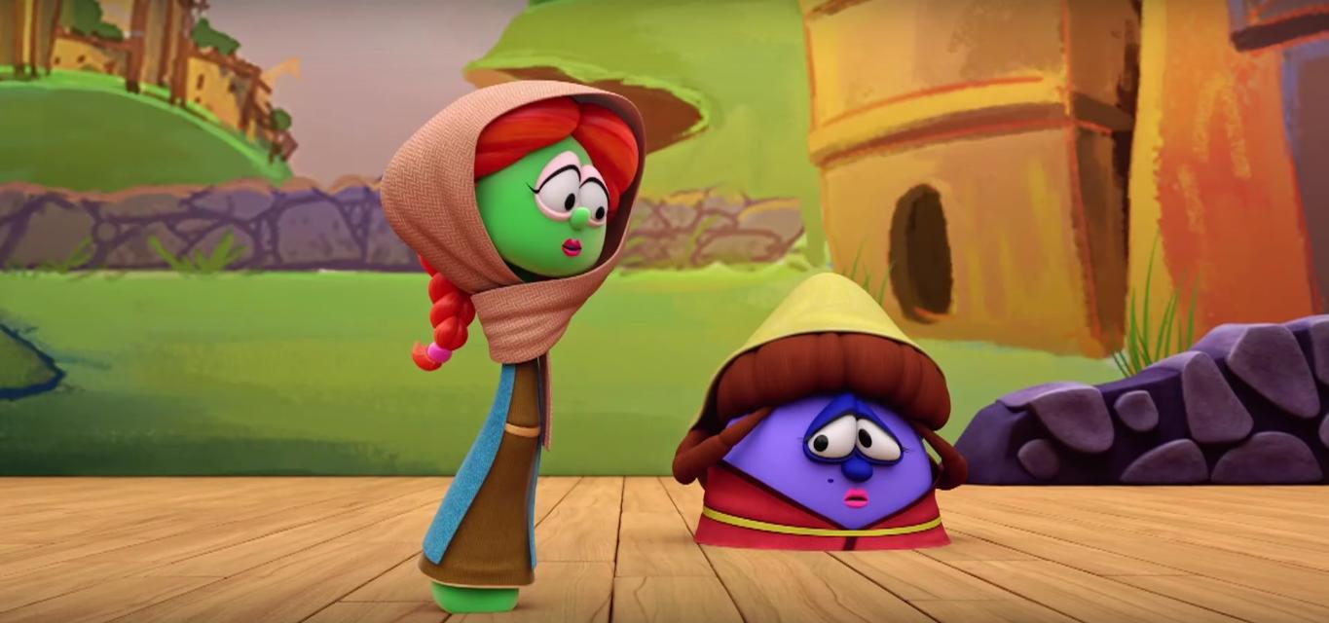
Petunia
(Inspired by Ruth)
Nona
(Inspired by Naomi)

Slide 59

Duke
(Inspired by Boaz)
Petunia
(Inspired by Ruth)

Slide 60
3. Ruth
“Salmon the father of Boaz, whose mother was Rahab,
Boaz the father of Obed, whose mother was Ruth” (Matt 1:5a-b).

Slide 61
4. Wife of Uriah
“Bathsheba”

Slide 62
4. Bathsheba
“and Jesse the father of King David. David was the father of Solomon, whose mother had been Uriah’s wife” (Matt 1:6b).

Slide 63

King David
Uriah
Nathan
Bathsheba

Slide 64
4. Bathsheba (wife of Uriah)
“For David had done what was right in the eyes of the Lord and had not failed to keep any of the Lord’s commands all the days of his life—except in the case of Uriah the Hittite” (1 Kings 15:5).

Slide 65
4. Bathsheba (wife of Uriah)
“Then Nathan said to David, “You are the man! This is what the Lord, the God of Israel, says: ‘I anointed you king over Israel, and I delivered you from the hand of Saul. I gave your master’s house to you, and your master’s wives into your arms. I gave you all Israel and Judah. And if all this had been too little, I would have given you even more. Why did you despise the word of the Lord by doing what is evil in his eyes? You struck down Uriah the Hittite with the sword and took his wife to be your own. You killed him with the sword of the Ammonites” (2 Sam 12:8-9a).

Slide 66
4. Bathsheba (wife of Uriah)
“In the spring, at the time when kings go off to war…David remained in Jerusalem” (2 Sam 11:1).
“One evening David got up from his bed and walked around on the roof of the palace. From the roof he saw a woman bathing. The woman was very beautiful” (2 Sam 11:2a).

Slide 67
4. Bathsheba (wife of Uriah)
“And David sent someone to find out about her. The man said, “She is Bathsheba, the daughter of Eliam and the wife of Uriah the Hittite” (2 Sam 11:3).
  Uriah was one of David’s 30 elite warriors (2 Sam 23:39; 1 Chr 11:41).
  “Uriah” means “The LORD is my light.”

Slide 68
4. Bathsheba (wife of Uriah)
“Then David sent messengers to get her” (2 Sam 11:4).

Slide 69
4. Bathsheba (wife of Uriah)
“In the morning David wrote a letter to Joab and sent it with Uriah. In it he wrote, “Put Uriah out in front where the fighting is fiercest. Then withdraw from him so he will be struck down and die.”” (2 Sam 11:14).

Slide 70
4. Bathsheba (wife of Uriah)
“When Uriah’s wife heard that her husband was dead, she mourned for him. After the time of mourning was over, David had her brought to his house, and she became his wife and bore him a son. But the thing David had done displeased the Lord” (2 Sam 11:26-27).

Slide 71
4. Bathsheba (wife of Uriah)
“But the thing David had done displeased the Lord” (2 Sam 11:27).

Slide 72
4. Bathsheba
“and Jesse the father of King David.
David was the father of Solomon, whose mother had been Uriah’s wife”
(Matt 1:6b ).

Slide 73
The Women in Jesus’ Genealogy
Tamar (Gen 38)
Rahab (Judg 2, 6)
Ruth (Ruth 1-4)
Uriah’s Wife (Bathsheba)
(2 Sam 11-12)
Mary (Matthew, etc.)

Slide 74
The Women in Jesus’ Genealogy
Tamar (widow, prob. Canaanite, marginalized)
Rahab (prostitute, Canaanite, marginalized)
Ruth (widow, Moabite, marginalized)
Wife of Uriah (widow, maybe Hittite like Uriah, marginalized)

Slide 75
The Women in Jesus’ Genealogy
Tamar (“righteous” {Gen 38:26}, ancestor to Jesus)
Rahab (“by faith” {Heb 11:31}, ancestor to Jesus )
Ruth (“kindness/loyal” {Ruth 3:10}, ancestor to Jesus)
Wife of Uriah (survivor, ancestor to Jesus)

Slide 76
The Women in Jesus’ Genealogy
Tamar (ancestor to Jesus)
Rahab (ancestor to Jesus )
Ruth (ancestor to Jesus)
Wife of Uriah (ancestor to Jesus)

Slide 77
Genealogy in Matthew
Part of a longer introduction to Jesus that emphasizes:
  Gentiles, marginalized ancestors (1:1-17)
    Tamar, Rahab, Ruth, Bathsheba, Mary
  Maji from the East (2:1)
  Refugee status for Jesus’ family in Egypt (2:13-15)
  A hometown of “Galilee of the Gentiles” (4:15)

Slide 78
“From every nation, tribe, people, and language”
“After these things I looked, and here was an enormous crowd that no one could count, made up of persons from every nation, tribe, people, and language, standing before the throne and before the Lamb dressed in long white robes, and with palm branches in their hands. They were shouting out in a loud voice, “Salvation belongs to our God, to the one seated on the throne, and to the Lamb!”” (Rev 7:9-10).

Slide 79


Slide 80
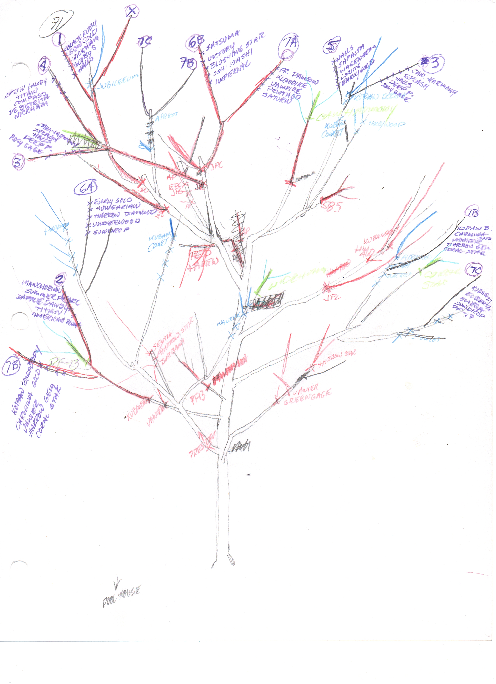
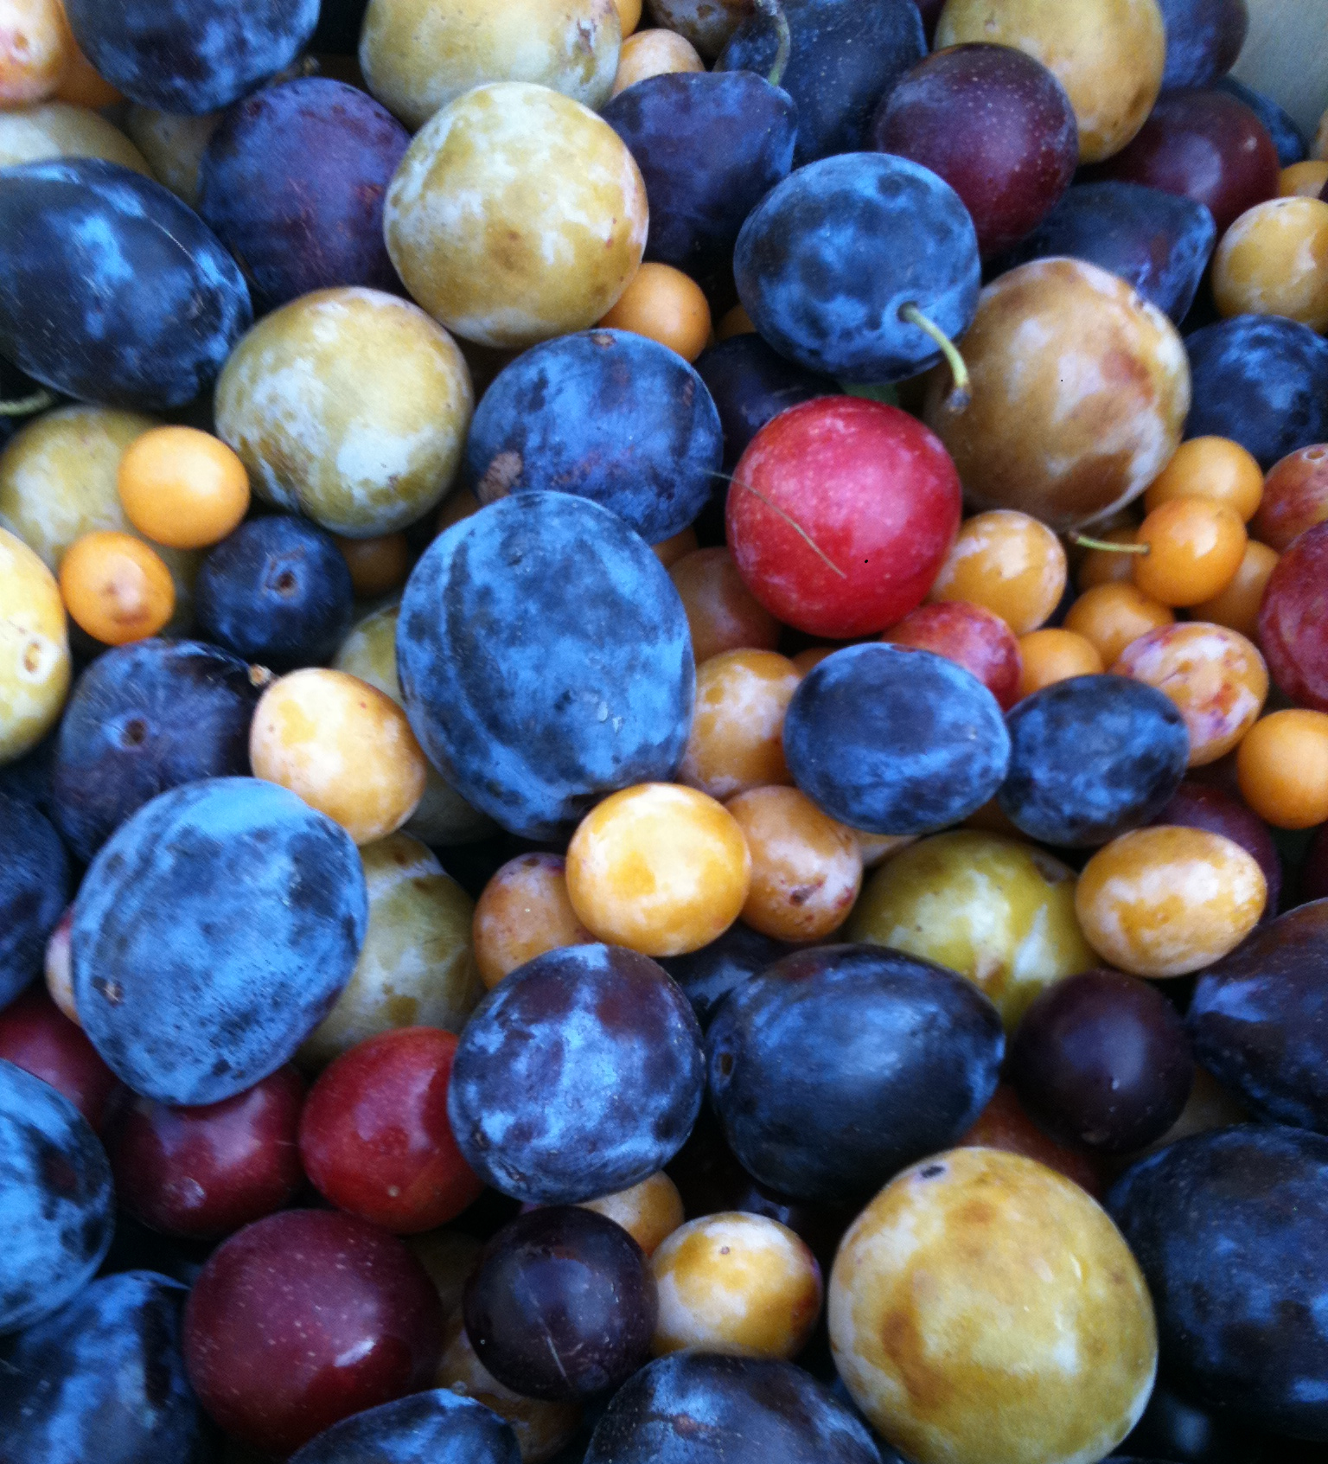
“Tree of 40 Fruit”
Professor Sam Van Aken, Syracuse University

