Slide 1
Is There an Echo in Here?
Type scenes and formulaic Narratives in the Old and New Testament

Slide 2

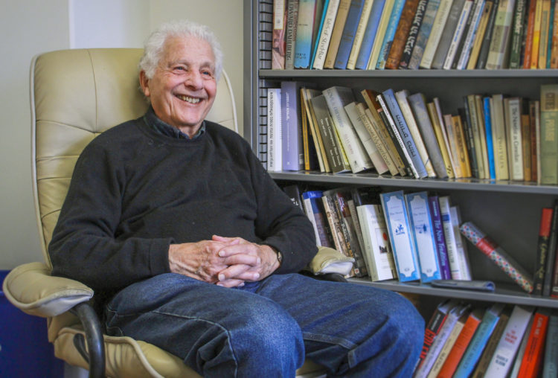
Robert Alter and the Biblical Type Scene
Robert Alter’s The Art of Biblical Narrative
Professor of Hebrew and Comparative Literature and
UC Berkley

Slide 3
“I should like to propose that there is a series of recurrent narrative episodes attached to the careers of biblical heroes that are analogous to Homeric type-scenes in that they are dependent on the manipulation of a fixed constellation of predetermined motifs” (51).

Slide 4
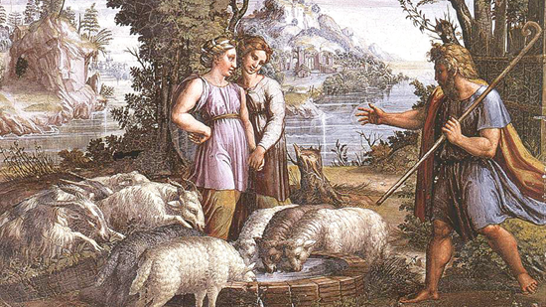
The Betrothal Type Scene
  Bride-Groom (or surrogate) travels to a foreign land
  He encounters a young woman at a well
  Someone draws water (usually the man)
  The young woman rushes away to announce the man’s arrival
  The two are betrothed (usually following a meal)

Slide 5
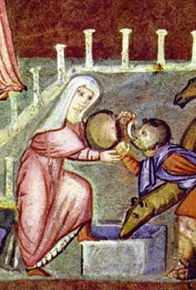
Betrothal Type Scenes
  Isaac (via Eliezer) & Rebekah (Gen 24)
  Jacob & Rachel (Gen 29:1-20)
  Moses & Zipporah (Ex 2:15-21)

Slide 6
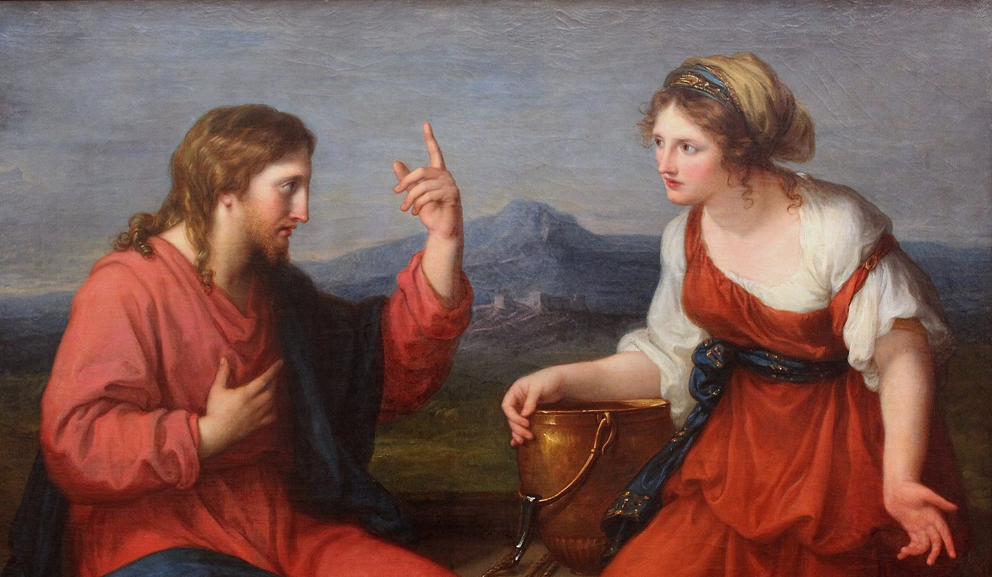
Jesus and the Samaritan Woman
  John 4
  Jesus has traveled to a foreign land (Samaria)
  The woman came out to draw water at the well
  The subject of marriage is discussed
  The woman leaves to announce the man’s arrival

Slide 7
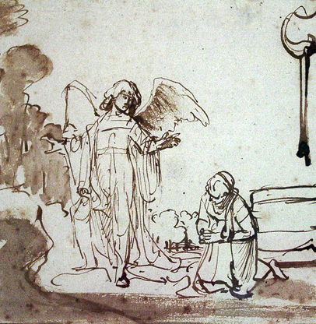
Hagar at the Well
Gen 16
  Pregnant, Hagar is sent away by Sarah into the wilderness to die
  The Angel of the Lord found her by a spring in the wilderness
  The Lord blessed Ishmael and sent Hagar back to Abraham
  ¹³ She gave this name to the LORD who spoke to her: “You are the God who sees me,” for she said, “I have now seen the One who sees me.” ¹⁴ That is why the well was called Beer Lahai Roi; it is still there, between Kadesh and Bered.

Slide 8
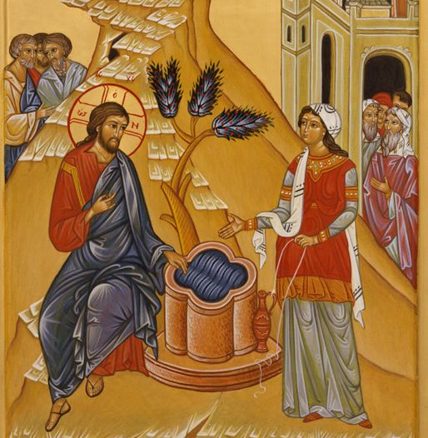
Come and see a man who saw me!
Many of the Samaritans from that town believed in him because of the woman’s testimony, “He told me everything I ever did”
(Jn 4:39 NIV).

Slide 9
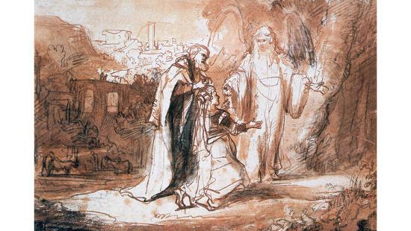
The Annunciation Type-Scene
Plight of barrenness
Divine Promise
Birth of Son

Slide 10
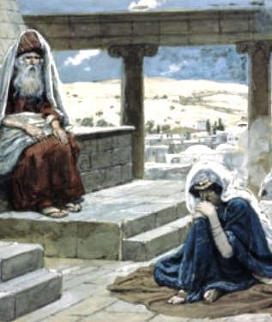
Annunciation Scenes
Sarah (Gen 18:9-15)
Rebekah (Gen 25:19-25)
Manoah’s wife (Judges 13)
Hannah (1 Sam 1)
The Shunamite Woman (2 Kings 4:8-17)
Elizabeth (Luke 1:5-23)

Slide 11
Annunciation to Mary
Barrenness not explicitly a problem
Follows the pattern of Zechariah (which follows the pattern of Abraham) from the preceding verses
“However, at every point the experience of Mary surpasses that of Zechariah; and while the Zechariah account stays with the model provided by the OT birth annunciations . . . In the case of Mary the birth oracle form has been heavily modified in the direction of a call narrative form” (John Nollan Luke 1-9:20 57).

Slide 12
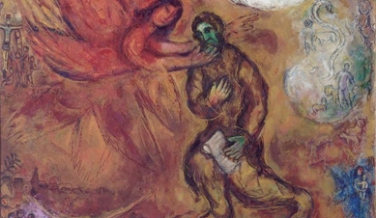
The Commissioning Story
Introduction
Confrontation
Reaction
Commission
Protest
Reassurance
Conclusion
Benjamin Hubbard “Commissioning Stories in Luke-Acts”

Slide 13
Commissioning Type Scenes
Moses (Ex 3:7-4:17)
Isaiah (6)
Jeremiah (1:4-10)
Ezekiel (2-3)

Slide 14
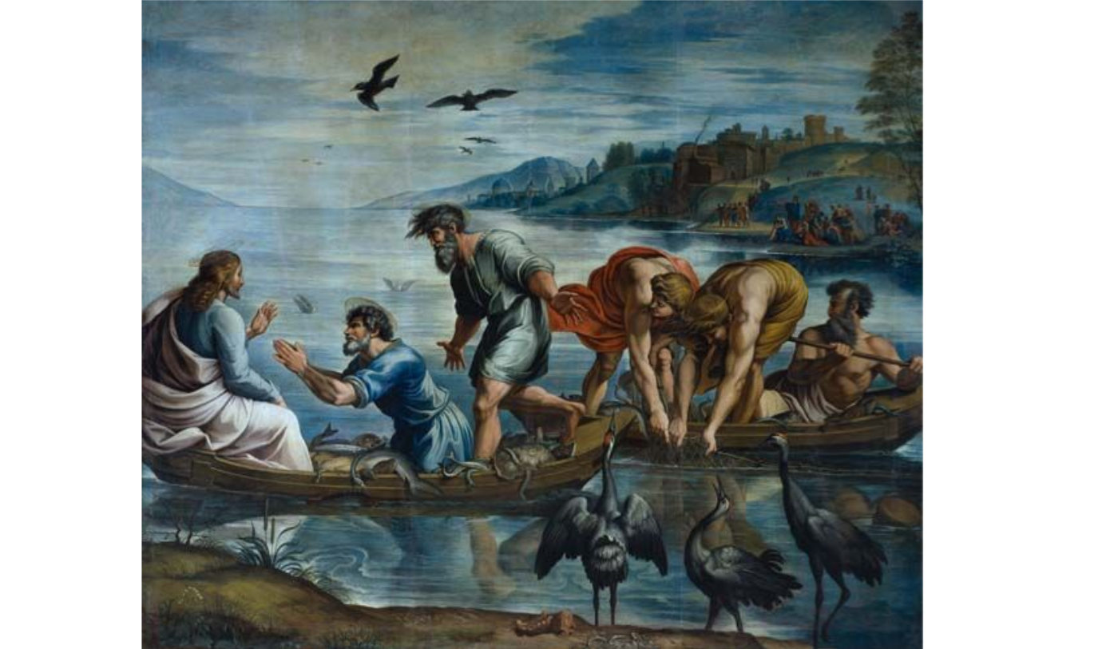
The Commissioning of Peter
Luke 5:1-11 shows how biblical authors, through selection and arrangement, can shape the narrative to fit a biblical precedent.
Luke’s telling includes details that are not included in the other Gospels
The additional details help to shape the story in to the commissioning type scene
The arrangement of material infuses the text with significance borrowed from the common type scene

