Slide 1

Retention’s Secret Weapon
Dr. Terance Espinoza and professor Ellie Gates
SAGU Faculty Inservice – January 5-6, 2022

Slide 2
Learning Outcomes
Ellie to Open
Understand the Leaky Bucket Theory as it relates to retention and customer (student) lifetime value
Understand retention trends and SAGU’s current state
Share best practices around student engagement and retention
Be inspired and identify 1-2 things to make a difference this semester
By the end of this training you should...

Slide 3

What If...

Slide 4
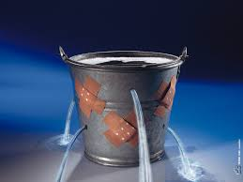
What this means in business.
THREE CHOICES:
Increase the water flow
Plug the holes
Acknowledge reality (there will always be holes) but work to minimize loss
New Customers
Steady Customer
Base
Lost Customers

Slide 5
What this means in education
THREE CHOICES:
Increase recruiting efforts
Increase retention efforts
Do both AND close holes
New Students
Students who
remain
Lost Students

Slide 6

What are the benefits of retention in 1-2 Words
Help us build this Word Art:
https://wordart.com/796xel7uap0q/retention

Slide 7
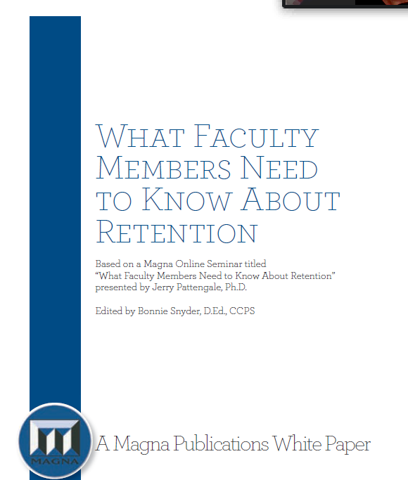
Source for Today
White paper on student retention from a faculty perspective
Six reasons retention matters
Twelve ideas to help retain students
Written towards Millennial learners, yet good foundational principles.

Slide 8
Six Reasons Retention Matters
Important for the institution
Financially necessary
Civic Expectation
Individually Fulfilling
Important Professionally (Evaluations)
Retention is inherently important
Source: “What faculty members need to know about retention”Jerry Pattengale, Ph.D. (2010).

Slide 9
National Retention Levels: Public Universities
Terance leads
81%
First-time, Full-time Degree seeking students
Source: https://nces.ed.gov/programs/coe/indicator/ctr

Slide 10
National Retention Levels: Private Universities
82%
(62-96%)
First-time, Full-time Degree seeking students
Source: https://nces.ed.gov/programs/coe/indicator/ctr

Slide 11
Comparison schools: Fall/Fall
Retention Rates
Northwest University, Kirkland, WA | 83%
Criswell College, Dallas, TX | 80%
Evangel University, Springfield, MO | 80%
Dallas Baptist University, Dallas, TX | 76%
Vanguard, Costa Mesa, CA | 75%
SAGU, Waxahachie, TX | 72%
Barton College, Wilson, NC | 70%
Southeastern University, Lakeland, FL | 66%
Texas Wesleyan, Fort Worth, TX | 64%
Toccoa Falls College, T.F., GA | 58%
Olivet College, Olivet, MI | 57%
SOURCE: https://nces.ed.gov/programs/coe/indicator/ctr

Slide 12
6 year persistence rate:
<60%
Entering college today, complete their degree within 6 years.
Source: Bowen, Chingos, & McPherson, 2009

Slide 13
Comparison schools: 6 Year Grad Rate
Six-year graduation rate (started programs in 2014)
Texas Wesleyan, Fort Worth, TX | 64%
Vanguard, Costa Mesa, CA | 63%
Northwest University, Kirkland, WA | 58%
Olivet College, Olivet, MI | 57%
Dallas Baptist University, Dallas, TX | 56%
Evangel University, Springfield, MO | 55%
Barton College, Wilson, NC | 52%
Criswell College, Dallas, TX | 50%
SAGU, Waxahachie, TX | 49%
Toccoa Falls College, T.F., GA | 49%
SOURCE: https://nces.ed.gov/programs/coe/indicator/ctr

Slide 14
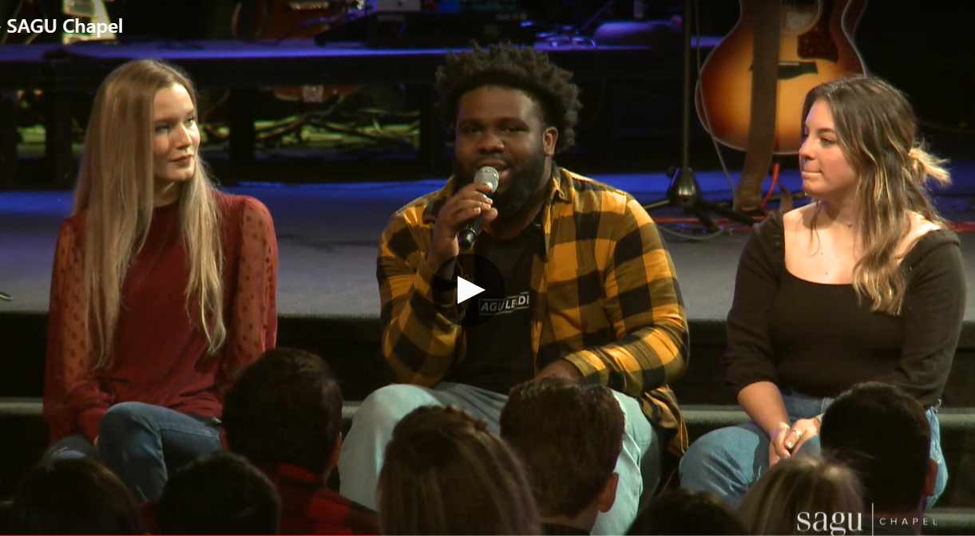
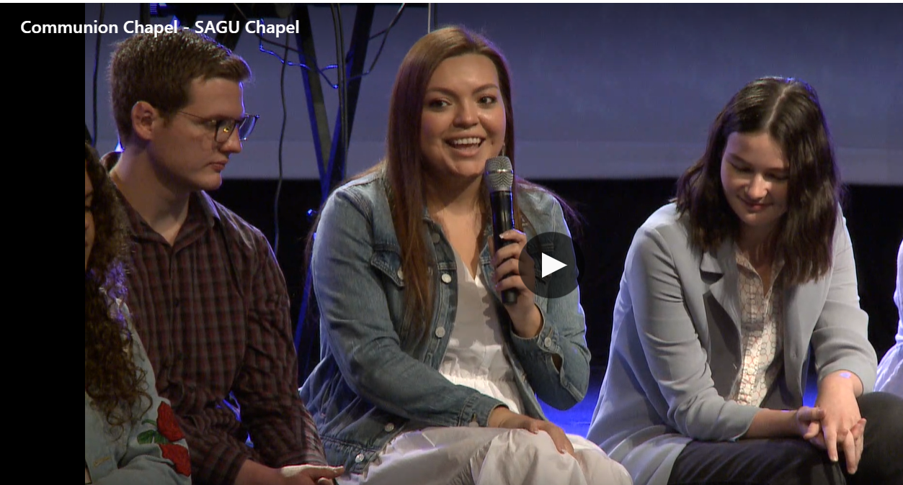
Why our Student’s Stay...
YOU

Slide 15
Some other ideas from Pattingale’s Article
Review student’s profiles before class
Frontload your class with “Support”
Help students find peer support
Run an Engaging classroom
Create an “endowed chair” at a local restaurant
Ask students’ directly if they are contemplating leaving
Make your retention efforts INTRUSIVE
Make a seating chart early on so you can use their names in class right away
Collect information cards from the students in the first week, incl. “How can I pray for you” answers
Invite students to office hours. Consider reframing as “drop-in office hours”
Use support services at the university
Source: “What faculty members need to know about retention”Jerry Pattengale, Ph.D. (2010).

Slide 16
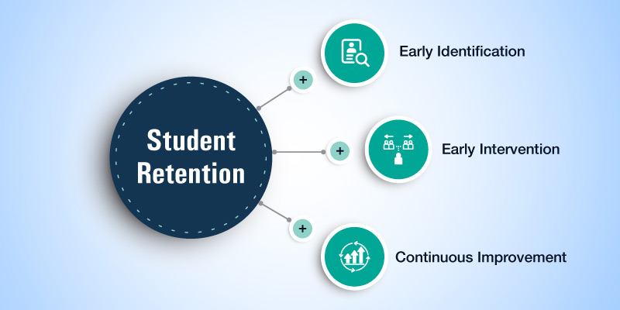
Simple Strategy
Ellie to Jumxp back in

Slide 17
Why Faculty makes a HUGE difference
Can connect purpose to work in the classroom
Know them on a personal level
Provide options and choices
Share and encourage
Inspire and challenge
When the goal is irresistible, students will want to drag themselves across the academic finish line.
Source: “What faculty members need to know about retention”Jerry Pattengale, Ph.D. (2010).

Slide 18
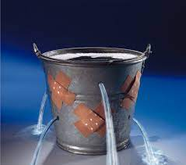
BEST PRACTICE SHARE:
What are some of the great things YOU do to retain students?

Slide 19

Make it practical: Little things, big impact!
Leverage your work study to reach out & notify you of missing students
Put questions in your quizzes/exams
AND WHAT ELSE?

Slide 20

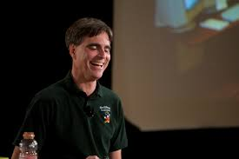
Those that inspire us change us
“Carpe Diem! Seize the day boys, make your lives extraordinary!”
Robin Williams, as Prof. John Keating
Dead Poet’s Society
It’s not about how you achieve your dreams,
It is about how you live your life.
- Randy Pausch, The Last Lecture

Slide 21
So What will YOU do?
What’s one thing you could do differently this semester to retain your students?

Slide 22
Resources
Terrance to close out
www.BibTheo.com/FIS
1. Article: What faculty members need to know about retention
2. This Slide deck
3. List of best practices we curated from our discussions (Posted by 1/7)

Slide 23
By the Numbers
32.1%
Over the age of 25 have completed a college degree or higher. Those that do have higher earnings potential.
Source: https://www.census.gov/content/dam/Census/library/publications/2021/acs/acsbr-009.pdf

Slide 24
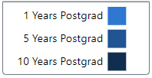
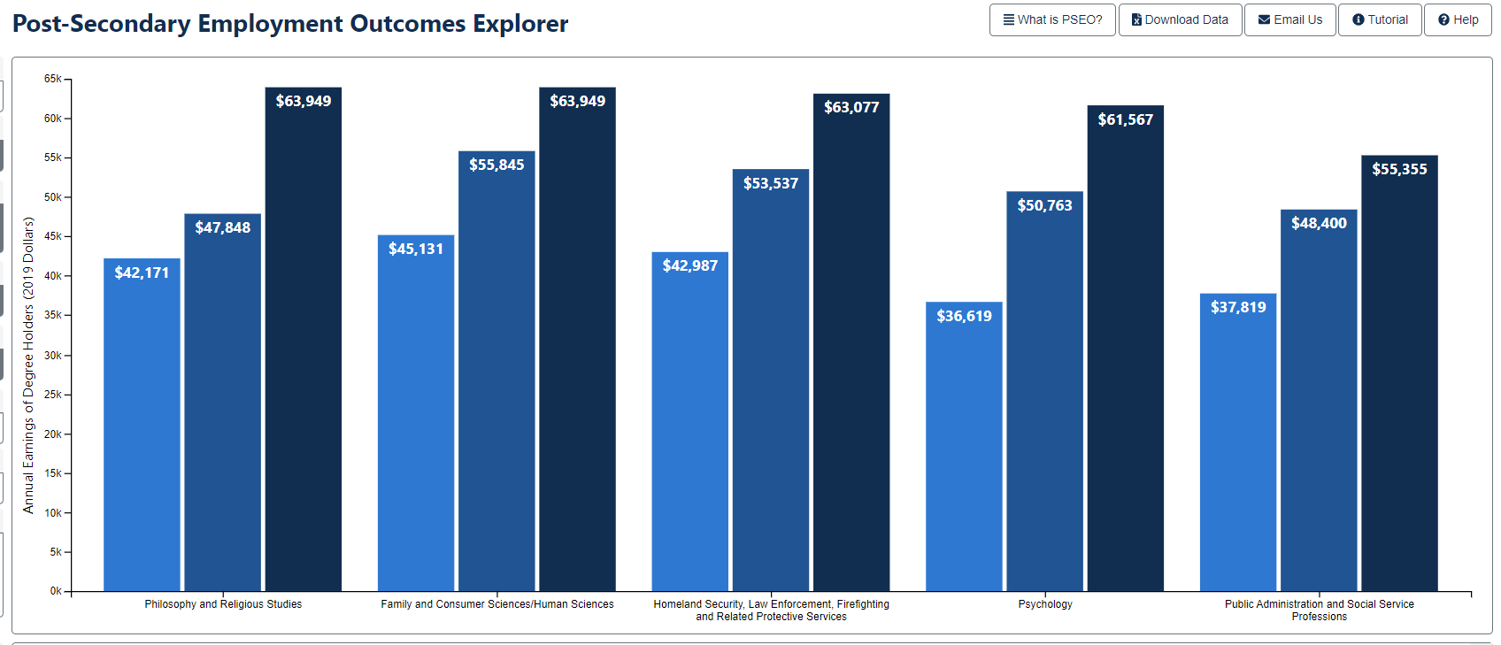
Average Salaries – CBCM
Source: PSEO - Undergraduate Salary Data from UNT- Austin Grads All Cohorts
To access more info: https://bit.ly/3mWp5xh

Slide 25
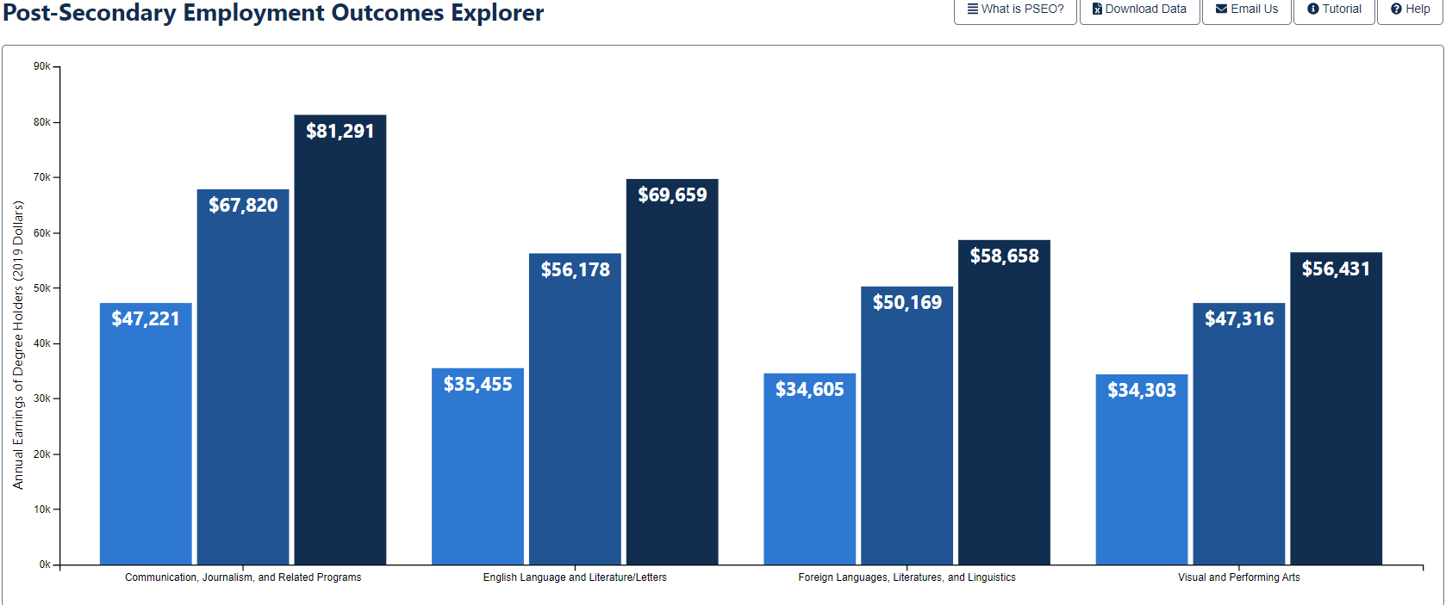
Average Salaries: COM-ARTS
Source: PSEO - Undergraduate Salary Data from UNT- Austin Grads All Cohorts
To access more info: https://bit.ly/3mWp5xh

Slide 26
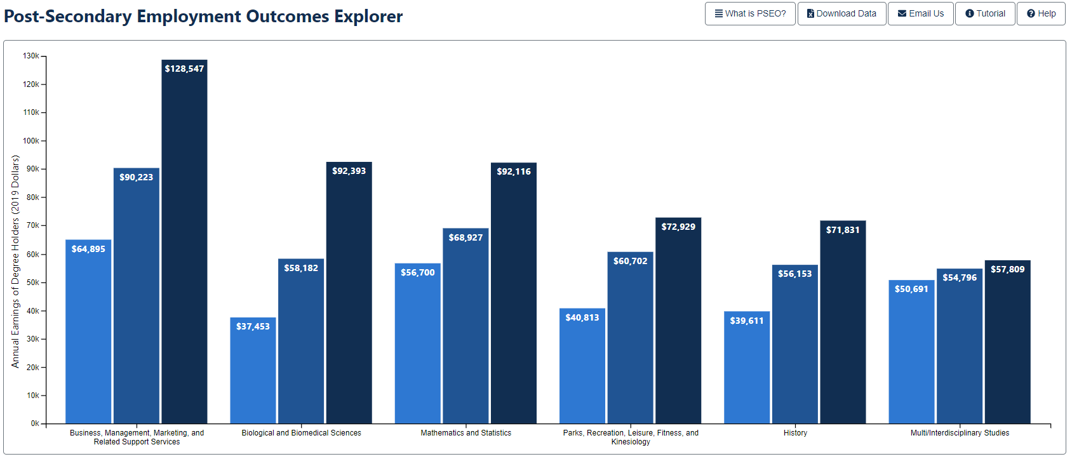
Average Salaries - CBE
Source: PSEO - Undergraduate Salary Data from UNT- Austin Grads All Cohorts
To access more info: https://bit.ly/3mWp5xh

