Slide 1
Women in Ministry and Leadership
A Biblical Survey

Slide 2

Is Hierarchy in Gender God’s Design for Humans?

Slide 3

Scripture in the Context of its Big Story
Notes:
Image From CT https://www.christianitytoday.com/edstetzer/2012/november/big-story-of-scripture-creation-fall-redemption.html where it was taken from a church website https://christcommunity.org/

Slide 4

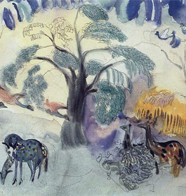
Creation
All humans, both male and female, are created in the image of God and were assigned the task of ruling over the rest of creation (Gen 1:26-29).
When Eve was created to be a “helper” to Adam, this does not imply subordination. The Hebrew word translated helper is עזר (‘ezer). This word can mean helper or even savior and is used most often in the Hebrew Bible of God (Ex 18:4, Deut 33:7, 29; Hos 13:9; Ps 70:5 [HEB 70:6]; 121:1; 124:8; 146:5) and when it does not clearly mean God it refers to a rescuer or savior usually in a military context (Isa 30:5; Ezek 12:14; Ps 89:19 [HEB 89:20]; Dan 11:34).

Slide 5
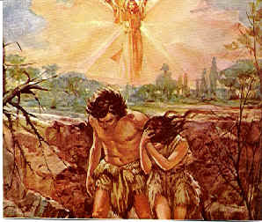
Sin and its Consequences
The Only Hint of Hierarchy is in the Curse after Human Rebellion (Gen 3:16).
Are we consistent in insisting other aspects of the curse must not be ameliorated?
  Pain in childbirth?
  Painful toil to produce food?
  Death?

Slide 6
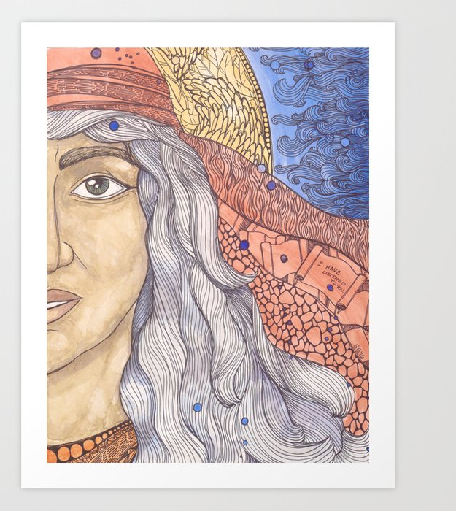
Prominent Women in Leadership in the Old Testament
  Miriam (Exod 15:20-21)
  Deborah (Judg 4-5)
  Huldah (2 Kgs 22; 2 Chr 34)

Slide 7
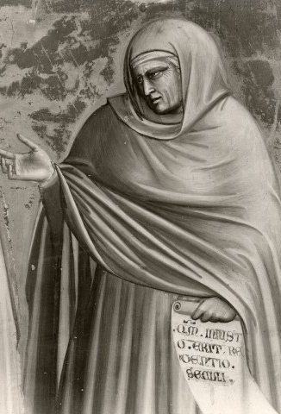
Women in Ministry in the New Testament
As Prophets
  Mary the mother of Jesus (Luke 1:46-55)
  Elizabeth (Luke 1:39-45)
  Anna (Luke 2:36-38)
  Daughters and Female Slaves (Acts 2:17-18)
  Philips Daughters (Acts 21:9)

Slide 8
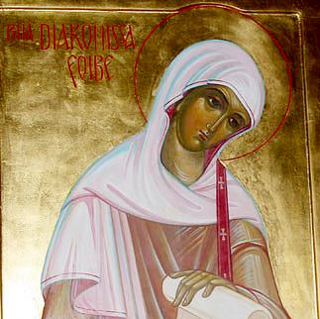
Women in Ministry in the New Testament
As Deacon
  Phoebe (Rom 16:1)
As Patrons
  Mary Magdalene, Joanna, Susanna (Luke 8:1-3)
  Phoebe (Rom 16:1-2)
As Teachers
  Priscilla (Acts 18:4-26)
  *Phoebe (Romans 16:1-2)

Slide 9
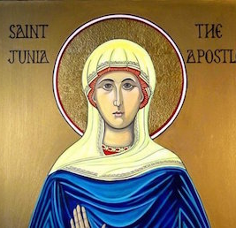
Women as Apostles?
“Greet Andronicus and Junia, my fellow Jews who have been in prison with me. They are outstanding among the apostles, and they were in Christ before I was” (Rom 16:7, NIV).
“Greet Andronicus and Junia,³ my kinsmen and my fellow prisoners. They are well known to the apostles, and they were in Christ before me” (Rom 16:7, ESV).
³Or Junias

Slide 10
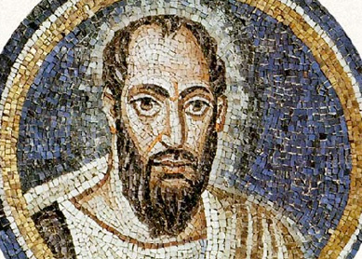
Paul and Women in Leadership
Women should remain silent in the churches. They are not allowed to speak, but must be in submission, as the law says. ³⁵ If they want to inquire about something, they should ask their own husbands at home; for it is disgraceful for a woman to speak in the church” (1 Cor 14:34-35, NIV).
“A woman should learn in quietness and full submission. 12 I do not permit a woman to teach or to assume authority over a man; she must be quiet. 13 For Adam was formed first, then Eve. 14 And Adam was not the one deceived; it was the woman who was deceived and became a sinner. 15 But women will be saved through childbearing—if they continue in faith, love and holiness with propriety” (1 Tim 2:11-15, NIV).

Slide 11

Principal of Subordination or
Concession to Culture and Situation
Clearly Paul limits the ministry of women in at least some circumstances.
Careful reading of Paul's writings and knowledge of the 1st century Greco-Roman culture provide numerous reasons that Paul might have made a cultural concession.
We should be consistent in our hermeneutic.
The ideal for Paul is represented by humanity "in Christ"

Slide 12
Men and Women "In Christ"
“So in Christ Jesus you are all children of God through faith, ²⁷ for all of you who were baptized into Christ have clothed yourselves with Christ. ²⁸ There is neither Jew nor Gentile, neither slave nor free, nor is there male and female, for you are all one in Christ Jesus” (Gal 3:26-28, NIV).
“Nevertheless, in the Lord woman is not independent of man, nor is man independent of woman. ¹² For as woman came from man, so also man is born of woman. But everything comes from God” (1 Cor 11:11-12).

Slide 13
Gender in the Context of the Big Story
Notes:
Image From CT https://www.christianitytoday.com/edstetzer/2012/november/big-story-of-scripture-creation-fall-redemption.html where it was taken from a church website https://christcommunity.org/

Slide 14
Resources
https://bibtheo.com/2017/01/30/womeninministry/
https://www.patheos.com/blogs/cruxsola/2021/01/women-scripture-antiquity-ministry-a-bibliography/
https://juniaproject.com/
https://www.womenministers.ag.org/podcast
https://ag.org/Beliefs/Position-Papers/The-Role-of-Women-in-Ministry

Slide 15
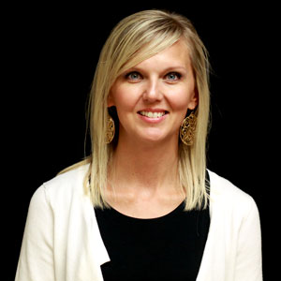
Rev. Amy VanPay

Slide 16

Why do you think it is important that women are included in leadership and ministry in our churches?

Slide 17
What advice do you have for women who want to minister in the Church?

Slide 18
What can men do to help pave the way for women participating fully in the ministries that God equips them for?

