Slide 1
Slidehood.com
Department of
Breakout
Chapel
Bible & Theology

Slide 2
Home is Where the WiFi Connects Automatically:
The Intersection of Technology & Theology

Slide 3
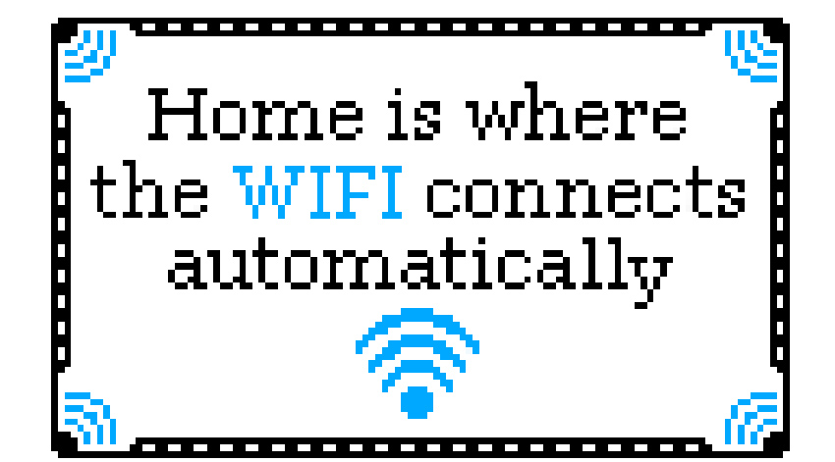

Slide 4
1. Is that still awkward?

Slide 5
2. Are you ever, truly, offline?

Slide 6

Physical World
Virtual World

Slide 7
Augmented Reality

Slide 8
3. How do you define “cyborg”?

Slide 9
cy·borg
/ˈsīˌbôrɡ/
noun.
  1. A being that is part robot, and part human. {cyb(ernetic) + org(anism)}.
  2. A human who has certain physiological processed aided or controlled by mechanical or electronic devices.” (Urban Dictionary)

Slide 10
cy·borg
/ˈsīˌbôrɡ/
“a fictional or hypothetical person whose physical abilities are extended beyond normal human limitations by mechanical elements built into the body.” (Google)
“A cyborg (short for ‘cybernetic organism’) is a being with both organic and biomechatronic parts.” (Wikipedia)

Slide 11



Slide 12
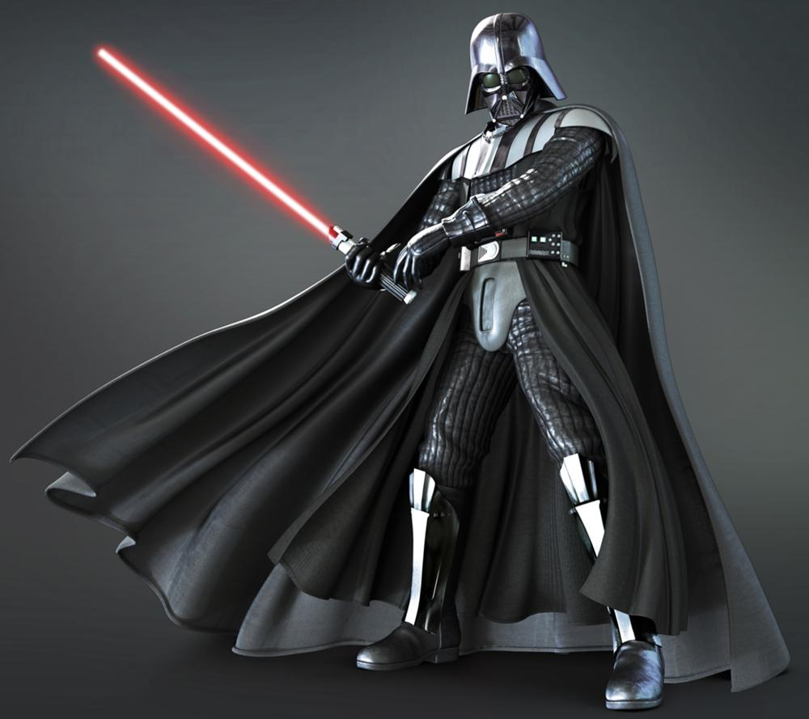
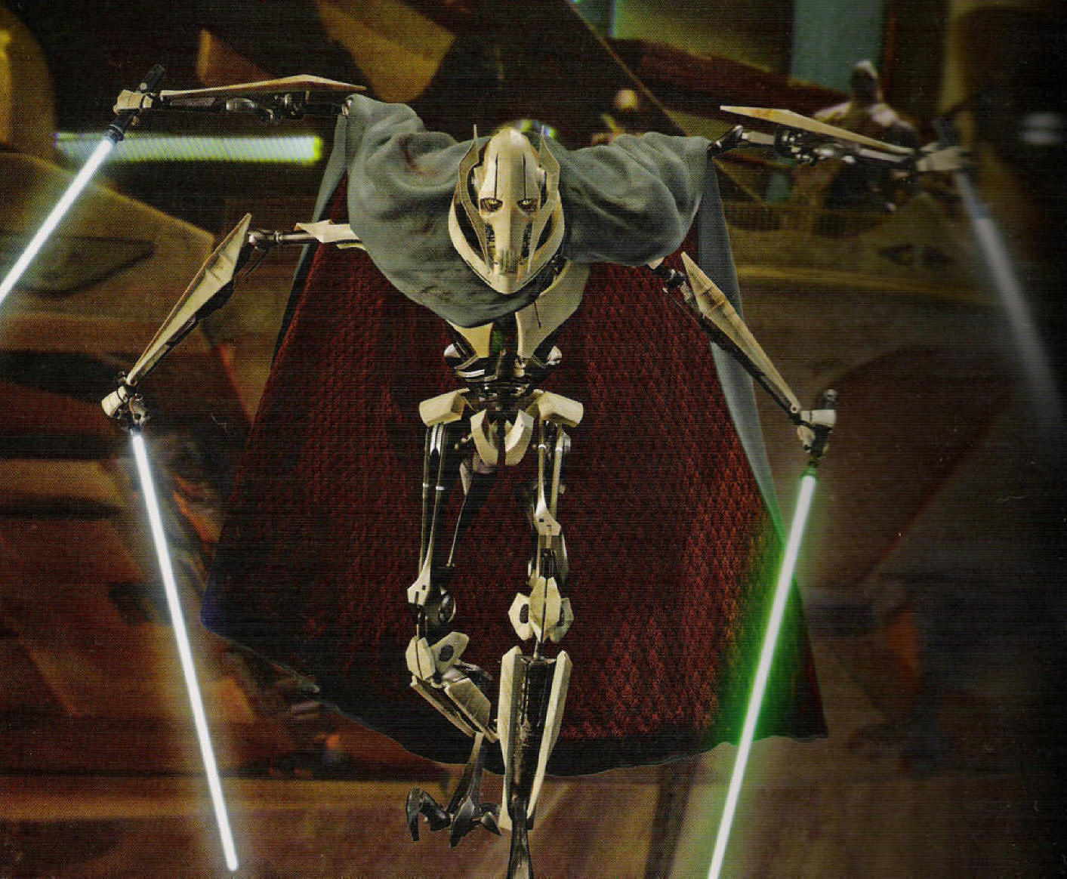


Slide 13


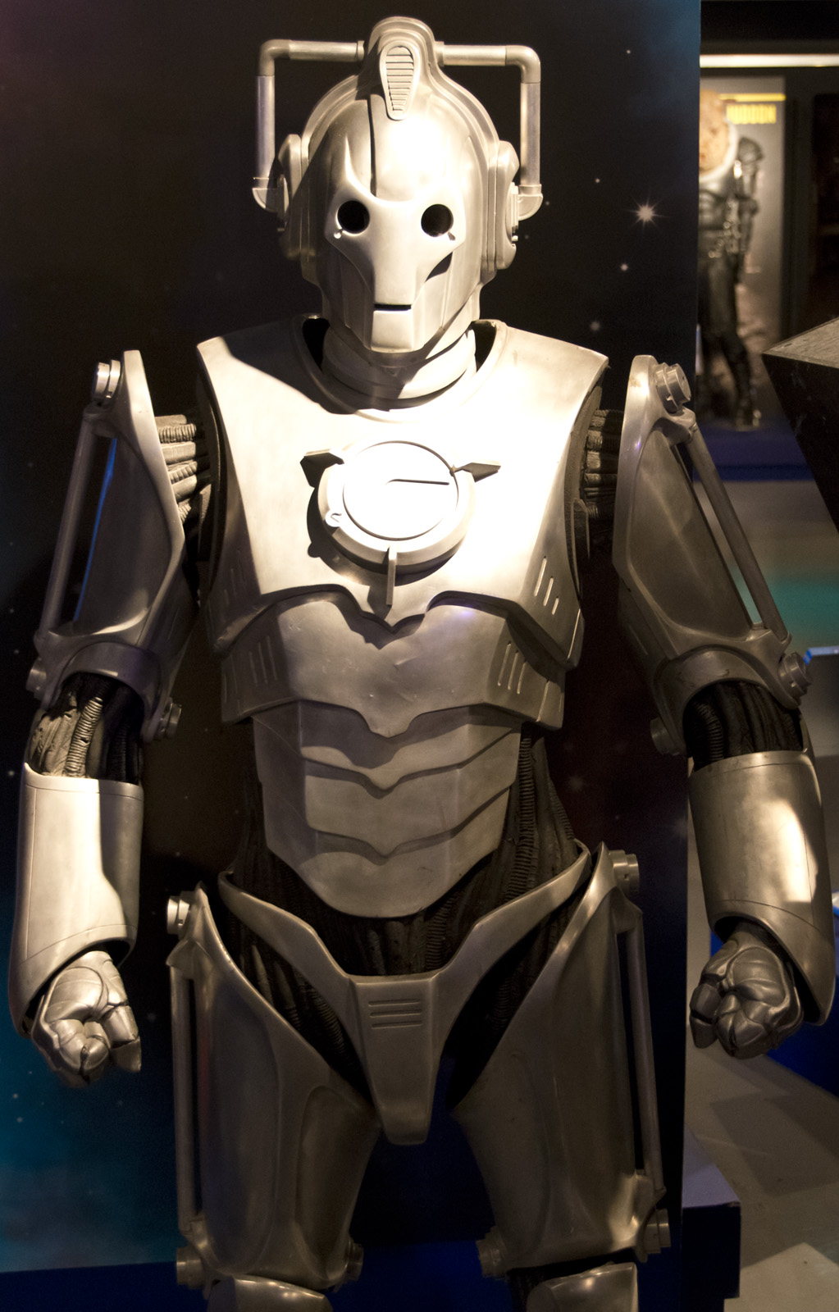
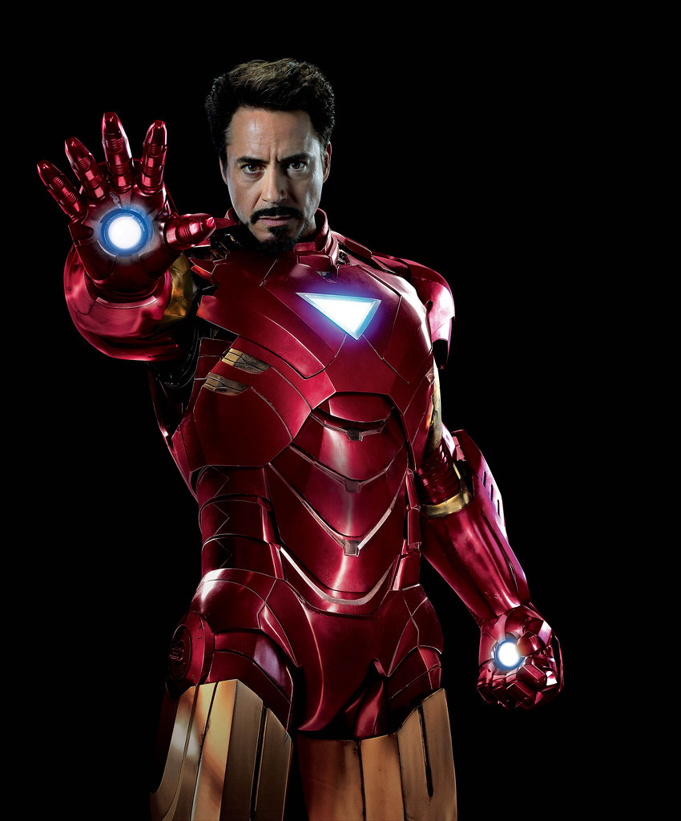
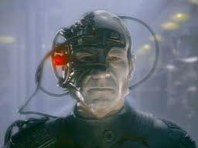
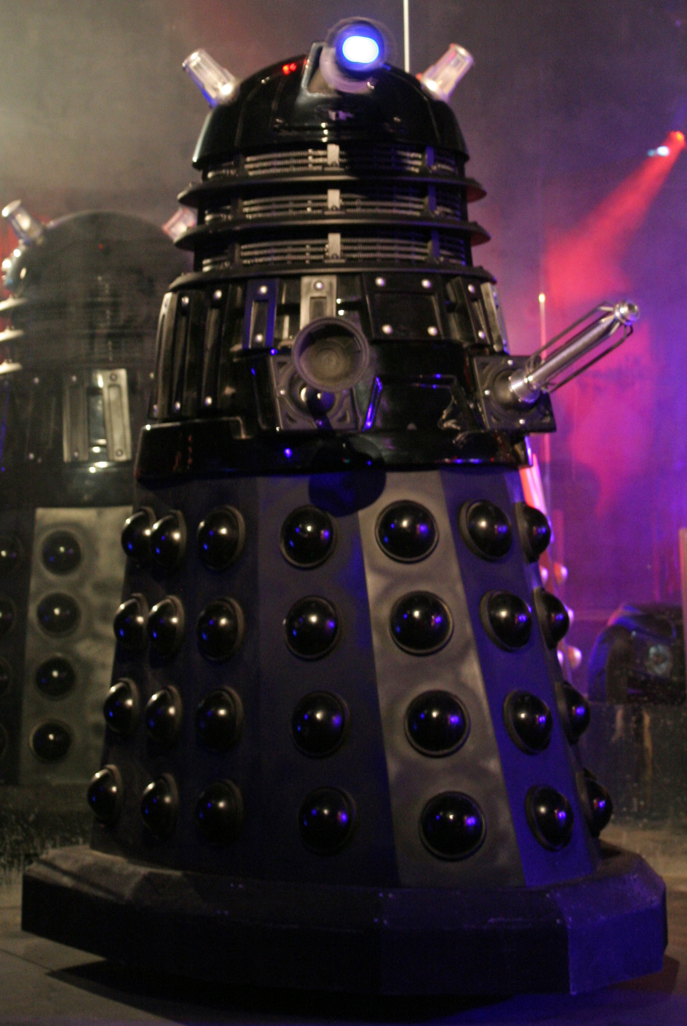
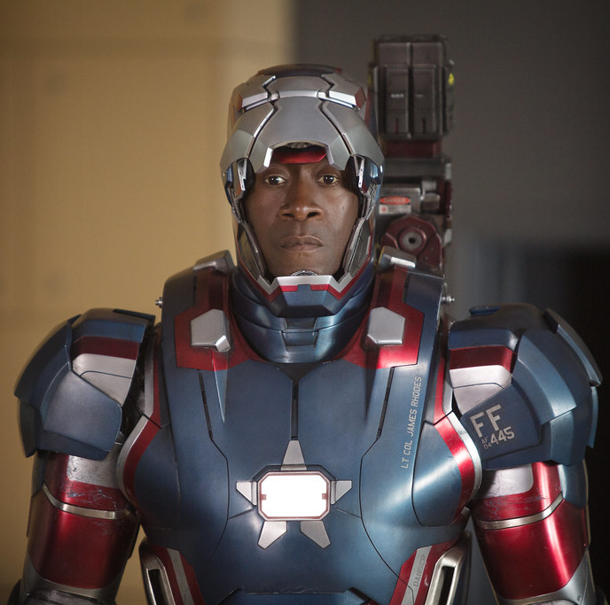

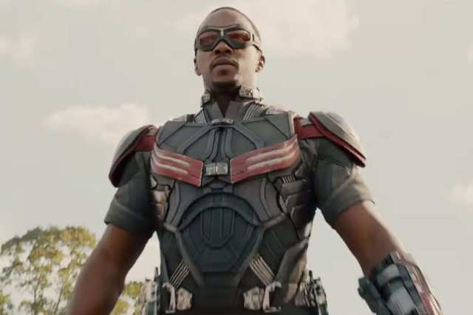

Slide 14
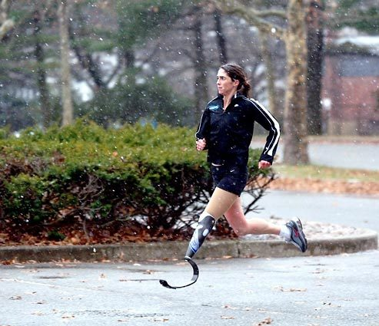

Slide 15
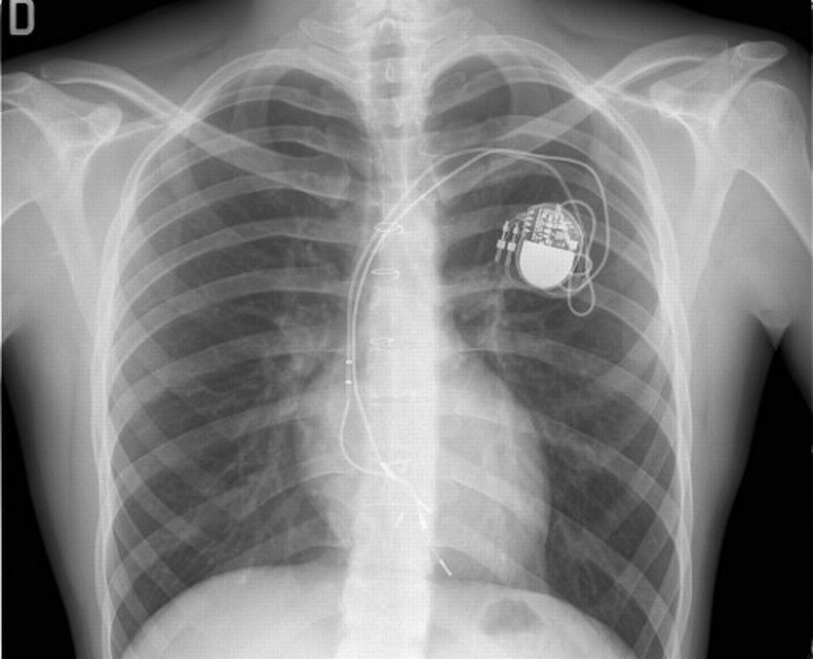
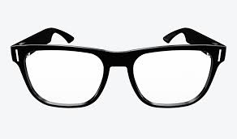
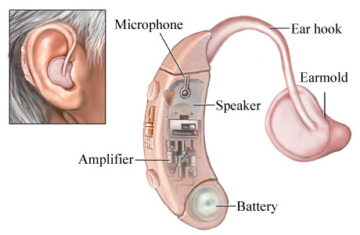

Slide 16
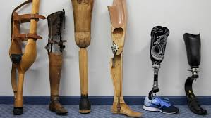
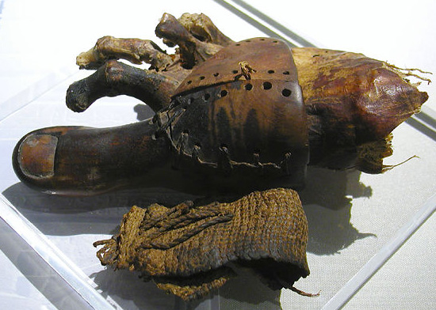
Cairo Toe
c. 950 bc

Slide 17
cy·borg
/ˈsīˌbôrɡ/
“a fictional or hypothetical person whose physical abilities are extended beyond normal human limitations by mechanical elements built into the body.” (Google)
“A cyborg (short for ‘cybernetic organism’) is a being with both organic and biomechatronic parts.” (Wikipedia)

Slide 18
Retrospect & Prospect
Is it awkward for a new person to interact with an old picture on your social media?
Do you need to be on the internet to be online?
Can you define “cyborg” as a human with a permanent prosthesis?

Slide 19
In Other Words
Humanity has changed.
The way we experience life, as physically and digitally embodied people, has changed.
  (Transhumanism, H+, Cyber Culture, Prosthetic Culture, Mental Prosthesis, Wired/Social Cyborgs)
If these first two ideas are true, even a little bit, how does this affect the ways we gather together?

Slide 20
4. Are we all cyborgs now?

Slide 21



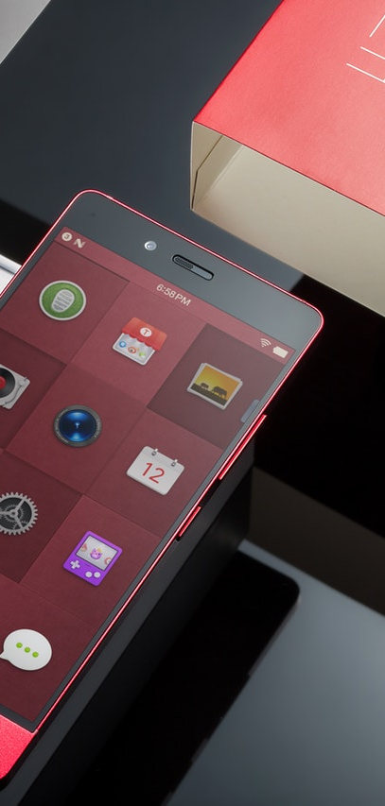

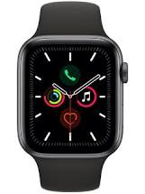
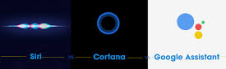

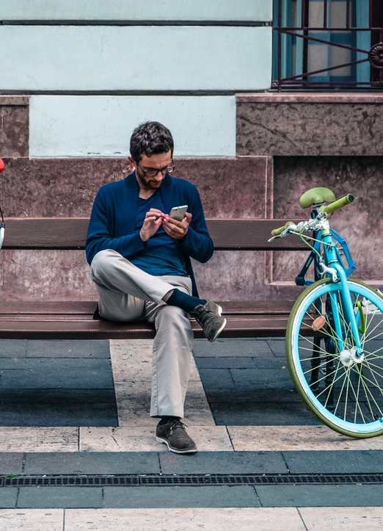

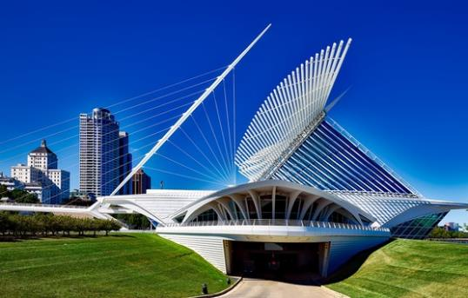
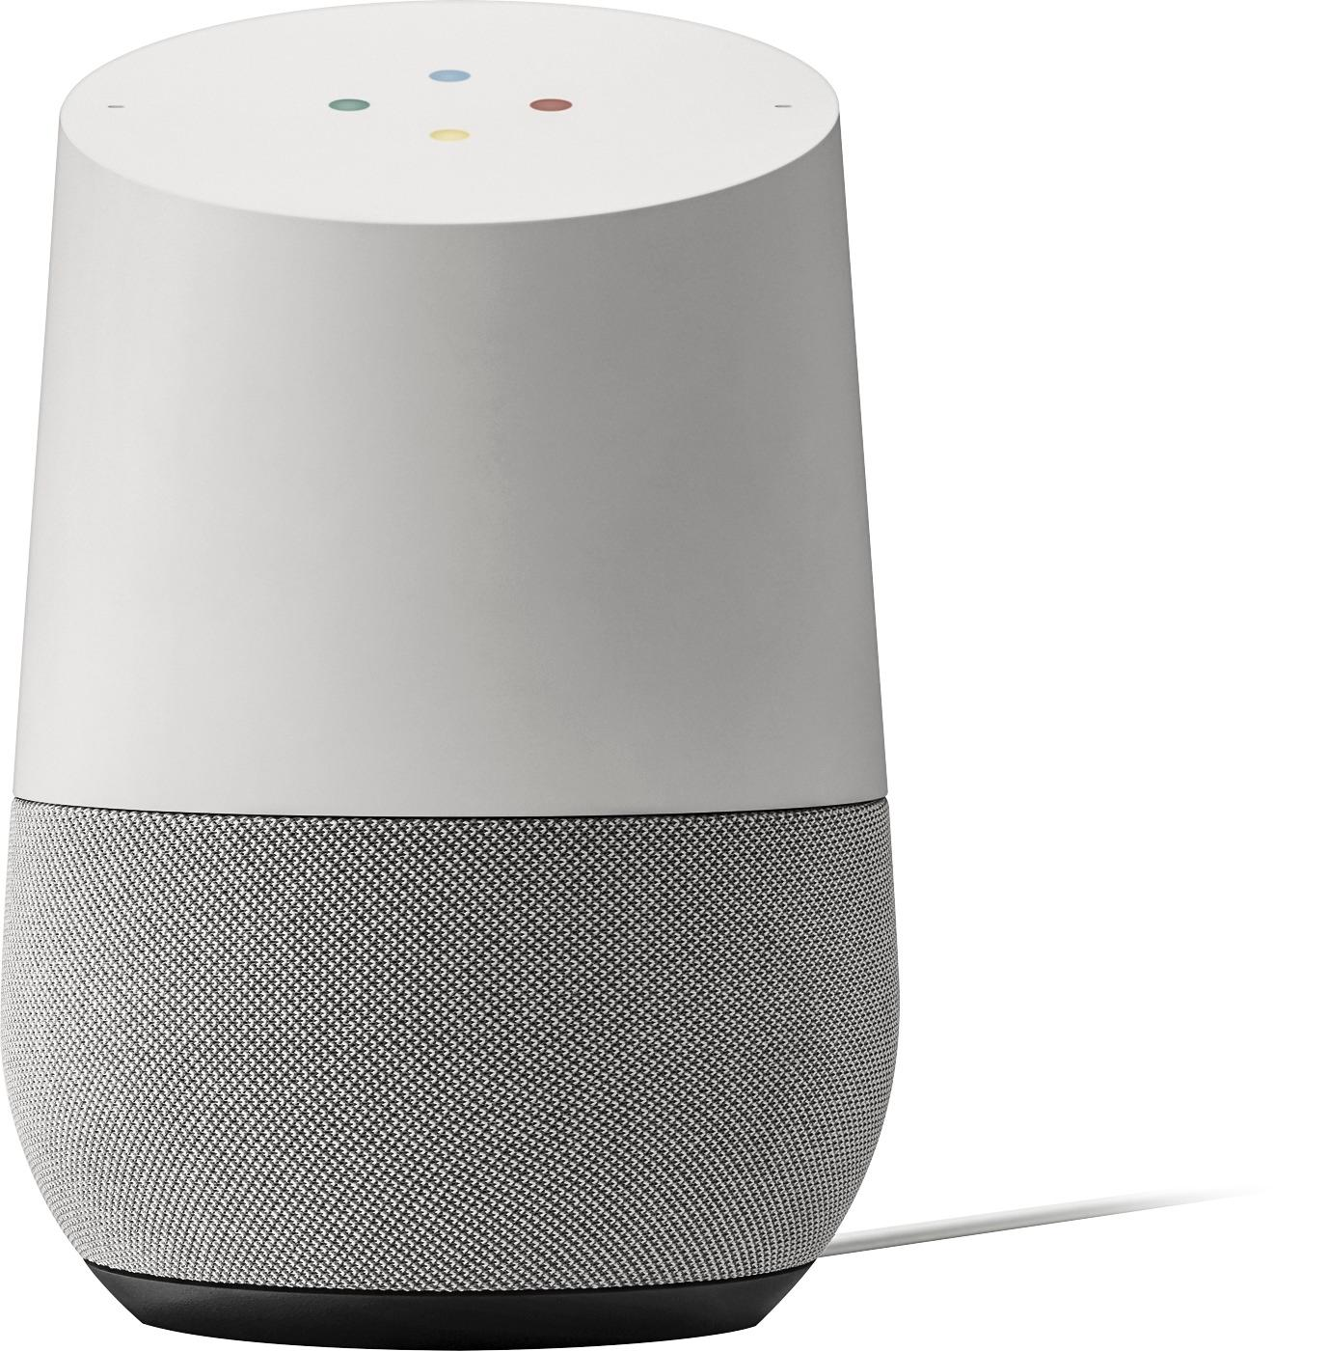
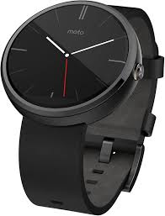


Slide 24
Ways to think of Christianity
“The Way”
(Acts 9:2; 18:26; 19:9, 23; 22:4; 24:14, 22)
“Family of God/Children of God”
(John 1:12-13; Rom 8:15, 29;
Eph 2:19-22; 1 John 3:1-2)
“The Temple/building”
(1 Cor 2:16; 3:9; 6:12-20)
“Body of Christ”
(Romans 12:4-5;
1 Cor 12:12-27;
Col 1:18; Eph 3:6)

Slide 25
Is the Body of Christ cyborg too?

Slide 26
Retrospect & Prospect
Is it awkward for a new person to interact with an old picture on your social media?
Do you need to be on the internet to be online?
Can you define “cyborg” as a human with a permanent prosthesis?
Internet-connected technology is mental prosthesis, making us all cognitive cyborgs.
When cyborgs gather together, is that gathered body cyborg too?

Slide 27
Brainstorming CyberTheology
Gathering Together at Church
Gathering Together at School

Slide 28
Gathering Together: Ethical Considerations
Privacy
  Unwanted advances
  Data brokers, real names, discrimination
  Escaped abuse, don’t want to be trackable
  Not everyone wants to download your app
Accessibility
  10% of Americans don’t use the internet.
  Internet Use: Rural (85%), Urban (91%), Suburban (94%)
  Home Broadband (73%)
  Cellphone-only households (17%)
  Broken tech, older tech, low battery, low data or WiFi
Discrimination
  American cell phone market share: iPhone (52%), Android (47%)
  Online harassment, “well actually,” in-group/out-group dynamics

Slide 29
Gathering Together: Brainstorming Best Practices
Live, Collaborative Tools (Padlet, Microsoft Teams, Google Suite)
Video (Flipgrid, YouTube, Vimeo, Insta(?))
Synchronous Meetings (Zoom, Google Hangouts, Google Meet, Facetime, Facebook Live, Instagram Live[?])
Group Text (WhatsApp, GroupMe, Discord, Messenger, DMs)
Social Media (TicTok, Instagram, Twitter, SnapChat, Facebook, Pinterest)
Music & Podcasts (Spotify, Apple Music, Stitcher, YouTube, Vimeo)
Banking (CashApp, Venmo, PayPal, ApplePay)

Slide 30
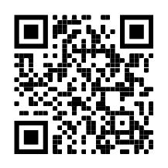



For Further Reading
Notes for this presentation are at:
https://bibtheo.com/breakoutchapel
Department of Bible & Theology
Espinoza, Terance. Cyber Christianity. Online:
https://cyberchristianity-blog.tumblr.com/
BRosdahl@sagu.edu, TBlakney@sagu.edu, TEspinoza@sagu.edu,
DLangston@sagu.edu, JMagruder@sagu.edu, PReynolds@sagu.edu
@SAGUBibTheo

