Slide 1
Royal Game of Ur

Slide 3
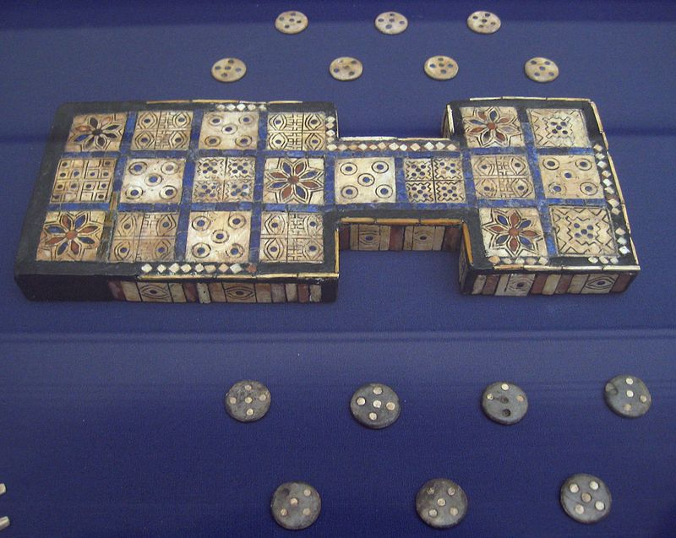
Royal Game of Ur (Game of 20 Squares)
2,600 B.C.

Slide 4
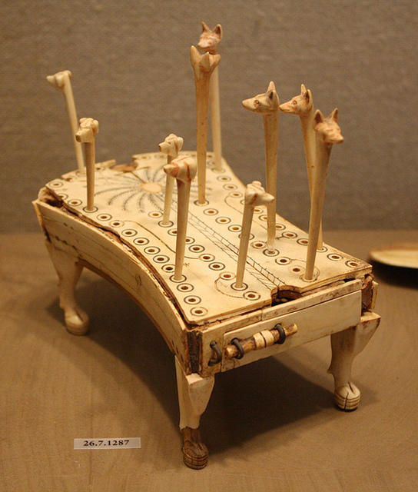
Hounds and Jackals

Slide 5
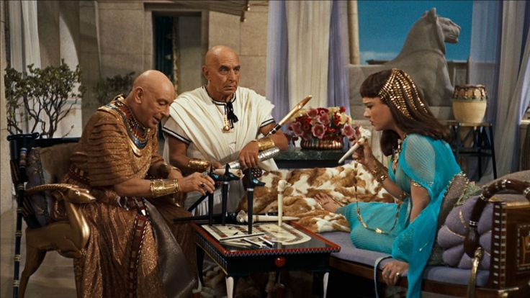

Slide 6
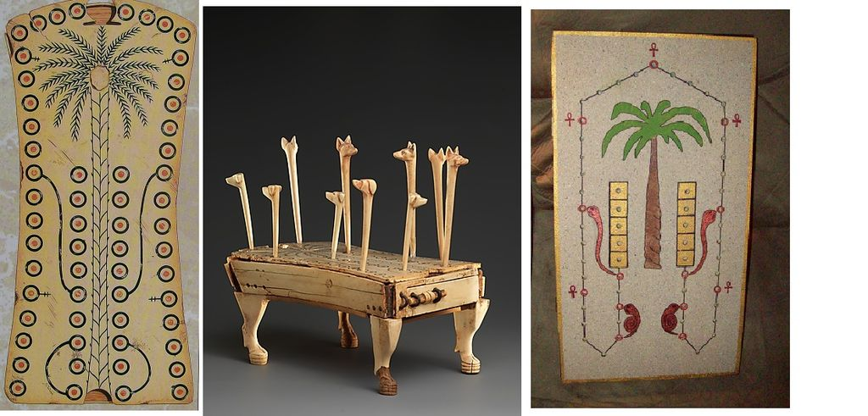
Hounds and Jackals

Slide 7
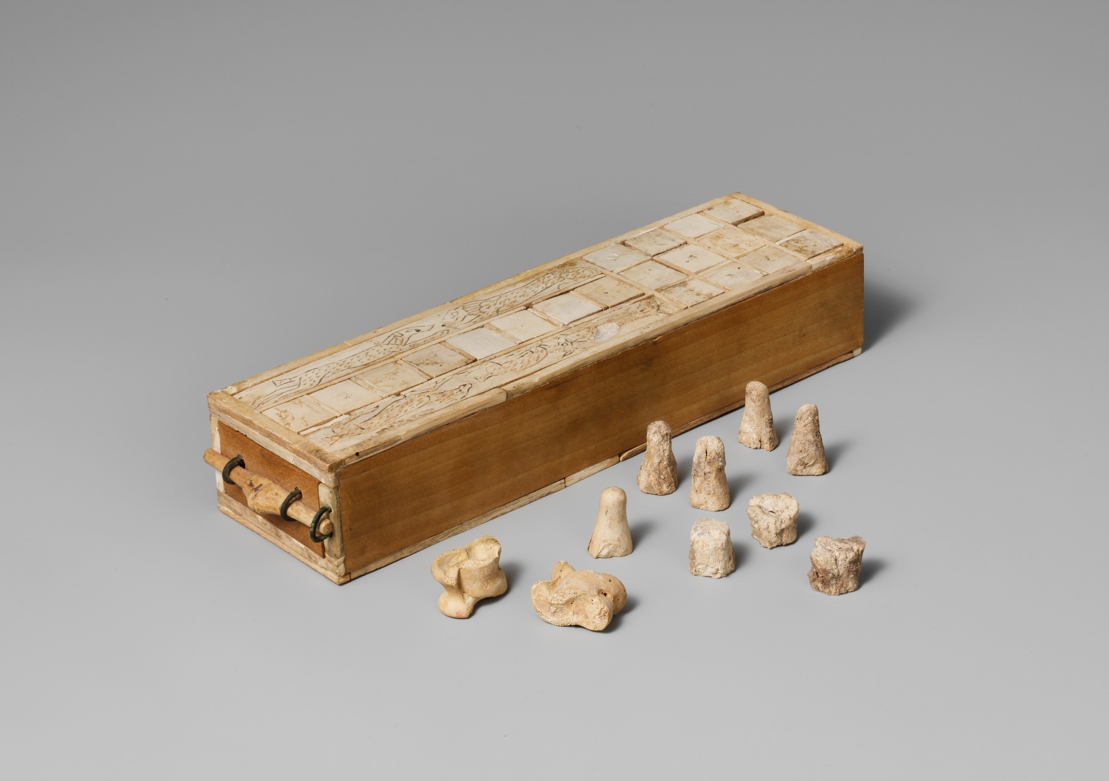
Senet

Slide 8
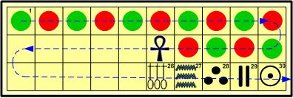

Slide 9
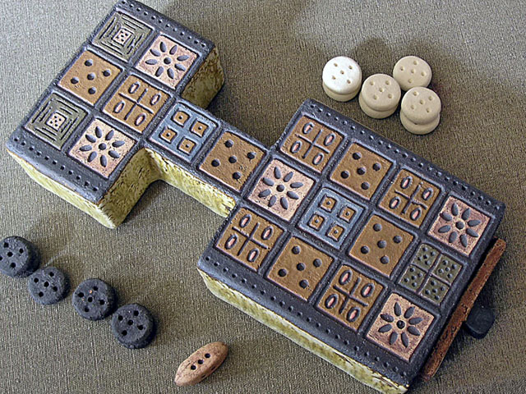

Slide 10
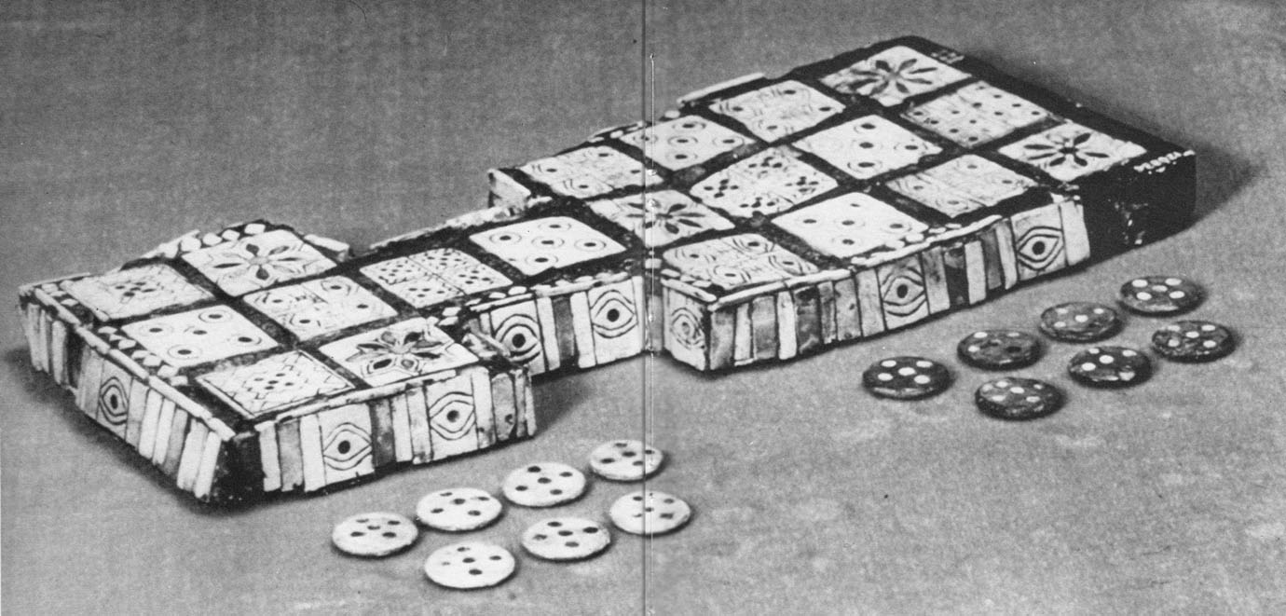

Slide 12
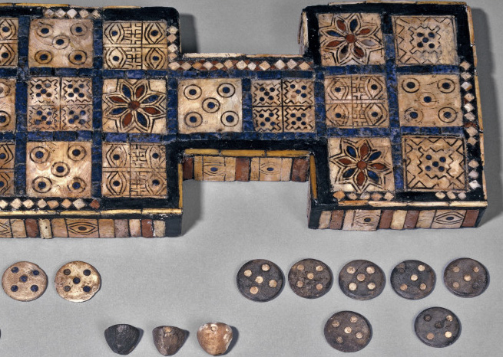

Slide 13
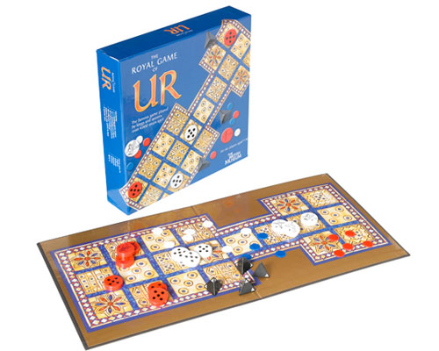

Slide 14
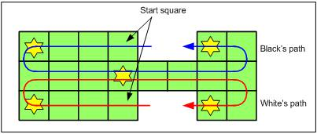
Simplified Path

Slide 15
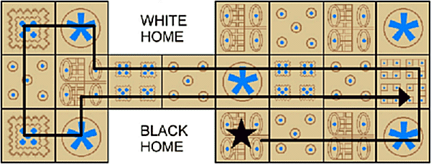
Alternate Path 2

Slide 16
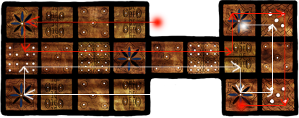
Alternate Path 3

Slide 17
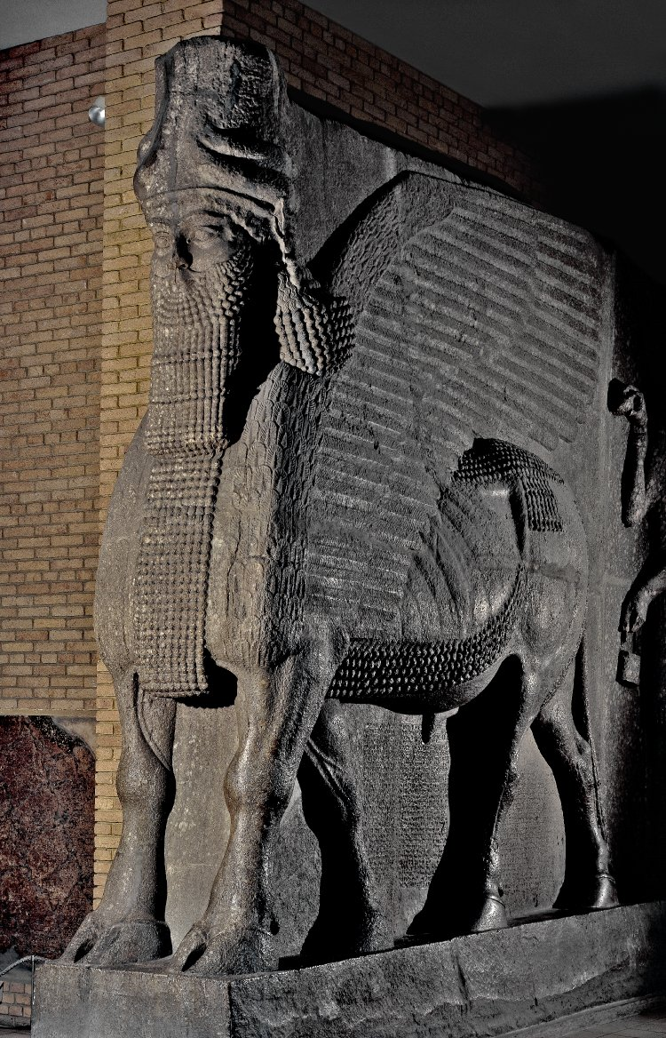

Slide 18
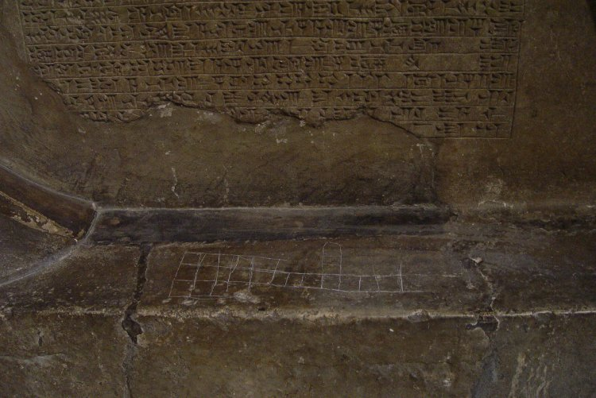

Slide 20
For Further Reading
BibleWoot.com/AncientGames
Pinterest.com/biblewoot/ancient-games

Slide 21
House Rules
Three Pyramid Dice.
  1 tip up = move 1 space
  2 tips up = move 2 spaces
  3 tips up = move 3 spaces
  0 tips up = move 4 spaces
Only 1 piece can occupy a space at a time (you’ll have 5 total).
Rosettes are safe zones.
Exact number not necessary to move off board.
As many of your pieces can be on the board at the same time.

Slide 22
Simplified Path

