Slide 1







Small Teaching Lab 2:
Electric Boogaloo
Based on James M. Lang, Small Teaching: Everyday Lessons from the Science of Learning (San Francisco: Jossey-Bass, 2016).

Slide 2
“Memory is the residue of thought”
-Daniel Willingham, Why Don’t Students Like School?: A Cognitive Scientist Answers Questions about How the Mind Works and What it Means for the Classroom
(San Francisco: Josey-Bass, 2009), 54.

Slide 3
Bloom’s Taxonomy of Educational Objectives: The Classification of Educational Goals

Slide 4
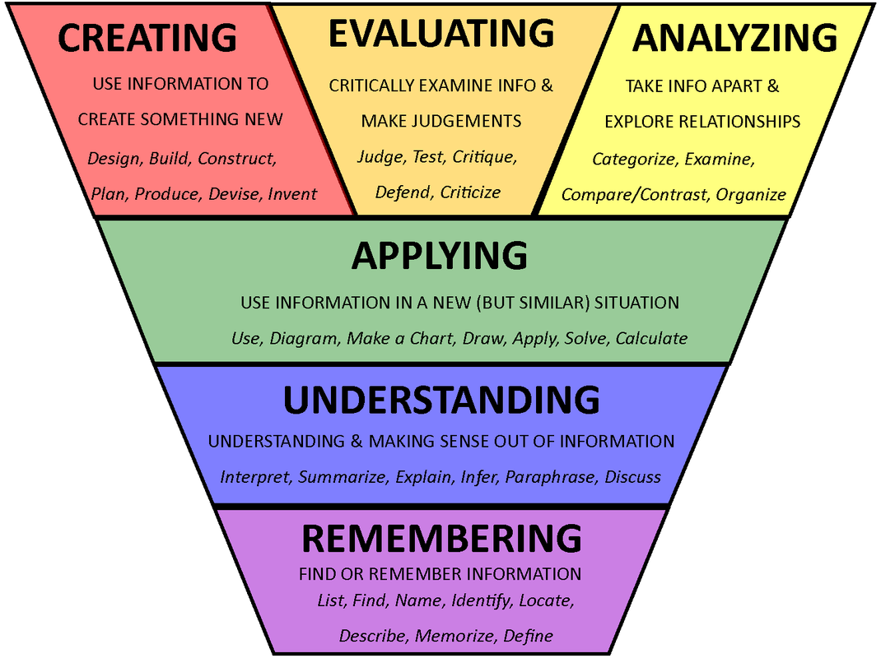

Slide 5
Understanding: Connecting
“In short, they have knowledge, in the sense that they can produce individual pieces of information in specific contexts; what they lack is understanding or comprehension.
And they lack comprehension…because they lack connections…Neurons that fire together, wire together” (93, 95).
KWLH
At end of class, have them write 3 questions they have or 3 things they want to learn.
Provide the framework for lecture via notes, whiteboard TOC
Change the System: Interleaving Course Content

Slide 6
Interleaving
Blocked Instruction
3 Wks | Topic A + Unit Exam
3 Wks | Topic B + Unit Exam
3 Wks | Topic C + Unit Exam
3 Wks | Topic D + Unit Exam
2 Wks | Review + Final Exam
Interleaved Instruction
2 Wks | Topics A, B, C, D
2 Wks | Topic A + Unit Quiz
2 Wks | Topic B + Unit Quiz
1 Wk | Topics A & B + Cumulative Exam
2 Wks | Topic C + Unit Quiz
2 Wks | Topic D + Unit Quiz
1 Wk | Topics C & D + Cumulative Exam
2 Wks | Topics A, B, C, D + Final Exam

