Slide 1

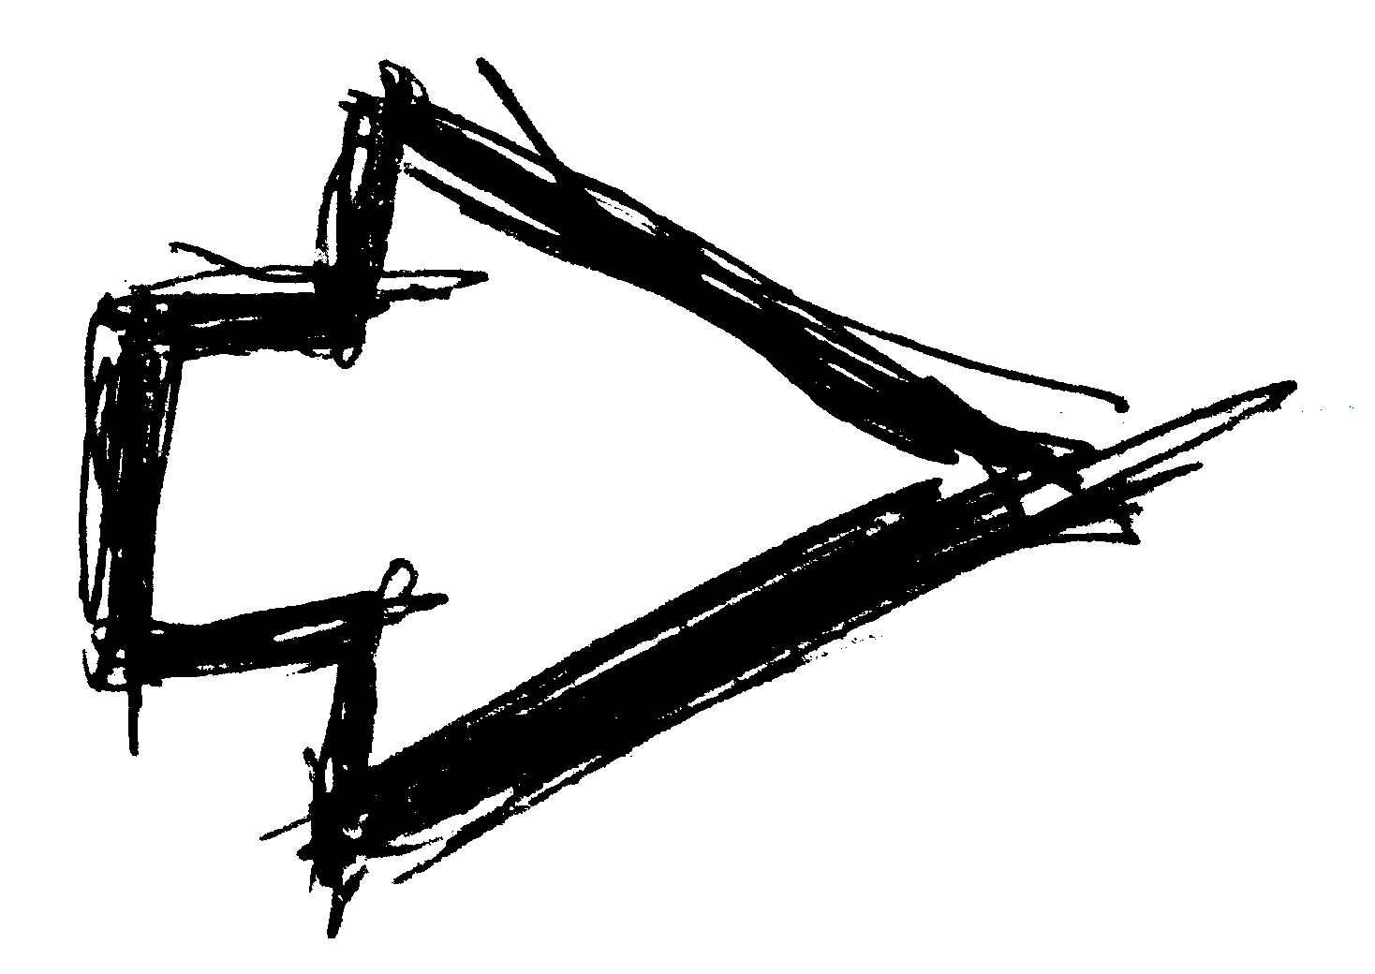
The Magic of Critical Thinking

Slide 2
Plato, Phaedrus 275a-b (c. 360 B.C.)
Theuth, Egyptian god who invented letters.
Ammon (Amun), Egyptian supreme god.
“This invention, O king, will make the Egyptians wiser and will improve their memories; for it is an elixir of memory and wisdom that I have discovered.”

Slide 3
“For this invention will produce forgetfulness in the minds of those who learn to use it, because they will not practice their memory.
Their trust in writing—produced by external characters which are no part of themselves—will discourage the use of their own memory within them.

Slide 4
You have invented an elixir not of memory,
but of reminding;
and you offer your pupils the appearance of wisdom, not true wisdom,
for they will read many things without instruction and will therefore seem to know many things,
when they are for the most part ignorant
and hard to get along with,
since they are not wise, but only appear wise.”

Slide 5
“For this invention will produce forgetfulness in the minds of those who learn to use it, because they will not practice their memory.
Their trust in writing—produced by external characters which are no part of themselves—will discourage the use of their own memory within them.
You have invented an elixir not of memory, but of reminding;
and you offer your pupils the appearance of wisdom, not true wisdom,
for they will read many things without instruction and will therefore seem to know many things, when they are for the most part ignorant and hard to get along with, since they are not wise, but only appear wise.”

Slide 6


The Magic of Critical Thinking

Slide 7

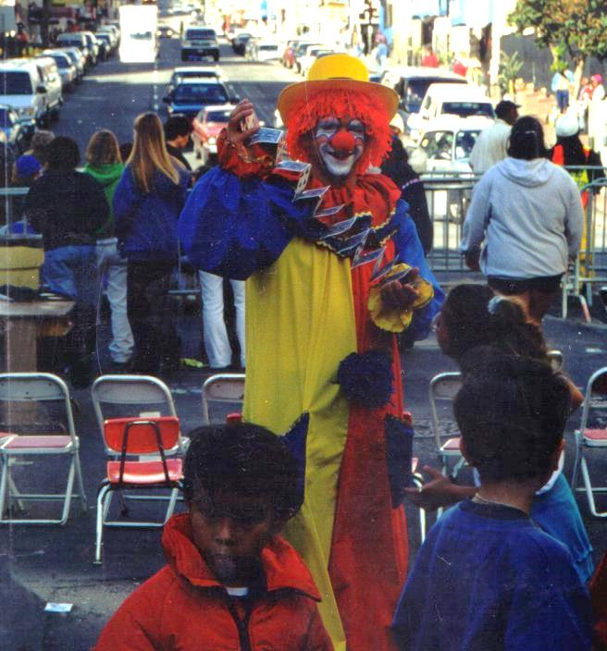


Slide 8
The Magic of Critical Thinking

Slide 9
Sleight of Hand
French Drop

Slide 10
Sleight of Hand
Card Vanish

Slide 11
Sleight of Hand
Sleight of Mind
Illusion of Choice
Force

Slide 12
Illusion of Choice
Theodore Annemann, 202 Methods of Forcing (1933/36)
    Cards
    Numbers
    Miscellaneous

Slide 13



Slide 14



Think of a number between 5-20
Place finger on X
Count out your number,
  moving from X to symbols, continue clockwise w/in circle
Note the symbol where you stopped
Count out your number again, counterclockwise this time,
starting with the symbol where you
stopped.

Slide 15



Is
this
your
symbol?
“Quirkology Mind Reading Shirt”
https://teespring.com/en-GB/QuirkologyTeeUS?src=tsshop#pid=369&cid=6529&sid=back

Slide 16


ad hominem | personal incredulity | correlation / causation | post hoc ergo propter hoc | false continuum
argument from authority | cherry picking the data | non sequitur | begging the question | false dichotomy
reductio ad absurdum | false analogy | the fallacy fallacy | slippery slope | to quoque
straw man | circular reasoning | argument from final consequences/ teleological/ reverse cause & effect | genetic fallacy / | special pleading / ad hoc reasoning
moving goalpost | semantic anachronism | illegitimate totality transfer/ genetic fallacy/ word root fallacy | Texas sharpshooter | ad ingorantium

Slide 17


Spurious Correlations
http://www.tylervigen.com/spurious-correlations

Slide 18
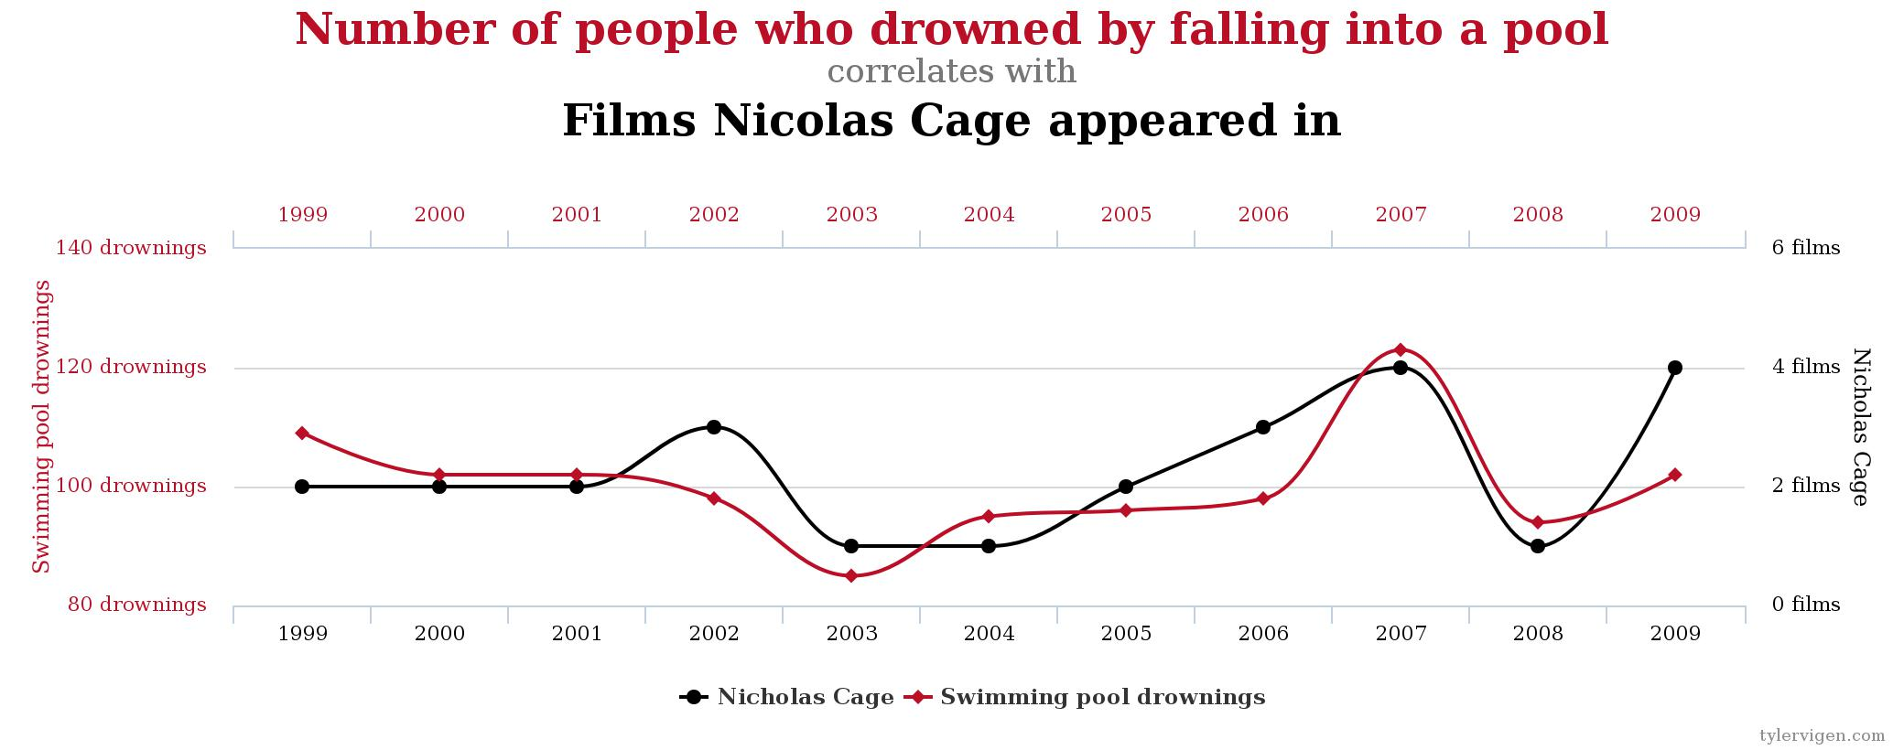
Spurious Correlations

Slide 19
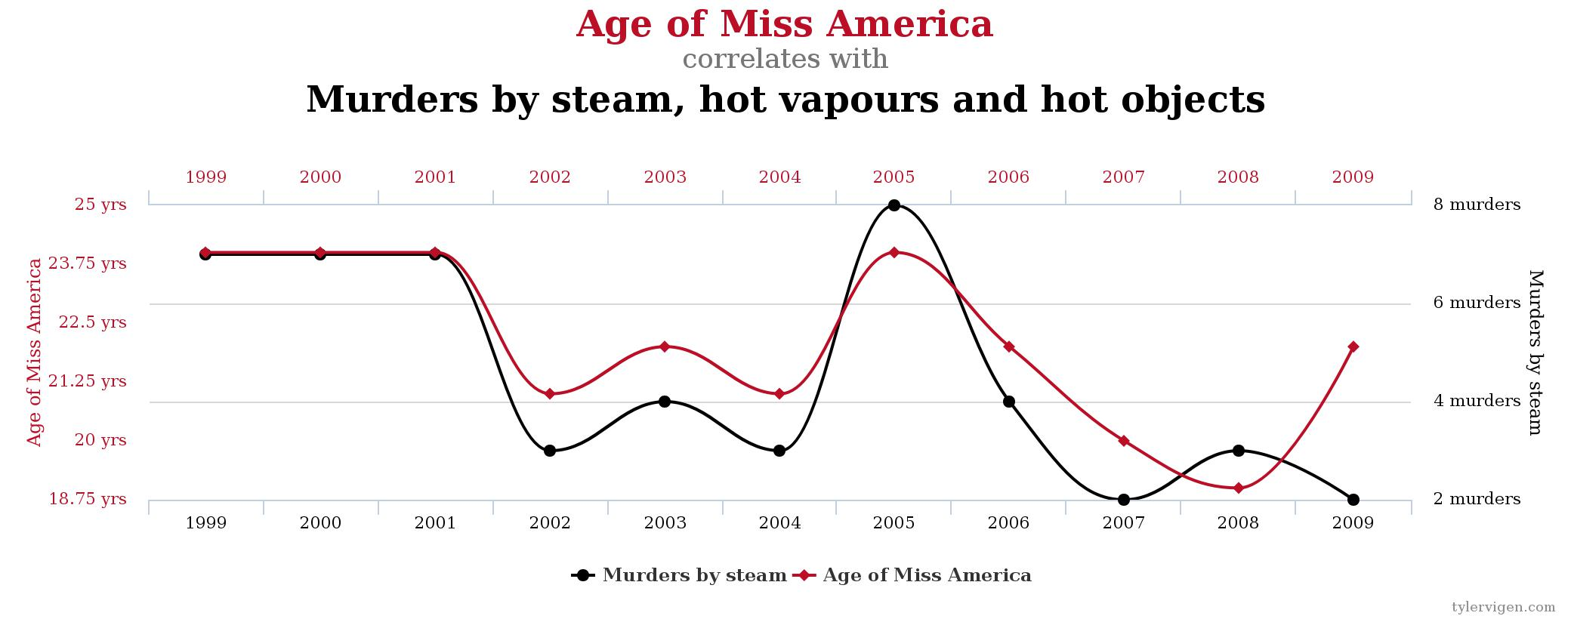
Spurious Correlations

Slide 20
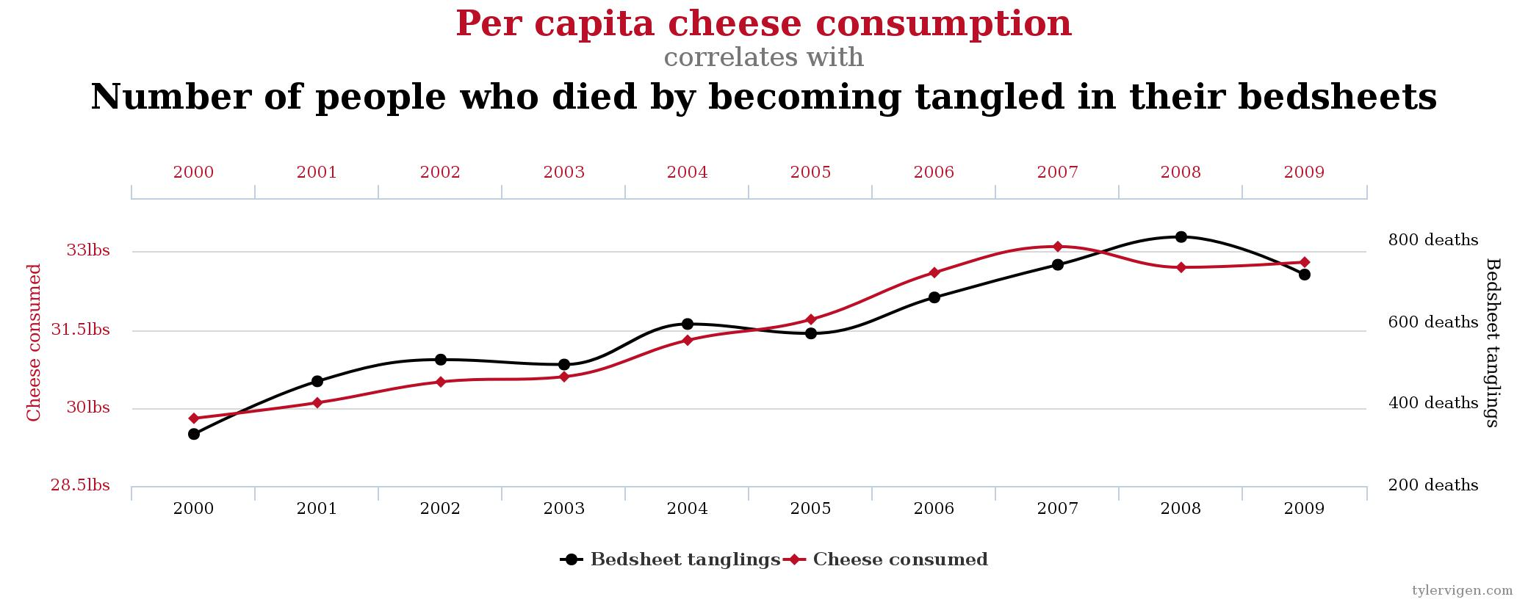
Spurious Correlations

Slide 21
Other Examples
Cold Reading
Memory Test

Slide 22
Memory Test

Slide 23
door

Slide 24
glass

Slide 25
pane

Slide 26
shade

Slide 27
ledge

Slide 28
sill

Slide 29
house

Slide 30
open

Slide 31
curtain

Slide 32
frame

Slide 33
view

Slide 34
breeze

Slide 35
sash

Slide 36
screen

Slide 37
shutter

Slide 39
door glass pane
shade ledge sill
house open curtain
frame view breeze
sash screen shutter

Slide 40


A Model of Critical Thinking
Evidence-based thinking
Tearing Down Building Up
Mythbusters Five Paragraph Essay
Brain Games Sherlock
Snopes.com Occam’s Razor
Jeremiah 1:10b

Slide 41
For Further Reading
  BibleWoot.com/mct
  BibTheo.com/fallacies
  Pinterest.com/biblewoot/critical-thinking
  ExegeticalFallacies.Tumblr.com

